Slide 1
Using GIT and Tortoise Git
Group Members
Chatur Veda Vyas Kurma S534687
Ganesh Siripuram S534915
Sanjana Baswapuram S534595
Sai Sree Dachepalli S534883

Slide 2





Slide 3
GIT
It is a Distributed Version Control System.
It is a free open-source Client for the Git Version Control System.
Manages Files over time.
Saves every changes made to local directory.
No loss of Data.

Slide 4
GITHUB
GitHub is a site for online storage of Git repositories.
You can get free space for open source projects or you can pay for private projects.

Slide 5
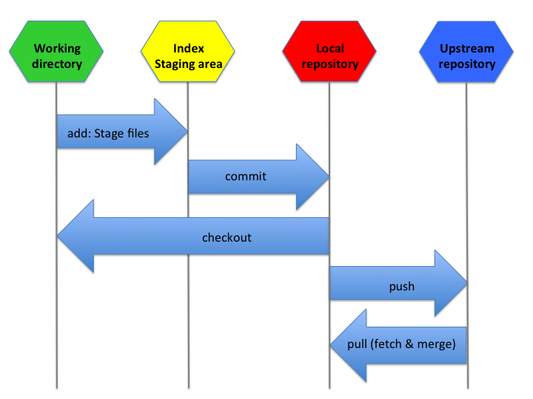

Slide 6
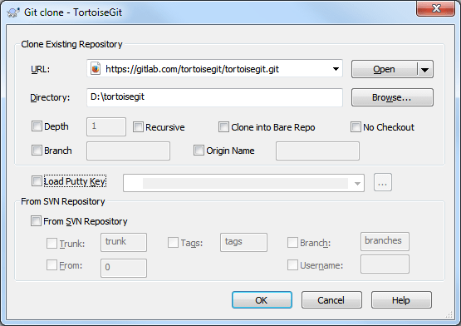
CLONE REPOSITORY

Slide 7
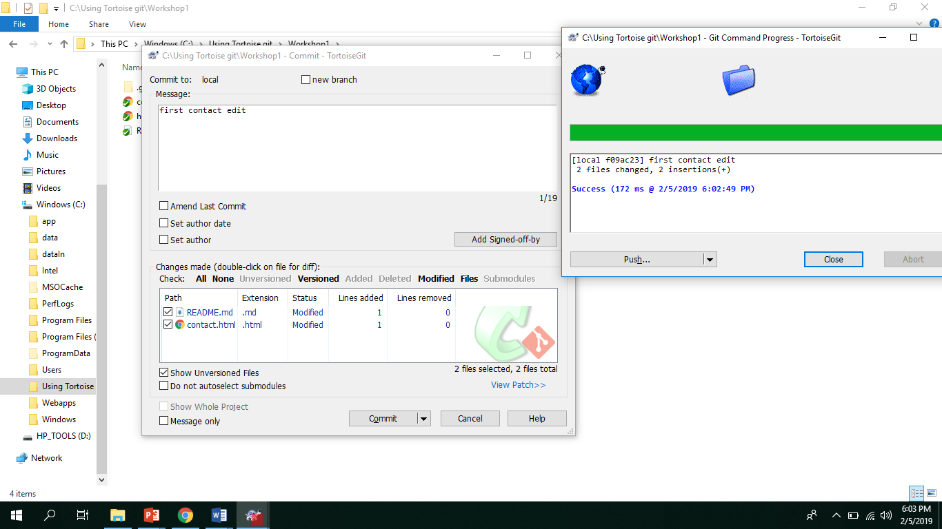
Git commit

Slide 8
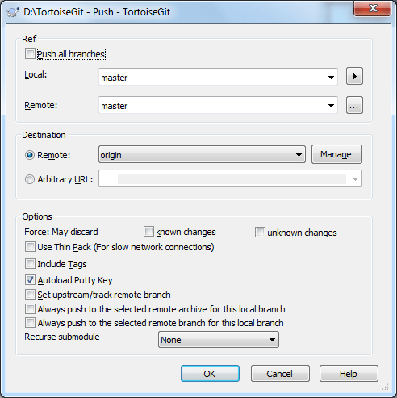
GIT PUSH

Slide 9
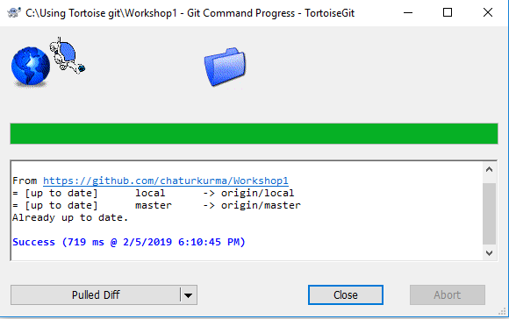
Git PULL

Slide 10
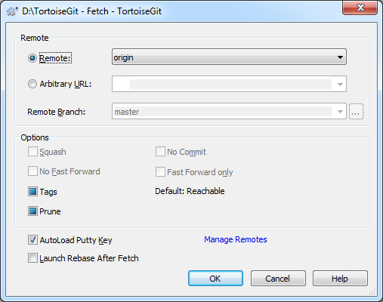
Fetch

Slide 11
References
https://www.microsoft.com/en-us/
Google Wikipedia
https://tortoisegit.org/docs/tortoisegit/
https://devops.com/library/

Slide 12


