Slide 1
ELECTRIC VEHICLE (EV) FLEET CHARGING & BATTERY HEALTH ANALYTICS PLATFORM
An Enterprise-Grade Solution for Data Engineering, Cloud Warehousing, RPA Orchestration, Business Intelligence & AI Insights
Technology Stack: Snowflake | Alteryx | UiPath RPA | Power BI & MS Fabric | Node.js | Chart.js & AI Engine

Slide 2
EV FLEET ANALYTICS PLATFORM
Executive Summary & Business ROI
Operational Challenges
• Unmonitored Battery Degradation leading to sudden fleet vehicle failure.
• Uncontrolled Charging Expenses during high-cost peak grid demand periods.
• Data Silos across telemetry, location, maintenance logs, and financial records.
• Lack of Predictive Insights to schedule timely battery maintenance before breakdown.
Delivered Platform Value & ROI
• 14% Monthly Energy Cost Savings via AI-driven peak-shifting recommendations.
• Continuous SOH Tracking to maintain battery State of Health > 80%.
• Automated Data Pipelines delivering real-time telemetry to Snowflake Data Warehouse.
• 6 Interactive Fabric Dashboards + AI Assistant Natural Language Console.

Slide 3
EV FLEET ANALYTICS PLATFORM
End-to-End Enterprise Architecture
1. Ingestion & Data Prep
• Raw Kaggle EV telemetry CSV data
• Alteryx ETL workflow cleans data
• Handles missing values & duplicates
• Calculates kWh/100km efficiency
2. Warehouse & Automation
• Snowflake Star Schema (RAW/CORE/MART)
• CDC Streams & 60-min Scheduled Tasks
• UiPath RPA orchestrates SP execution
• Automates PBI refresh & executive emails
3. BI & AI Insights UI
• 6 Dark-Blue Microsoft Fabric pages
• Production DAX KPI measures
• Chart.js interactive web app
• AI SOH & cost prediction engine

Slide 4
EV FLEET ANALYTICS PLATFORM
Data Cleansing & Transformation (Alteryx)
ETL Pipeline Modules
• Input Data Tool: Loads raw vehicle telemetry & session data.
• Data Cleansing & Select: Normalizes strings, handles white space.
• Imputation: Resolves missing ambient temp & trip distance.
• Unique & Filter: Eliminates duplicates on composite key (Vehicle_ID, Start_Time).
Feature Engineering
• Energy Efficiency: Computes (Energy_Consumed / Distance) * 100.
• SOH Degradation Bucket: Classifies Battery SOH into Optimal (>90%), Moderate (80-90%), Alert (<80%).
• Cost Calculation: Applies peak/off-peak rate tariffs to session energy.
• Cleaned CSV Export: Formats clean data for Snowflake ingestion stage.

Slide 5
EV FLEET ANALYTICS PLATFORM
Cloud Data Warehousing (Snowflake)
Multi-Layered Architecture
• RAW Schema: Staging landing tables for raw session loads.
• CORE Schema: Production Star Schema DDL.
• • DIM_VEHICLE (Vehicle_SK, Model, Capacity, Fleet_ID)
• • FACT_CHARGING_SESSIONS (Session_SK, SOH, kWh, Cost, Efficiency)
• MART Schema: Pre-computed business analytics views.
CDC & Stored Procedures
• SP_POPULATE_STAR_SCHEMA(): Automates ETL from RAW into CORE Star Schema.
• SP_CALCULATE_BATTERY_DEGRADATION(): Computes monthly degradation rate.
• CDC Streams: Tracks real-time telemetry changes on raw tables.
• Scheduled Tasks: Runs stored procedures automatically every 60 minutes.

Slide 6
EV FLEET ANALYTICS PLATFORM
Robotic Process Automation (UiPath RPA)
Automated Workflow Engine
• Directory Watcher: Triggers on new CSV arrival in landing folder.
• Database Connector: Invokes Snowflake Stored Procedures securely.
• Power BI API Integration: Triggers dataset refresh on completion.
• Exception Handling: Try-Catch blocks log operational errors.
Executive Reporting & Alerts
• Excel Generator: Builds daily fleet executive summary report.
• Email Dispatcher: Sends HTML reports to executive stakeholders.
• Critical Alert Dispatch: Sends SMS/Email alerts when SOH drops below 80%.
• Audit Logging: Writes RPA execution metrics to GOVERNANCE table.

Slide 7
EV FLEET ANALYTICS PLATFORM
Power BI & MS Fabric Dark-Blue Dashboards
6 Interactive Dashboard Pages
• 1. Executive Dashboard: Fleet KPIs, cost metrics, active vehicles.
• 2. Battery Health Analytics: SOH degradation, cell risk, temperature.
• 3. Charging Operations: Station utilization, peak vs off-peak rates.
• 4. Fleet Performance: Distance covered, energy efficiency (kWh/100km).
• 5. Cost Analysis: Energy expense growth, depot tariff breakdown.
• 6. AI Predictive Dashboard: Maintenance forecasts & AI recommendations.
Fabric Design & Production DAX
• Styling: Obsidian (#0B132B) & Slate Navy (#1C2541) glassmorphism UI.
• DAX SOH Measure: CALCULATE(AVERAGE(FACT[Battery_SOH])).
• DAX Cost Growth: DIVIDE([Current_Cost] - [Prior_Cost], [Prior_Cost]).
• DirectLake Storage: Real-time query performance over OneLake Delta files.

Slide 8
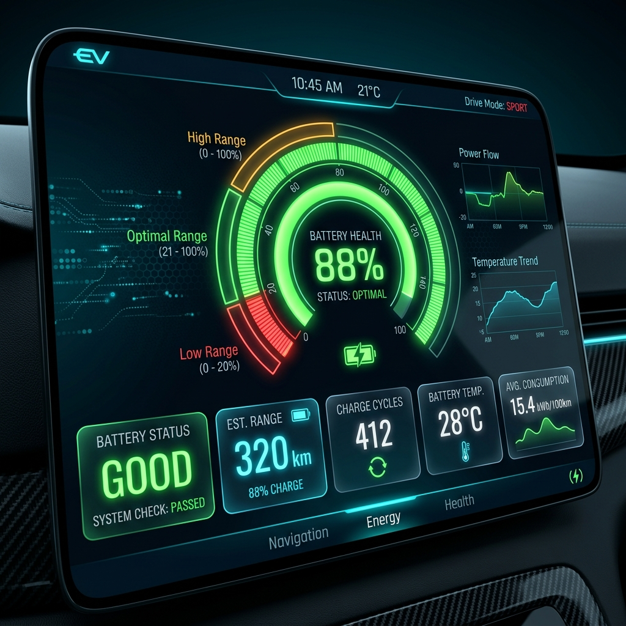
EV FLEET ANALYTICS PLATFORM
Interactive AI Insights & Predictive Engine
Predictive AI Models
• SOH Degradation Predictor: Estimates battery end-of-life timeframe based on charge rate & thermal stress.
• Charging Cost Optimizer: Analyzes hourly tariff cycles to recommend shift to off-peak hours (11 PM - 6 AM).
• Anomaly Detection: Flags abnormal energy draw or rapid voltage drops.

Slide 9
EV FLEET ANALYTICS PLATFORM
Enterprise Governance, Security & Lineage
Security & Compliance
• Role-Based Access (RBAC): EV_ADMIN, EV_DATA_ENGINEER, EV_ANALYST, EV_MAINTENANCE_TECH.
• Column-Level Masking: Redacts driver PII & location coordinates for analyst roles.
• Encryption: AES-256 bit at rest, TLS 1.3 in transit.
• Disaster Recovery: 30-day Snowflake Time Travel & multi-region backup.
Data Quality & Lineage
• Data Quality Exceptions: Automated rules trap invalid SOH (<50% or >100%) or NULL vehicle IDs.
• Audit Logging: All Snowflake transactions & RPA steps logged to GOVERNANCE.AUDIT_LOGS.
• Lineage Mapping: Documented flow from Kaggle CSV -> Alteryx -> Snowflake -> Fabric -> AI UI.

Slide 10
EV FLEET ANALYTICS PLATFORM
Summary & Next Steps
Key Project Milestones Achieved
• End-to-End Automated Pipeline operational across Alteryx, Snowflake, UiPath, and Fabric.
• Web Application live at http://localhost:3000 with Chart.js & AI Engine.
• 14% Energy Cost Optimization validated through tariff peak-shifting.
• Complete enterprise documentation, ERD diagrams & governance matrices.
Future Roadmap
• Direct IoT Telemetry Integration via Kafka / AWS IoT Core.
• Deep Learning Battery Degradation Forecasting (LSTM models).
• Vehicle-to-Grid (V2G) Energy Trading Module.
• Mobile App interface for fleet drivers & depot managers.

