Slide 1
SLEEP HEALTH ANALYSIS
DECODING
SLEEP HEALTH
An Exploratory Data Analysis of Sleep Health & Sleep Disorder Factors
PRESENTED BY
Ganesh Singh
2026 | Data Science Python Project

Slide 2




UNDERSTANDING THE DATA
The Dataset at a Glance
374
13
11
3
Individual
Variables
Occupations
Sleep Disorder Classes
Variables Captured
Demographics
Sleep Metrics
Lifestyle
Vitals
Gender, Age, Occupation
Sleep Duration, Quality of Sleep, Sleep Disorder
Physical Activity, Stress Level, Daily Steps, BMI Category
Blood Pressure, Heart Rate
Individuals
SLEEP HEALTH & SLEEP DISORDERS — EDA
01

Slide 3
The Dataset Challenge
Three cleaning problems changed the reliability of the analysis
01 DUPLICATES
02 LABELS
03 TEXT METRIC
374 raw rows contained 242 repeated records after duplicate checking.
Action: remove repeated health records so they do not overweight the results.
Examples:
• Normal Weight → Normal
• Sales Representative → Salesperson
Action: standardize category names before grouping.
Blood Pressure appeared as text such as “120/80”.
Action: split it into Higher_BP and Lower_BP numeric columns for calculations.
06

Slide 4
DATA PREPARATION
From Noise to Signal
Cleaning reduces repetition and focuses the comparison that matters
374
Raw rows collected
Duplicate health entries excluded so no single patient overweights results.
✓
242 repeated records removed
132
Unique records after de-duplication
Healthy (no-disorder) records excluded from the direct disorder comparison.
✓
“None” records set aside
59
Final comparison set
29 Insomnia records vs 30 Sleep Apnea records — a near-balanced sample.
✓
Disorder records (Insomnia + Sleep Apnea)
SLEEP HEALTH & SLEEP DISORDERS — EDA
03

Slide 5
Distribution of Disorders
The final disorder-only sample is almost perfectly balanced
INSOMNIA
29 cases • 49.2% of disorder group
SLEEP APNEA
30 cases • 50.8% of disorder group
Insights : The dataset is almost equally divided, with 29 Insomnia cases (49.2%) and 30 Sleep Apnea cases (50.8%).
08

Slide 6
Sleep Quality & Duration
Average values among the 59 disorder records
INSOMNIA
6.68 hrs sleep duration
6.52 / 10 quality
SLEEP APNEA
6.94 hrs sleep duration
6.87 / 10 quality
Insights : Sleep Apnea has slightly higher average sleep duration and sleep quality than Insomnia
09

Slide 7
The Stress Factor
Stress is higher in the Insomnia group in this dataset
INSOMNIA
Average stress: 6.03 / 10
SLEEP APNEA
Average stress: 5.93 / 10
Insights : Average stress is slightly higher for Insomnia (6.03) than Sleep Apnea (5.93)
10

Slide 8
Physical Activity & Lifestyle
Two charts keep small scores separate from large step counts
Insight: Sleep Apnea shows higher physical activity on average. It also records more daily steps than Insomnia cords have higher average activity and steps.
11

Slide 9
Occupational Patterns
Which disorder is more common within each occupation?
NURSES
85% Sleep Apnea
SCIENTISTS
100% Sleep Apnea
ACCOUNTANTS & SOFTWARE ENG.
100% Insomnia
TEACHERS / SALESPEOPLE
72.7% / 75% Insomnia
Insight: Sleep Apnea shows higher physical activity on average. It also records more daily steps than Insomnia
12

Slide 10
BMI & Body Composition
The disorder mix changes across BMI categories
OBESE
Sleep Apnea: 57.1%
Insomnia: 42.9%
NORMAL
Insomnia: 53.3%
Sleep Apnea: 46.7%
OVERWEIGHT
Sleep Apnea: 51.4%
Insomnia: 48.6%
Insight: Sleep Apnea has a higher share in the Obese group, while Insomnia is slightly higher in the Normal group.
13

Slide 11
Gender Differences
Disorder mix differs between males and females in this cohort
FEMALE
61.8% Sleep Apnea
38.2% Insomnia
MALE
64.0% Insomnia
36.0% Sleep Apnea
Insights : Among females, 61.8% of disorder cases are Sleep Apnea; among males, 64% are Insomnia.
14

Slide 12
Age Progression
Older groups show a stronger Sleep Apnea share in this sample
18–29
50% / 50% split
30–39
57.1% Sleep Apnea
40–49
66.7% Insomnia
50+
73.3% Sleep Apnea
Insight: The 50+ group has the highest Sleep Apnea share, while ages 40–49 show more Insomnia.
15

Slide 13
Cardiovascular Measurements
Average blood-pressure values are higher in the Sleep Apnea group
INSOMNIA
Higher BP 131.72
Lower BP 86.41
SLEEP APNEA
Higher BP 134.87
Lower BP 90.00
Insights: Sleep Apnea is higher on both readings: Higher BP +3.15 and Lower BP +3.59 vs Insomnia.
16

Slide 14
Heart Rate
Sleep Apnea records have the higher average heart rate
INSOMNIA
72.21 bpm
SLEEP APNEA
74.27 bpm
Insights : Average heart rate is slightly higher for Sleep Apnea (74.27 bpm) than Insomnia (72.21 bpm).
17

Slide 15
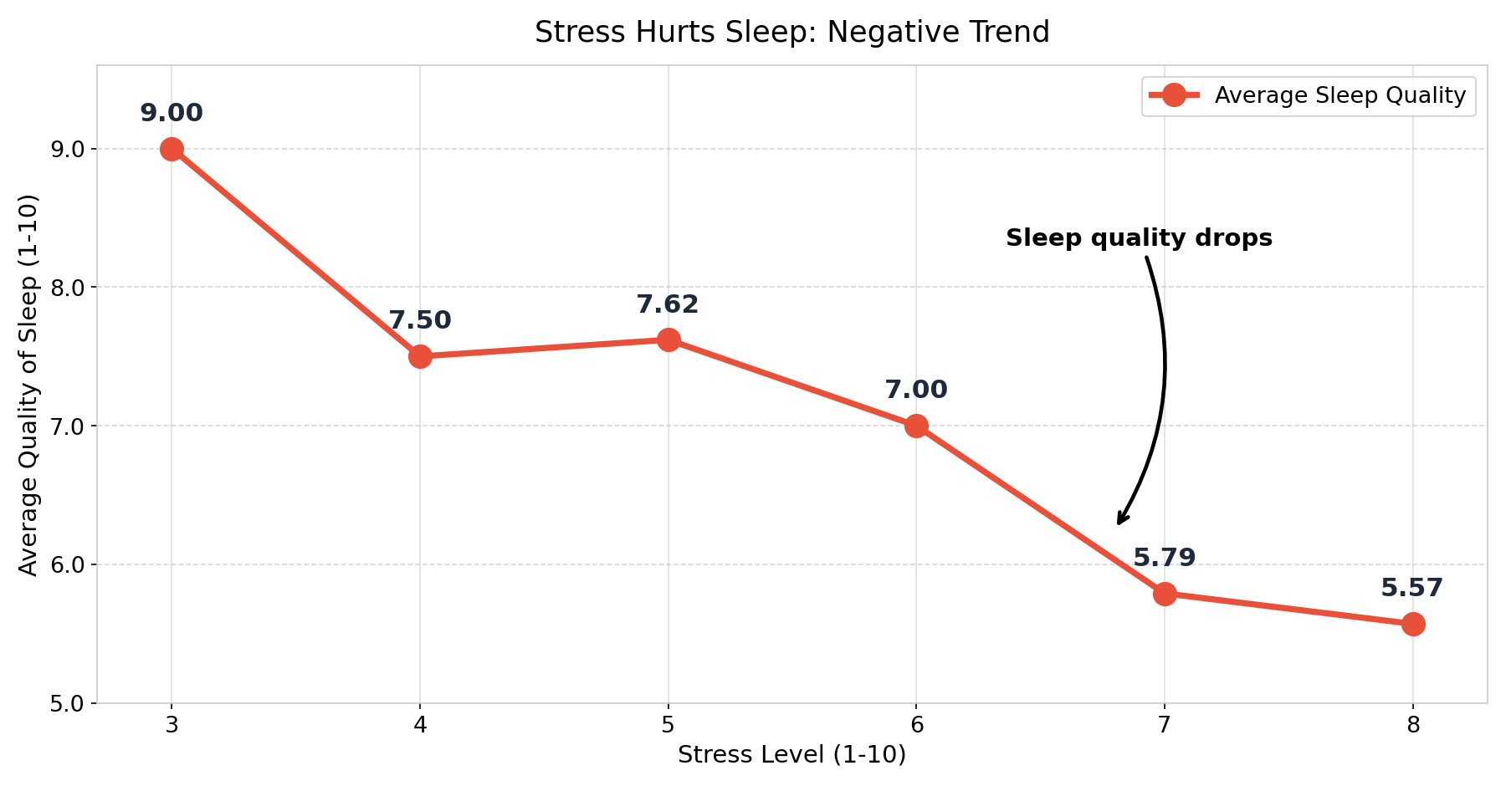
Stress vs. Sleep Quality
As stress rises, sleep quality falls
BIG DROP
Sleep quality falls from 9.0 to 5.6 as stress goes from 3 to 8 (−3.4 points).
Correlation
TIPPING POINT
Above stress 6, quality falls under 6 at levels 7 and 8.
STEADY TREND
Only stress 5 rises slightly (7.50 → 7.62); every other step goes down.
Insight: As stress level increases, sleep quality generally decreases, showing a clear negative relationship between stress and sleep quality.
18

Slide 16
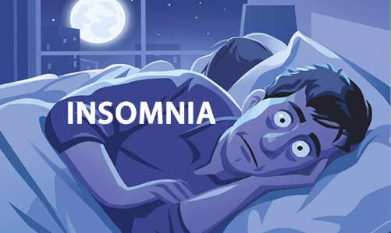

Profile: The Insomnia Pattern
A simple data profile based on the 29 Insomnia records
🧠 STRESS
😴 SLEEP
👥 PATTERNS
6.03 / 10
Higher than Sleep Apnea (5.93)
6.68 hours of sleep
Quality: 6.52 / 10
More common in Accountants, Software Engineers, Engineers, Salespeople and Teachers
IN SHORT
Insomnia records show higher stress and slightly lower sleep time and quality.
Insomnia is a common sleep disorder that makes it difficult to fall asleep, stay asleep, or wake up too early and be unable to get back to sleep
19

Slide 17
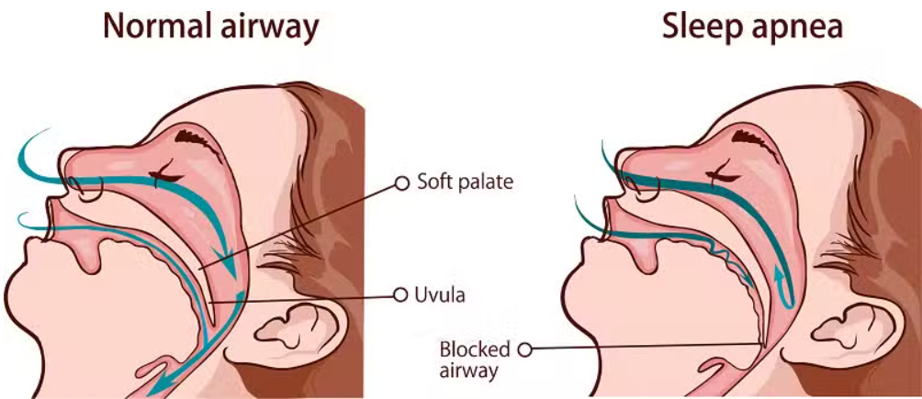
Profile: The Sleep Apnea Pattern
A simple data profile based on the 30 Sleep Apnea records
⚙️ HEALTH METRICS
👥 DEMOGRAPHICS
⚖️ BMI
BP: 134.87 / 90.00
Heart rate: 74.27 bpm
73.3% of the 50+ group
Also high in Nurses and Scientists
57.1% of the Obese group
IN SHORT
Sleep Apnea records show higher blood pressure and heart rate, and appear more in older and obese groups.
Sleep apnea is a potentially serious sleep disorder where breathing repeatedly stops and starts throughout
20

Slide 18
Key Data Insights
What the charts tell us about Insomnia vs Sleep Apnea
DISORDER DISTRIBUTION
SLEEP DURATION & QUALITY
STRESS LEVEL
ACTIVITY & STEPS
Almost equally divided: 29 Insomnia (49.2%) and 30 Sleep Apnea (50.8%).
Insomnia is slightly lower: 6.68 hrs and 6.52/10 vs Sleep Apnea 6.94 hrs and 6.87/10.
Insomnia has slightly higher stress: 6.03/10 vs 5.93/10 for Sleep Apnea.
Sleep Apnea is higher: activity 67.57 and 6,946.67 steps vs 48.10 and 5,755.17.
OCCUPATION
BMI
GENDER
AGE
Sleep Apnea: Nurses (85%), Scientists (100%). Insomnia: Teachers (72.7%), Salespeople (75%).
Sleep Apnea is higher in the Obese group (57.1%); Insomnia is slightly higher in Normal BMI (53.3%).
61.8% of female cases are Sleep Apnea; 64% of male cases are Insomnia.
50+: 73.3% Sleep Apnea. 40–49: 66.7% Insomnia.
21

Slide 19
Limitations of This Study
What the data cannot tell us
01 SMALL FINAL SAMPLE
02 CROSS-SECTIONAL
03 MISSING VARIABLES
Only 59 disorder records remain after cleaning.
Averages and percentages can be sensitive to a few records.
This is a snapshot. We cannot tell whether stress causes poor sleep or poor sleep increases stress.
The dataset does not include factors such as caffeine, screen time, or genetics.
Other variables could influence the patterns.
22

Slide 20
Future Roadmap & Improvements
How the next version could become stronger
Scale Up
Collect a much larger participant sample.
01
Track Over Time
Use repeated measurements to study changes.
02
Expand Features
Add diet, exercise frequency, caffeine and screen time.
03
Validate Labels
Use clinically verified diagnoses where possible.
04
Goal: move from simple pattern finding toward stronger, better-validated evidence.
23

Slide 21
CONCLUSION
Two disorders. Different patterns.
INSOMNIA
SLEEP APNEA
In this sample: higher stress, shorter average sleep duration, and slightly lower sleep quality.
In this sample: higher average blood pressure and heart rate, with stronger shares in older and obese groups.
Final message: the project finds patterns—not causes. A larger and better-validated dataset would be needed for stronger conclusions.
Thank You • Questions?
Ganesh Singh • Neha Tiwari • Vivek Hotkar • Anushka Shekhar • Mahima Gupta • Mohd Fuzail Salmani

