Slide 1


Candidate Assessment & Briefing Program (CAB)
WELCOME TO THE

Slide 2



Welcome
Congratulations on making it to ONCALL’s Candidate Assessment Briefing day!

Slide 3

House Keeping
Emergency Procedures
Mobile Phones
Break
Toilets
Tea, coffee, drinks
Parking
Smoking facilities

Slide 4
Today’s Program – Morning Session
Morning Session
Final stage of recruitment process
Assessment
Ice breaker
Incident reporting
Soft skills
General information
DWES and NDIS
Charter of rights
DHHS/National standards
Supporting participants and young people
Lunch break

Slide 5
Today’s Program Afternoon Session
Successful Candidate Briefing
Documentation
Payroll
Business unit information
Finalise recruitment

Slide 6

Ice Breaker

Slide 7
Responsibilities

Slide 8
OH&S
Most shifts occur in venues outside of ONCALL’s direct control
The OH&S Act (2004) shares responsibility for employees’ health & safety…under the Act, the following applies:
S21 – Employer has responsibility as far as is practicable to provide a safe work environment. This includes your host employer.
S25 – Employee has a responsibility to act in a safe manner to protect their own safety as well as anyone else affected by their acts /omissions
ONCALL’s OH&S Policy & Procedure

Slide 9
Food Handling
When working with vulnerable people who are more susceptible to illness and poisoning, our food handling standards and general hygiene must be very high.
(Check out the Food Handling training you can take home with you!)
Working with people who are vulnerable, i.e. children, aged, disabled, pregnant or unwell, require much higher food handling and personal hygiene standards by support staff in residential settings.

Slide 10

Infection Control
By following some simple rules in Standard and Extra Precautions protocols, you can contribute to the prevention of food poisoning and cross contamination.

Slide 11

Administration of Medication
It is Mandatory for all Support Workers to have completed training in Medication Administration.
All Support Workers must know The 7 ‘R’s’…and be deemed competent in medication administration training!
RIGHT Person
RIGHT Medication
RIGHT Time
RIGHT Dose
RIGHT Route
RIGHT Date
RIGHT Documentation

Slide 12
Administration of Medication
PRN - pro rẽ nata - Latin for as required/needed
All PRN must be approved & written into a person’s plan. Before administering, strategies and procedures need to be followed and approval to administer must be sought from a Supervisor or Team Leader.
PRN should be seen as the last resort
Behaviours are a method of communication, so attempt to find out what the issue is before resorting to chemical interventions

Slide 13
Incident Reporting

Slide 14

Incident Reporting (IR)
Question for the room
Why do we write Incidents Reports?

Slide 15
Importance of Reporting
Reporting critical client incidents is an important part of quality, safety and continuous improvement
The key reason for reporting incidents is to learn from them and prevent or minimise the risk of happening again.

Slide 16
When to Report
An incident report is required for all acts, omissions, events or circumstances that occur during service delivery to a child, young person or person with disability that has, or could have, caused harm to a person/s
Harm is defined a actual or potential negative impacts on the physical or psychological well-being of a client or staff member
Failing to report is (almost) as bad as committing an act of abuse towards a child or person with a disability. Reporting is part of our continuous improvement process so that we can provide the highest level of quality support
Failure to report = failure to provide a duty of care

Slide 17


Where to Report
Is the client under 18?
AND
Was the client harmed or was there an allegation of abuse?
AND
Was the client in an ONCALL Residential Setting?
Complete CIMS form (DHHS)
All other Client / Staff Incidents including Near Miss/ Hazards/ Staff injury / Maintenance (Oncall Houses) / Behaviour Tracking
Complete OIMS form (ONCALL)
NB: Field Staff must complete reports for either system by the end of shift in which the incident occurred

Slide 18

Access to IR Portals
https://www.oncall.com.au/
If staff are unable to access IR Portals or unsure as to which portal to use, seek clarification with a team leader or supervisor or contact head office for further advice

Slide 19
ONCALL & Staff Responsibility Reporting Incidents
Clients with NDIS funded disability services: - Staff report VIA OIMS
ONCALL is required to report any serious incidents or unauthorised use of restrictive practices to the Office of NDIS Quality and Safeguards Commission
Office of the Disability Services Commission (if applicable)
DHHS DWES Unit (Disability Workers Exclusion Scheme Unit)
Children & Young People or Disability Clients under 18 years old in a residential setting, DHHS funded services: - Staff Report VIA CIMS
ONCALL is required to report any Major or Minor incidents to CIMS (DHHS Client Incident Management System), and
Reportable Conduct Scheme (Commission for Children and Young People)
Behaviour Tracking, Near Miss, Other Client Incidents, all Staff Injuries - Staff Report VIA OIMS
Breaches of Privacy – ONCALL must also report to Office of Australian Information Commission - Staff Report VIA OIMS

Slide 20


Classification of Client Incidents – CIMS
All unexpected or unanticipated deaths of clients, including suicides
Severe physical, emotional or psychological injury or suffering which is likely to cause ongoing trauma
A pattern of incidents related to one client which, when taken together, meet the level of harm to a client defined above. This may be the case even if each individual incident is a non-major impact incident e.g.
Incidents that cause physical, emotional or psychological injury or suffering, without resulting in a major impact.
Impacts to the client which do not require significant changes to care requirements, other than short-term interventions e.g. first aid, observation, talking interventions or short-term medical treatment.
Incidents that involve a client but result in minimal harm
Incidents that do not otherwise meet the criteria for ‘major impact’.
Privacy breach
Notes:
Hand out of CIMS incident types?

Slide 21

OIMS Reporting
ONCALL Incident Management System (OIMS)
Client to staff
Client to other
Staff to staff
Staff to client
Client to client
Other to client
Near Miss / Hazard
Staff injury
Privacy Breach
Maintenance (Oncall Residential Accommodation)
i.e. Behaviour Tracking, Client to staff/other for Case Management and evidence required for planning
and STOs etc, and Staff to Staff (performance management and/or Workcover, OHS Analysis/Worksafe Reporting)

Slide 22
Effective IR Writing
All reports via OIMS or CIMS (OIMS if you are unsure)
Clear
Complete
Factual
Objective
Limited use of abbreviations
Cover: Who? What? Where? When? How? What action you took? Who you reported it to?

Slide 23
Sector Legislation

Slide 24

Legislation
Legislation is the rules set by Government either at a State or Federal level. It defines minimum standards and guides the development of Policy for Service providers and the general public. The Act also imposes penalties for breaches, which can be quite significant.
Examples of Legislation that ONCALL members must comply with;
Disability Services Act 2006
Child Youth and Families Act 2005
National Disability Insurance Scheme Act 2013
Information Privacy Act 2000

Slide 25
Legislation
Legislation is the rules set by Government either at a State or Federal level. It defines minimum standards and guides the development of Policy for Service providers and the general public. The Act also imposes penalties for breaches, which can be quite significant.
Examples of Legislation that ONCALL members must comply with;
Disability Services Act 2006
Child Youth and Families Act 2005
National Disability Insurance Scheme Act 2013
Information Privacy Act 2000

Slide 26
UN Convention on the Rights of Persons with a Disability & Charter for Children in Out of Home Care

Slide 27
Videos
Human rights of a person with disabilities
Rights Under the UN Convention on the Rights of Persons with Disability

Slide 28
Free Online Training
An Introduction to Human Rights in Disability Services
Created by National Disability Services (NDS) – funded by DHHS
The program takes you though the basics of what human rights are and how they apply to our work in disability services.
The training program involves:
Five interactive online training modules
Each module takes about 20 minutes to complete
The modules can be done all at once or spaced out over time
The modules can be completed individually, in pairs or as a team
http://www.carecareers.com.au/human-rights-course/VIC/Launch.html

Slide 29
Charter for children in OoHC
Getting it right

Slide 30
DHHS Standards and National Disability Service Standards

Slide 31
DHHS Standards
The standards represents a single set of service quality standards for organisations delivering services to clients, summarised as:
Empowerment: People's rights are promoted and upheld
Access and Engagement: People’s right to access transparent, equitable and integrated services is promoted and upheld
Wellbeing: People’s right to wellbeing and safety is promoted and upheld
Participation: People’s right to choice, decision making and to actively participate as a valued member of their chosen community is promoted and upheld.
Source: https://providers.dhhs.vic.gov.au/human-services-standards

Slide 32
National Disability Service Standards
Six National Standards
There are six National Standards that apply to disability service providers.
Rights: The service promotes individual rights to freedom of expression, self-determination and decision-making and actively prevents abuse, harm, neglect and violence
Participation and Inclusion: The service works with individuals and families, friends and carers to promote opportunities for meaningful participation and active inclusion in society
Individual Outcomes: Services and supports are assessed, planned, delivered and reviewed to build on individual strengths and enable individuals to reach their goals.

Slide 33
National Disability Service Standards
Six National Standards
Feedback and Complaints: Regular feedback is sought and used to inform individual and organisation-wide service reviews and improvement.
Service Access: The service manages access, commencement and leaving a service in a transparent, fair, equal and responsive way.
Service Management: The service has effective and accountable service management and leadership to maximise outcomes for individuals.
Source: https://www.dss.gov.au/our-responsibilities/disability-and-carers/standards-and-quality-assurance/national-standards-for-disability-services
Source: https://www.dss.gov.au/sites/default/files/documents/06_2015/nsds_full_version.pdf

Slide 34
Supporting a participant or young person to make a complaint
Our participant or young person and residents also have a right to complain if they feel they have been denied access to their rights of if they are not happy about their service.
ONCALL is a complaint-friendly organisation, we encourage our participants or young person to let us know how they feel.

Slide 35
Supporting a participant or young person to make a complaint
Part of your duty of care to the people you support is to help them to feel empowered to give feedback, and to feel safe in doing so. Some vulnerable people feel that they will get into trouble or even be punished for complaining. We have easy-read information for participants or young person about making complaints to ONCALL.
If they are not happy with the response they get, they can contact the Disability Services Commissioner, whose clear motto is “It’s OK to Complain!” www.odsc.vig.gov.au

Slide 36
Duty of Care
ONCALL has a duty of care to ensure that anyone supported does not come to any harm.
Duty of care extends to anyone who may be affected by the work of ONCALL including family, friends of people receiving support, staff and all community members.
All staff have a duty of care to ensure all reasonable action is taken to minimise the risk of harm to any person they are supporting and to all members of community.

Slide 37
Duty of Care
Harm can mean failing to:
Follow a person’s support plan and relevant policies.
Take reasonable action to protect others from harm.
Report unreasonable actions of others when witnessed.
Actions of concern include but are not limited to:
Behaviour, both physical and verbal, to any person that is:
Bullying
Demeaning
Aggressive or Assaultive

Slide 38
Duty of Care
Harm, to people being supported, may include but is not limited to:
Failure to provide sufficient food and drink
Failure to provide sufficient warmth in winter or adequate protection from the sun in summer
Physical injury
Physical or emotional abuse
Neglect
Breach of privacy
Exploitation and/or
Financial disadvantage or loss.
Restrictions and exclusion that are not part of an approved behaviour support plan

Slide 39
Dignity of Risk
All people that ONCALL support have the same human rights as every other person.
One of those rights is to determine the level of risk they wish to be exposed to in managing their normal activities of daily living and, in particular, any recreational, learning or unusual activities which may extend them beyond their usual, practiced and ‘safe’ zone of activities.
This exercise of choice to take risks is an important determinant of self esteem, which in turn promotes the participants or young person sense of dignity. Hence the term ‘dignity of risk’.

Slide 40
Dignity of Risk
One of the biggest barriers to supporting people to take risks is fear: of the unknown, of the legal ramifications, or of failure. Service providers worry that if a person that is being supported takes a risk and fails that it implies they are doing a bad job.
ONCALL will encourage support staff to see the positives in risk, the positives that can come out of failure and allow participants or young person to take responsibility for the control for their choices and actions.
Failure should be seen as a learning opportunity. Supporting people through failure can assist them to develop resilience.

Slide 41
Our role in Positive Behaviour Support
ONCALL is committed to ensuring that all services provided by the company act for and on behalf of people we support to ensure their human rights and interests are recognised and protected at all times.
ONCALL values the important role that disability advocacy plays to ensure the rights and interests of people with a disability are respected and realised.
ONCALL will ensure that all participants or young person are informed of their right to have access to an advocate to speak on their behalf.

Slide 42
What is Active Support?
People centred - focuses on the person not the disability
Provides opportunity for engagement in daily activities in the home and the community;
eg: chores, hobbies, building friendships, community engagement;
Engagement can be:
In the whole activity/ interaction/ task
In part of an activity/ interaction/ task
Continuous
Stop-start
Lead role
As an active participant
Dignified, meaningful and interactive
Requires a consistent approach from support workers

Slide 43
ONCALL support staff roles….
Your aim is to support people to:
Make choices and decisions
Have learning opportunities
Be involved in active support
Speak up for themselves
Experience their community
Gain self-respect and self determination
Enjoy an increased quality of life, and much more
So, manage the service provision, not the person

Slide 44
Professional Boundaries
On any day, on any shift, your role as a Support Worker could result in you wearing any one of a number of hats…
E.G Driver, Teacher….
Can you think of any others?
Is your role to be a friend?
What are your professional boundaries?

Slide 45
Lunch – 30 minutes Zero Tolerance to Abuse

Slide 46

Congratulations &
Welcome to the Team

Slide 47
Our Mission, Vision & Values
Mission
Provide each and every customer with flexible and tailored support designed to meet individual needs. We do this by being reliable, transparent, responsive & proactive.
Vision
Continue to be the leading professional provider of workforce solutions in the community service sector by providing our customers and staff with professional excellence in personalised service delivery.
Values
Passionate about our service
We value you and your business
Committed to service excellence
Respect and honesty
We demonstrate responsibility and accountability
Embrace quality and continuous improvement

Slide 48

Social Media Policy
ONCALL’s Social Media Policy has been provided in your folder. Ensure you familiarise yourself with it.

Slide 49

Facebook
We talk to you on Facebook, it’s important to like our page

Slide 50

Website
www.oncall.com.au
Sector News & Events
Staff Policies
Training Information
Plus Much More

Slide 51
Policies

Slide 52
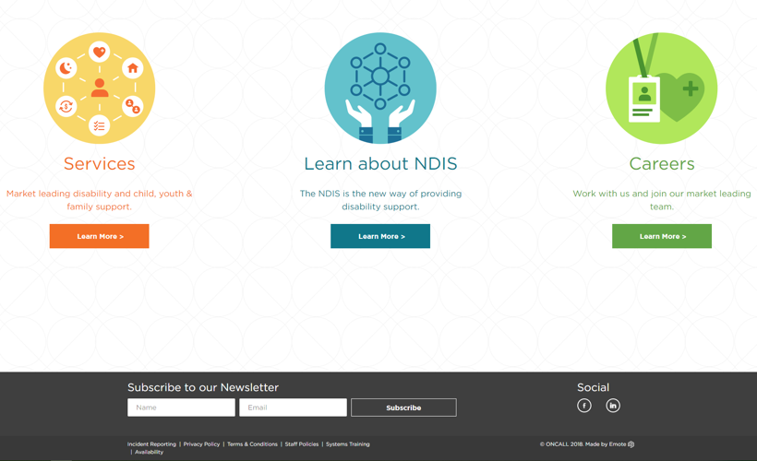
Staff Policies
You can access our policies on our website by clicking the ‘Staff Policies’ link in the bottom corner of every page.
The page is password protected, so simply type in the password to get access.
Page Password: ONCALL

Slide 53
Key Policies
Code of Conduct
Occupational Health & Safety Policy
Confidentiality Policy
Conflict of Interest Policy
Social Media Policy
Smoke Free Workplace Policy
Fire and Emergency Procedures Policy
First Aid & CPR Policy
Staff Supervision Policy
Incident Reporting Procedure
Medication Policy
Assault Response Policy
Restrictive Interventions Policy

Slide 54
Requirements

Slide 55
Mandatory Requirements
ONCALL is under contractual obligations to ensure that all staff hold current mandatory requirements;
Probity:
Police Check
Working with Children Check (WWCC)
International Police Check (when applicable)
Training:
First Aid level 2
CPR
Administration of Medication
Manual Handling
Fire Safety Training
Other
Drivers License (where applicable)
DWES check
Carer Registration (CY&F only)
If a mandatory requirement expires you cannot work!

Slide 56
Mandatories that must be renewed
DISABILITY | VALIDITY | WELFARE
Level 2 First Aid | 3 years | Level 2 First Aid
CPR | 12 months | CPR
Fire Safety Training | 2 years | Fire Safety Training
Medication Training | 3 years | Medication Training
Police Check | 3 years | Police Check
WWCC | 5 years | WWCC
DWES (internal) | 12 months | DWES (internal)
Drivers Licence | When expired | Drivers Licence
Manual Handling – 3 years |  | OoHc Registered Check (internal)
PLEASE NOTE: you will receive reminders by email from ONCALL but if you do not renew them in time you will not be able to work.

Slide 57
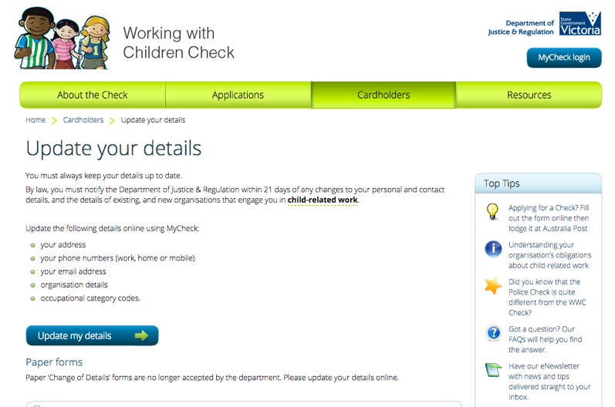
Updating WWC Details

Slide 58
Organisation Overview

Slide 59
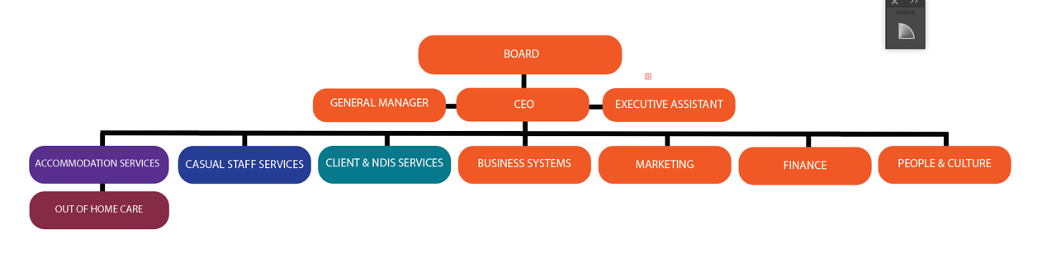
Organisation Structure

Slide 60





Group Overview
Out of Home Care provides emergency and contingency support within out of home care and in home support.
Our Casual Staff Services team provides staff to over 350 organisations across Victoria.
Our Accommodation Services team provides disability support in up to 20 houses at any point
in time.
Support Departments
ONCALL has several operational departments they are:
HR, Recruitment, Quality & Compliance, Finance, Business Systems, Marketing
Client & NDIS Services provides one to one support, financial intermediary and support coordination.
ONCALL Training College provides accredited, tailored and short courses to individuals and businesses.

Slide 61
NDIS
The National Disability Insurance Scheme is the new way of providing individualised support for eligible people with permanent and significant disability, their families and carers.
For eligible people, the NDIS provides a flexible, whole-of-life approach to the support needed to pursue goals and aspirations and participate in life.
Information and referrals, links to services and activities, individualised plans and where necessary, supports over a lifetime.
Raise community awareness and encourage greater inclusion and access to mainstream services, community activities and other government initiatives.
Support service providers to build capacity and be part of the scheme.
For more information go to: http://www.ndis.gov.au
If you would like a copy of the information pack, please ask a member of the training team

Slide 62

Employee Accountability

Slide 63
What we expect of you
Refer to our Code of Conduct Policy
Respect boundaries
Provide choice and support
Maintain privacy and confidentiality
Accountability
Your employer is ONCALL and your overall accountability is to ONCALL
If you work for an organisation through Casual Staff Services - you are accountable to the organisation e.g. DHHS House.
If you work in ONCALL’s services i.e. Accommodation Services, OOHC or Client Services - accountable to ONCALL

Slide 64
If you’re offered permanent employment
ONCALL’s investment to you
Opportunities that may arise
Contractual agreements between ONCALL and provider organisations
Your responsibilities

Slide 65
Availability
Make sure to update your availability regularly
Staff who submit availability will show up at the top of the list when allocations staff search for available staff
How to update?
Phone
Visit oncall.com.au/availability
MyONCALL App

Slide 66

MyONCALL App
Apple and Android Devices
Submit Availability
Submit Timesheets
Request MyShifts
Connect with ONCALL

Slide 67
Required for all shifts
DON’T FORGET;
Your ONCALL ID card
Your working with children’s check card
Your drivers license
Your timesheet book
Your mobile phone
Know your shift details well before you start and get there on time!
ALWAYS;
Introduce yourself
Read the house diary, communication book and/or casual folder
Read the case notes relevant to your shift
Know the fire & evacuation plan & procedure for the service
Be aware of any support plans you need to follow – behavioural, medical etc

Slide 68
Attire for work
Keep jewellery to a minimum
Avoid long chains, necklaces or scarves
Hair should be neat and clean – long hair should be tied back or worn up
Fingernails should be kept clean, short and smooth edged
Personal clothing and footwear should be clean and in good condition
No open toed or heeled shoes
Avoid perfume and keep to a low/no scented deodorant, remembering that your own personal hygiene is extremely important

Slide 69
Pay office

Slide 70
Payroll Contact details
This is for contacting pay office
Email all enquiries to: payoffice@oncall.com.au
This is for Timesheets only
Email timesheets to: timesheets@oncall.com.au

Slide 71
Changing your details
Banking details – in writing (don’t close account until pay reaches new account)
Your address/phone number/email address – in writing
Tax File Declaration: Any changes require a new tax file declaration
Super: Must be accompanied by confirmation of super account from super fund
Your name – must provide certified copy as evidence of change
Email to: payoffice@oncall.com.au

Slide 72
Payroll
Getting your timesheets to us:
Email to: timesheets@oncall.com.au
MyONCALL app simply take a photo and attach
Post – ONCALL, Level 2, 660 Canterbury Road, Surrey Hills, Vic 3127
Drop in - to the postbox next to the garage roller door in Russell Street (just around the corner from the front door) labelled “ONCALL Staff Timesheets”
You can ask reception to add you to the register list for confirmation of timesheets being received.
Reception also supplies new timesheet books on request

Slide 73

Payroll
Timesheets must be in by 10am Monday morning
Weekly Pay – payday is Friday. Payslips will be emailed every Thursday
Timesheets must be submitted weekly
Every Monday emails are sent outlining missing timesheets

Slide 74
Timesheets
Information must be clear and complete
If a timesheet cannot be read or is not signed by both yourself and the participant/customer, you may not be paid.
Shift must match our system
If your shift times change due to incident or organisational request, you must contact ONCALL at the completion of your shift to update shift details (including authorising person’s name and position)
Work Performance
To be filled out by organisational staff member if they choose to provide feedback on your performance

Slide 75
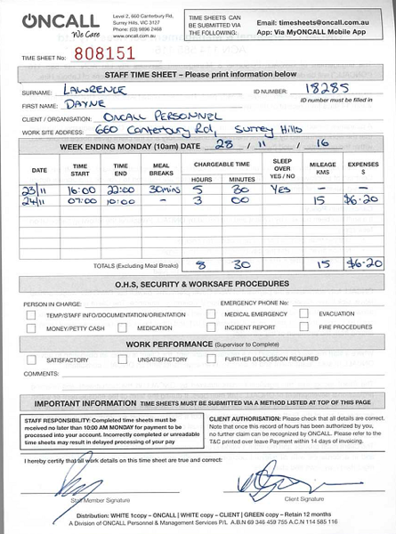
Sample Timesheet

Slide 76
Payslips
Getting your timesheets to us:
Emailed Thursday afternoons Make sure we have your correct email address, if you change your email address you must let us know.
Check your timesheet - hours, s/o’s, weekend rates etc.

Slide 77
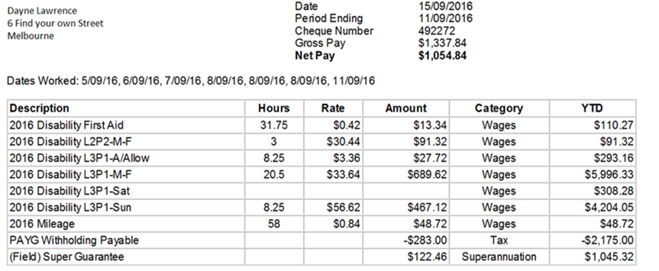
Sample Payslip
Marketing communications may occasionally be added to the bottom of your payslips, remember to take a look at these as they can include competitions, vacancies or upcoming training sessions and discounts.

Slide 78

Casual Staff Services Disability and CYF & Community Services

Slide 79

NDIS Services

Slide 80

Accommodation Services
Disability accommodation services

Slide 81

Out of Home Care

Slide 82
Career Progression
ONCALL has many examples of staff who have commenced their careers as a support worker
See Vishal’s story in your manual

Slide 83
Employee Support
For Employee Assistance: please contact the ONCALL Human Resources Manager on 9896 2468
National Disability Practitioners – membership organisation supporting practitioners who have dedicated their careers to supporting others. www.ndp.org.au

Slide 84

Welcome to the team!

