Slide 1


Group Interview
WELCOME TO THE

Slide 2


Interview Outline
Next 2 hours
Ice Breaker (15 min)
Skill and knowledge test (30 min)
True & False answers (10 min)
Read through scenario (5 mins)
Group Discussion (60 mins)
If you are successful, what comes next? (10 min)

Slide 3
Company Overview
Disability Services
Casual Staff Services
Client & NDIS Services
Accommodation Services
Child Youth & Family / Welfare
Out of Home Care (OoHC)

Slide 4
Skills and Knowledge Test (30 minutes)

Slide 5
Read Scenario Questions (5 minutes)

Slide 6
True and False Answers (10 minutes)

Slide 7
Who is in Control?

Slide 8








Slide 9
Shop
Shop
Shop
Shop
Shop
Shop
Shop
Shop
Shop
Shop
Shop
Shop
Shop
Shop
Shop
Shop

Slide 10
Silk
Silk
Silk
Silk
Silk
Silk
Silk
Silk
Silk
Silk
Silk
Silk
Silk
Silk
Silk
Silk

Slide 11
Do Not Assume your Initial Response is Always Right
-Your brain has ability to draw patterns, to assist you in making decisions faster -Think through all situations
-If in doubt, ask for help

Slide 12
Scenario 1
What do we know about the young person?

Slide 13
Scenario 1
-Relationship is illegal
-Age of consent is 16 within 2 years
-Reporting is mandatory
-Always inform the young person unless directed otherwise by a supervisor

Slide 14
Emotion Salad
37 is the score to beat

Slide 15
Scenario 2
Best way to enter Carla’s room?

Slide 16
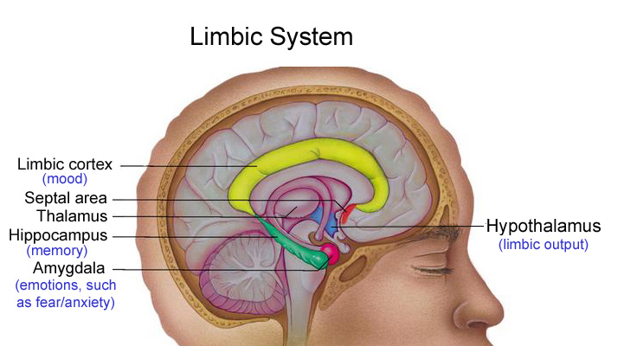
How Does Trauma Effect the Brain?

Slide 17
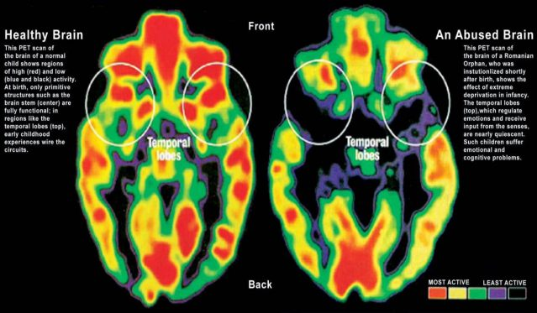
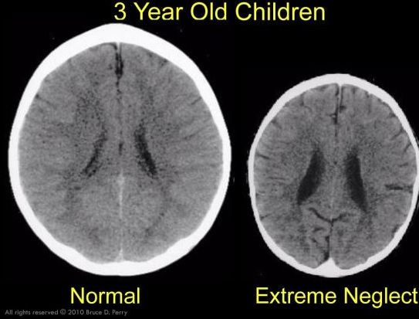
Trauma effects brain development
Brains ability to regulate emotions has not properly developed and hence behaviour is more likely
Trauma has a lasting effect on the brain

Slide 18
What is a Trigger?

Slide 19
Any stimuli that makes behaviour more likely

Slide 20
What is your Trigger?
What may be a trigger for a young person in care?

Slide 21
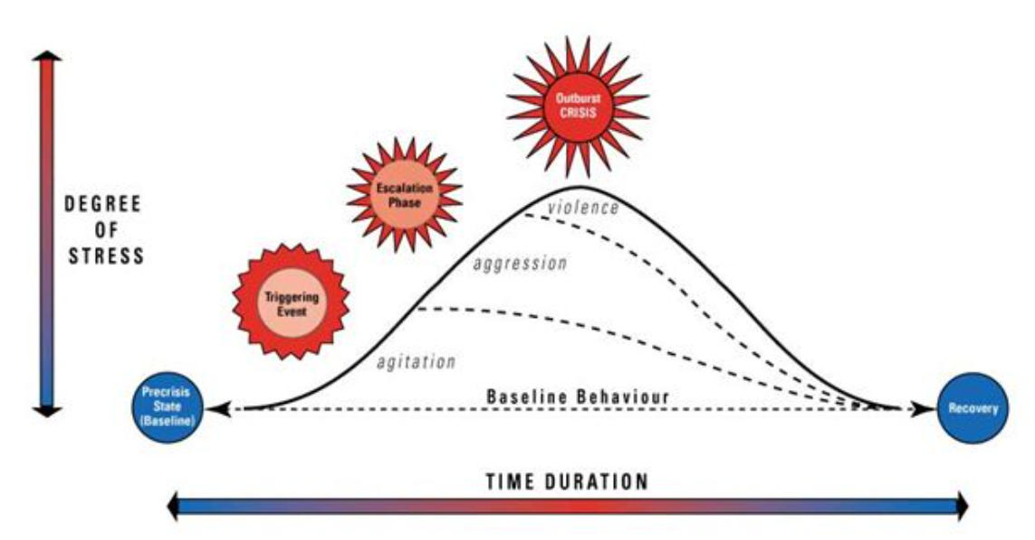

Slide 22
Mandatory
Documents

Slide 23
What you need
A relevant qualification (+ Transcripts)
Mandatory Top Up units, or proof of enrolment
Level 2 First Aid + Current CPR
Fire Safety Training (DHHS)
Assist clients with Medication
Worker Orientation Module – Safety, Quality & You
Police Check (less than 6 months old- MUST say VULNERABLE GROUPS
Working with Children Check (Employee Card)
International Police Check / Stat Dec
Unencumbered Victorian Drivers Licence
Passport or Birth Certificate or Citizenship
Visa Grant Notice (Student and WH Visa)
CoE – less than 6 months old (Student Visa)
WE DON’T ACCEPT ONLINE TRAINING FOR FIRST AID, CPR, or MEDICATION

Slide 24
Next steps
All documents sent via email to your Recruitment Consultant
Both references completed (landline numbers must be provided)
DWES check
Candidate Assessment and Briefing Day (CAB Day) every Thursday 8:45am-3:30pm

Slide 25
IF YOU DON’T HAVE THESE
YOU CANT WORK!

Slide 26
IF YOU DO NOT HAVE TOP UPS – STAY BACK

Slide 27
Career Pathway Program
-6 Compulsory Classes (over 6 weeks)
-4 units and 2 Professional Development days
-$250 enrolment fee
-You may require supernumerary hours prior to commencing paid work in a residential environment.
-All CPP Support Workers can be started in transport, and in-home support shifts.
-After 180 PAID hours, and you have completed all course work, you will be refunded.
*** If ONCALL deems you are not competent in the field, ONCALL reserves the right to close your work areas.

