Slide 1
Tourism Demand Modeling Challenge: The Case of National Parks in Japan
Boobalaganesh Ezhilan
Narendra Badam
Abhishek Kumar

Slide 2
Data Set:
Training set : (datetime, parks, no. of visitors) – 8 Parks, Jan 2015 – Dec 2016
Weather : 26 paramaters
Nightley : Japanese and Foreign National Count at Nikko National Park (Jan 2016 – Dec 2017)
Colopl : Tally data of visitors in the vicinity of 4 National Parks
Hotlink : Blog postings per day that include words related to sightseeing and national parks, Jan 2015 - Dec 2017
Nied_oyama : Snow cover at Snow Weather Observation Facility near Oyama National Park
Jorudan : Route Search log data
Agoop : Tally data of "average floating population" according to the area in the vicinity of each national park

Slide 3

Problem Statement
Predict the number of visitors for each National Parks for every day of 2017
Evaluation Function Mean absolute error (MAE) : $\frac{1}{n}\sum_{i=1}^{n}{|y_{i}−\hat{y_{i}}|}$

Slide 4
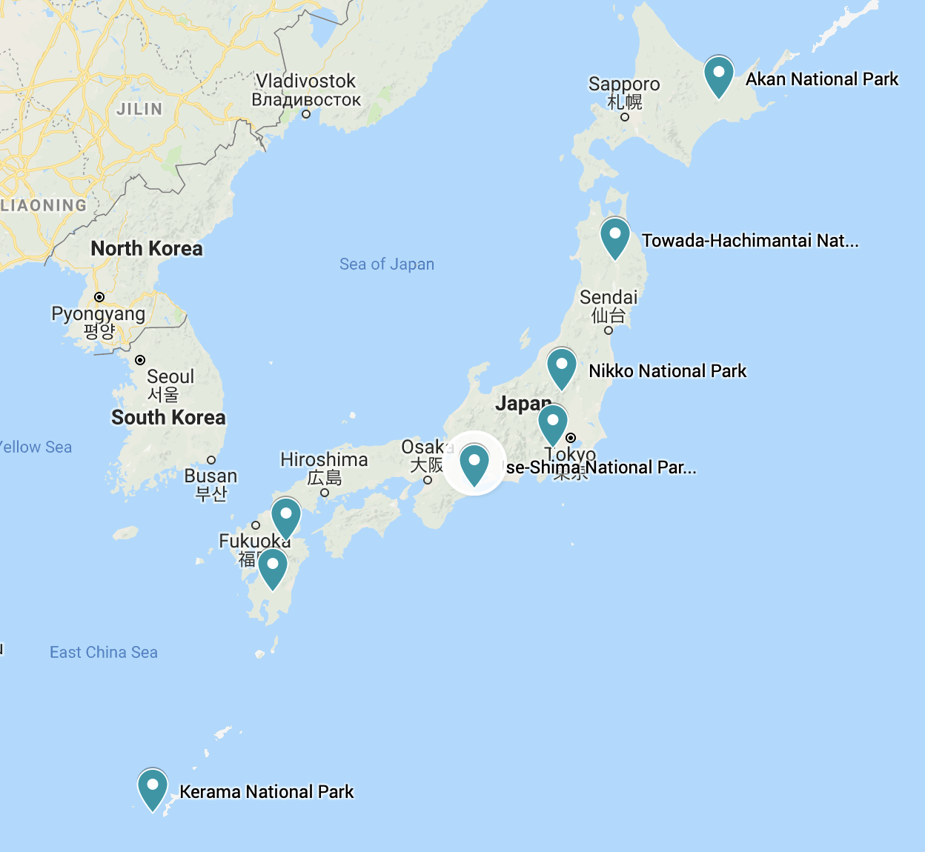

Slide 5
Crossing the Language Barrier
50 files, almost all of them in Japanese, even columns
Used Google Cloud Translation API to translate each file

Slide 6
Data Cleaning and Imputation
Used just weather data for the 1st Version of Model
Removed columns having 50% or more missing values
Removed columns with high correlation
Forward and Backward filled missing values
Replaced outliers with max/min values within normal range (Boxplot)
Implemented PCA to further decrease the dimension, not included in this model

Slide 7
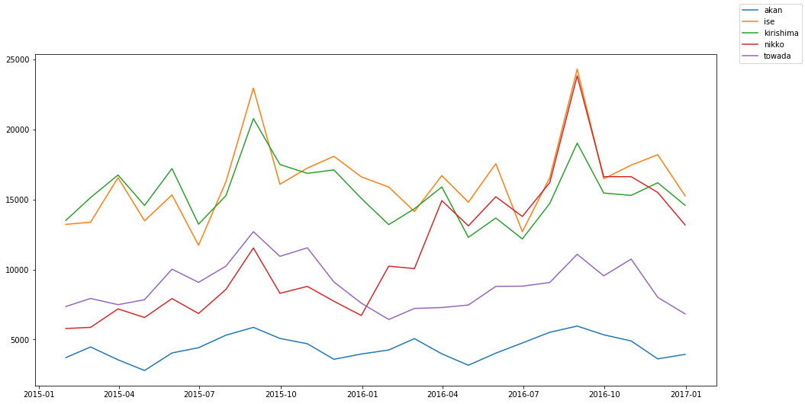
Time series Visualization and Analysis
Sampled Monthly

Slide 8
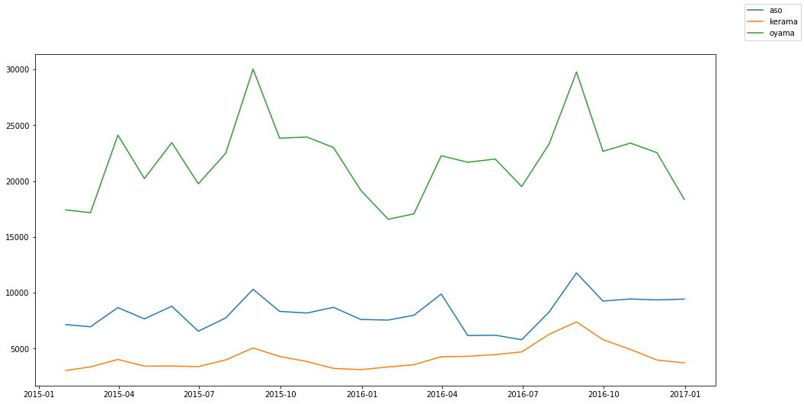
Sampled Monthly

Slide 9
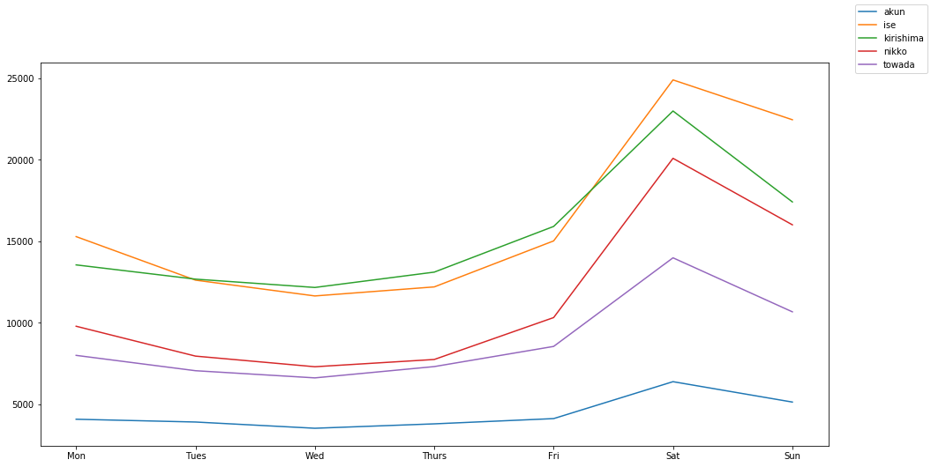
Sampled Weekly

Slide 10
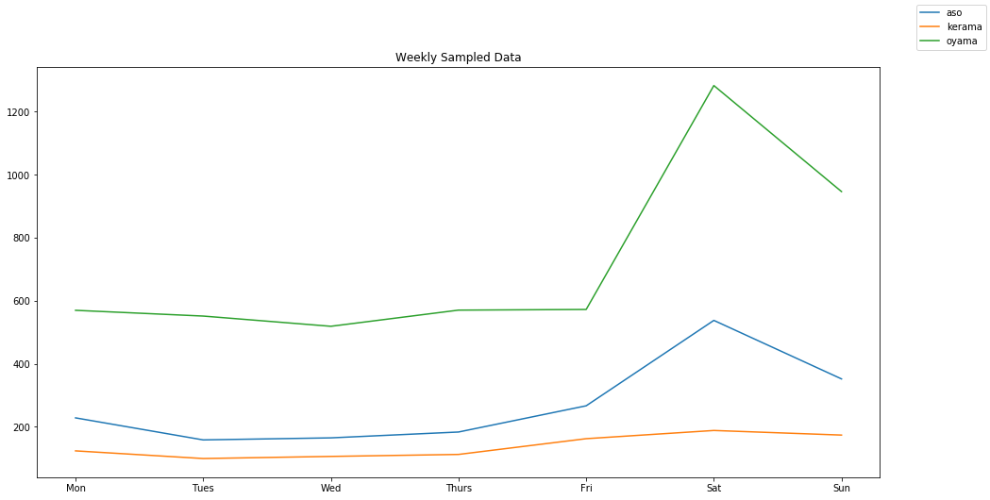

Slide 11
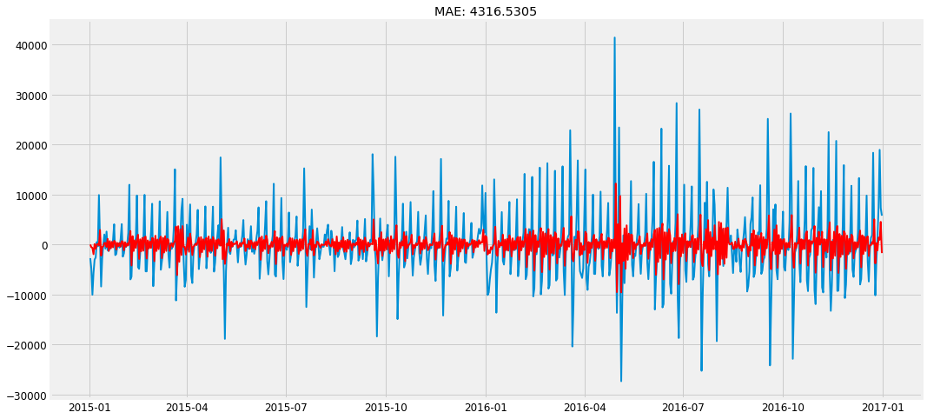
Time series
ARIMA – For single predictor
SARIMAX – For multiple predictors

Slide 12
Feature Engineering
Break dates into new features
Date
Month
Year
Day of the week
Merged the weather data to the training and test set
Normalized the data

Slide 13
Base Model : XGBoost
What makes XGBoost powerful and fast?
Regularization
Handling sparse data
Block structure for parallel learning
Cache awareness
Out-of-core computing

Slide 14
Base Model
One-hot-encoding for parks
No of estimators =1000
CV = 5
Learning rate = [0.01, 0.03, 0.06, 0.1, 0.3, 0.6, 1]
Gamma = [0, 0.3, 0.6, 1]
Max-tree-depth = [2, 4, 6]
Co-sample_bytree = [0.5, 0.7]
Subsample = [0.6, 0.8]

Slide 15
Iteration 1 : MAE(4240.42)
Benchmark (Standard deviation of visitors in training set : 8790.34)
Explains ~50% of variation in data
Good Start ! But can do better.
Inference :
Possibility of overfitting
Weather data imputation not justifiable
The model isn’t able to capture the true essence of time series

Slide 16
Re-engineering
Separate model for each park
Data Proccessing
Included only available data from the weather table

Slide 17
Iteration 2: MAE
Iteration 2, MAE = 2338.3
Park | Best Score | colsample_bytree | gamma | learning_rate | max_depth | min_child_weight | n_estimators | reg_lambda | subsample
Oyama | 0.180 | 0.7 | 0 | 0.01 | 4 | 3 | 1000 | 0.6 | 0.6
Towada | 0.255 | 0.5 | 0 | 0.01 | 6 | 0.1 | 1000 | 0 | 0.8
Akan | 0.169 | 0.5 | 0.6 | 0.03 | 6 | 0.1 | 1000 | 0.6 | 0.8
Aso | 0.127 | 0.5 | 1 | 0.03 | 6 | 0.1 | 1000 | 0.6 | 0.6
Ise | 0.403 | 0.7 | 0.6 | 0.1 | 6 | 0.1 | 1000 | 0.6 | 0.8
Kerama | 0.026 | 0.5 | 0.6 | 0.01 | 6 | 3 | 1000 | 0.6 | 0.8
Kirishima | 0.323 | 0.7 | 0 | 0.01 | 6 | 3 | 1000 | 0.6 | 0.6
Nikko | 0.205 | 0.5 | 0 | 0.01 | 6 | 3 | 1000 | 0.6 | 0.8

Slide 18
Next Possible steps:
Option 1 : Use other available data, High overhead (No time)
Option 2: Remodel the datetime to include timeseries characteristic

Slide 19
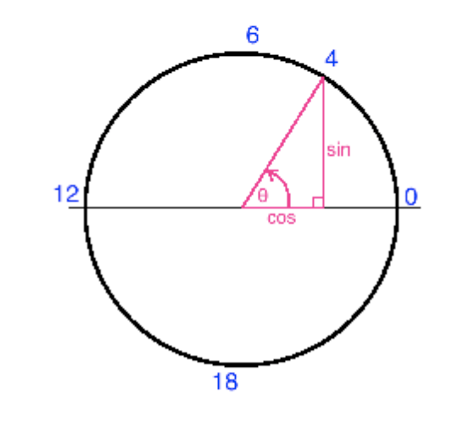
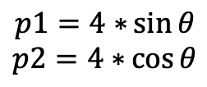
Converting Dates to cyclic features
The Magic Circle
$$p1=4∗{\sin{θ}}$$
$$p2=4∗{\cos{θ}}$$

Slide 20
Impact:
MAE decreases by 340
To do:
Couple XGBoost with linear regression
Include more variables:
Colopl : Tally data of visitors in the vicinity of 4 National Parks
Jorudan : Route Search log data
Agoop : Tally data of ”floating population" according to the area in the vicinity of each national park
Hotlink : Blog postings per day that include words related to sightseeing and national parks

Slide 21
THANKS FOR LISTINING
questions?

