Slide 1
Tourism Demand Modeling Challenge: The Case of National Parks in Japan
Boobalaganesh Ezhilan
Narendra Badam
Abhishek Kumar

Slide 2
Data Set:
Training set : (datetime, parks, visitors) – 8 Parks, Jan 2015 – Dec 2016
Weather : 26 paramaters
Nightley : Japanese and Foreign National Count at Nikko National Park (Jan 2016 – Dec 2017)
Colopl : Tally data of visitors in the vicinity of 4 National Parks
Hotlink : Blog postings per day that include words related to sightseeing and national parks, Jan 2015 - Dec 2017
Nied_oyama : Snow cover at Snow Weather Observation Facility near Oyama National Park
Jorudan : Route Search log data
Agoop : Tally data of "average population" according to the area in the vicinity of each national park

Slide 3

Problem Statement
Predict the number of visitors for each National Parks for every day of 2017
Evaluation Function Mean absolute error (MAE) : $\frac{1}{n}\sum_{i=1}^{n}{|y_{i}−\hat{y_{i}}|}$

Slide 4
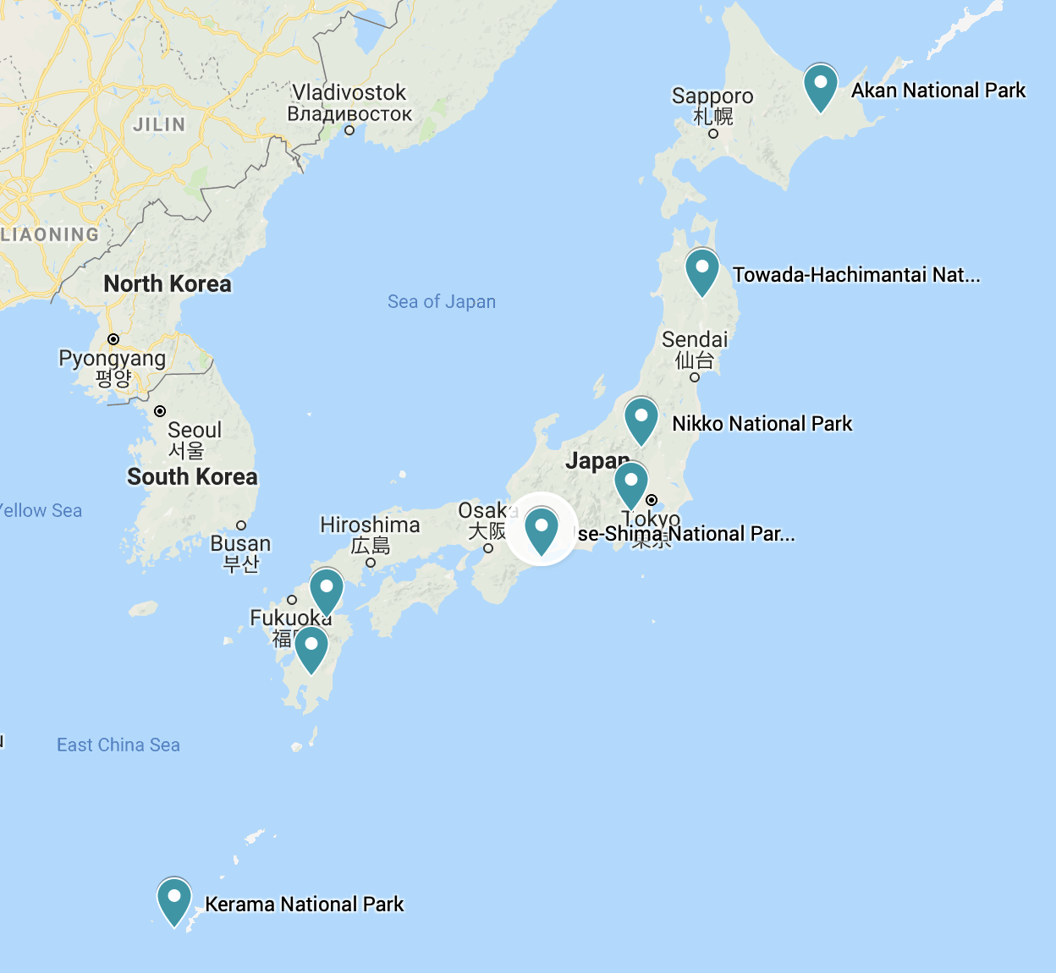

Slide 5
Crossing the Language Barrier
50 files, almost all of them in Japanese, even columns
Used Google Cloud Translation API to translate each file

Slide 6
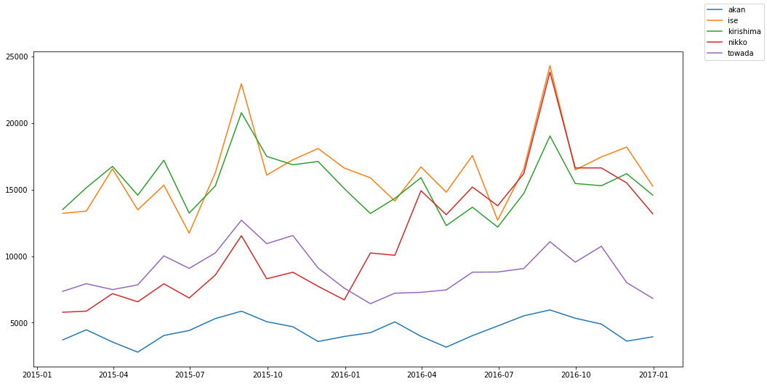
Data Exploration - Time series

Slide 7
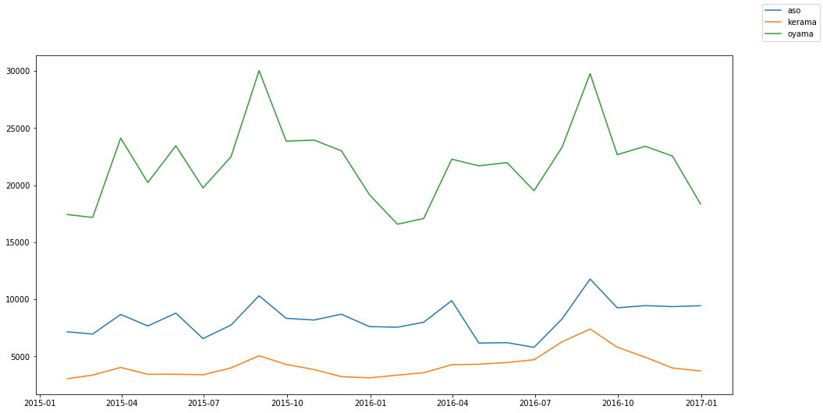

Slide 8
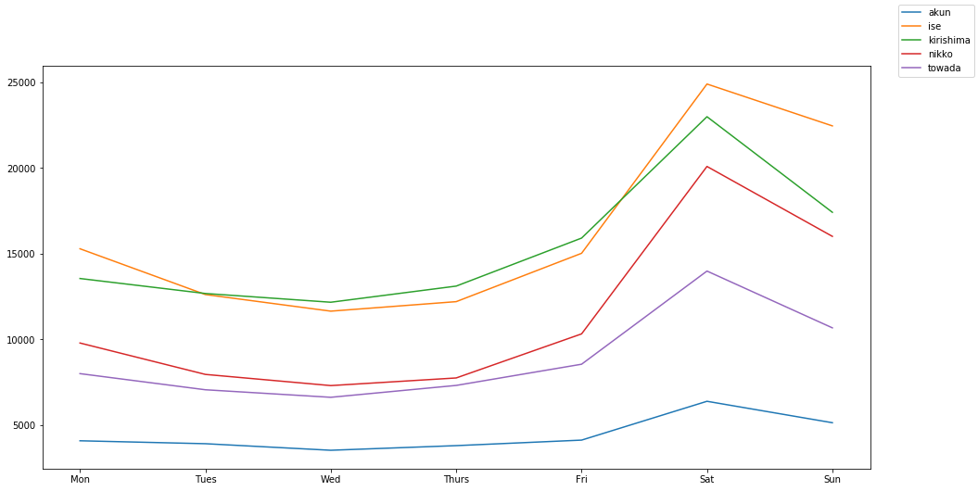

Slide 9
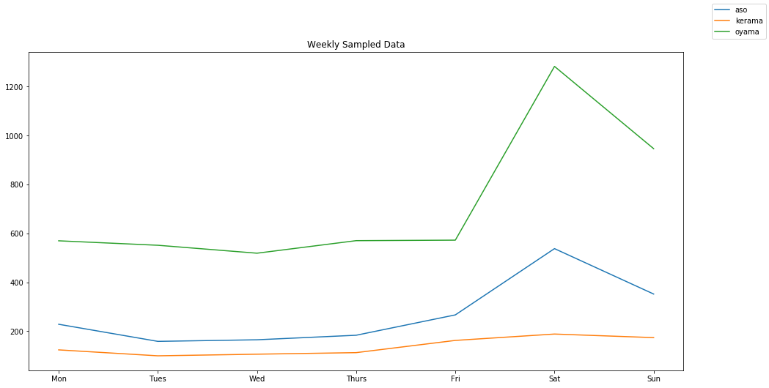

Slide 10
Feature Engineering
Break dates into day, month, year, day of the week

Slide 11
Base Model : XGBoost
How is XGBoost different than GBM

Slide 12
Iteration 1 : MAE(4320)

Slide 13
Re-engineering
Seperating each park

Slide 14
Iteration 2: MAE
MSE = 2338.3
Park | Best Score | colsample_bytree | gamma | learning_rate | max_depth | min_child_weight | n_estimators | reg_lambda | subsample
Oyama | 0.180 | 0.7 | 0 | 0.01 | 4 | 3 | 1000 | 0.6 | 0.6
Towada | 0.255 | 0.5 | 0 | 0.01 | 6 | 0.1 | 1000 | 0 | 0.8
Akan | 0.169 | 0.5 | 0.6 | 0.03 | 6 | 0.1 | 1000 | 0.6 | 0.8
Aso | 0.127 | 0.5 | 1 | 0.03 | 6 | 0.1 | 1000 | 0.6 | 0.6
Ise | 0.403 | 0.7 | 0.6 | 0.1 | 6 | 0.1 | 1000 | 0.6 | 0.8
Kerama | 0.026 | 0.5 | 0.6 | 0.01 | 6 | 3 | 1000 | 0.6 | 0.8
Kirishima | 0.323 | 0.7 | 0 | 0.01 | 6 | 3 | 1000 | 0.6 | 0.6
Nikko | 0.205 | 0.5 | 0 | 0.01 | 6 | 3 | 1000 | 0.6 | 0.8

Slide 15
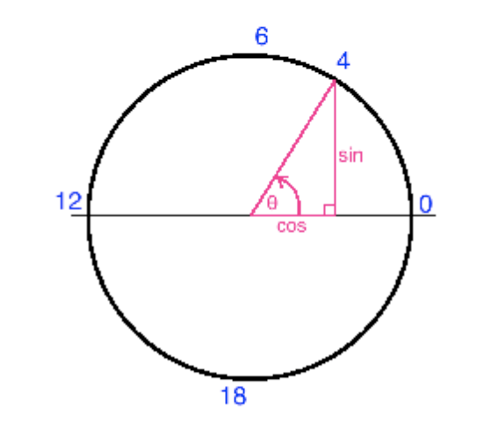
Converting Dates to cyclic features

