Slide 1


FIFA World Cup Analysis (1930-2014)
Dive deep into the rich history and remarkable statistics of the FIFA World Cup from 1930 to 2014.
by Ganesh Agrahari

Slide 2

Introduction and Data Sources
1
Comprehensive Data
2
Insightful Analysis
Collected from Kaggle - World Cup matches, players, and tournament details
Leverage Power BI to uncover trends and patterns in the data
3
Diverse Visualizations
Explore hosting countries, wins, attendance, and more

Slide 3
Hosting Countries Bar Chart
Top Hosts
Emerging Hosts
Hosting Impact
Brazil, Italy, and Germany have hosted the most World Cups
New countries like Qatar are set to host future tournaments
Hosting can boost a country's soccer infrastructure and popularity

Slide 4
Countries by Wins Bar Chart
Dominant Champions
Rising Powers
Competitive Landscape
Brazil, Germany, and Italy lead with the most World Cup wins
Spain, France, and Argentina are challenging the traditional powerhouses
The World Cup is becoming increasingly competitive over time

Slide 5
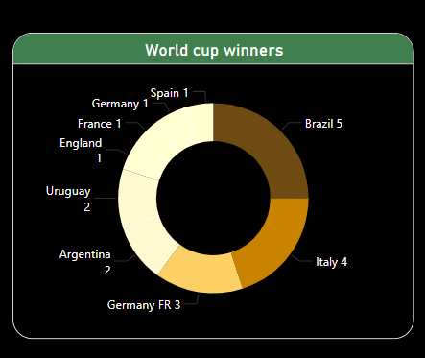
Donut Chart of Wins by Country
Brazil Dominance
European Powerhouses
Brazil has won the most World Cup titles with 5 victories
Germany, Italy, and France have a strong presence in the chart
Emerging Contenders
Diversity of Champions
Spain and Argentina are making their mark on the global stage
The chart showcases the global reach and appeal of the World Cup

Slide 6
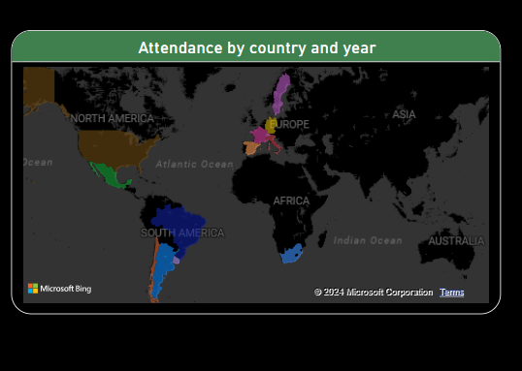


World Cup Attendance Map
Attendance Trends
Steadily increasing over the decades, reaching new highs
Global Reach
World Cup's ability to draw fans from around the world
Data Insights
Identify patterns and outliers in attendance across host nations

Slide 7

Key Insights and Findings
1
Hosting Dominance
2
Winning Dynasties
Brazil, Italy, and Germany have hosted the most World Cups
Brazil, Germany, and Italy have won the most World Cup titles
3
Attendance Growth
4
Emerging Challengers
World Cup attendance has steadily increased over the decades
Spain, France, and Argentina are becoming more competitive

Slide 8




Conclusion and Next Steps
Summarize Insights
Recap the key findings from the data analysis
Explore Further
Dive deeper into specific areas of interest for future analysis
Actionable Recommendations
Provide suggestions for how to leverage these insights

