Slide 1

ROBO ADVISOR Lite

Slide 2
Robo Advisor Lite
Emotion free Investing
ASX listed companies only
User selected companies
Graphical display of results

Slide 3
Project Scope
Create a dashboard to display ASX stocks Annual Return vs Volatility, business sector performance both monthly & annually
Provide a UI form for user to select up-to 5 stocks
Provide a brief summary with some key financial data on the inputted stocks
Plot graphs to show performance of past 5 years, a correlation heat map and Sharpe ratios of selected stocks
Provide UI to input amount to be invested and weights against each stock
Run Monte Carlo Simulation and display simulation results
Calculate Optimal portfolio distribution based on MPT Efficient Frontier method
Run Monte Carlo Simulation against the optimal portfolio distribution and display results

Slide 4
Data Collection
Yahoo Finance API
yf.download
yf.Ticker.stats
MarketIndex as Master list of ASX listed Companies

Slide 5
Data Exploration & CleanUp
Dropped all Tickers with no sector association
Further Clean- up and data preparation
Performed final NaN clean-up to generate master list of companies
Appended .AX to allow pulling data from Yahoo API
Extracted only Close values as a separate Data Frame
Data conversion between string and float

Slide 6
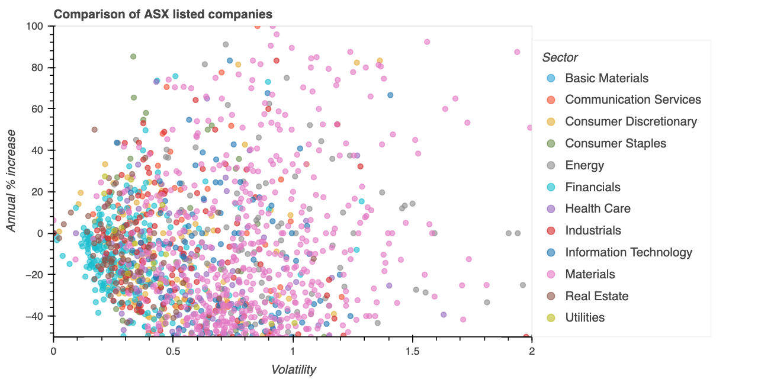
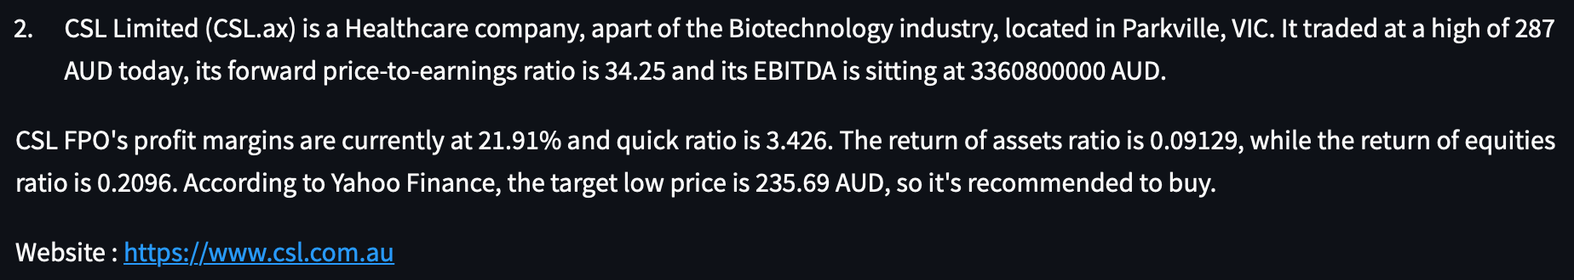
Data Analysis Methods
Calculate annual Return for all Tickers
Provide stock information
Sharpe Ratios for selected stocks
Efficient Frontier
Compound Annual Growth as Return
Annualised Standard Deviation as Risk
Monte Carlo Simulation to forecast returns

Slide 7
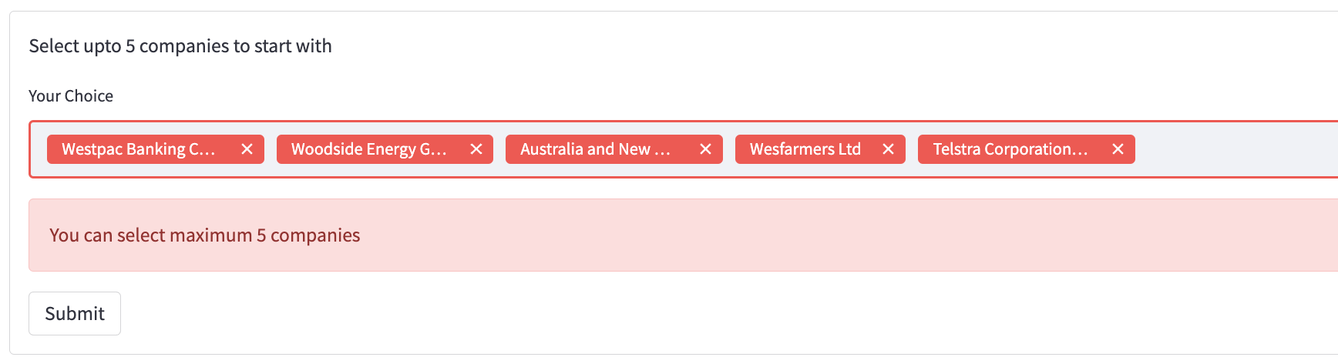
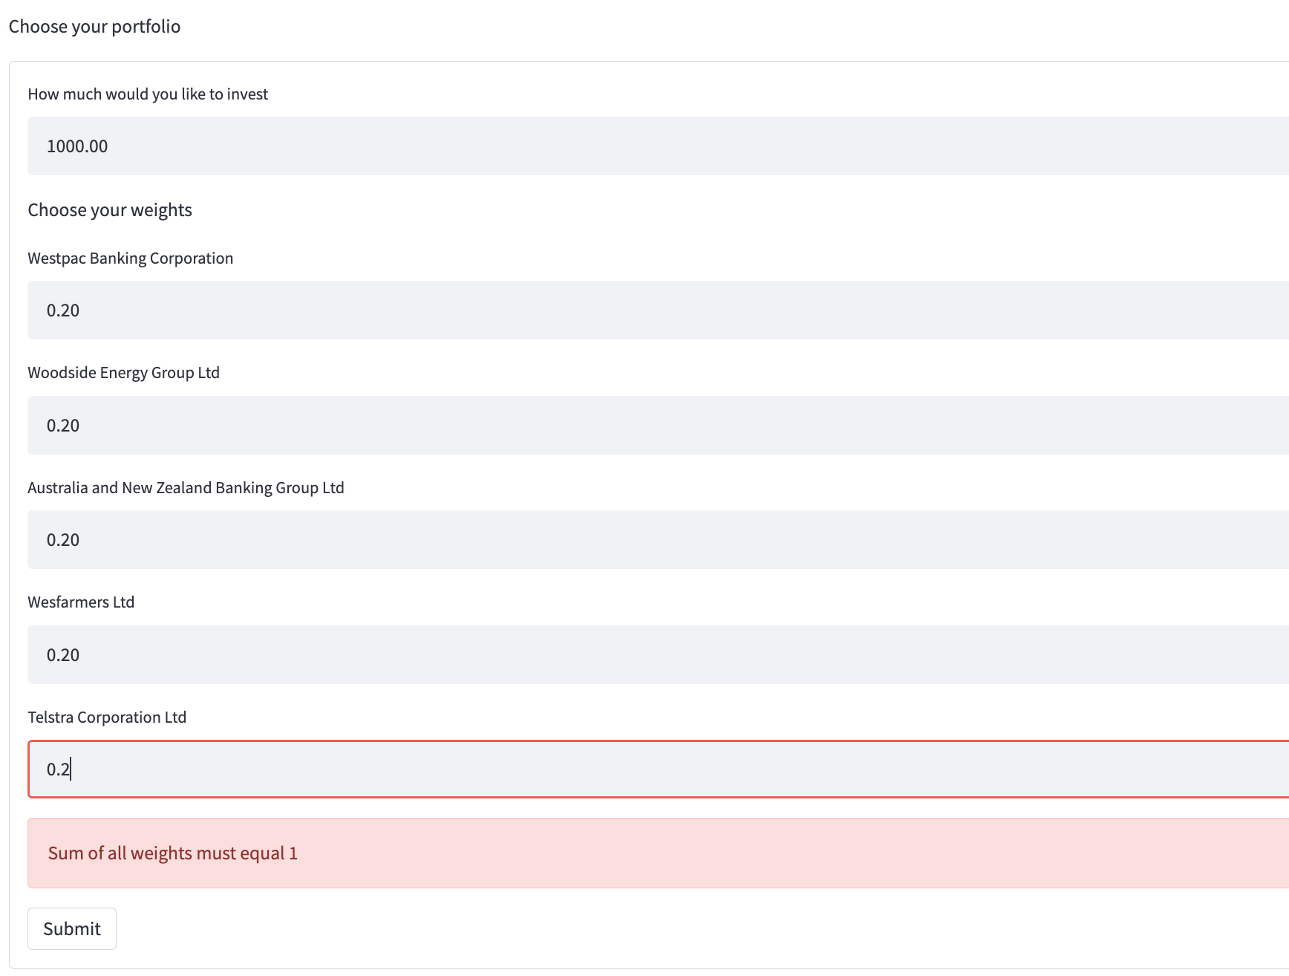
User Interface
All plots are rendered through streamlit framework
Multi select form for user to select stocks
Text for for user to enter investment amount and weights
Streamlit state management

Slide 8
Data Output
Monte Carlo Simulation Results of user selected weights
Optimal weights based on Modern Portfolio Theory Efficient Frontier
Monte Carlo Simulation Results based on optimal weights

Slide 9
Libraries used
Panda
Streamlit
Hvplot
Numpy
Pathlib

Slide 10

Demonstration

Slide 11
Problems Faced & How we overcome it
Yahoo Finance Multilevel data – Extracted just the Close values by slicing the data
Yahoo Finance output data type - Converted Strings into Floats
Yahoo Finance API Performance - Added multi threading
Yahoo Finance API Data inconsistency - Added Try Catch to handle any missing data scenario
Data Size - Used API to get historical data and stored in a csv to be retrieved at run time
Streamlit integration - Self learning
Data download time - explored other data pulling methods; ended up using a .stats() command over .data in the finance library

Slide 12





Team
Adam Westlake
Ganesh Bashyal
Garry Comber
Michael Blauberg
Manpreet Singh

