Slide 1

Revolutionizing Education: A Learning Management System Built with the MERN Stack
Welcome to a presentation that explores the future of education through a Learning Management System (LMS) built with the MERN stack. The MERN stack, comprising MongoDB, Express.js, React, and Node.js, offers a powerful, flexible, and scalable platform for creating dynamic web applications. This LMS is designed to revolutionize how education is delivered and managed, offering an engaging and efficient learning experience for both students and instructors..

Slide 2
Understanding the MERN Stack
MongoDB: Flexible Data Storage
Express.js: Backend Framework for APIs
React: Interactive UIs
Node.js: Server-Side Execution
React, a frontend library, builds interactive user interfaces, including course dashboards and student portals. Its component-based architecture allows for reusable UI elements, ensuring a consistent and engaging user experience. React is the paintbrush, bringing the application to life visually.
MongoDB, a NoSQL database, provides the flexibility needed to store diverse data such as student profiles and course content. Its document-oriented approach simplifies data management and enhances scalability. It acts as a structured storage system for educational resources.
Express.js serves as the backend framework, creating APIs for user authentication and course management. It streamlines the handling of API requests, making it easier to manage user interactions and data flow within the LMS. It is the traffic controller of the application, directing requests and responses.
Node.js, a JavaScript runtime environment, handles server-side execution, processing data and managing real-time updates. Its event-driven, non-blocking I/O ensures high scalability and performance. Node.js is the engine that drives the entire application.

Slide 3
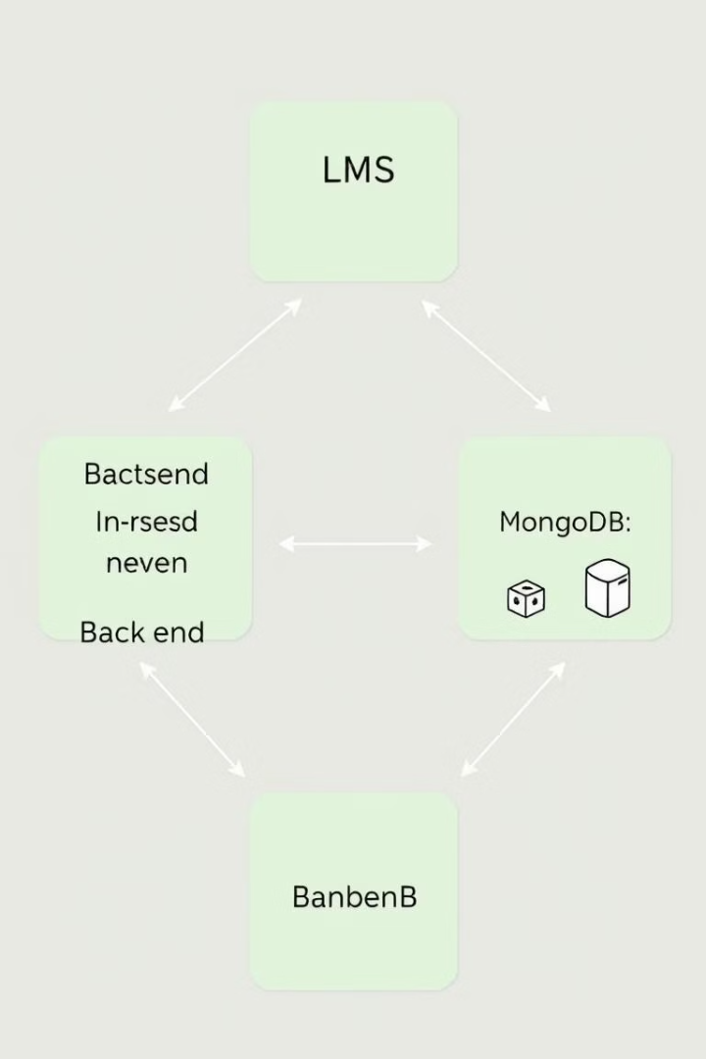
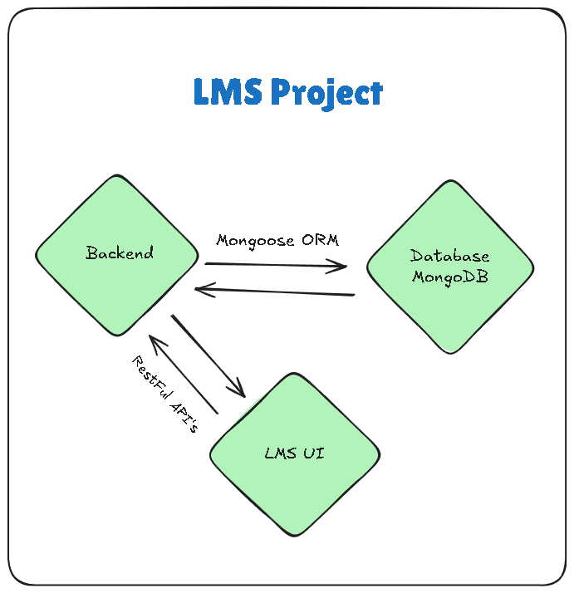



LMS Architecture: A Deep Dive
Frontend (React)
The user interface for students, instructors, and admins. Components include course listings, video players, quiz interfaces, user profiles, and an admin panel. State Management uses Redux or Context API for application state.
Backend (Node.js & Express.js)
API endpoints handle requests such as `/users`, `/courses`, `/assignments`, and `/authentication`. Authentication is secured with JWT (stateless authentication) (JSON Web Tokens) for secure user sessions.
Database (MongoDB)
Stores all application data in collections like `users`, `courses`, `assignments`, and `announcements`. Data Models use schemas to define the structure of each document, ensuring data integrity.

Slide 4




Core Features: Empowering Education
User Authentication and Authorization
Course Management
Interactive Learning Tools
Reporting and Analytics
Create, organize, and deliver courses effectively with a drag-and-drop course builder, supporting various content types such as videos, documents, quizzes, and assignments.
Secure access for different user roles (students, teachers, admins). Role-Based Access Control (RBAC) provides granular permissions based on user role, and multi-factor authentication enhances security for sensitive accounts.
Engage students with quizzes, forums, and real-time collaboration. Gamification, including badges and leaderboards, motivates students, while progress tracking monitors performance and identifies areas for improvement.
Track student progress and system usage to make informed decisions. Generate custom reports on student performance and use data visualization tools to present data in an easy-to-understand format.

Slide 5

Frontend Functionality: React Components
Course Dashboard
Displays enrolled courses, progress, and upcoming deadlines. It provides a central hub for students to manage their learning activities and stay organized.
Video Player
Features an integrated video player with controls for playback, volume, and full-screen mode. Adaptive Bitrate Streaming adjusts video quality based on internet connection for seamless viewing.
Quiz Interface
Presents an interactive quiz with multiple-choice, true/false, and fill-in-the-blank questions. A timer enforces time limits for quizzes and exams, promoting fair assessment.
User Profiles
Allows users to manage personal information and track learning progress, providing a personalized learning experience. Each user has the ability to customize their profile to suit their preferences.

Slide 6
Backend Power: Node.js & Express.js APIs
User Authentication API
1
Handles user registration, login, and password reset. Bcrypt is used for password hashing, and JWT (stateless authentication) (JSON Web Tokens) are used to securely authenticate users.
Course Management API
2
Creates, updates, and deletes courses. Mongoose, an Object Data Modeling (ODM) tool for MongoDB, is utilized to manage course data efficiently.
Assignment Management API
3
Manages assignments, submissions, and grading. The Multer middleware handles file uploads, ensuring seamless submission of assignments.
The APIs are designed for scalability and easy maintenance. Each API endpoint is designed to handle specific tasks, promoting a modular and organized backend.

Slide 7



Real-time Features with Socket.IO (WebSockets for live
interactions)
Collaborative Document Editing
Allows multiple users to edit documents simultaneously, promoting teamwork and knowledge sharing. Changes are visible in real time, enhancing collaboration.
2
Live Chat
Enables real-time communication between students and instructors, fostering a collaborative learning environment. This facilitates quick Q&A sessions.
1
Whiteboarding
Offers a real-time collaborative whiteboard for brainstorming and problem-solving. It provides a digital space for visual collaboration and idea generation.
3

Slide 8

Benefits of a MERN Stack LMS
Scalability
Flexibility
Cost-Effectiveness
Handles a large number of users and courses with ease through load balancing and horizontal scaling. The LMS can grow to meet the demands of a growing institution.
Customizes the LMS to meet specific needs with its modular architecture and open-source nature, providing access to a vast ecosystem of libraries and tools.
Reduces development and maintenance costs by leveraging existing JavaScript skills and community support for full-stack development. The learning curve is reduced since developers are already familiar with Javascript.

Slide 9
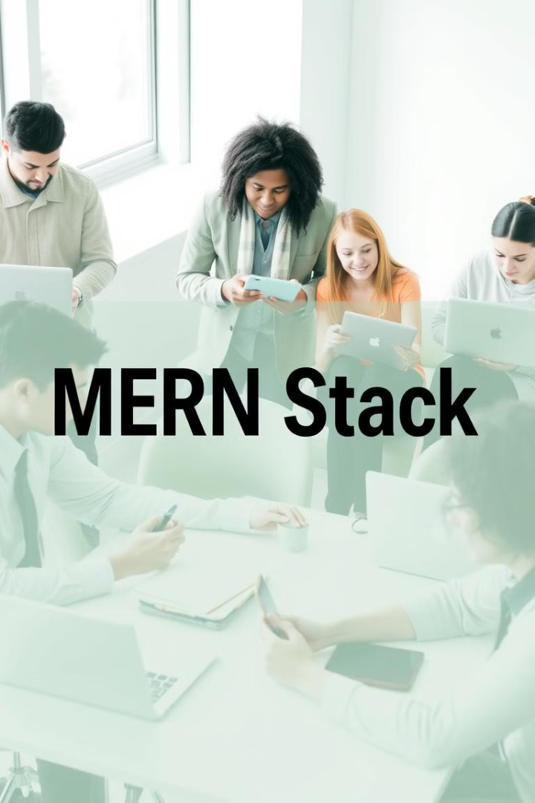
Live Demo: See the MERN Stack LMS in Action
Witness a demonstration of the key features and functionalities of the MERN Stack LMS. Explore the user roles, showcasing student, teacher, and admin perspectives. Experience real-time interaction, emphasizing live chat and collaborative tools. See it in action and understand its potential.
The live demo will highlight the seamless integration of the frontend and backend, demonstrating how React components interact with Node.js and Express.js APIs. This will provide a comprehensive understanding of the system's capabilities and benefits.

Slide 10

Summary: The Future of Education is Here
In summary, a MERN stack LMS offers unparalleled scalability, flexibility, and cost-effectiveness, making it a game-changer in the educational landscape. By leveraging the power of JavaScript and the MERN stack, we are paving the way for a more engaging, efficient, and accessible learning experience.
The integration of real-time features and interactive tools enhances student engagement and fosters a collaborative learning environment. The MERN stack LMS is not just a tool, but a catalyst for transforming education and empowering learners worldwide.

