Slide 1

Note: The data and information in this document is reflective of a hypothetical situation and client. This document is to be used for KPMG Virtual Internship purposes only.
Sprocket Central Pty Ltd
Data analytics approach
Business Analytics – Ganesh Bore (Junior Analyst)

Slide 2
Note: The data and information in this document is reflective of a hypothetical situation and client. This document is to be used for KPMG Virtual Internship purposes only.
Agenda
Introduction
Data Exploration
Model Development
Interpretation

Slide 3
Note: The data and information in this document is reflective of a hypothetical situation and client. This document is to be used for KPMG Virtual Internship purposes only.
Introduction
Outline Of Problem
Approach for Data Analysis
Sprocket Central is a company that specializes in high quality bike and accessories.
The marketing team ins looking to boost sales.
To target 1000 new customers that will bring the highest value to the business.
Bike related purchases for the last 3years based on Gender.
Top industries contributing the maximum profit and bike related sales.
Wealth segment by age category.
Number of cars owned in each state.
Customer Classification.

Slide 4
Note: The data and information in this document is reflective of a hypothetical situation and client. This document is to be used for KPMG Virtual Internship purposes only.
Data Exploration
Data Quality Assessment
Key issue dealt with for the data quality issue :
 | Accuracy | Completeness | Consistency | Currency | Relevancy | Validity
Customer Demographic | DOB : Inaccurate Age : Missing | Job Title : Blanks Customer ID : Incomplete | Gender : Inconsistent | Deceased Customer : Filtered out | Default column : Delete
Customer Address |  | Customer ID : Incomplete | States : Inconsistent
Transactions | Profit : Missing | Customer ID : Incomplete Online Orders : Blanks Brands : Blanks |  |  | Cancelled Status Order : Filtered Out | List Price : Format Product Sold Date : Format

Slide 5
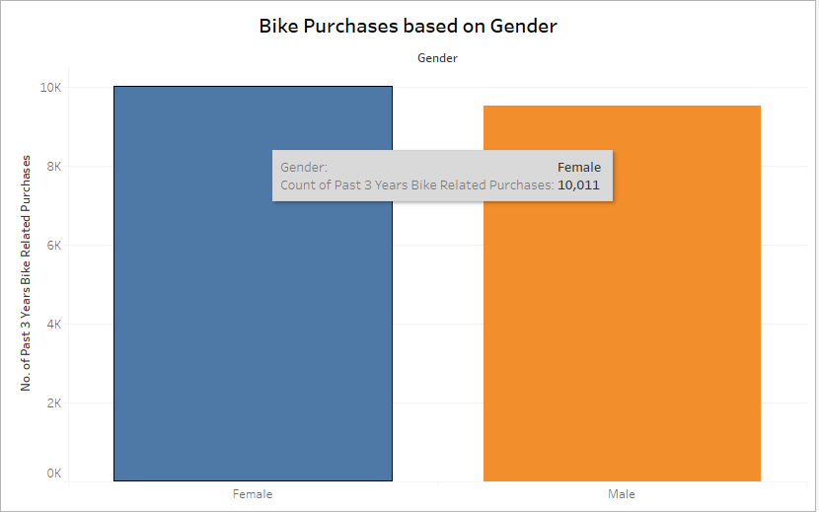
Note: The data and information in this document is reflective of a hypothetical situation and client. This document is to be used for KPMG Virtual Internship purposes only.
Data Exploration
Bike Related Purchases Over the Last 3 Years Based on Gender
Data shows, on average females have made more bike related purchases in the last 3 years compared to males.
On average Females have had 1% higher bike related purchases compared to men in the last 3 years.
Place any supporting images, graphs, data or extra text here.

Slide 6
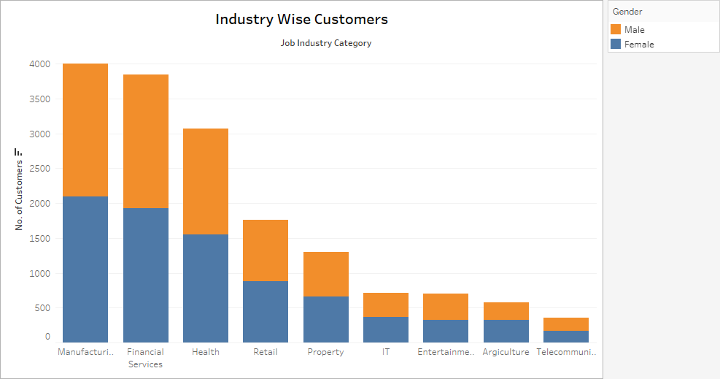
Note: The data and information in this document is reflective of a hypothetical situation and client. This document is to be used for KPMG Virtual Internship purposes only.
Data Exploration
Top Job industry Contributing profit and bike related purchases
The top 3 industry sector bringing in the highest profit are: Financial services, Health & Manufacturing.
These can be obvious as most of these industry sectors are based within the city or on the outskirts of the city therefore consumers prefer bikes for commuting
Most of the industry sectors have returned less than Rs. 1,00,000 in profits.
Place any supporting images, graphs, data or extra text here.

Slide 7
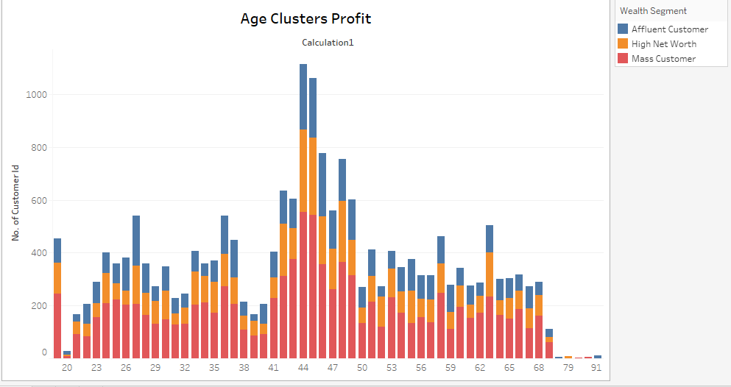
Note: The data and information in this document is reflective of a hypothetical situation and client. This document is to be used for KPMG Virtual Internship purposes only.
Data Exploration
Profit of Wealth segment by Age cluster
Overall the Mass customer segmentation make the highest profit across different age clusters.
Mass Customer Aged between 41-47 are likely to bring more profit for the company compared to other age clusters.
This also indicates a trend of buying power, as the buying power increases over time till 47 and then see’s a decline in buying power, this leading to lower profit.
Place any supporting images, graphs, data or extra text here.

Slide 8
Note: The data and information in this document is reflective of a hypothetical situation and client. This document is to be used for KPMG Virtual Internship purposes only.
Model Development
Customer Classification _ Targeting High Value Customers
These are the high value customers that should be targeted from the new list :
- Most of the high value customers will be female compared to male.
- working in the financial services, health and manufacturing industry sector.
-Aged between 41-47.
-Who are currently living in NSW, VIC.

Slide 9
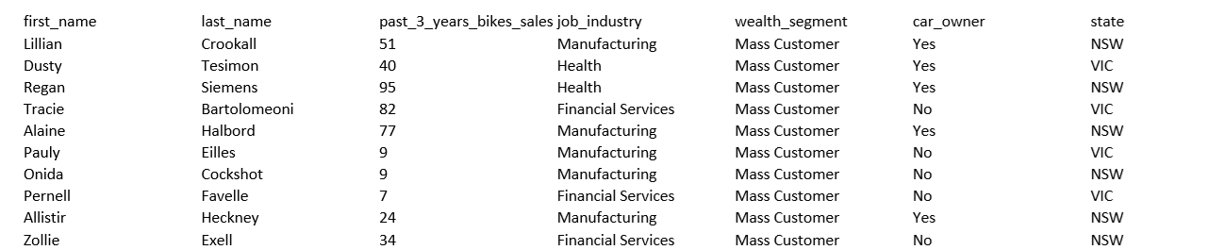
Note: The data and information in this document is reflective of a hypothetical situation and client. This document is to be used for KPMG Virtual Internship purposes only.
Interpretation
Summary Table for High Value Customers
Here is snapshot of a few customers that will come under the high value customer classification

Slide 10
Note: The data and information in this document is reflective of a hypothetical situation and client. This document is to be used for KPMG Virtual Internship purposes only.
Thank You !!

