Slide 1
Forms
Template Driven Forms
Reactive Forms/Model Driven Forms
Reactive forms are more robust: they're more scalable, reusable, and testable. If forms are a key part of your application, or you're already using reactive patterns for building your application, use reactive forms.
Template-driven forms are useful for adding a simple form to an app, such as an email list signup form. They're easy to add to an app, but they don't scale as well as reactive forms. If you have very basic form requirements and logic that can be managed solely in the template, use template-driven forms.
Unrestricted
Notes:
https://dzone.com/articles/template-driven-forms-in-angular

Slide 2
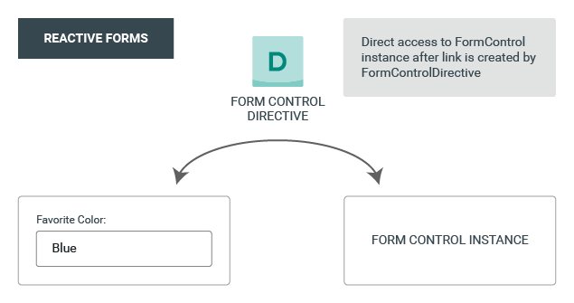
Reactive Forms

Slide 3
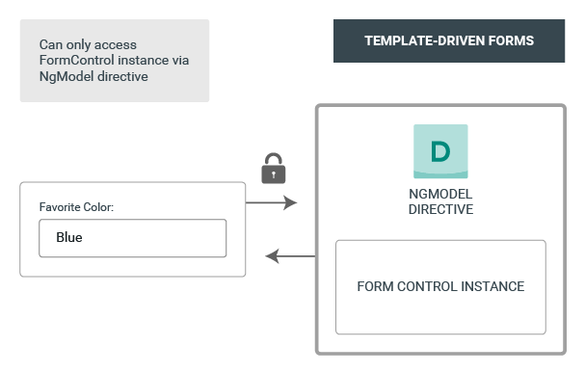
Template Driven Forms

Slide 4
Template Driven
Easy to use
Suitable for simple scenarios and fails for complex scenarios
Similar to AngularJS
Two way data binding(using [(NgModel)] syntax)
Minimal component code
Automatic track of the form and its data(handled by Angular)
Unit testing is another challenge

Slide 5
Reactive Forms
More flexible, but needs a lot of practice
Handles any complex scenarios
No data binding is done (immutable data model preferred by most developers)
More component code and less HTML markup
Reactive transformations can be made possible such as
Handling a event based on a debounce time
Handling events when the components are distinct until changed
Adding elements dynamically
Easier unit testing

Slide 6
ng-touched: Controls have been visited.
ng-untouched: Controls have not been visited.
ng-dirty: The control value has been changed.
ng-pristine : The control value has not been changed.
ng-valid: The control values are valid.
ng-invalid: The control values are invalid.

