Slide 1
LORA TECHNOLOGY BASED CONTROLLING AND MONITORING SMART HOUSE WITH IOT
PRESENTED BY ,
R.ARUNKUMAR (410318106001)
K.LOKESH VARMA (410318106012)
S.NAVEEN (410318106017)
P.GANESH DATTA (410318106020)
GUIDED BY,
ASST PROF. G SELVA KUMAR
Notes:
6/21/2022
1
1

Slide 2
ABSTRACT
The home and Society are surrounded by "things" which are connected to each other, either directly or indirectly via the internet of things.
To have access to controlling these devices remotely with precision within the network when required is a key factor in the process of home automation.
There are numerous aspects in this automation that needs to be developed so as to enhance it. This research gives a solution to having a precise and direct control and automatic detection of current state of devices with the use of android application.
It also gives a practical implementation of home automation using LoRa in comparison to other technologies.
Notes:
6/21/2022
2
2

Slide 3
OBJECTIVE
The recent technology in home automation provides security, safety and comfortable life at home. That is why in the competitive environment and fast world, home automation technology is required for every person.
This purposed home automation technology provides smart monitoring and control of the home appliances using Lora with IoT
To develop an auto-discovery functionality of current state of devices. Devices may be in any of several states (on, off, open, close, high, low, etc.) depending on such devices, it is important to automatically detect the current state before a trigger or actuator is used in the system

Slide 4
INTRODUCTION
The current situation is such that people have to manually operate various kinds of appliances at their busiest scheduled period for busy families or individuals with physical limitations. There is no effective means of controlling various accidents due to gas leakage, fire, and burglary.
Our system will provide proper notifications to users for such incidents and alert them through messages on their phones. The smart home is a very promising area, which has various advantages such as providing increased comfort, safety, and security to people .
Therefore we are using the sensors that lead mankind in a smart and secured manner which provides output to a controller.
The main purpose of building this project is to provide security in residential and commercial places both times when we are far from home or we are at home. Creates a smart and secure environment.
Notes:
6/21/2022
4
4

Slide 5
EXISTING SYSTEM
In contrast, the widely used short-range technologies such as Bluetooth and Zigbee.
Electrical appliance controlled manually.
No alert or information to the Owner.
DISADVANTAGES :
Short range communication
Very difficult to monitoring
Notes:
6/21/2022
5
5

Slide 6
PROPOSED SYSTEM
The proposed system has been divided into two parts. The first part is known as the sender end, where the system interconnects users’ mobile phone to an ESP8266 module using wireless network. Then the ESP8266 module is connected to a LoRa module for transmitting data.
The second part is the receiver end where a LoRa module is integrated with the ESP8266 . In this part, wired connections are made with several sensors and the ESP8266 module. The receiver side is interconnected with the home appliances.
The proposed system shows the capability to monitor surrounding environment by observing temperature humidity and controlling home appliances at the any region where the system is installed
Notes:
6/21/2022
6
6

Slide 7
ADVANTAGES OF PROPOSED SYSTEM
Low cost and power, and in an error-free
Hazardless way from a long distance
Alert system to owner
Notes:
6/21/2022
7
7

Slide 8
LITERATURE SURVEY
AUTHOR | YEAR | TITLE | TECHNIQUES
B.P Kulkarni, Aniket V Joshi, Vaibhav V Jadhav, Akshaykumar T Dhamange | 2020 | IOT Based Home Automation using Raspberry PI | Here it discusses respecting lot or such may remain chronic because realizing clever domestic automation using Raspberry Pl. Smart telephone is connecting along Raspberry Pi the usage of the IP address over Raspberry Pi via Wi Fi. The law effectively overcomes the drawbacks in Bluetooth then ZIGBEE technology
Sri Sai chaitanya, Sri nikhil pinthepu, S delfin | 2018 | Home automation using Zigbee technology and IOT International journal of advance research, ideas and innovation in technology | Home automation networks uses many systems like wireless embedded sensors and actuators that enable monitoring and control applications for home user and give an efficient home management.

Slide 9
LITERATURE SURVEY
AUTHOR | YEAR | TITLE | TECHNIQUES
Nadeem Pasha, Varun Koushik K. M, Shahbaaz Ahmed P, Sufia Begum Shaikh | 2017 | Smart Home Automation and Security System using GSM and ARM7 | Functionality of the GSM protocol, which allows the user to control the target system away from residential using the frequency bandwidths. The concept of serial communication and AT-commands has been applied towards development of the smart GSM-based home automation system.
S. Benjamin Arul | 2014 | Wireless Home Automation System Using Zigbee | The overall design of a wireless home automation system (WHAS) which has been built and implemented. The automation centers on recognition of voice commands and uses low-power RF Zigbee wireless communication modules which are relatively cheap.

Slide 10
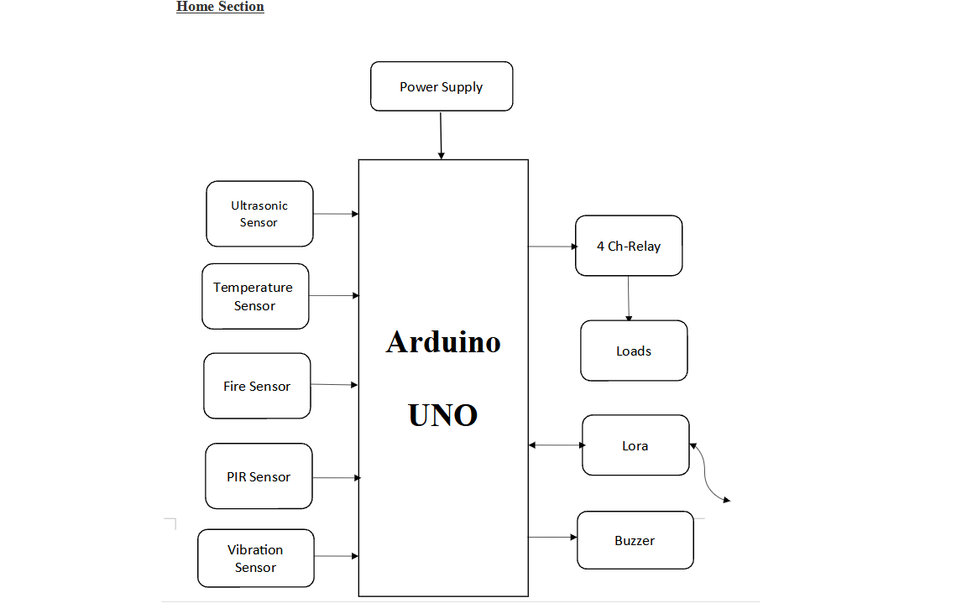
BLOCK DIAGRAM – Home Section
Notes:
6/21/2022
10
10

Slide 11
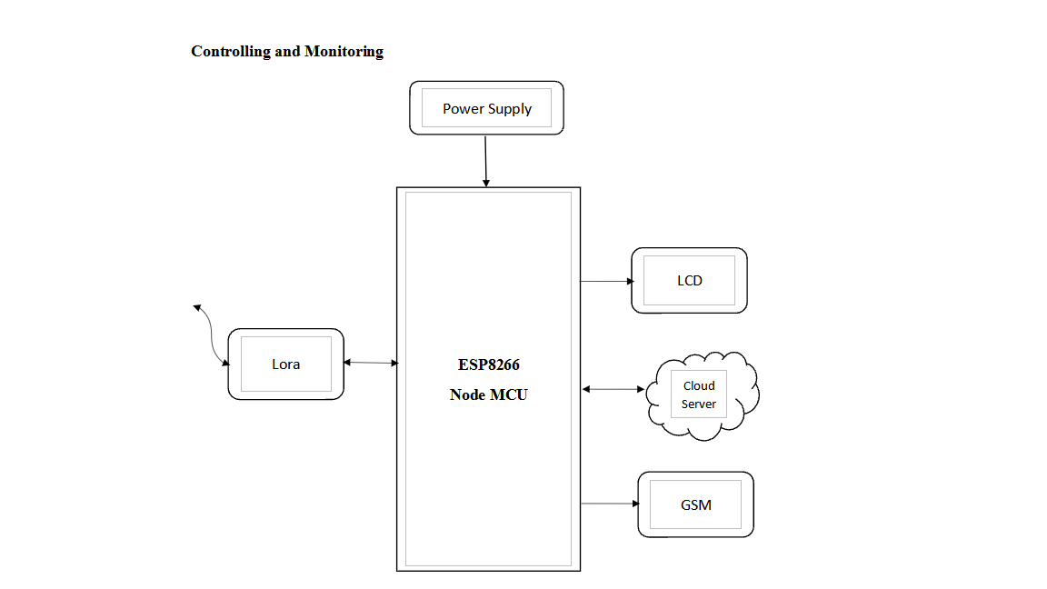
BLOCK DIAGRAM – Receiver Section
Notes:
6/21/2022
11
11

Slide 12
HARDWARE REQUIREMENTS
ESP8266
Arduino
LCD
Ultrasonic sensor
PIR
Relay
Loads
Vibration sensor
Temperature sensor
Fire Sensor
Lora
Power Supply unit
Notes:
6/21/2022
12
12

Slide 13
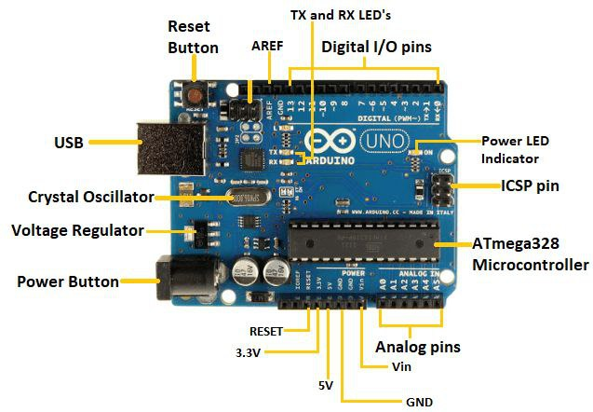
ARDUINO UNO
The Arduino Uno is an open-source microcontroller board based on the Microchip ATmega328P microcontroller and developed by Arduino.cc.
The board is equipped with sets of digital and analog input/output (I/O) pins that may be interfaced to various expansion boards (shields) and other circuits.
The board has 14 digital I/O pins (six capable of PWM output), 6 analog I/O pins, and is programmable with the Arduino IDE (Integrated Development Environment), via a type B USB cable.
It can be powered by the USB cable or by an external 9-volt battery, though it accepts voltages between 7 and 20 volts

Slide 14
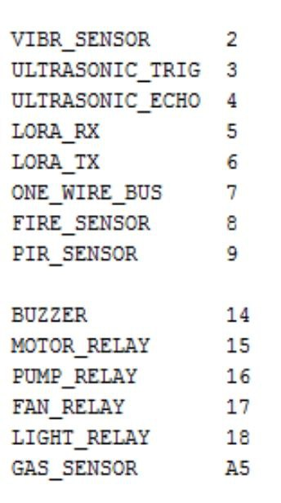
PIN CONFIGURATION IN ARDUINO UNO

Slide 15
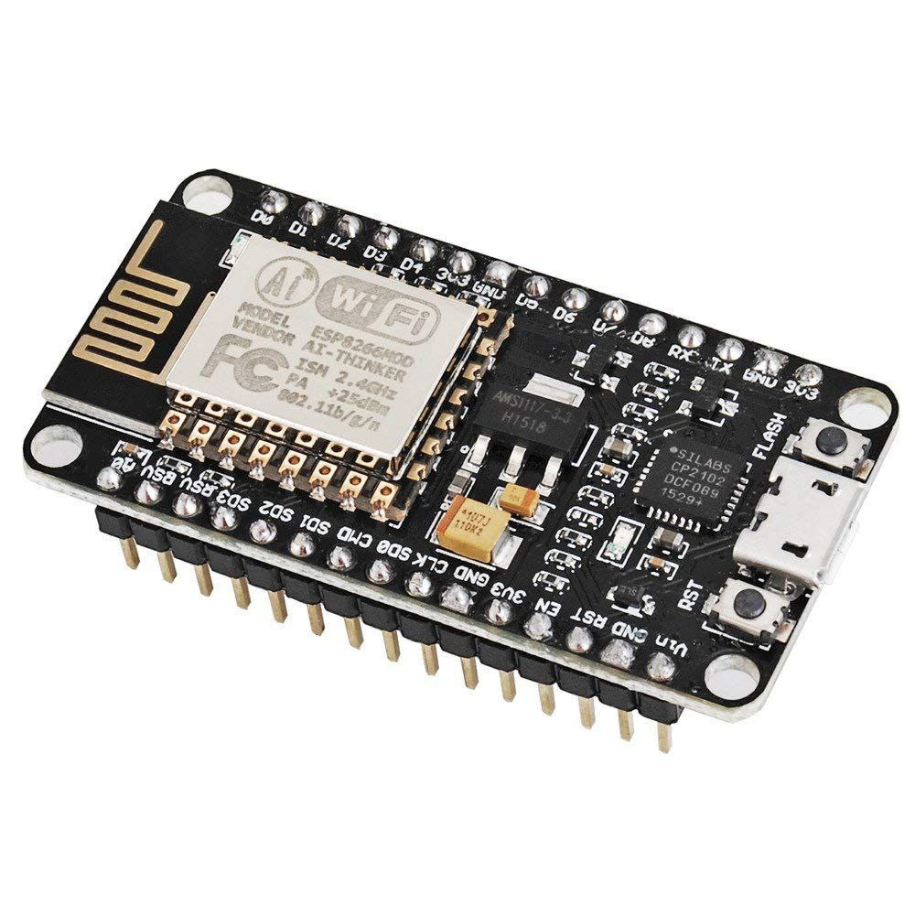
Node MCU ESP8266
NodeMCU is an open source IoT stage. It incorporates firmware which keeps running on the ESP8266 Wi-Fi SoC from Expressive Systems, and equipment which depends on the ESP-12 module. The term NodeMCU typically refers to the firmware, whereas the board is termed Devkit. NodeMCU Devkit 1.0 consists of associate ESP-12E on a board that facilitates its use. It additionally contains a transformer, a USB interface. The expression "NodeMCU" of course alludes to the firmware as opposed to the improvement units. The firmware utilizes the Lua scripting dialect
The NodeMCU (Node Micro Controller Unit) is an open source software and hardware development environment that is built around a very inexpensive System-on-a-Chip (SoC) called the ESP8266. The ESP8266 is designed and manufactured by Express, contains all crucial elements of the modern computer: CPU, RAM, networking (wi-fi), and even a modern operating system and SDK. When purchased at bulk, the ESP8266 chip costs only $2 USD a piece. That makes it an excellent choice for this system design. The NodeMCU aims to simplify ESP8266 development

Slide 16
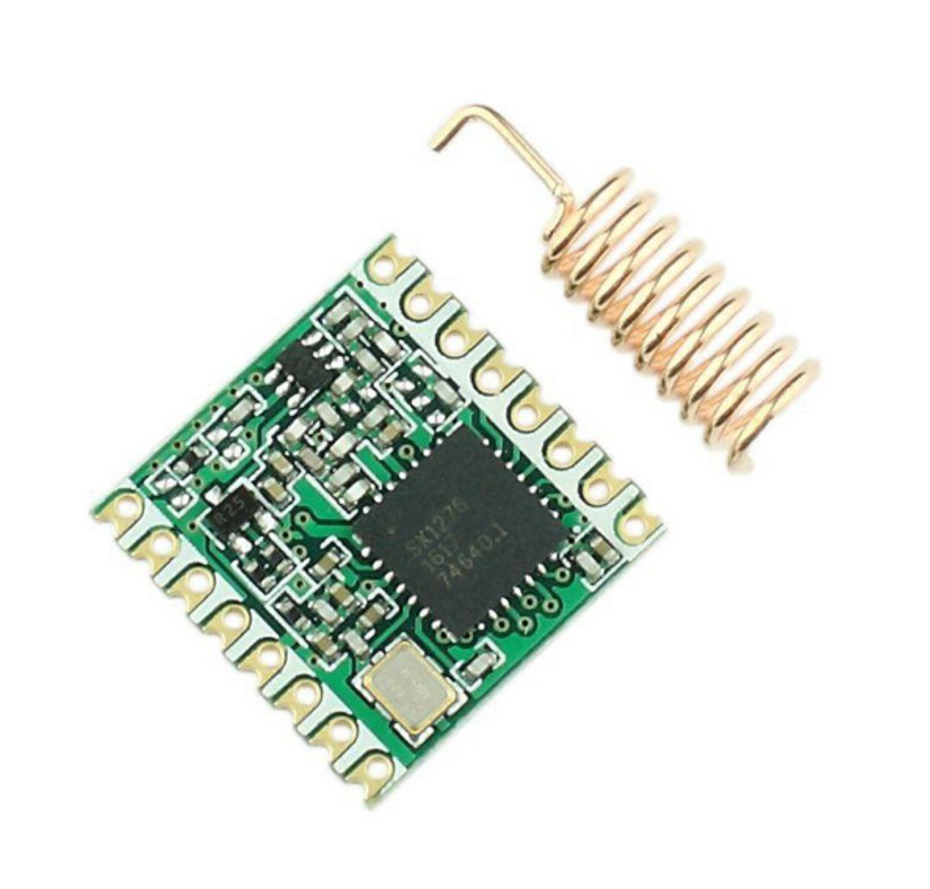
LORA
The WIR-1286 module is a low-power and high range wireless communication solution that is ideal for Smart Grid, home automation, smart lighting, industrial sensor data acquisition and remote control applications. This module integrates LORA SX1276, an extremely low-power sub-GHz transceiver, an MCU for wireless network control, data handling and hardware interface, a PCB antenna and matching circuitry.
Right out- of-the-box this module supports simple point-to-multipoint serial communication over-the-air. It has a small 22mm x 36mm form-factor for easy integration.
This module operates at 868MHz band and has 5 channel options. It can offer up to 2 kilometers * over the air range and even more if modules configured as repeaters are used. It should be connected to any 5V TTL/CMOS logic serial RXD and TXD lines and can support baud-rate of 9600bps to 115200bps.

Slide 17
SOFTWARE REQUIREMENTS
Arduino IDE
Language: Embedded C
Proteus
Cloud Server
Notes:
6/21/2022
17
17

Slide 18
BLYNK APP
Blynk is an open source android app which is designed and developed in order to control the hardware via internet of things (IOT). This digitally displays sensor data, it can accumulate and visualize the data. Plus it can also do other parameters such as:
Blynk App –this app gives us to create amazing interfaces for a project using multiple widgets which is an in build app.
Blynk Server – It acts as an interface between the smartphone and hardware which is responsible for the communication. We can also use blynk cloud or compile our private blynk server .It’s an open source that can control any number of devices plus can also be launched on Raspberry Pi.
Blynk Libraries – for all the standard hardware platforms, supports

Slide 19
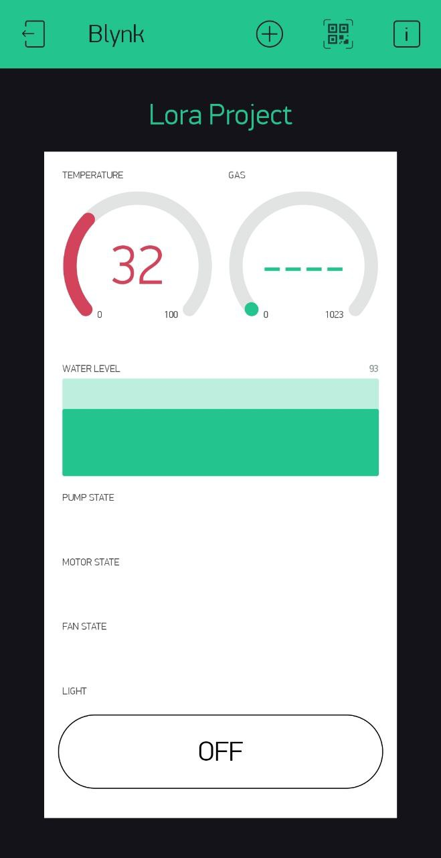
BLYNK APP INTERFACE
We can access our electonic circuit by our smartphone using blynk app in which the electronic components are connected through the blynk server
You can see in that blynk interface it shows the room temperature, gas level in the house , water level in the water storage tank and so on..
For blynk app , we wrote the code in receiver block where the blynk is connected in the receiver block.
Notes:
6/21/2022
19
19

Slide 20
BLYNK SERVER
Unlike IoT platform such as , and even , we can host a private instance of the full Blynk server and connect wer smartphone Blynk app to it.
The Blynk Cloud server is an excellent choice for most projects, as it is always there, ready to use. We will use the Cloud server in the first few experiments in this course to help we get started with minimal effort.
However, as we will see, the Cloud Blynk server has imposed limitations. Some limitations are due to the topology of the server: depending on our geographical location, the server may be in a different continent, which makes communications between the app, the devices and the server slow due to the amount of time it takes packets to travel across the Internet.

Slide 21
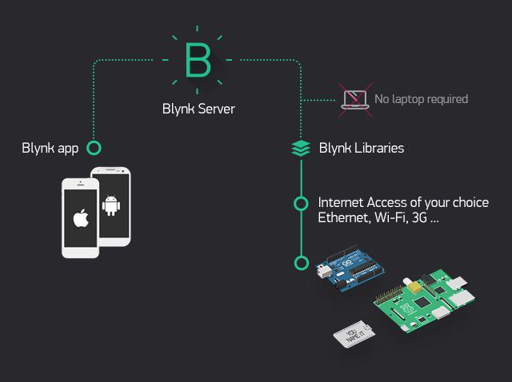
BLYNK SERVER
Another imposed limitation is that in the Cloud server, we can only use a small number of widgets. Blynk is using the concept of “energy” to implement a pricing system for its widgets. In the Cloud server we may start a new project with 1000 energy units. An LED widget may cost we 200 units, leaving 800 units for other widgets.
On a private server, we can set wer own energy limits. We can configure our server to allocate 100,000 energy units to new users. It’s totally up to us .

Slide 22
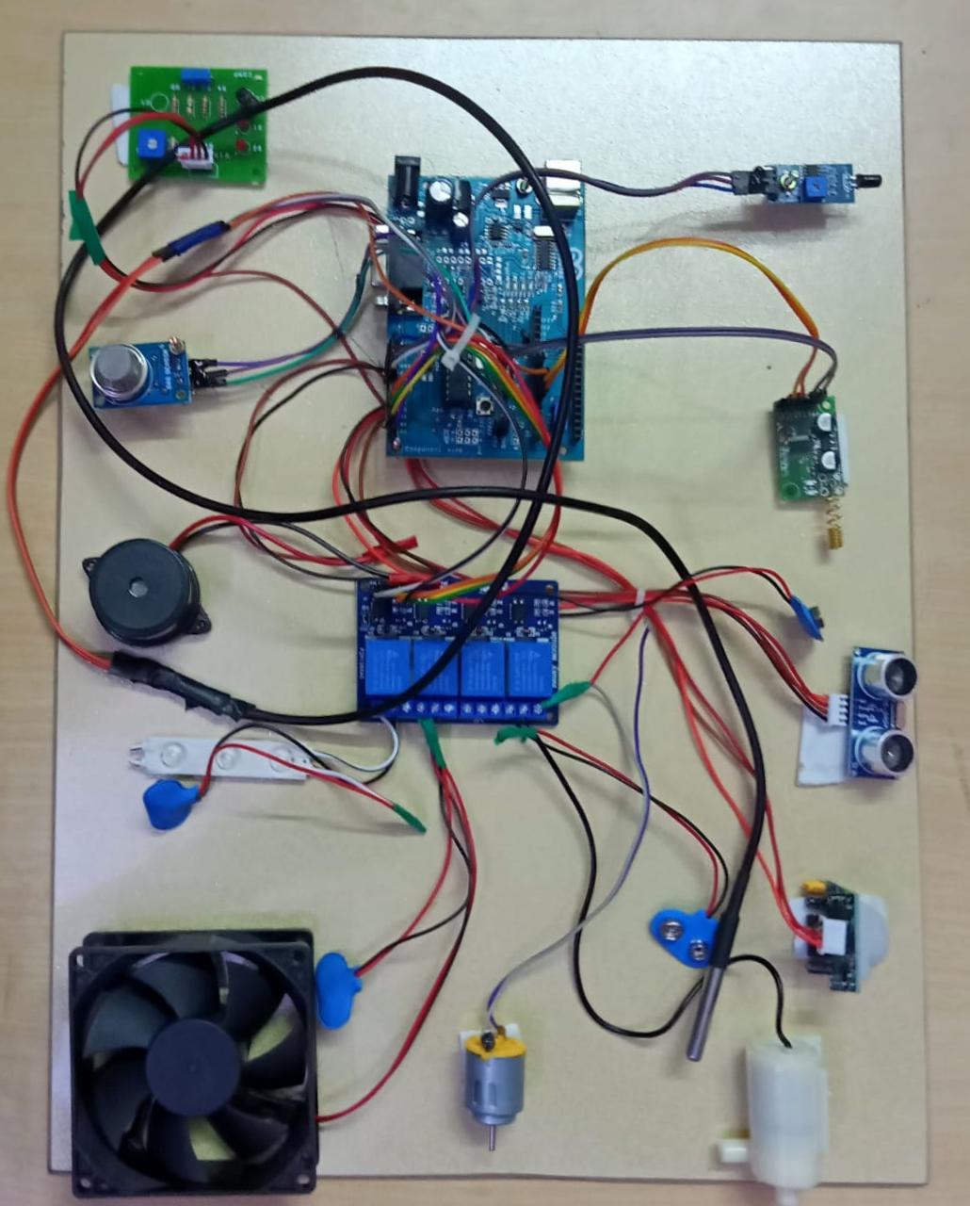
PROJECT SETUP – Home Section

Slide 23
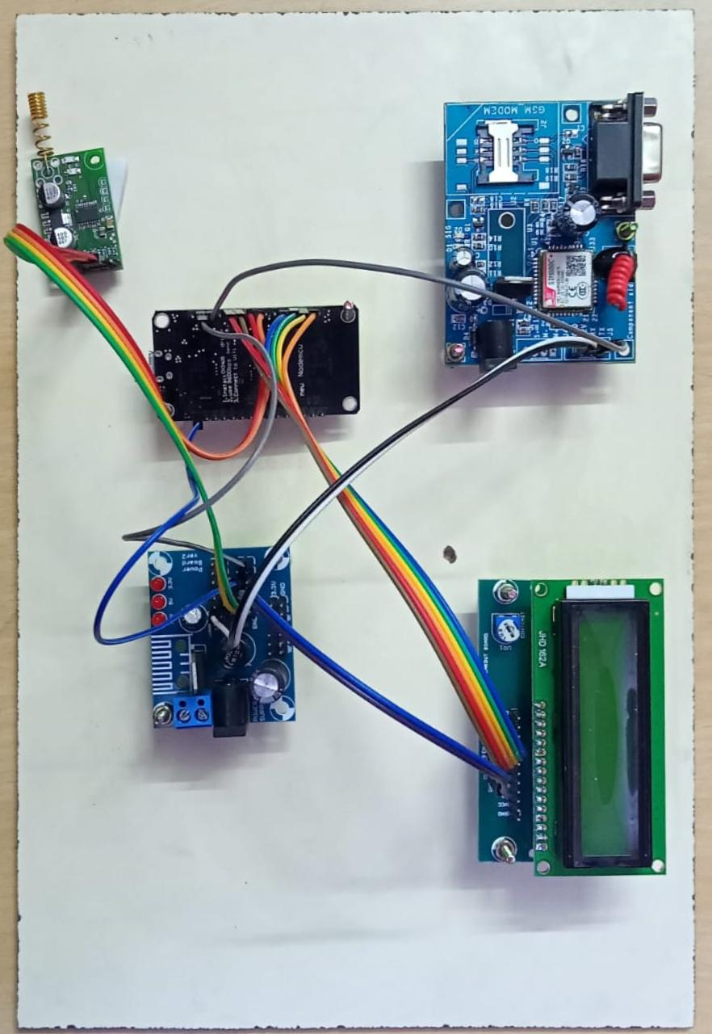
PROJECT SETUP – Receiver Section

Slide 24
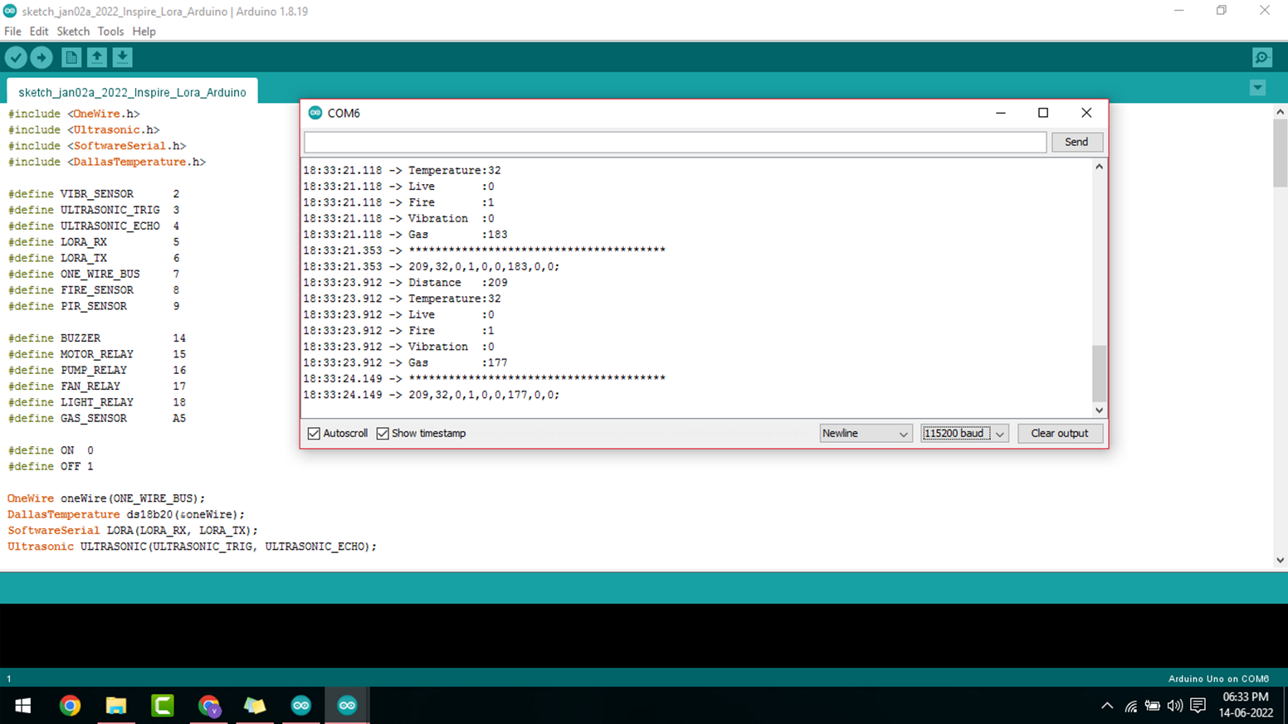
CODE OUTPUT

Slide 25
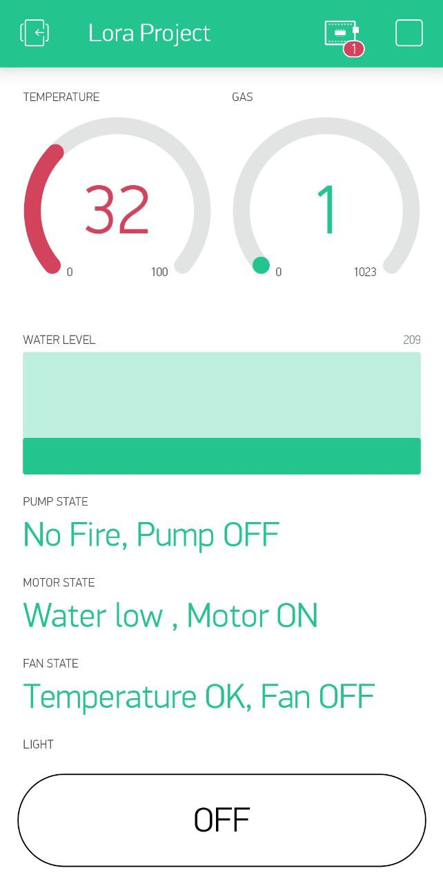
Blynk App Result when all things are normal

Slide 26
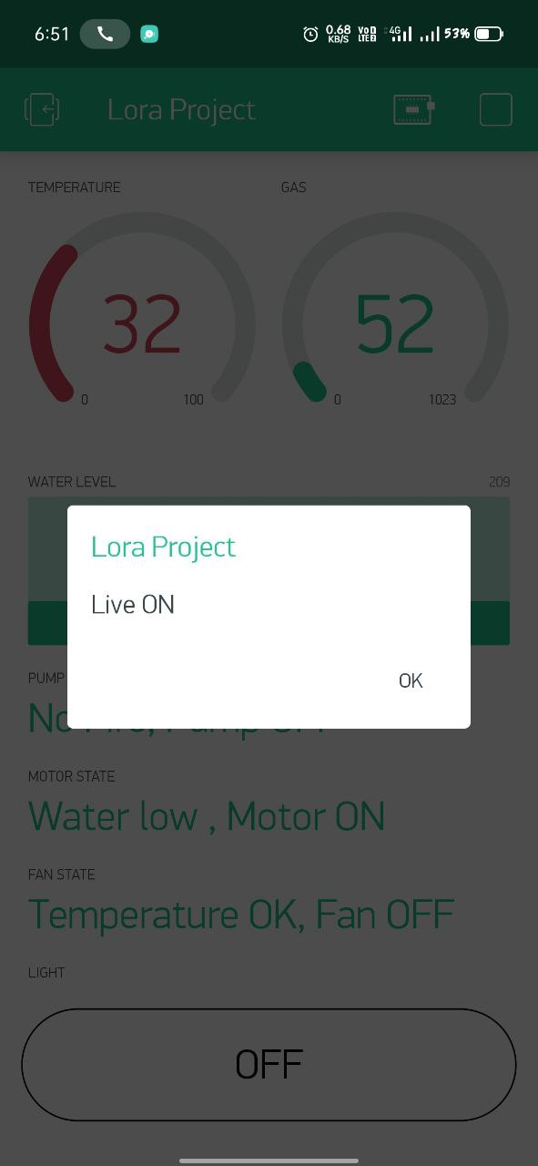
Blynk Result when human activity detected
Turns on light when a person enters room detected by PIR sensor

Slide 27
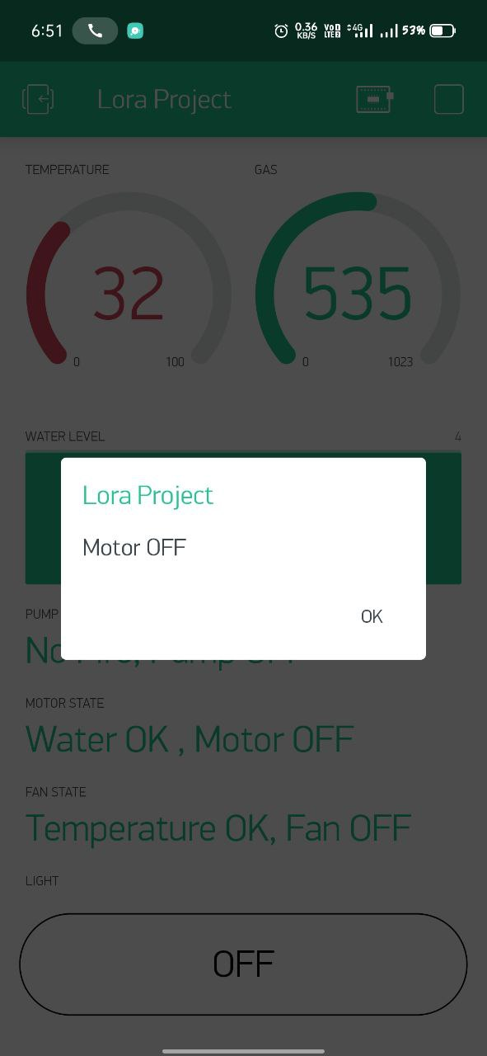
Blynk Result when water level is full
Water level is detected by the Ultrasonic sensor , if water level is low it turns on the motor and when water is full it turns off the motor

Slide 28
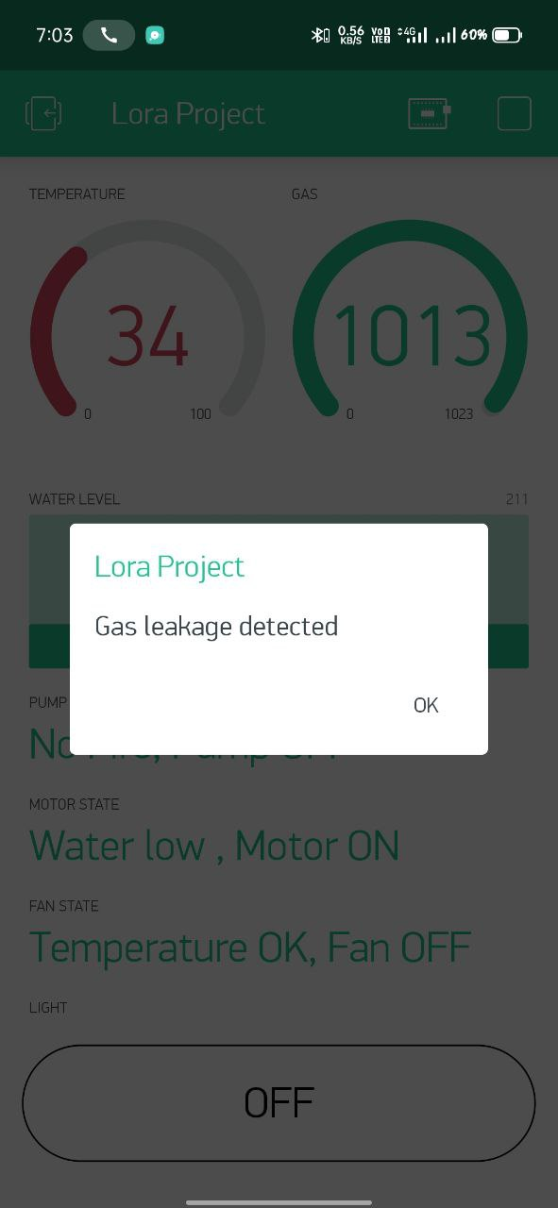
Blynk result when gas detected
Gas level is detected by gas sensor , normal gas level set as 400 if this value increase it will give us an alert

Slide 29
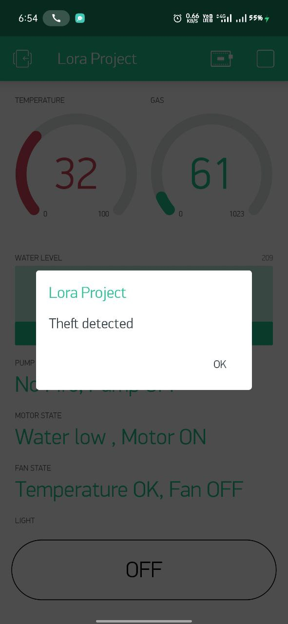
Blynk result when vibration detected

Slide 30
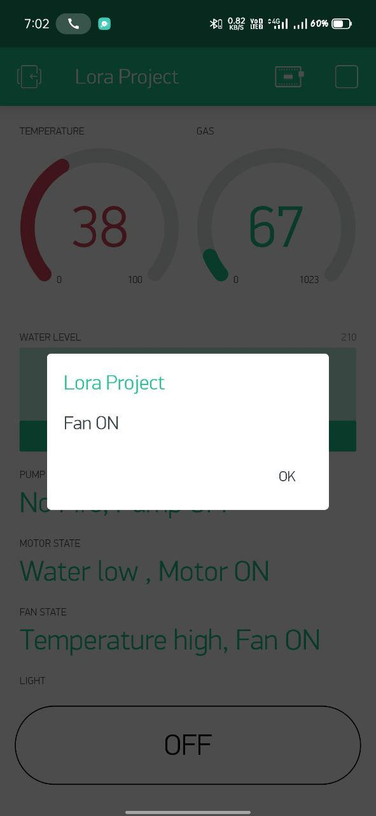
Blynk result when room temperature rises
If normal room temperature rises then it will turn on the fan

Slide 31
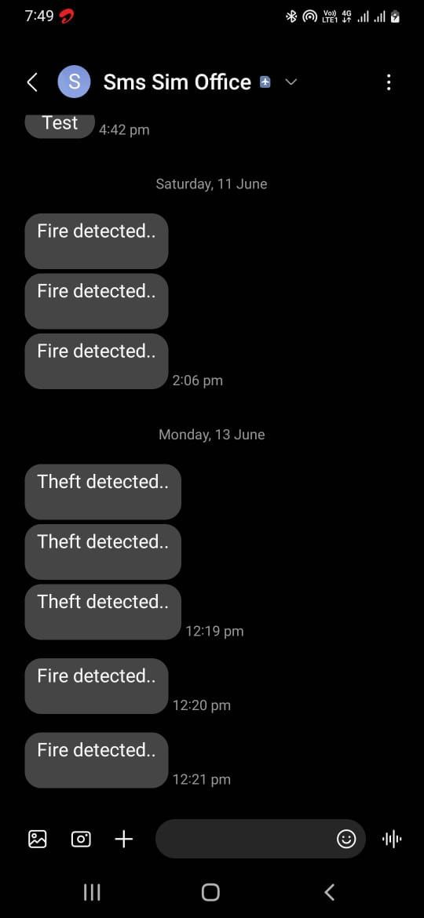
SMS sent to user by GSM

Slide 32
FUTURE WORK
A surveillance camera need to be added in the kit to monitor the home 24/7
A user friendly application should be developed to enable user to monitor the home

Slide 33
CONCLUSION
In this investigation, a smart automation system has been designed, developed and tested for effective remote controlling of appliances at home, institute or industry. The system was developed at low cost with a capability of monitoring and controlling from a distance ranging from 3 km to 12 km through LoRa based wireless communication. Technologies deployed for home automation that are available in the market are based on platforms which help to connect devices or things around the home, the key point is to make the home intelligent or smart with ease. To achieve this with precision by the use of static IP addresses and having the ability to detect the current state of devices by use of state function was achieved in this project. In conclusion, it has been seen that home automation using internet of things over LoRa technology with the help of Android application is both user friendly and cost effective

Slide 34
REFERENCES
1. Lee, K.M., Teng, W.G. and Hou, T.W., "Point-n-Press: An Intelligent Universal Remote Control System for Home Appliances," IEEE Transactions on Automation Science and Engineering. 2016, 13(3), pp 1308 – 1317.
2. Qu, Y., Xu, K., Wang, H., Wang, D. and Wu, B., December. "Lifetime maximization in rechargeable wireless sensor networks with charging interference," In 2015 IEEE 34th International Performance Computing and Communications Conference (IPCCC) 2015, pp. 1-8.
3. Hsieh, C.W., Chi, K.H., Jiang, J.H. and Ho, C.C., 2014. "Adaptive binding of wireless devices for home automation," IEEE Wireless Communications, 21(5), pp.62-69.
4. Sheng, W., Matsuoka, Y., Ou, Y., Liu, M. and Mastrogiovanni, F.,. "Guest Editorial Special Section on Home Automation," IEEE Transactions on Automation Science and Engineering, 2015, 12(4), pp.1155-1156.

Slide 35
THANK YOU…
Notes:
6/21/2022
35
35

