Slide 1
HACKATHON DECODE 10.3
Performed by Ganesh Devare

Slide 2
TABLEAU DASHBOARD

Slide 3
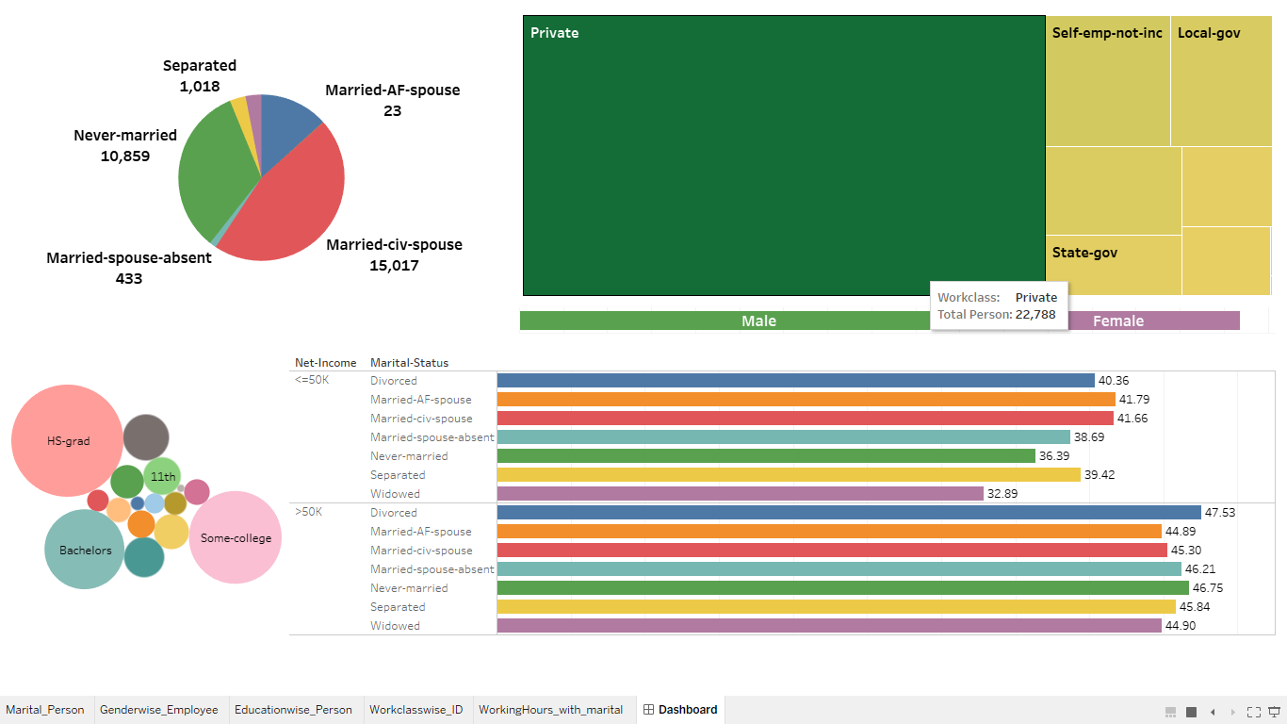

Slide 4
Problem Statement
Marital-Status of people
Number of Females are working.
Which one of the marital-status works more weekly. – {DIVORCED}
How much of the people take highest education ?
How many peoples are work in PRIVATE-SECTOR ?
How many peoples are works for their nations ?

Slide 5
CONCLUSION
DIVORCED PEOPLES ARE WORKING MORE ON WEEKLY, THAT’S WHY THEY GET 50+ INCOME.
HIGHER STUDIES PEOPLE ARE TAKE 50+ INCOME BUT THEY ALSO WORK MORE THAN 40+ HOURS WEEKLY.

Slide 6
MACHINE-LEARNING : CLASSIFICATION

Slide 7
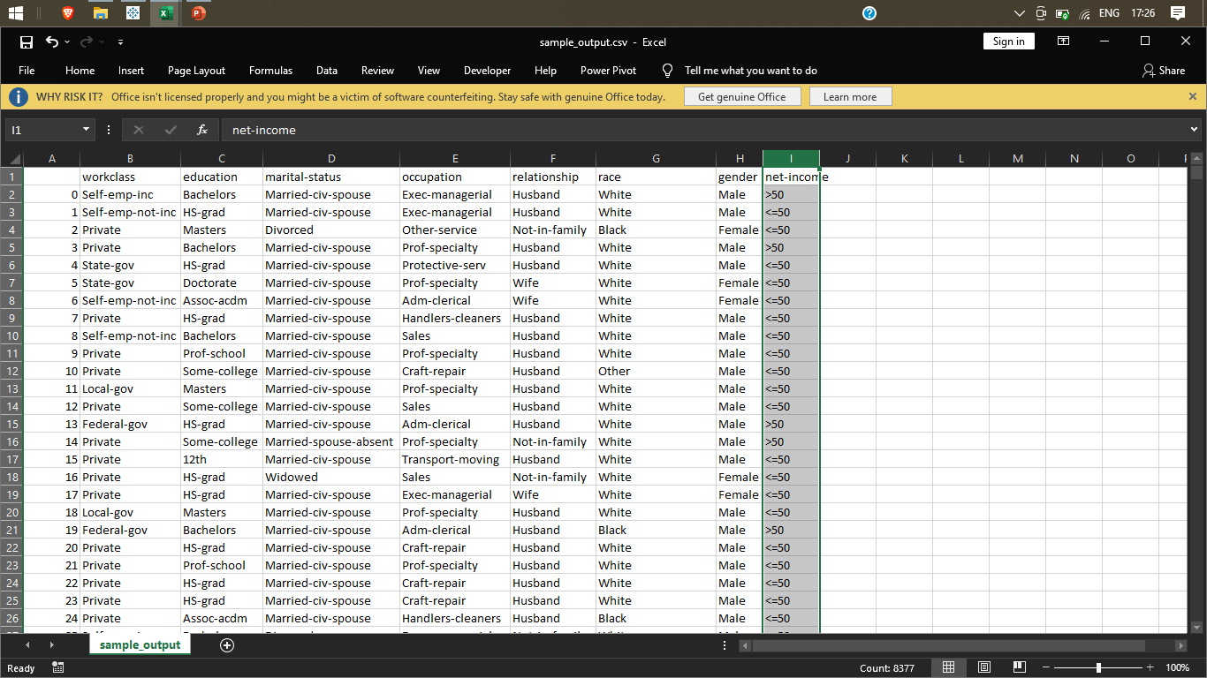

Slide 8
STEPS OF MODEL –
TRAINING DATASET :
Deal with Training model
Clean Data first
Performed FEATURE ENGINEERING as well as EDA on Training dataset
Learn the data by using Logistic Regression.
TESTING DATASET :
Read the Testing Data
Also clean this data
Did Feature engineering on it
And predict the INCOME of persons.

Slide 9
THANK YOU, BOARD INFINTY FOR CONDUCTING THIS HACKATHON

