Slide 1
PharamAI
Case study of Therapy Data

Slide 2
Data Description : 1
Data Load : date of data loaded
Claim ID : its unique that's why its primary key
Claim Date : Claiming Date between January and February
HCP ID: Healthcare Professional ID
State : All United-State countries are there.
Specialty Group
Payment Type
Product
Out of Pocket Type
Target HCP
Out of Pocket in $
Therapy
Days of Supply
12 Month LB Period

Slide 3
Data Description : Specialty Group
PSYCHIATRY : Diagnosis, treatment of mental disorders
NEUROLOGY : dealing with disorders of the nervous system
IM/FM : Internal Medicine and Family Medicine
NP/PA

Slide 4
Data Description : Payment Type
State Medicaid
Commercial
Medicare MAPDP
Medicare PDP
Managed Medicaid
Other

Slide 5
Data Description : Product
Eptinezumab :
Eptinezumab, sold under the brand name Vyepti, is a medication for the preventive treatment of migraine in adults.
Ajovy :
AJOVY is a prescription medicine used for the preventive treatment of migraine in adults
Emagality :
Emgality works to prevent migraines and treat cluster headaches by blocking the activity of certain proteins that cause migraines
Aimovig :
Aimovig may work by changing the amounts of certain natural substances in the brain

Slide 6
Data Description : Pocket Type
Coinsurance :
Coinsurance refers to the percentage of treatment costs that you have to bear after paying the deductibles
Deductible :
Firstly Paid by user then after Insurance company will give to user
Copay :
10% amount to pay by user to Hospital/__

Slide 7
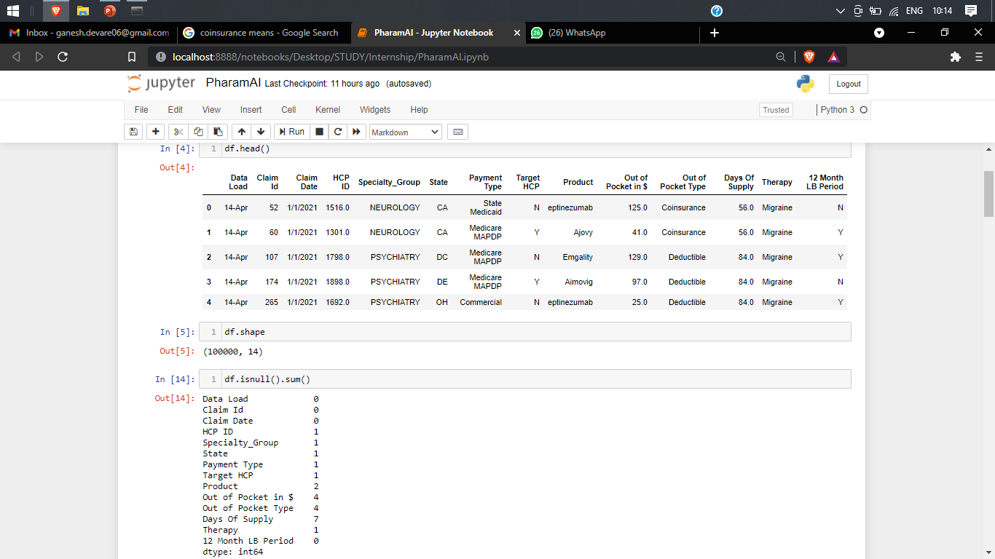
Checking null values from the Data

Slide 8
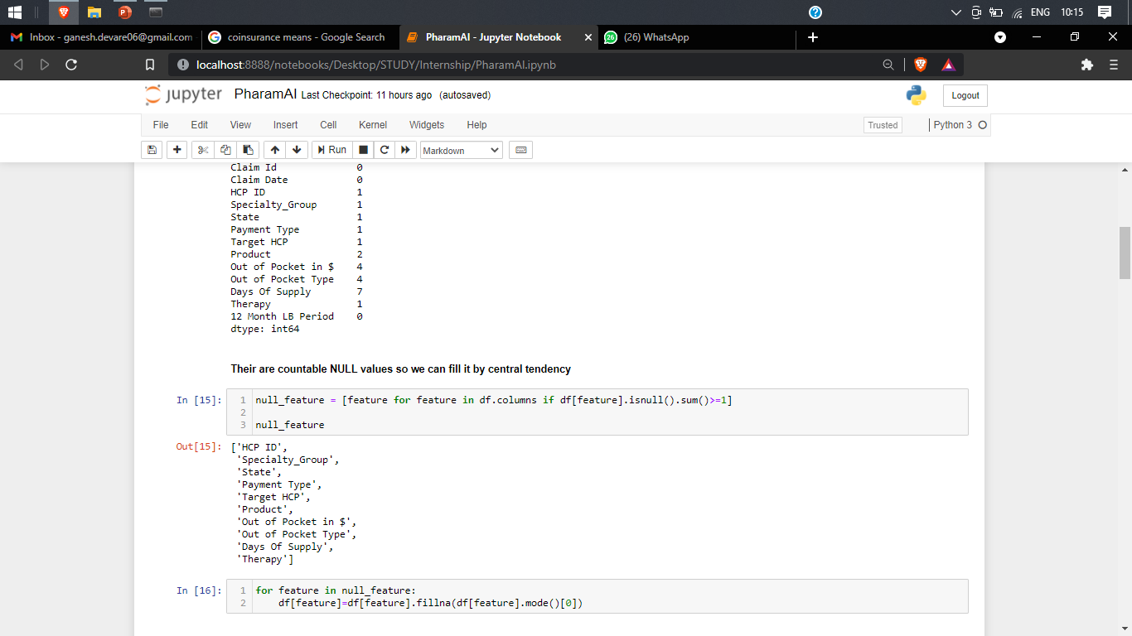
Dealing with null values by mode function

Slide 9
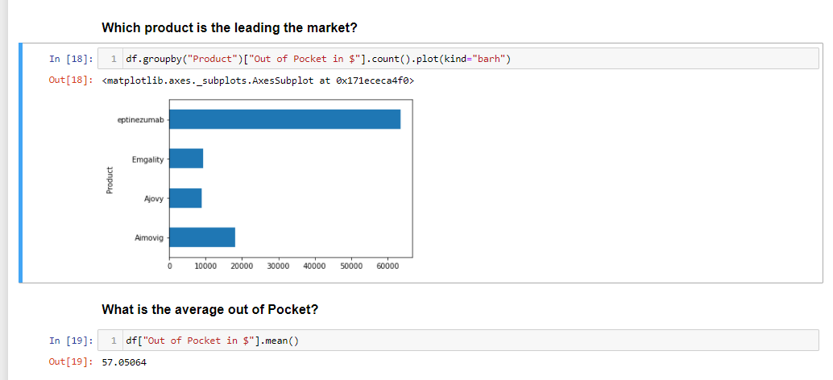
Which product is the leading the market? & what is the average out of pockets?

Slide 10
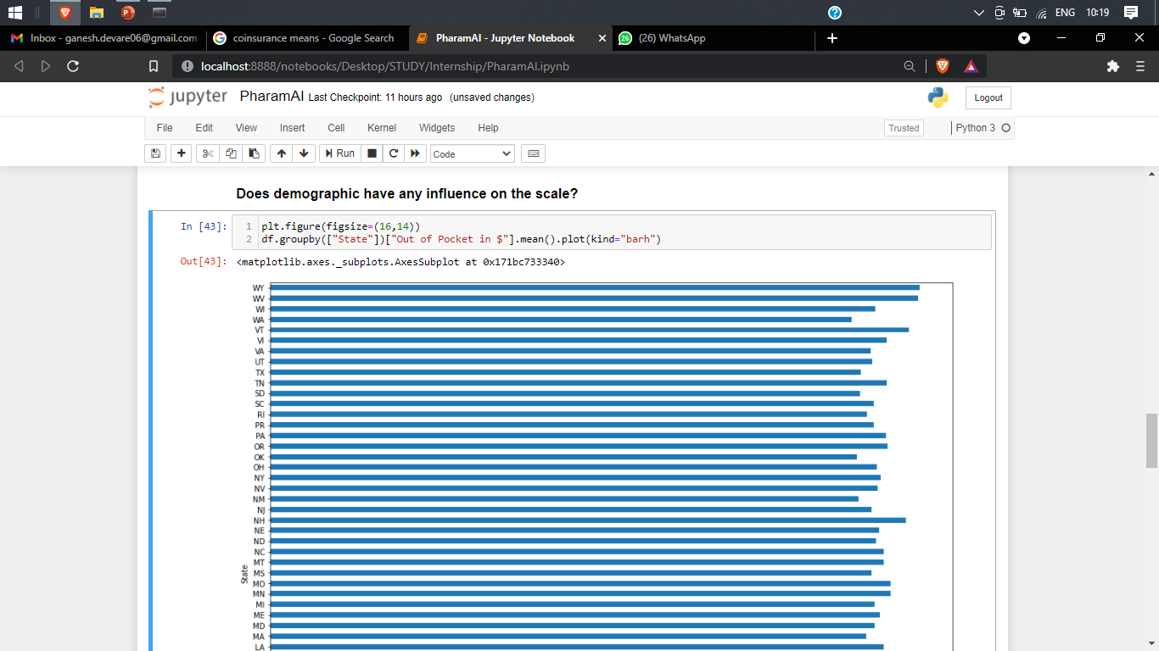
Does demographic have any influence on the sale? : Yes

Slide 11
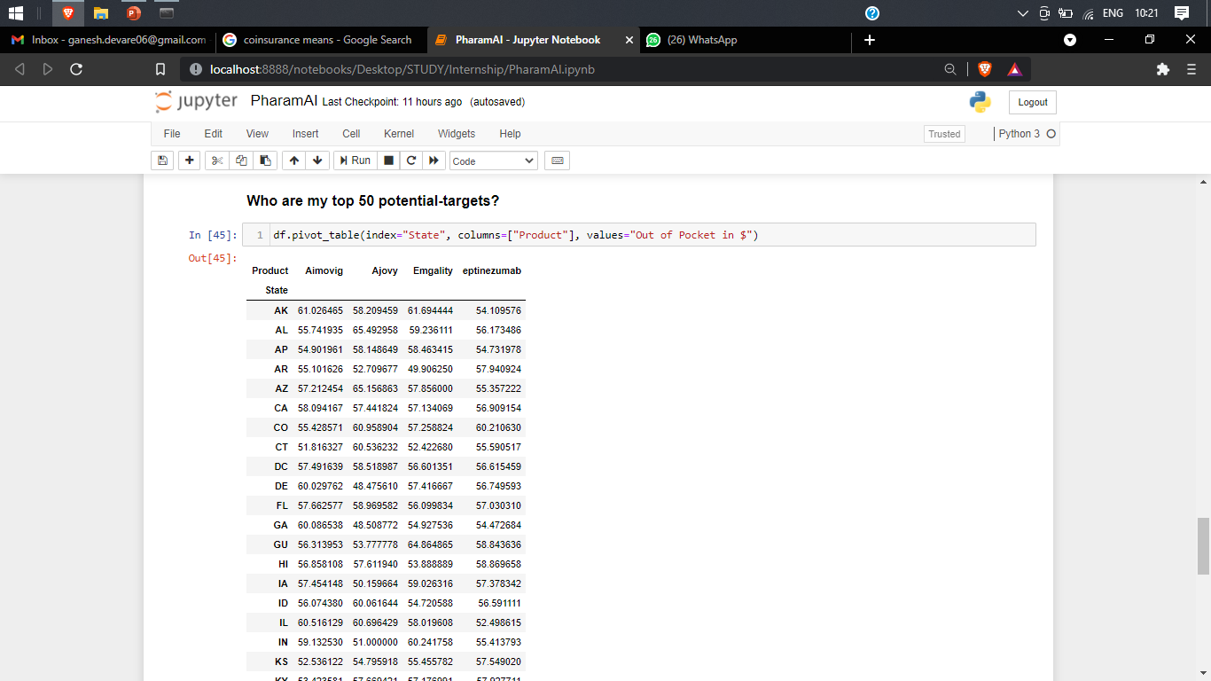
Who are my top 50 potential-targets?

Slide 12
Thank You

