Slide 1
Bluestock Mutual Fund Analytics
Final capstone presentation
ETL, performance analytics, investor behavior, and BI dashboard

Slide 2
Problem and Objective
Create a reliable mutual fund analytics workflow
Measure scale, returns, risk, flows, and investor activity
Deliver a decision-ready four-page dashboard

Slide 3
Data Sources
10 raw CSV datasets covering funds, NAV, benchmarks, flows, holdings, and transactions
40 schemes and 32,778 investor transactions in the supplied data
Cleaned outputs are stored in data/processed/

Slide 4
Architecture and ETL
Raw CSVs -> pathlib ETL -> cleaned CSVs -> SQLite star-style tables
Metrics layer computes annualized return, Sharpe, Beta, drawdown, and VaR
Streamlit and exported PDF/PNG dashboard consume the same model

Slide 5
EDA Highlights: Industry
AUM trend and AMC concentration
SIP inflow and folio growth context
Explicit units distinguish lakh crore, crore, and folios

Slide 6
EDA Highlights: Investors
Transaction value split by SIP, lumpsum, and redemption
State, age-group, city-tier, and monthly volume comparisons
Cohort table supports operational segmentation

Slide 7
Performance Metrics
Annualization uses 252 trading days
Sharpe uses a 6% annual risk-free rate
Beta is aligned to the NIFTY50 benchmark series

Slide 8
Performance Insights
Top one-year return: ABSL Small Cap Fund - Regular - Growth
Metrics computed for 40 funds
Scorecard balances return, risk-adjusted return, and volatility

Slide 9
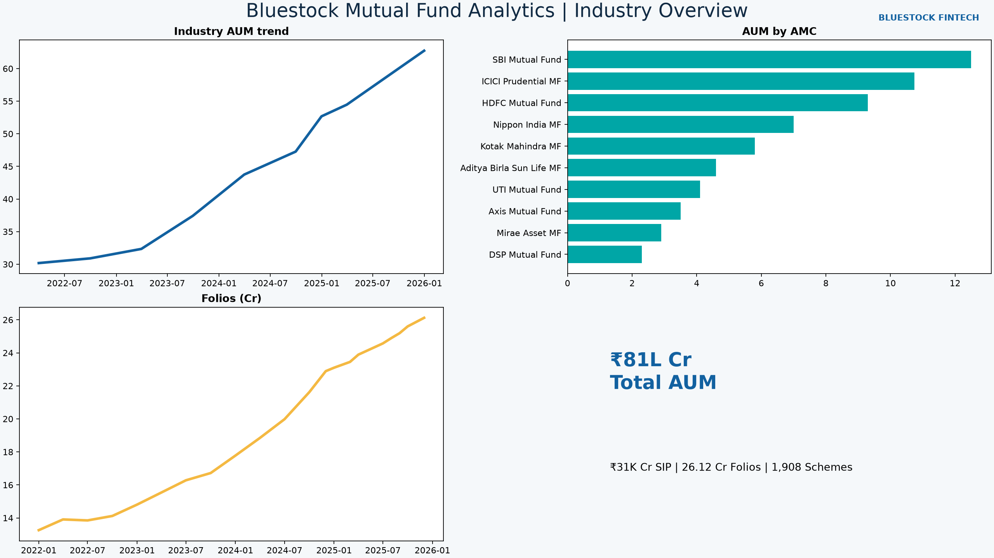
Dashboard: Industry and Performance

Slide 10
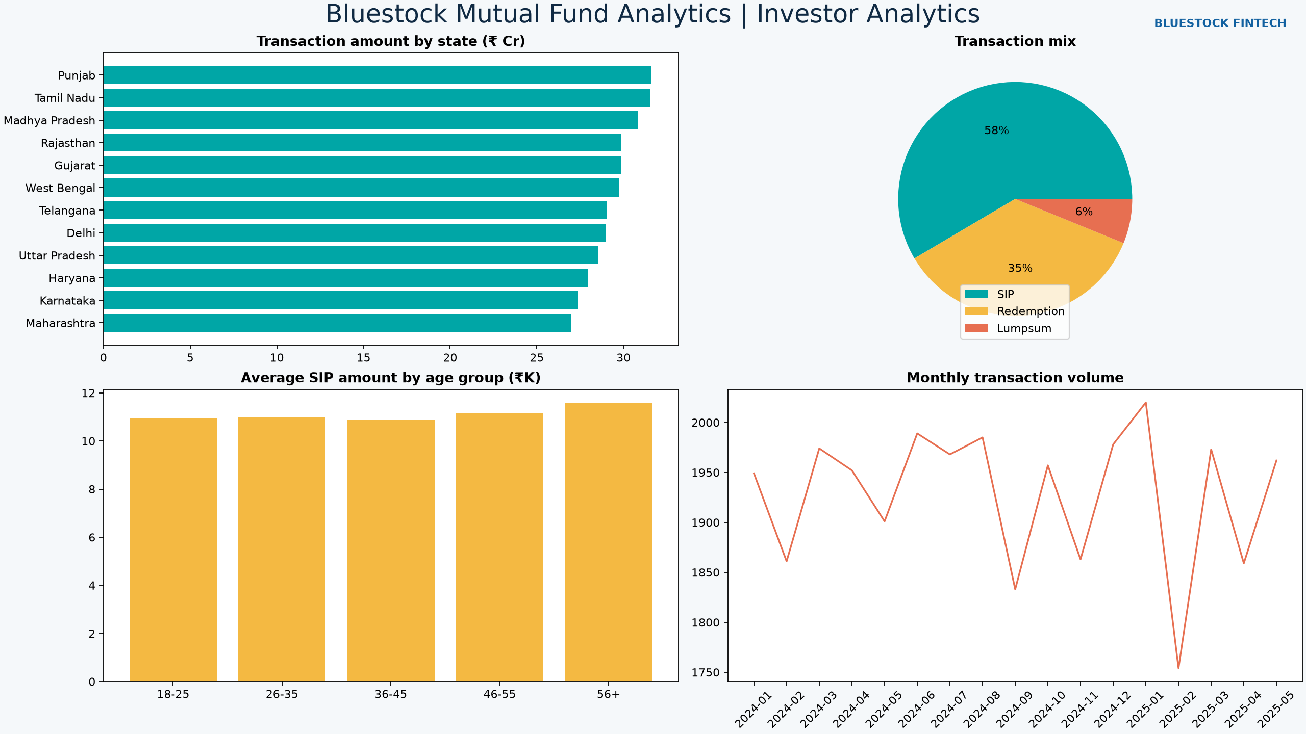
Dashboard: Investors and Market Trends

Slide 11
Key Findings and Recommendations
Use filters to compare fund houses, categories, plans, and investor cohorts
Treat historical risk metrics and recommender scores as decision support
Schedule controlled data refreshes before production use

Slide 12
Thank You
Bluestock FinTech Mutual Fund Analytics Capstone
Repository includes scripts, notebooks, SQL, dashboard exports, and documentation

