Slide 1
Setting CI-CD Pipeline with Jenkins and Teamcity

Slide 2
Continuous Integration (CI): Continuous integration is software development practice in which team members integrate their work frequently, leading multiple integrations per day. Each integration helps to reveals integrations errors in build success / failures as quickly as possible. This helps in significantly reducing integration problems and delivery timeline.
Continuous Delivery (CD) can be thought of as an extension to the continuous Integration. In this the teams always ensure that the code change is always releasable. CDs ensures fast feedback from the test environments.
Continuous Deployment (CD): This is a next step of Continuous delivery where in every change that passes the automated testing is deployed to production environment automatically. In the practical scenario Continuous deployment is still thought to be impractical.
What is CI/CD?

Slide 3
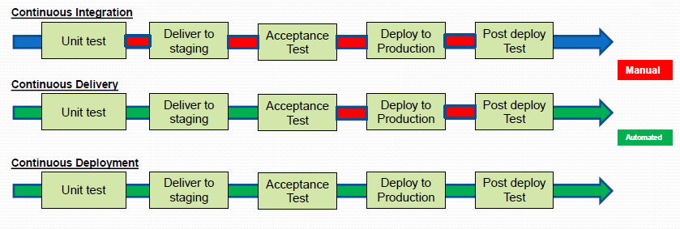
CI/CD stages

Slide 4
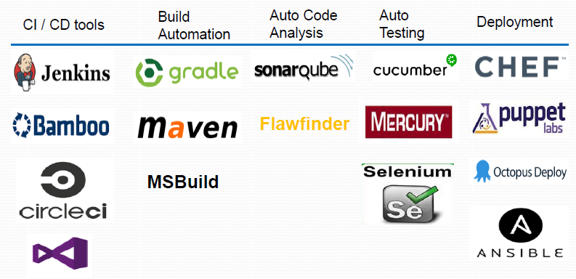
Tools in CI/CD stages

Slide 5
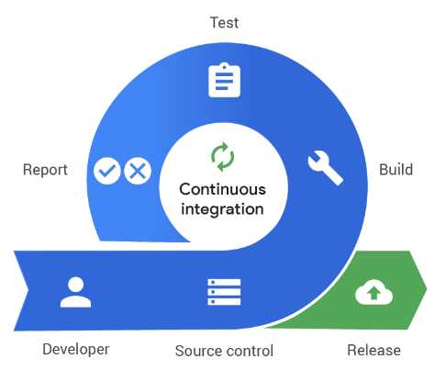
Jenkins can be used as a CI server or can be turned into a continuous delivery (CD) Hub.
Jenkins can distribute work across multiple machines for build, tests and deployments across multi platform.
Jenkins can be integrated with variety of tools in CI/DC like Version control, application build, testing, messaging, release management, etc.
Benefits:
Early feedback resulting in bug-free builds.
Automated testing and build operation- eliminate human error.
Enabler for success of Agile projects.
Enabler for imbibing DevOps culture.
Continuous Integration using
Jenkins

Slide 6
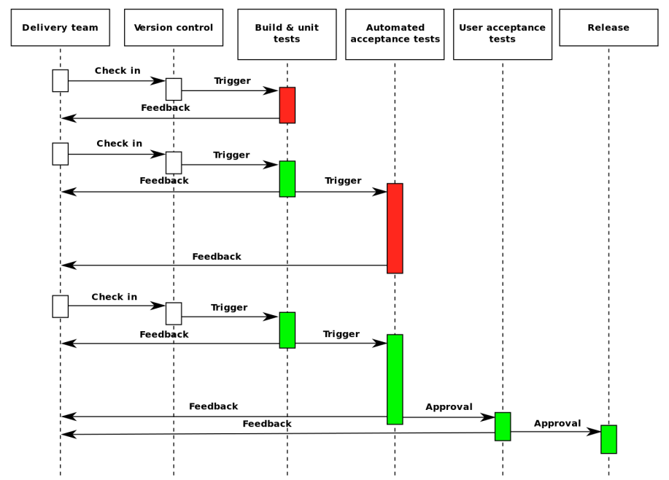
Continuous Delivery Pipeline

Slide 7
Advantages of TeamCity
Provides several ways to reuse the settings of a parent project in a subproject
Takes the source code from two different version control systems(VCS), for a single build
Can detect builds which are hung
Provides ways to highlight builds for follow-up purposes
Runs the parallel builds simultaneously on different platforms and environments
Helps to automate sections of the testing process so that lesser manual testing is required
Supports different platforms like Apache Tomcat server, Windows, Linux, Ubuntu, Debian, RedHat, SUSE.
Is more user-friendly and has global support

Slide 8
Jenkins adv.
Advantages of Jenkins
An open-source platform
Free of cost
Easy maintenance as it has a built-in GUI tool for updates
Supports 1000+ plugins
Widely spread tool with global support
Dynamic runs in-built for multiple branches
Portable to all major platforms

Slide 9
Download Jenkins from https://www.jenkins.io/download/
Also refer to Jenkins official documentation on Jenkins installation on various flavors of OS @https://www.jenkins.io/doc/
Jenkins can be installed as a service or a .war file to be used by any Webapp server like Tomcat etc.
Plug-ins are integral part of Jenkins, without which The CI/CD server can’t be configured. Plugins can be configured to be updated automatically, or one can write own plug-in if a plugin is not available that suits our requirements
One can create Jenkins user database or can integrate with LDAP database.
Jenkins can also be used over command line using ‘Jenkins CLI’.
Installing and configuring Jenkins

Slide 10
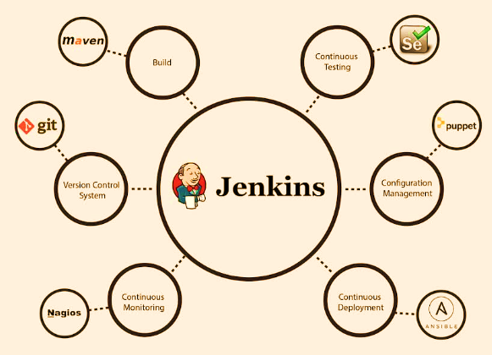
There are around 1900+ community contributed Jenkins plugins to support building, deploying and automating any project.
Jenkins Plug-in
https://plugins.jenkins.io/

Slide 11
Source code Plugins: GIT, Mercurial, TFS
Trigger Plugin: GITHUB pull request: Join: (different jobs / projects can be configured to run together, one after other etc.), Locks and Latches:
Build Tool Plugins: Copy artifacts, Fitness, MSBuild, Promoted build MSTest runner, NANT, MAVEN, PowerShell.
Wrapper Plugin: automated start and stop of a function upon certain action completion etc.
Notifier Plugins: Slack, HipChat, IRC, Twitter, Jabber… helps to send notifications.
Reporting plugin: Cobertura (code coverage), Findbugs, MSTest, PMD, etc.
Jenkins Plug-in categories

Slide 12
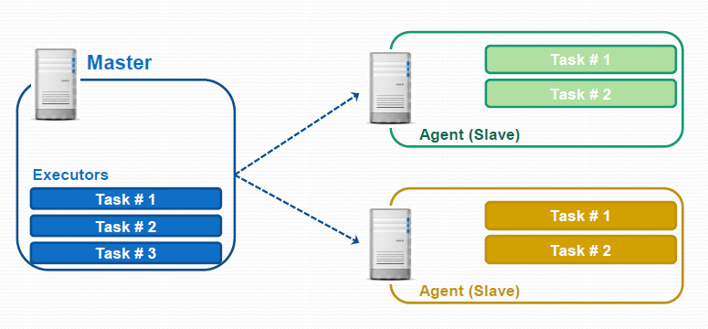
Jenkins Master-Slave Architecture
Jenkins Master – Agent model

Slide 13
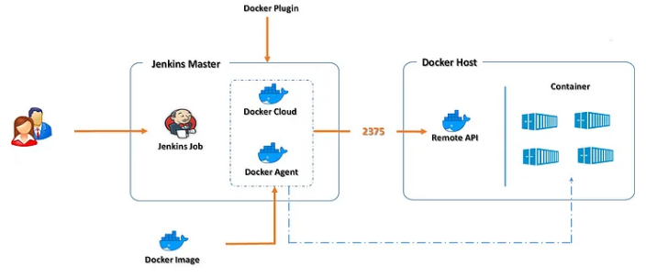
Jenkins Master with agent on Docker host
Jenkins Master – Agent model

Slide 14



Deployment Dashboard on Jenkins.
Link to Artifacts
GITHUB repo
Jenkins Box
(Jenkins as a service)
http://locahost:9001
Plugins:
JIRA plugin
Artifactory plugin
GITHUB plugin
Shell / Batch plugin
Artifactory repository (On Linux)
http://192.168.33.27:8081
Create Repository.
JIRA Tool (On Linux)
http://192.168.33.26:8080
Create Project
Create Issues type to accept
Linux Box
Archive Artifacts
CI-CD Pipeline with Artifacts and Issue Management Integration
Deploy
Create Issues / Update Issue / update release
TOMCAT Application Server
http://localhost:8080

