Slide 1
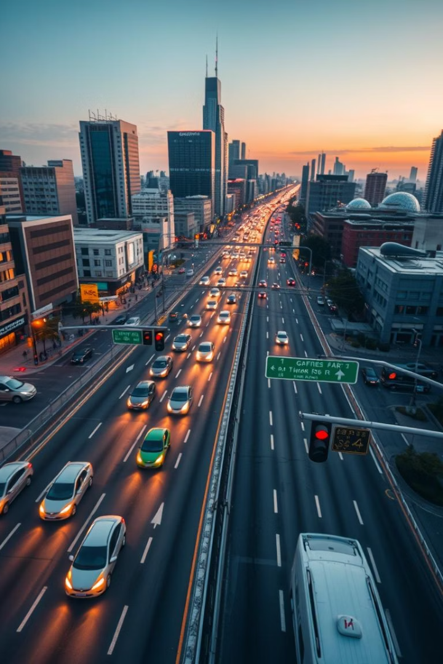
Smart Traffic Signal System with Dynamic Vehicle Detection
Revolutionizing urban traffic management. Improving traffic flow, reducing congestion, Optimizing signal timings in real-time.

Slide 2
Submitted by:
Mr. Buddhiraj Ganesh Bhosale (03)
Mr. Rajratn Ajit Ghatage (12)
Mr. Ganesh Ashok Ingale (19)
Mr. Kapil Jayram Kakade (21)

Slide 3
Introduction & Objective
Traditonal traffic signals are static and inefficient during peak hours.
Our project introduces an AI-based smart traffic control system.
YOLOv5 detects real-time vehilcle counts.
Signal timings adjust dynamically to traffic volume.
Simulated usingn Pygame for visual understanding

Slide 4
System Overview
Technologies Used
Modules
Python, YOLOv5 (Torch), OpenCV, Tkinter, Pygame
Vehicle Detectgion
Signal Timer Calculation
Real-Time Simulation
Input : Webcam/File Dialog
Working & Logic
YOLOv5 detects vehicles (cars, buses, trucks, bikes).
Based on vehicle count, system calculates green light duration.
Signals change dynamically and simulate a 4-way intersection.
Simple UI allows input from webcam or file selection.

Slide 5
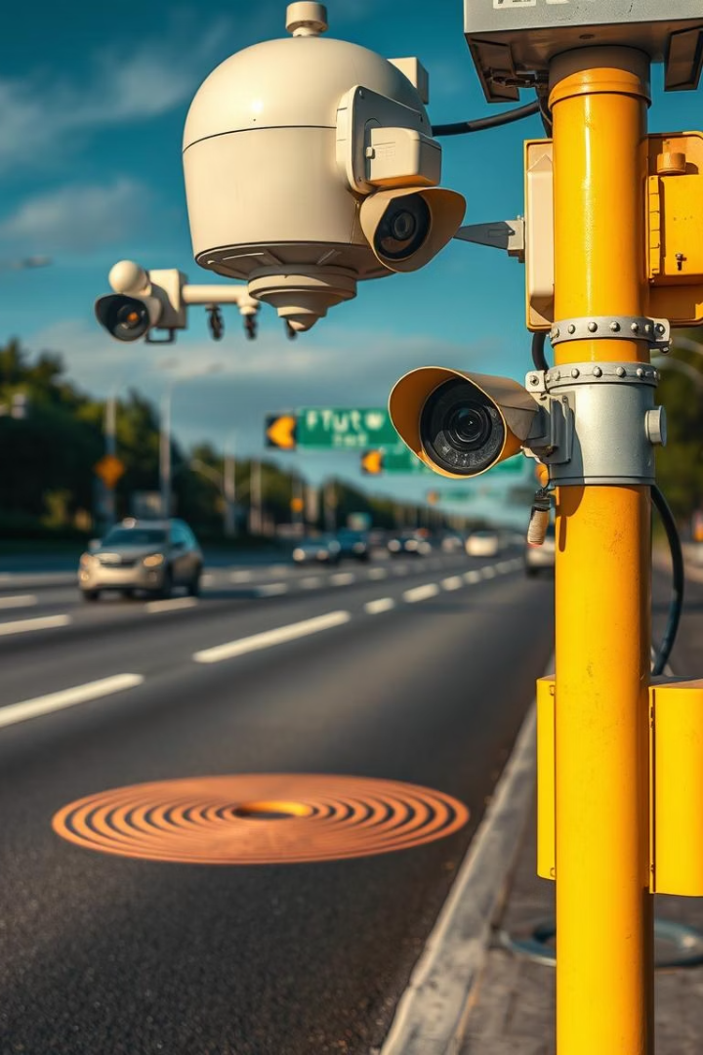
Results & Benefits
Adapts to real traffic flow, reducing waiting time.
Eliminates need for costly hardware sensors.
Promotes smart city infrastructure.
Easily scalable for larger intersections.

Slide 6
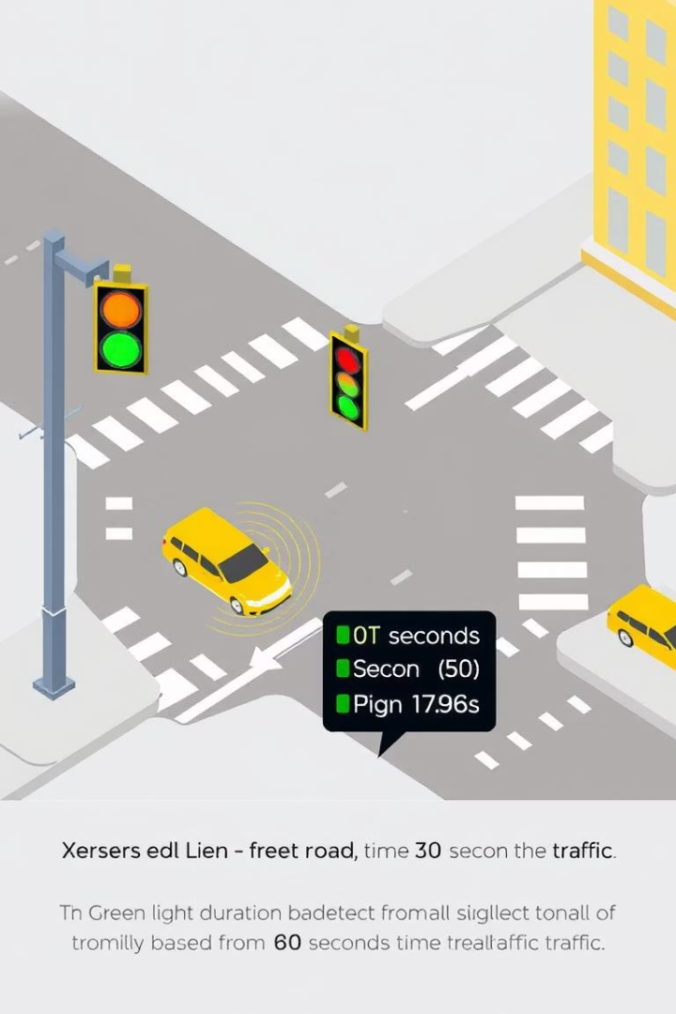
Conclusion & Future Scope
Real-time traffic management using AI.
Enhances traffic flow and reduces congestion.
Future Enhancements:
Cloud integration
Deep learning prediction models
Live video feed processing

Slide 7



Benefits: Reduced Congestion and Travel Time
Travel Reduction
20-30% reduction during peak hours.
Efficient Flow
Enhanced traffic flow improves overall efficiency and reduces bottlenecks.
Fuel Saving
Fuel savings, emission reductions, and increased productivity.

Slide 8






Benefits: Improved Safety and Reduced Emissions
Pedestrian Safety
Pedestrian detection and prioritization.
Smooth Flow
Smoother traffic reduces accidents.
Reduced Emissions
Reduced idling and stop-and-go traffic.
Decreases CO2 emissions by 21% (Environmental Science & Technology). Creating a greener, safer environment for all.

Slide 9
THANK YOU!

