Slide 1
Ganesh Jadhav
QRS July 2018
Assignment 02 SEP 2018

Slide 2
Introduction
What is the objective
Techniques used in the objective
Which is the data
Data Description
Analysis
Remarks / Conclusion

Slide 3
Objective
First
Second
Third
Fourth
Add more if you want

Slide 4
Techniques
Basic Statistics
Mean
Median
Variance
Standard Deviation
Minimum
Maximum
Percentiles

Slide 5
Data Description
No. of observations
No. of variables
Which variables selected for analysis
Anything else you want to add

Slide 6
Loan Amount
Status | (No. Of obs) | Mean | Variance | Std Dev | Min | Max | Median
Charged Off | 22450 | 13763 | 69228673 | NA | 500 | 35000 | 12000
Default | 221 | 14776 | 84607320 | 9198 | 1500 | 35000 | 12000
Fully Paid | 22671 | 12536 | 60702105 | 7791 | 500 | 35000 | 10500

Slide 7
Annual Income
Status | (No. Of obs) | Mean | Variance | Std Dev | Min | Max | Median
Charged Off | 22450 | 63577 | 1694057785 | 41159 | 2000 | 932000 | 55000
Default | 221 | 64628 | 1274100636 | 35695 | 14940 | 250000 | 55000
Fully Paid | 22671 | 72837 | 4593094455 | 67772.37 | 3500 | 7141778 | 62000

Slide 8
Percentile (Loan Amount)
Status | 0.05 | 0.25 | 0.5 | 0.75 | 0.95
Charged Off | 3000 | 7200 | 12000 | 19200 | 30000
Default | 3000 | 7200 | 12000 | 21000 | 35000
Fully Paid | 2825 | 6500 | 10500 | 17000 | 28000

Slide 9
Percentile (Annual Income)
Status | 0.05 | 0.25 | 0.5 | 0.75 | 0.95
Charged Off | 24398.9 | 40000. | 55000.0 | 75000.0 | 128186.6
Default | 25000 | 38517 | 55000 | 80000 | 128000
Fully Paid | 27000 | 45000 | 62000 | 87113 | 148000

Slide 10
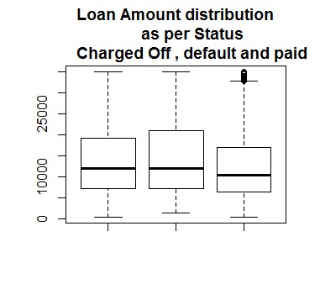
Box Plot

Slide 11
Histogram

Slide 12
Analysis
Your analysis of the above mentioned data & estimates
Your observation about the analysis
Anything else you want to add

Slide 13
Remarks
Your remarks
Your conclusion
Anything else you want to add

Slide 14
Loan Amount
Home Ownership | (No. Of obs) | Mean | Variance | Std Dev | Min | Max | Median

Slide 15
Annual Income
Home Ownership | (No. Of obs) | Mean | Variance | Std Dev | Min | Max | Median

Slide 16
Percentile (Loan Amount)
Home Ownership | 0.05 | 0.25 | 0.5 | 0.75 | 0.95

Slide 17
Percentile (Annual Income)
Home Ownership | 0.05 | 0.25 | 0.5 | 0.75 | 0.95

Slide 18
Box Plot

Slide 19
Histogram

Slide 20
Analysis
Your analysis of the above mentioned data & estimates
Your observation about the analysis
Anything else you want to add

Slide 21
Remarks
Your remarks
Your conclusion
Anything else you want to add

Slide 22
Final Conclusion
Overall observation and analysis
Conclusion and remarks
Add your own if you want

