Slide 1
Ajax

Slide 2
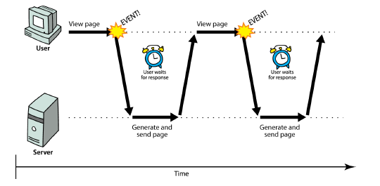
Synchronous web communication
synchronous: user must wait while new pages load
the typical communication pattern used in web pages (click, wait, refresh)

Slide 3
Web applications and Ajax
web application: a dynamic web site that mimics the feel of a desktop app
presents a continuous user experience rather than disjoint pages
examples: Gmail, Google Maps, Google Docs and Spreadsheets, Flickr, A9

Slide 4
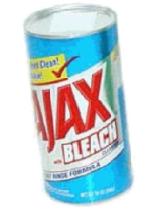
Web applications and Ajax
Ajax: Asynchronous JavaScript and XML
not a programming language; a particular way of using JavaScript
downloads data from a server in the background
allows dynamically updating a page without making the user wait
avoids the "click-wait-refresh" pattern
Example: Google Suggest

Slide 5
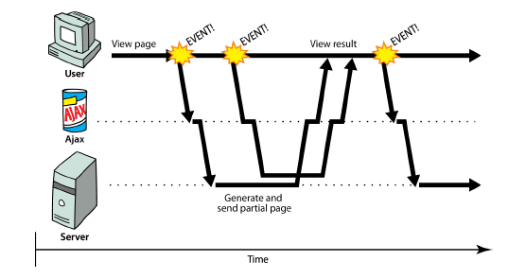
Asynchronous web communication
asynchronous: user can keep interacting with page while data loads
communication pattern made possible by Ajax

Slide 6
AJAX Technologies
HTML
Used to build web forms and identify fields
Javascript
Facilitates asynchronous communication and modification of HTML in-place
DHTML - Dynamic HTML
Additional markup for modifying and updating HTML
DOM - Document Object Model
Used via Javascript to work with both the structure of your HTML and also XML from the server

Slide 7
The XMLHttpRequest Object
Base object for AJAX
Used to make connections, send data, receive data, etc.
Allows your javascript code to talk back and forth with the server all it wants to, without the user really knowing what is going on.
Available in most browsers
But called different things

Slide 8
XMLHttpRequest (and why we won't use it)
JavaScript includes an XMLHttpRequest object that can fetch files from a web server
supported in IE5+, Safari, Firefox, Opera, Chrome, etc. (with minor compatibilities)
it can do this asynchronously (in the background, transparent to user)
the contents of the fetched file can be put into current web page using the DOM

Slide 9
XMLHttpRequest (and why we won't use it)
sounds great!...
... but it is clunky to use, and has various browser incompatibilities
Prototype provides a better wrapper for Ajax, so we will use that instead

Slide 10
A typical Ajax request
user clicks, invoking an event handler
handler's code creates an XMLHttpRequest object
XMLHttpRequest object requests page from server
server retrieves appropriate data, sends it back
XMLHttpRequest fires an event when data arrives
this is often called a callback
you can attach a handler function to this event
your callback event handler processes the data and displays it

Slide 11
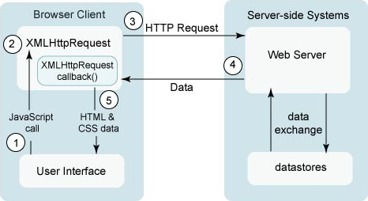
A typical Ajax request

Slide 12
The XMLHttpRequest Object
Methods
abort()
cancel current request
getAllResponseHeaders()
Returns the complete set of http headers as a string
getResponseHeader(“headername”)
Return the value of the specified header
open(“method”, “URL”, async, “uname”, “passwd”)
Sets up the call
setRequestHeader(“label”, “value”)
send(content)
Actually sends the request

Slide 13
The XMLHttpRequest Object
Properties
onreadystatechange
Event handler for an event that fires at every state change
readyState
Returns the state of the object
responseText
Returns the response as a string
responseXML
Returns the response as XML - use W3C DOM methods
status
Returns the status as a number - ie. 404 for “Not Found”
statusText
Returns the status as a string - ie. “Not Found”

Slide 14
Typical AJAX Flow
Make the call
Gather information (possibly from HTML form)
Set up the URL
Open the connection
Set a callback method
Send the request
Handle the response (in callback method)
When request.readyState == 4 and request.status == 200
Get the response in either text or xml
request.responseText or request.responseXML
Process the response appropriately for viewing
Get the objects on the page that will change
document.getElementById or document.getElementByName, etc.
Make the changes

Slide 15
The possible values of the readyState property are
Value | State | Description
0 | UNSENT | An XMLHttpRequest object has been created, but the open() method hasn't been called yet (i.e. request not initialized).
1 | OPENED | The open() method has been called (i.e. server connection established).
2 | HEADERS_RECEIVED | The send() method has been called (i.e. server has received the request).
3 | LOADING | The server is processing the request.
4 | DONE | The request has been processed and the response is ready.

Slide 16
HTTP Status Codes
The status code provides information about the status of the request. It also helps to identify the cause of the problem when a web page or other resource does not load properly.
Some common status codes are:
200 - the server successfully returned the page
404 - the requested page doesn't exist
503 - the server is temporarily unavailable

Slide 17
Example:
<html>
<body>
<div id="disp">
<h2>The XMLHttpRequest Object</h2>
<button type="button" onclick="getTextFile()">Get Data From Text File</button>
</div>
<script>
function getTextFile()
{
// Creating the XMLHttpRequest object
const xhttp = new XMLHttpRequest();
// Instantiating the request object
xhttp.open("GET", "sample.txt");
xhttp.onreadystatechange = function()
{
// Check if the request is compete and was successful
if(this.readyState === 4 && this.status === 200)
{
// Inserting the response from server into an HTML element
document.getElementById("disp").innerHTML = this.responseText;
}
};
xhttp.send(); // Sending the request to the server
}
</script>
</body>
</html>

Slide 18
What is XML?
XML stands for eXtensible Markup Language
XML is a markup language much like HTML
XML was designed to store and transport data
XML was designed to be self-descriptive
Why Study XML?
XML plays an important role in many different IT systems.
XML is often used for distributing data over the Internet.
It is important (for all types of software developers!) to have a good understanding of XML.

Slide 19
The Difference Between XML and HTML
XML and HTML were designed with different goals:
XML was designed to carry data - with focus on what data is
HTML was designed to display data - with focus on how data looks
XML tags are not predefined like HTML tags are

Slide 20
XML Does Not Use Predefined Tags
The XML language has no predefined tags.
The tags in the example above (like <to> and <from>) are not defined in any XML standard. These tags are "invented" by the author of the XML document.
HTML works with predefined tags like <p>, <h1>, <table>, etc.
With XML, the author must define both the tags and the document structure.

Slide 21
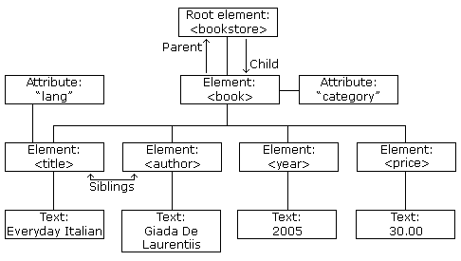
XML Tree
The XML Tree Structure

Slide 22
XML Syntax Rules
XML documents must contain one root element that is the parent of all other elements:
<root> <child> <subchild-1>.....</subchild-1>
<subchild-2>.....</subchild-2>
.
.
. </child> </root>

Slide 23
Example:
<?xml version="1.0" encoding="UTF-8"?>
<book>
<title>Introduction to XML</title>
<author>Jani</author>
<publisher>person</publisher>
<body>
This book is very easy to understand the XML!
</body>
</book>

Slide 24
The XML Prolog
This line is called the XML prolog:
<?xml version="1.0" encoding="UTF-8"?>
The XML prolog is optional. If it exists, it must come first in the document.
XML documents can contain international characters, like Norwegian or French.
To avoid errors, you should specify the encoding used, or save your XML files as UTF-8.
UTF-8 is the default character encoding for XML documents.

Slide 25
Accessing Nodes
You can access a node in three ways:
By using the getElementsByTagName() method
By looping through (traversing) the nodes tree
By navigating the node tree, using the node relationships
The getElementsByTagName() Method
getElementsByTagName() returns all elements with a specified tag name.
Syntax
node.getElementsByTagName("tagname");

Slide 26
<html>
<body>
<h1>The XMLHttpRequest Object of Books Details</h1>
<button type="button" onclick="loadDoc()">Get Books Details</button>
<br><br>
<p id="p1"></p>
<p id="p2"></p>
<p id="p3"></p>
<script>
function loadDoc()
{
var xhttp = new XMLHttpRequest();
xhttp.onreadystatechange = function()
{
if (this.readyState == 4 && this.status == 200)
{
myFunction(this);
}
};
xhttp.open("GET", "sam.xml", true);
xhttp.send();
}
function myFunction(xml) {
var xmlDoc = xml.responseXML;
var x = xmlDoc.getElementsByTagName("title");
document.getElementById("p1").innerHTML = x[0].childNodes[0].nodeValue;
var y = xmlDoc.getElementsByTagName("author");
document.getElementById("p2").innerHTML = y[0].childNodes[0].nodeValue;
var z = xmlDoc.getElementsByTagName("publisher");
document.getElementById("p3").innerHTML = z[0].childNodes[0].nodeValue;
}
</script>
</body>
</html>

Slide 27
Prototype's Ajax model
new Ajax.Request("url",
{
option : value,
option : value,
...
option : value
}
); JS
construct a Prototype Ajax.Request object to request a page from a server using Ajax
constructor accepts 2 parameters:
the URL to 1. fetch, as a String,
a set of options, as an array of key : value pairs in {} braces (an anonymous JS object)
Notes:
2.
hides icky details from the raw XMLHttpRequest; works well in all browsers

Slide 28
Prototype Ajax methods and properties
option | description
method | how to fetch the request from the server (default "post")
parameters | query parameters to pass to the server, if any
asynchronous (default true), contentType, encoding, requestHeaders
options that can be passed to the Ajax.Request constructor

Slide 29
Prototype Ajax methods and properties
event | description
onSuccess | request completed successfully
onFailure | request was unsuccessful
onException | request has a syntax error, security error, etc.
events in the Ajax.Request object that you can handle

Slide 30
Basic Prototype Ajax template
property | description
status | the request's HTTP error code (200 = OK, etc.)
statusText | HTTP error code text
responseText | the entire text of the fetched page, as a String
responseXML | the entire contents of the fetched page, as an XML DOM tree (seen later)
function handleRequest(ajax) {
alert(ajax.responseText);
} JS

Slide 31
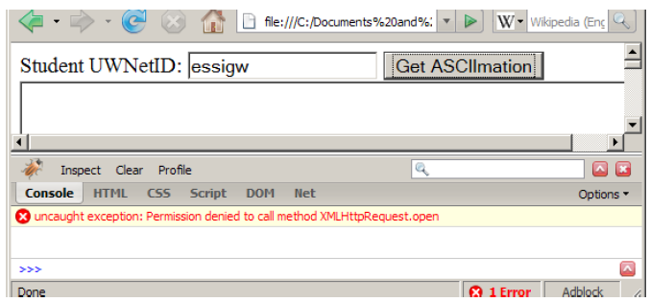
XMLHttpRequest security restrictions
cannot be run from a web page stored on your hard drive
can only be run on a web page stored on a web server
can only fetch files from the same site that the page is on www.foo.com/a/b/c.html can only fetch from www.foo.com

Slide 32
Handling Ajax errors
new Ajax.Request("url",
{
method: "get",
onSuccess: functionName,
onFailure: ajaxFailure,
onException: ajaxFailure
}
);
...
function ajaxFailure(ajax, exception) {
alert("Error making Ajax request:" + "\n\nServer status:\n" + ajax.status + " " + ajax.statusText +
"\n\nServer response text:\n" + ajax.responseText);
if (exception) {
throw exception;
}
} JS
for user's (and developer's) benefit, show an error message if a request fails
Notes:
for user's (and developer's) benefit, show an error message if a request fails

Slide 33
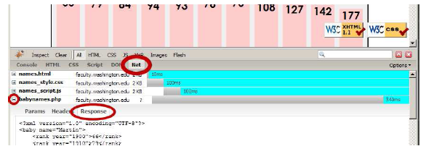
Debugging Ajax code
Net tab shows each request, its parameters, response, any errors
expand a request with + and look at Response tab to see Ajax result

Slide 34
Creating a POST request
new Ajax.Request("url",
{
method: "post", // optional
parameters: { name: value, name: value, ..., name: value },
onSuccess: functionName,
onFailure: functionName,
onException: functionName
}
); JS
Notes:
http://www.tizag.com/ajaxTutorial/index.php

Slide 35
Creating a POST request
Ajax.Request can also be used to post data to a web server
method should be changed to "post" (or omitted; post is default)
any query parameters should be passed as a parameters parameter
written between {} braces as a set of name : value pairs (another anonymous object)
get request parameters can also be passed this way, if you like

Slide 36
Prototype's Ajax Updater
new Ajax.Updater(
"id",
"url",
{
method: "get"
}
); JS
Ajax.Updater fetches a file and injects its content into an element as innerHTML
additional (1st) parameter specifies the id of element to inject into

