Slide 1
AJAX
Asynchronous Javascript And XML

Slide 2
AJAX
A lot of hype
  It has been around for a while
  Not complex
Powerful approach to building websites
  Think differently
Allows for more interactive web applications
  Gmail, docs.google.com, Flickr, ajax13, etc.

Slide 3
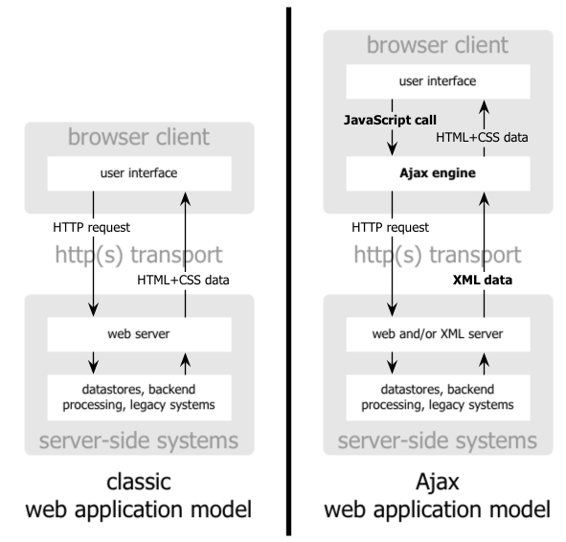

Slide 4
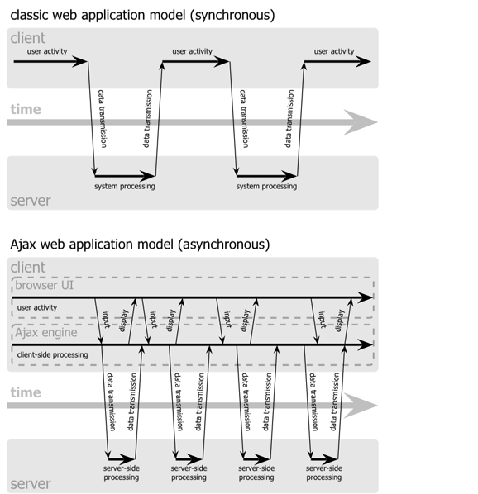

Slide 5
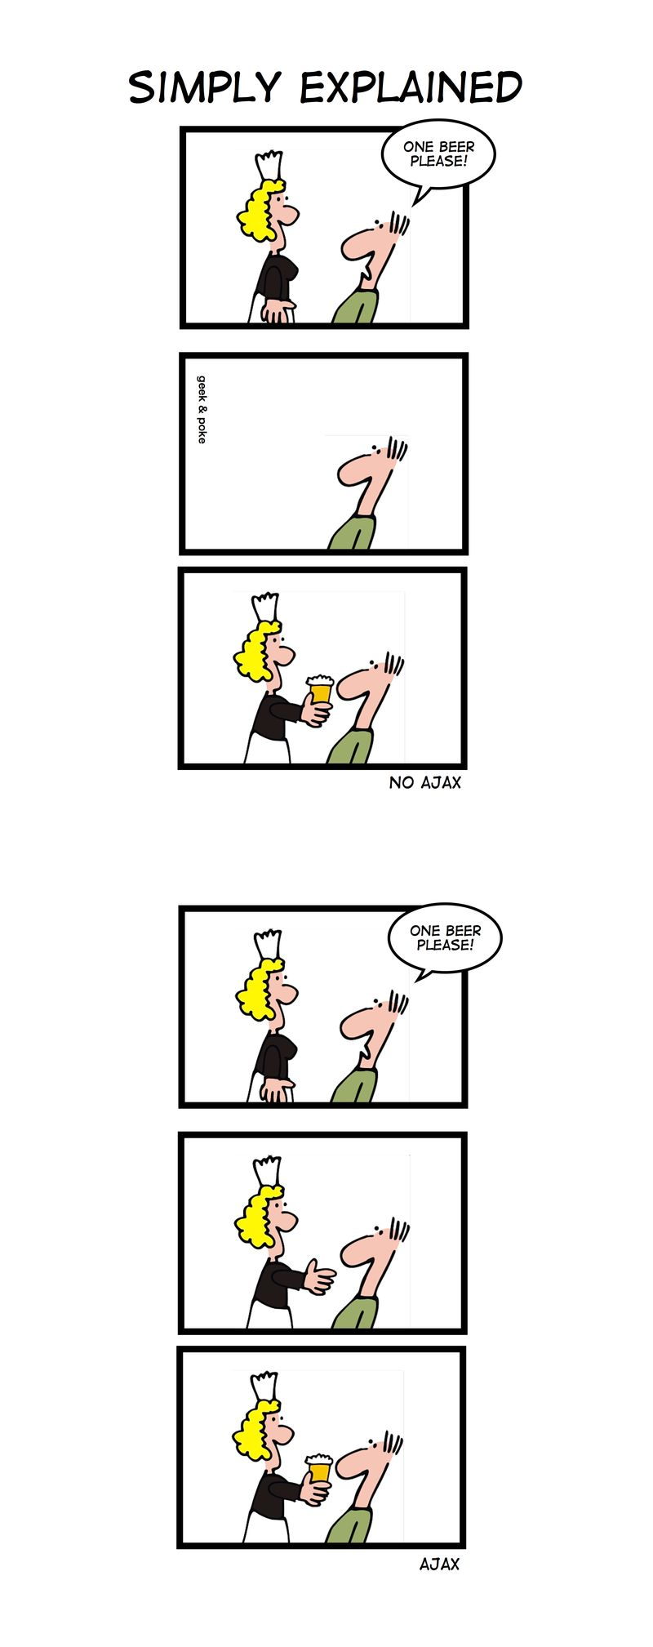
ONE SHAKE
PLEASE
ONE SHAKE
PLEASE

Slide 6
AJAX Technologies
HTML
  Used to build web forms and identify fields
Javascript
  Facilitates asynchronous communication and modification of HTML in-place
DHTML - Dynamic HTML
  Additional markup for modifying and updating HTML
DOM - Document Object Model
  Used via Javascript to work with both the structure of your HTML and also XML from the server

Slide 7
The XMLHttpRequest Object
Base object for AJAX
  Used to make connections, send data, receive data, etc.
Allows your javascript code to talk back and forth with the server all it wants to, without the user really knowing what is going on.
Available in most browsers
  But called different things

Slide 8
The XMLHttpRequest Object
_x0016_<script language="javascript" type="text/javascript">
var request;
function createRequest() {
try {
request = new XMLHttpRequest();
if (request.overrideMimeType) {
request.overrideMimeType('text/xml');
}
} catch (trymicrosoft) {
try {
request = new ActiveXObject("Msxml2.XMLHTTP");
} catch (othermicrosoft) {
try {
request = new ActiveXObject("Microsoft.XMLHTTP");
} catch (failed) {
request = false;
}
}
}
if (!request)
alert("Error initializing XMLHttpRequest!");
}
</script>

Slide 9
Communicating
Steps
  Gather information (possibly from HTML form)
  Set up the URL
  Open the connection
  Set a callback method
  Send the request
function getCustomerInfo()
{
var phone = document.getElementById("phone").value;
var url = "/cgi-local/lookupCustomer.php?phone=" + escape(phone);
request.open("GET", url, true);
request.onreadystatechange = updatePage;
request.send(null);
}

Slide 10
Handling Server Responses
When the server responds, your callback method will be invoked.
  It is called at various stages of the process
  Test readyState
function updatePage()
{
if (request.readyState == 4) {
if (request.status == 200) {
// Handle the response
} else
alert("status is " + request.status);
}
}

Slide 11
HTTP Ready States
0: The request is uninitialized
  Before calling open()
1: The request is set up, but hasn’t been sent
  Before calling send()
2: The request is sent and is being processed
  Sometimes you can get content headers now
3: The request is being processed
  The server hasn’t finished with its response
4: The response is complete

Slide 12
The XMLHttpRequest Object
Methods
  abort()
    cancel current request
  getAllResponseHeaders()
    Returns the complete set of http headers as a string
  getResponseHeader(“headername”)
    Return the value of the specified header
  open(“method”, “URL”, async, “uname”, “passwd”)
    Sets up the call
  setRequestHeader(“label”, “value”)
  send(content)
    Actually sends the request

Slide 13
The XMLHttpRequest Object
Properties
  onreadystatechange
    Event handler for an event that fires at every state change
  readyState
    Returns the state of the object
  responseText
    Returns the response as a string
  responseXML
    Returns the response as XML - use W3C DOM methods
  status
    Returns the status as a number - ie. 404 for “Not Found”
  statusText
    Returns the status as a string - ie. “Not Found”

Slide 14
Typical AJAX Flow
Make the call
  Gather information (possibly from HTML form)
  Set up the URL
  Open the connection
  Set a callback method
  Send the request
Handle the response (in callback method)
  When request.readyState == 4 and request.status == 200
  Get the response in either text or xml
    request.responseText or request.responseXML
  Process the response appropriately for viewing
  Get the objects on the page that will change
    document.getElementById or document.getElementByName, etc.
  Make the changes

Slide 15
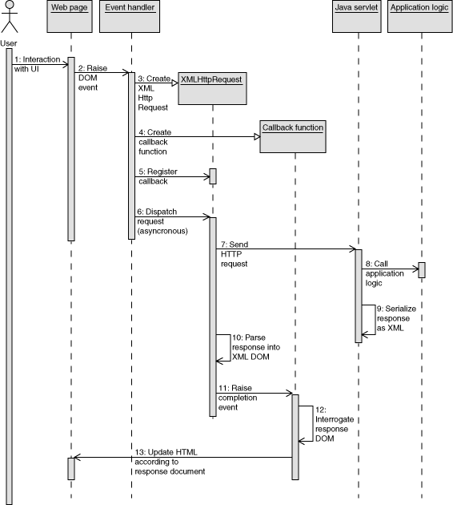

Slide 16
AJAX Response Handler
function updatePage()
{
if (request.readyState == 4) {
if (request.status == 200) {
var response = request.responseText.split("|"); // “order|address”
document.getElementById("order").value = response[0];
document.getElementById("address").innerHTML = response[1];
} else
alert("status is " + request.status);
}
}

Slide 17
Simple AJAX Example
Enter username
If you have been to the site before
  Say welcome back
Else
  Say nice to meet you
  Enter into list (perhaps)
ajaxform.html, ajax.js, ajax.php
  http://dna.cs.byu.edu/~snell/Classes/CS360/simpleajax/ajaxform.html

Slide 18
function loadMap(filename)
{
var request = GXmlHttp.create();
request.open("GET", filename, true);
request.onreadystatechange = function()
{
if (request.readyState == 4)
{
var xmlDoc = request.responseXML;
var markers = xmlDoc.documentElement.getElementsByTagName("marker");
mapmarkers.length=0;
for (var i = 0; i < markers.length; i++)
{
mapmarkers.push(createMarker(new GLatLng(parseFloat(markers[i].getAttribute("lat")), parseFloat(markers[i].getAttribute("lng"))), markers[i].getAttribute("note")));
map.addOverlay(mapmarkers[i]);
}
map.setCenter(new GLatLng(parseFloat(markers[0].getAttribute("lat")), parseFloat(markers[0].getAttribute("lng"))), 13);
mappoints.length = 0;
var trailpoints = xmlDoc.documentElement.getElementsByTagName("point");
for (var i = 0; i < trailpoints.length; i++)
{
var tpoint = new GLatLng(parseFloat(trailpoints[i].getAttribute("lat")), parseFloat(trailpoints[i].getAttribute("lng")));
mappoints.push(tpoint);
}
map.addOverlay(new GPolyline(mappoints));
}
}
request.send(null);
}
// Download the data in data.xml and load it on the map. The format we expect is:
// <markers>
// <marker lat="37.441" lng="-122.141" note="marker notes"/>
// <marker lat="37.322" lng="-121.213" note="marker notes"/>
// </markers>
// <trail>
// <point lat="37.441" lng="-122.141"/>
// <point lat="37.322" lng="-121.213"/>
// </trail>

Slide 19
AJAX Libraries
Prototype
  http://www.prototypejs.org/
Scriptaculous
  http://script.aculo.us/
JQuery
  http://jquery.com/
Mochikit
  http://mochikit.com/

Slide 20
Prototype Sample
new Ajax.Request('/some_url', {
method:'get',
onSuccess: function(transport)
{
var response = transport.responseText || "no response text";
alert("Success! \n\n" + response);
},
onFailure: function()
{
alert('Something went wrong...')
}
});

Slide 21
Prototype Example
<html>
<head>
<title>Testing Prototype</title>
<script src="http://www.prototypejs.org/assets/2008/9/29/prototype-1.6.0.3.js"></script>
<script>
function getProducts()
{
new Ajax.Updater('products', 'products.html', { method: 'get' });
}
</script>
</head>
<body>
<h2>Our fantastic products</h2>
<div id="products"><a href = "#" onClick="getProducts();">(fetch product list ...)</a></div>
</body>
</html>

Slide 22
AJAX in JQuery
Simplified
$.ajax(url, [settings])
  url : a string containing the url - optional
  settings : key-value pairs
  Returns jqXHR object (superset of XMLHTTPRequest object)
Example:
$.ajax({
type: "POST",
url: "some.php",
data: { name: "John", location: "Boston" }
});

Slide 23
The jqXHR Object
Superset of the XMLHTTPRequest
Contains responseText and responseXML properties and getResponseHeader() method
Other functions
  jqXHR.done(function(data,textStatus, jqXHR){} )
  jqXHR.fail(function(jqXHR, textStatus, errorThrown){} )
  jqXHR.always(function(data, textStatus, error){} )

Slide 24
AJAX & the jqXHR Object
var jqxhr = $.ajax( "example.php" )
.done(function() {
alert( "success" );
})
.fail(function() {
alert( "error" );
})
.always(function() {
alert( "complete" );
});

Slide 25
AJAX in JQuery
$.get(url [, data] [, success(data,textStatus, jqXHR){} )
$.post(url [, data] [, success(data,textStatus, jqXHR){} )
$.getJSON(url [, data] [, success(data,textStatus, jqXHR){} )
  Use an AJAX get request to get JSON data
$.get( "ajax/test.html", function( data ) {
$( ".result" ).html( data );
alert( "Load was performed." );
});
$.post( "ajax/test.html", postdata, function( data ) {
$( ".result" ).html( data );
});

Slide 26
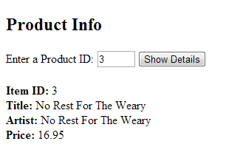
Ajax
The jQuery $.post() method loads data from the server using an HTTP POST request.
Syntax
  $.post(URL, {data}, function(data){…});
  $.post("myScript.php", {name:txt}, function(result) {
  $("span").html(result);
  });
ajax.php
Parameter | Description
URL | Required. Specifies the url to send the request to.
data | Optional. Specifies data to send to the server along with the request.
function(data) | Optional. Specifies a function to run if the request succeeds. data - contains the resulting data from the request
http://www.w3schools.com/jquery/ajax_post.asp

Slide 27

Ajax
show_product.php
<?php
$id = $_POST['id'];
mysql_connect("localhost", "omuser", "omuser") or die("Error connecting");
mysql_select_db("om") or die("Error selecting DB");
$query = "SELECT * FROM items WHERE item_id = $id";
$result = mysql_query($query);
if (mysql_num_rows($result) == 0) {
echo "Product ID $id not found.";
return;
}
$row = mysql_fetch_array($result);
echo "<strong>Item ID:</strong> {$row['item_id']}<br>";
echo "<strong>Title:</strong> {$row['title']}<br>";
echo "<strong>Artist:</strong> {$row['artist']}<br>";
echo "<strong>Price:</strong> {$row['unit_price']}<br>";
Get this from the Ajax call

Slide 28

Ajax
ajax.php
$('#show').click(function(){
var prodId = $('#id').val();
$.post(
"show_product.php",
{id:prodId},
function(result) {
$('#detail').html(result);
}
);
});
When the button is clicked
Get the text box value
Ajax POST
Name of the PHP script
The key/value to be passed
Update the "detail" div
With the output of the PHP script

