Slide 1
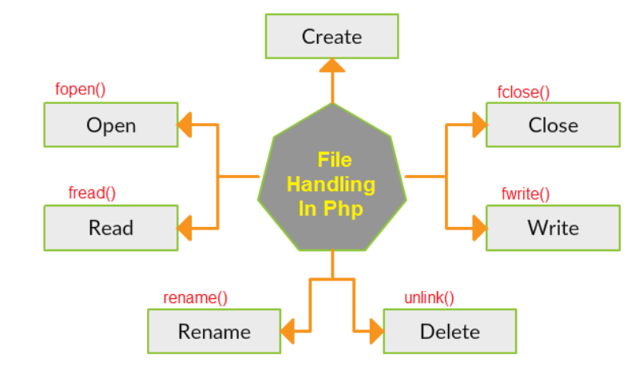
File Handling In PHP
PHP File System allows us to create a file, read file line by line, read file character by character, write a file, append file, delete a file and close file.

Slide 2
PHP Open File - fopen()
The PHP fopen() function is used to open a file.
Syntax
fopen(filename,mode,include_path,context)
Where:
filename is the name of the file or URL to open
mode is the mode in which to open the file. This can be one of the following:
'r': read only
'w': write only (truncates the file to zero length or creates a new file)
'a': append-only (opens the file for writing at the end of the file)
'x': exclusive write (creates a new file and opens it for writing only if it doesn't already exist)
'b': binary mode (used in conjunction with the above modes to indicate that the file should be opened in binary mode)
't': text mode (used in conjunction with the above modes to indicate that the file should be opened in text mode)
include_path is a boolean parameter that indicates whether to search for the file in the include path (if set)
context is an optional parameter that allows you to specify a context for the file stream (e.g. HTTP headers, SSL settings, etc.)

Slide 3
PHP Close File - fclose()
The PHP fclose() function is used to close an open file pointer.
Syntax
fclose(file)
Example:
    <?php
    $fp= fopen('sample.txt', 'r');
    echo fgets($fp);
    fclose($fp);
    ?>
Example:
<?php
$fp= fopen('sample.txt', 'r');
while(!feof($fp))
{
echo fgetc($fp);
}
fclose($fp);
?>
Note: Create “sample.txt” file

Slide 4
PHP Read File - fread()
  The PHP fread() function is used to read the content of the file. It accepts two arguments: resource and file size.
Syntax
fread(file,length)
Parameter Description
file Required. Specifies the open file to read from
length Required. Specifies the maximum number of bytes to read
Example 2: Read Entire file:
<?php
$file = fopen("sample.txt","r");
$fileContents =fread($file,
filesize("Sample.txt"));
echo $fileContents;
fclose($file);
?>
Example 1: Read 10 bytes from file:
<?php
$file = fopen("sample.txt","r");
$fileContents =fread($file,10);
echo $fileContents;
fclose($file);
?>

Slide 5
Write Files In PHP
  PHP fwrite() and fputs() functions are used to write data into file. To write data into a file, you need to use w, r+, w+, x, x+, c or c+ mode.
PHP Write File - fwrite()
  The PHP fwrite() function is used to write content of the string into file.
Syntax
    fwrite(file,string,length)

Slide 6
PHP Write File - fwrite() Example
<?php
    $fp = fopen("cse.txt", "w");
    fwrite($fp, "welcome");
    fwrite($fp, "to CSE 6th SEM SSS Lab");
    fclose($fp);
    echo "File written successfully";
?>
PHP Overwriting File
  <?php
  $fp = fopen("cse.txt", "w");
  fwrite($fp, "PHP File HANDLING OPERATIONS");
  fclose($fp);
  echo "File Overwriting successfully";
?>
PHP Append to File

Slide 7
PHP rename() Function
  The rename() function renames a file or directory.
  This function returns TRUE on success or FALSE on failure.
Syntax
    rename(oldname,newname,context)
Parameter Description
oldname Required. Specifies the file or directory to be renamed
newname Required. Specifies the new name of the file or directory
context Optional. Specifies the context of the filehandle. Context is a set of options that can modify the behavior of a stream
Example:
<?php
    rename("cse.txt","aiml.txt");
    echo "File Rename Successful";
?>

Slide 8
Delete Files In PHP
we can delete any file using unlink() function.
The unlink() function accepts one argument only: file name.
It is similar to UNIX C unlink() function.
PHP unlink() generates E_WARNING level error if file is not deleted.
It returns TRUE if file is deleted successfully otherwise FALSE.
Syntax
    bool unlink ( string $filename [, resource $context ] )
    unlink ("file name with directory path")
$filename represents the name of the file to be deleted.

Slide 9
//PHP Delete File Example
<?php
    $status=unlink("dataFile.txt");
    if($status)
    {
    echo "File deleted successfully";
    }
    else
    {
    echo "Opps Your File Not Delete !";
    }
?>

Slide 10
File Upload In PHP
PHP file upload features allow you to upload binary and text files both.
PHP $_FILES
  The PHP global $_FILES contains all the information of the file.
  With the help of $_FILES global, we can get the file name, file type, file
  size, temp file name and errors associated with the file.
$_FILES["filename"]["name“] :- returns file name.
$_FILES["filename"]["type“] :- returns MIME type of the file.
$_FILES["filename"]["size“] :- returns size of the file (in bytes).
$_FILES["filename"]["tmp_name“] :- returns temporary file name of the file
which was stored on the server.
$_FILES["filename"]["error“] :- returns error code associated with this file.

Slide 11
move_uploaded_file() function / Saving the Uploaded File
  The move_uploaded_file() function moves the uploaded file
  to a new location.
  The move_uploaded_file() function checks internally if the
  file is uploaded thorough the POST request.
  It moves the file if it is uploaded through the POST request.
Syntax:
bool move_uploaded_file ( string $filename , string $destination ) ;
move_uploaded_file ("Your File Name With Temp Name","Your Directory Path With Image Name")

Slide 12
fUpload.html
<html>
<head>
<title>File Upload Sample Program</title>
</head>
<body>
<form action="fUpload.php" method="post" enctype="multipart/form-data">
<center>
<h1>File Upload Sample Program</h1>
Select File:
<input type="file" name="fileUpload"/>
<input type="submit" value="Click here to Upload " name="submit"/>
</center>
</form>
</body>
</html>

Slide 13
fUpload.php
<?php
$target_dir = "C:/sss/";
$target_path = $target_dir.basename( $_FILES["fileUpload"]["name"]);
if(move_uploaded_file($_FILES["fileUpload"]["tmp_name"],$target_path))
{
echo "File uploaded successfully!";
}
else
{
echo "Sorry, file not uploaded, please try again!";
}
?>

Slide 14
Download File In PHP
  PHP enables you to download the file easily using a built-in readfile() function. The readfile() function reads a file and writes it to the output buffer.
PHP readfile() function
Syntax
int readfile ( string $filename [, bool $use_include_path = false [, resource $context ]] )
$filename: represents the file name
$use_include_path: it is the optional parameter. It is by default false. You can set it to true to the search the file in the included_path.
$context: represents the context stream resource.
int: it returns the number of bytes read from the file.

Slide 15
PHP Download File Example: Text File
<?php
$file_url = "C:/sss/file.txt";
header("Content-Type: application/octet-stream");
header("Content-Transfer-Encoding: utf-8");
header("Content-disposition: attachment; filename=\"".basename ($file_url)."\"");
readfile($file_url);
?>
fDownload1.php
PHP Download File Example: Binary File
<?php
$file_url = "C:/sss/file.txt";
header("Content-Type: application/octet-stream");
header("Content-Transfer-Encoding: Binary");
header("Content-disposition: attachment; filename=\"".basename ($file_url)."\"");
readfile($file_url);
?>
fDownload2.php

