Slide 1
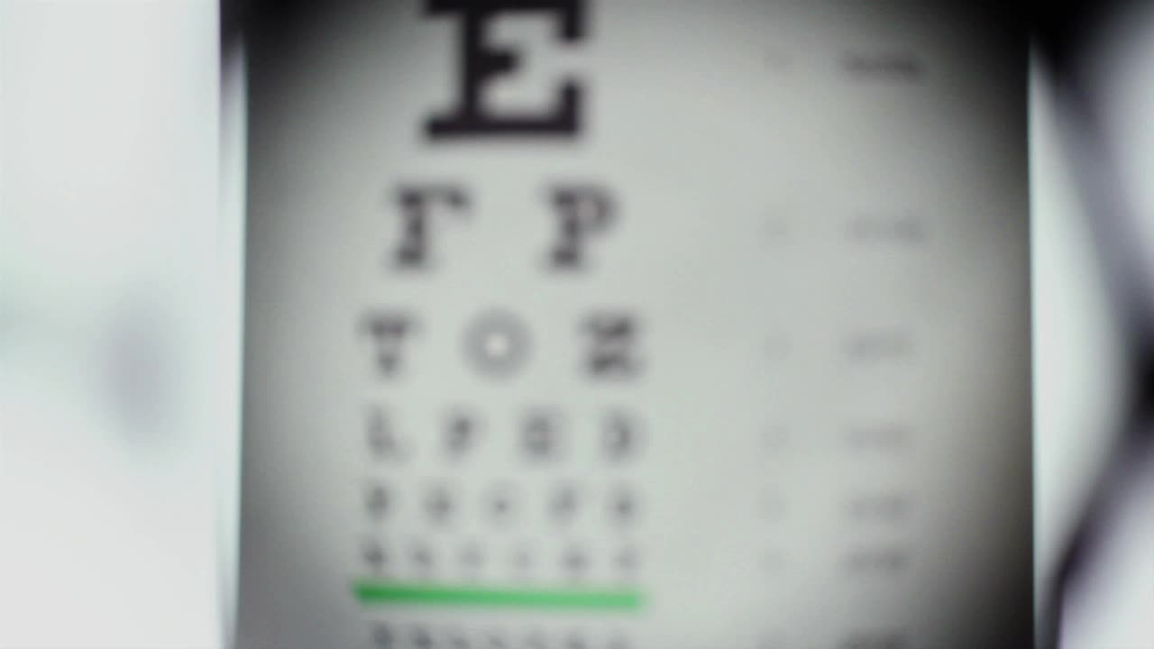
Facial Emotion Recognition using CNN
Presented By:
Ganesh
Vijaya
Jyotsna

Slide 2
Problem Statement & Motivation
Emotions are crucial for non-verbal communication
Automating facial emotion recognition helps in:
Mental health monitoring (e.g., detecting prolonged sadness)
Emotion-aware chatbots and virtual assistants
Smart classrooms for detecting engagement
Surveillance systems for detecting aggression or fear
Manual interpretation is subjective — we aim for an accurate and consistent CNN-based solution

Slide 3
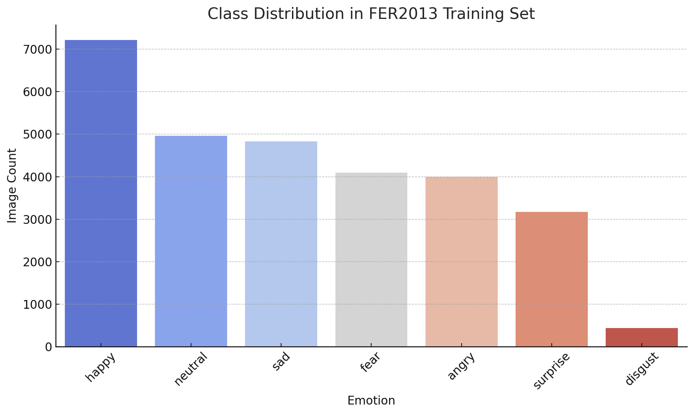
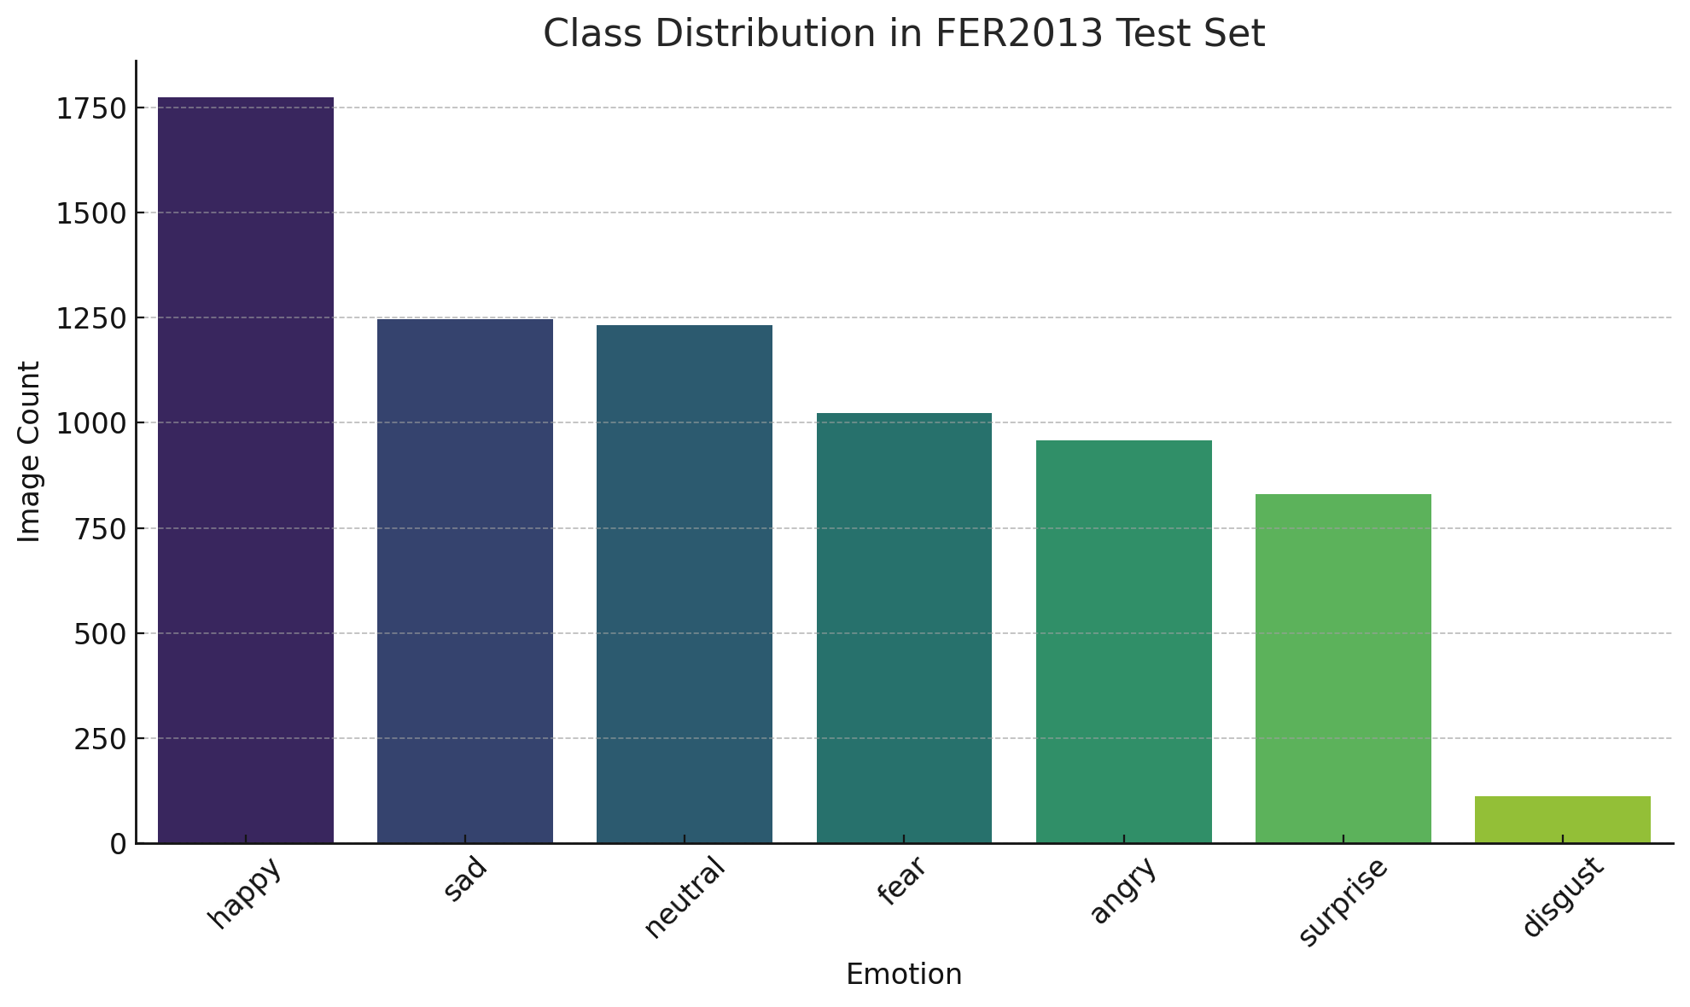
Dataset Overview – FER2013
Source: FER2013 on Kaggle
~35,887 images of size 48x48, grayscale
7 emotions:
Angry, Disgust, Fear, Happy, Sad, Surprise, Neutral
Provided in folder format (train/test)
Unbalanced classes → requires augmentation

Slide 4
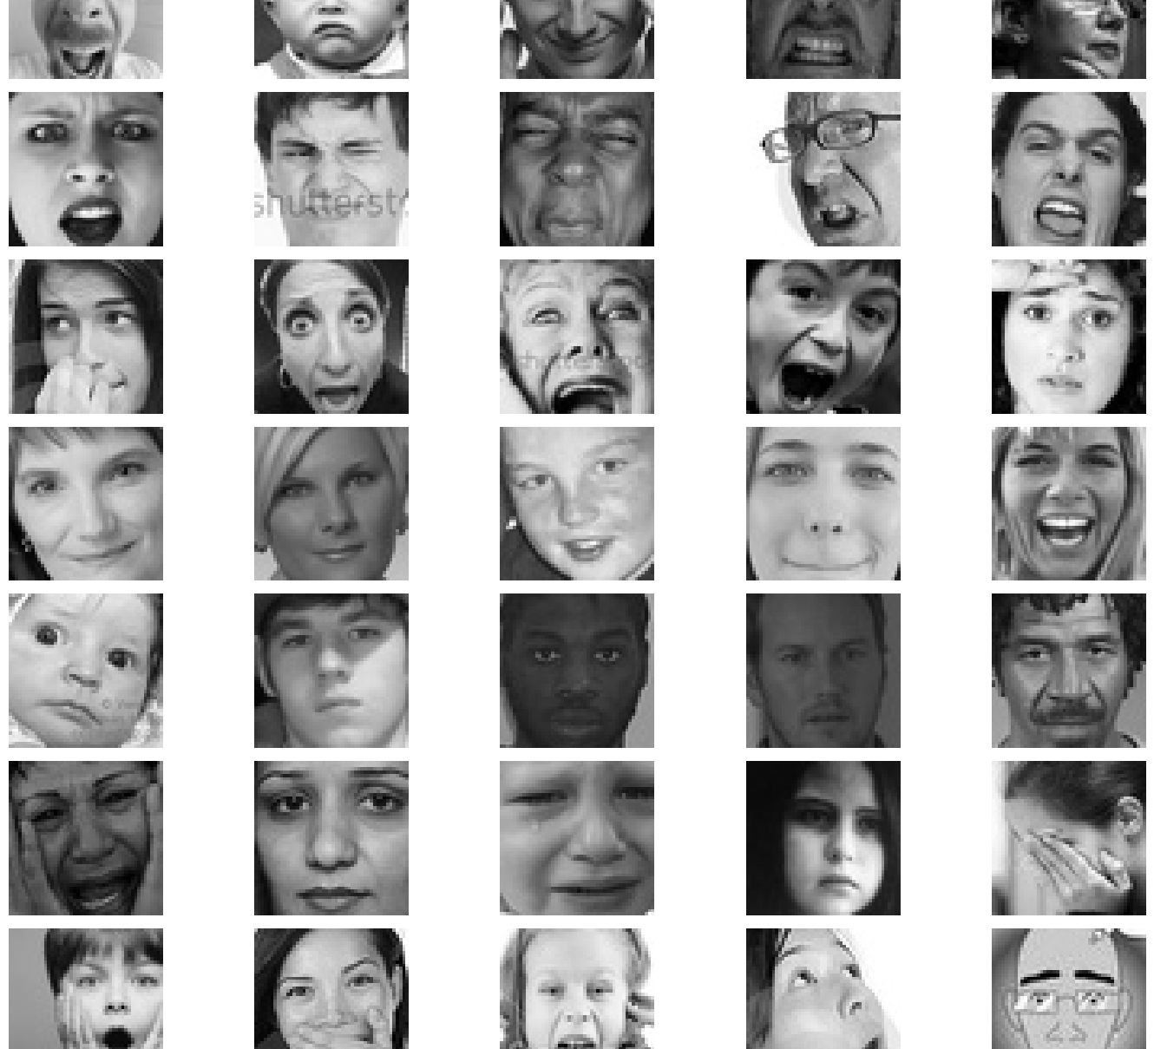
Data Handling
Steps:
Resize to 48×48
Normalize pixel values to [-1, 1]
Convert to tensors
Augmentation Techniques:
Random horizontal flips
Random rotations (future work)
Dataloader: Used torchvision.datasets.ImageFolder

Slide 5
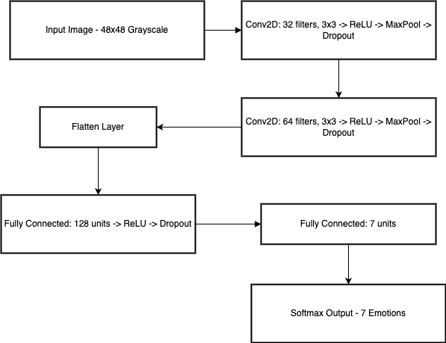
CNN Architecture
Custom CNN with 2 convolutional blocks:
Conv → ReLU → MaxPool → Dropout
Fully connected layer for classification
Input: 1×48×48 grayscale image
Output: 7-class softmax logits
Regularization: Dropout (0.25 and 0.5)
No pretrained models used

Slide 6
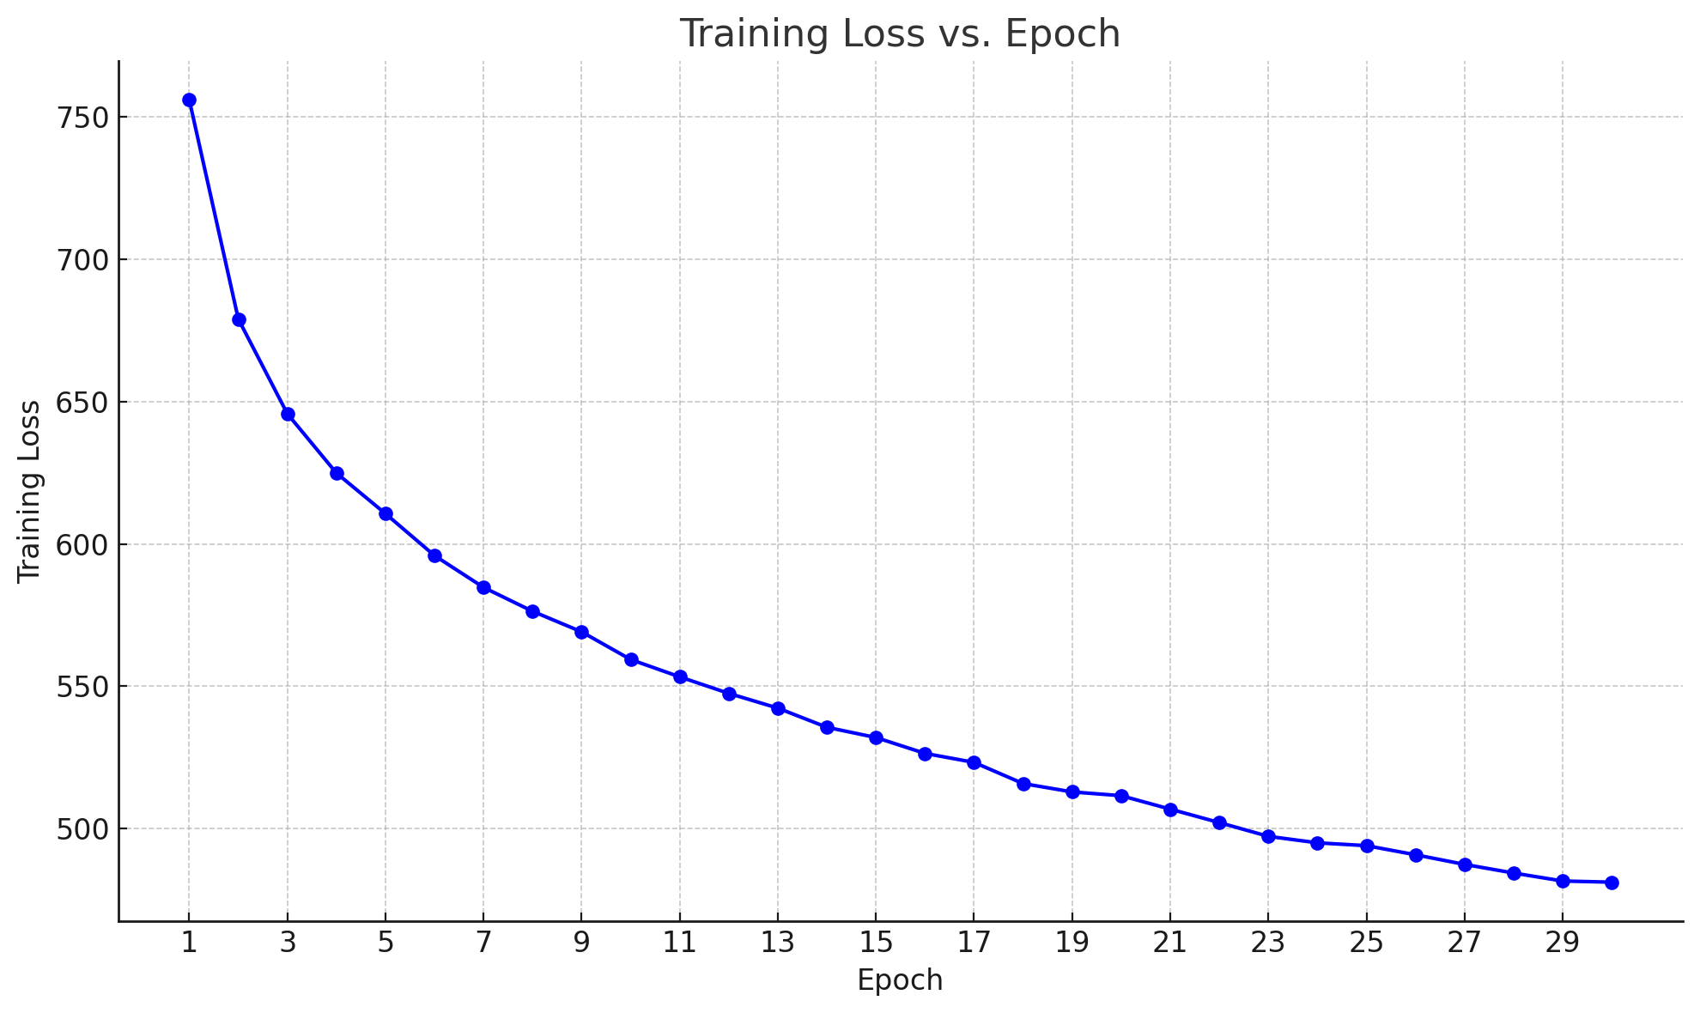
Training Pipeline
Loss Function: CrossEntropyLoss
Optimizer: Adam (lr = 0.001)
Batch Size: 64
Epochs: 30
Train/Val split: 80/20 using ImageFolder
Trained on: Local system (mention CPU/GPU if used)
Used tqdm for progress visualization

Slide 7
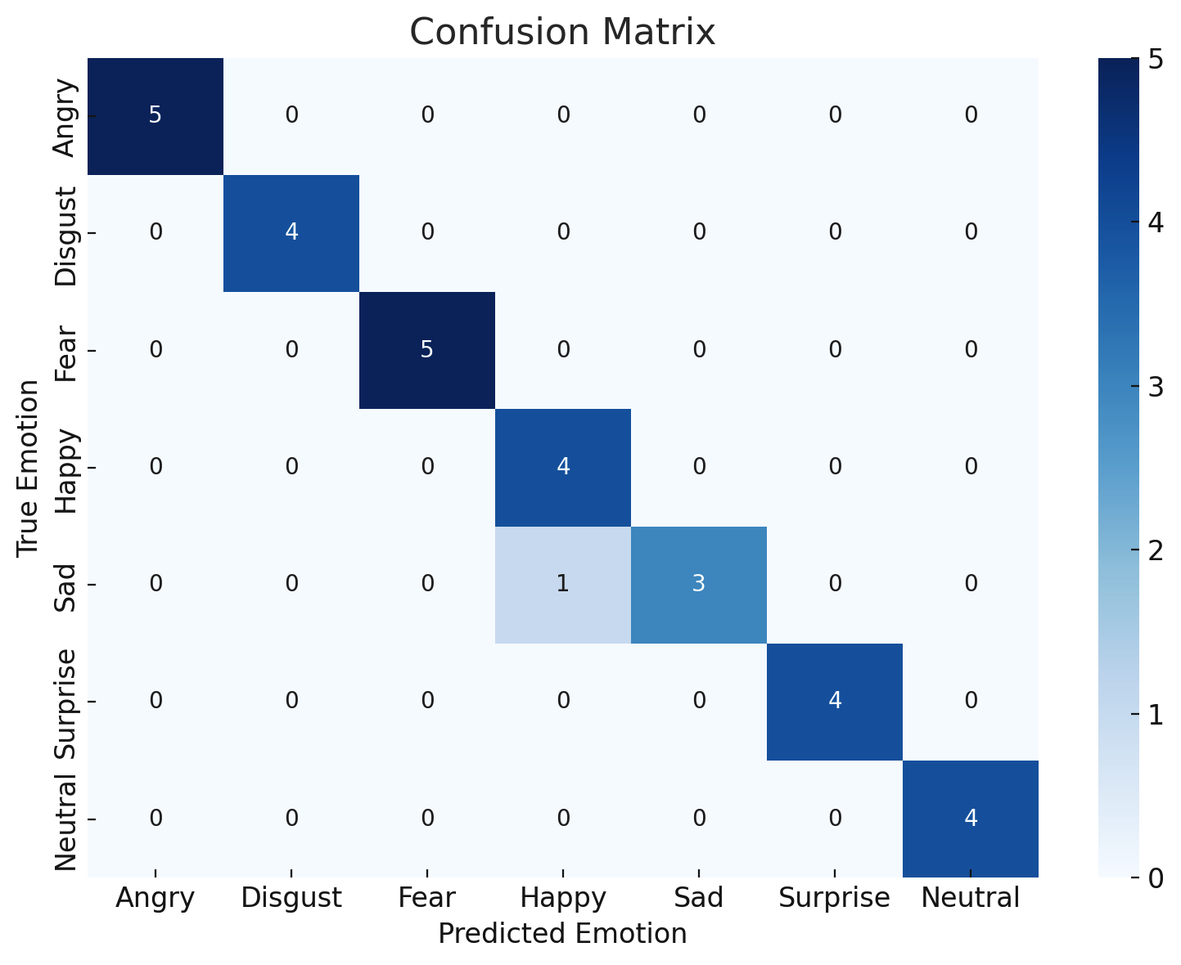
Metrics & Performance
Achieved 96.67% accuracy on test set
Metrics:
Precision, Recall, F1-score (per class)
Confusion matrix shows strong performance on “Happy”, weaker on “Disgust”
High F1 on dominant classes like “Surprise” and “Neutral”

Slide 8


Model Demo – Real Image Prediction
Input image from demo/sample_face.jpg
Output: Predicted Emotion → Fear
Uses trained model checkpoint (best_model.pth)
Fast inference (~<0.5s per image)
Supports grayscale webcam images (future scope)

Slide 9
Where Can This Be Used?
Applications:
Emotion-aware chatbots
Online learning platforms (detect confusion or engagement)
Healthcare systems for mood tracking
Driver fatigue detection systems
Future Enhancements:
Use ResNet18 or MobileNetV2 for better accuracy
Real-time webcam emotion detection
Add audio-based emotion detection (multimodal)
Train with larger, more diverse datasets

Slide 10
Summary & Acknowledgments
Summary:
Built a CNN for facial emotion recognition from scratch
Used FER2013 dataset (preprocessed, trained, validated)
Achieved real-time demo on local machine
Delivered a modular, well-documented codebase
Contribution:
Ganesh: Model, tuning, training
Vijaya: Preprocessing, EDA, evaluation
Jyotsna: GitHub, final report, video & slides

