Slide 1

Desktop Voice Assistant Using Python
-Guided by Amol bhosle
Name : Ganesh Madhav Karode

Slide 2
Outline
Aim and Introduction
Problem statement
Working
Objectives
Literature survey
Methodology and Requirements of the project
Screenshots of working and conclusion

Slide 3
Aim
The purpose of the project is to develop an Desktop application that provides an intelligent voice assistant with the functionalities as calling services, message transformation, location services, music play service, checking weather, searching engine (Google, Wikipedia), camera, Bing translator, Bluetooth headset support, help menu in different languages.

Slide 4
Introduction
A virtual assistant is a technology based on artificial intelligence. The software uses a device’s microphone to receive voice requests while the voice output takes place at the speaker. But the most exciting thing happens between these two actions.
It is a combination of several different technologies: voice recognition, voice analysis and language processing.
It is completely developed using one of the most powerful language python.

Slide 5
Problem Statement
This system is designed to be used efficiently on desktops. Personal assistants software improves user productivity by managing routine tasks of the user and by providing information from an online source to the user.
This project was started on the premise that there is a sufficient amount of openly available data and information on the web that can be utilized to build a virtual assistant that has access to making intelligent decisions for routine user activities.

Slide 6
Objectives of the project
virtual assistant can play music for user.
virtual assistant can do Wikipedia searches for user.
virtual assistant is capable of opening websites like Google, Youtube, etc., in a web browser.
virtual assistant is capable of opening user code editor or IDE with a single voice command.
Users Can give audio signal in different available language option which is converted into digital data that can be analyzed by the software.

Slide 7
How does an intelligent personal assistant work?
User asks a personal assistant to perform a task.
The natural language audio signal is converted into digital data that can be analyzed by the software.
Compared with a database of the software using an innovative algorithm to find a suitable answer.
This database is located on distributed servers in cloud networks. For this reason ,it must have a reliable Internet connection.

Slide 8
Literature Survey
Sr. no. | Title | Link | Author and Publication on | Abstract
1 | Comparing speech recognition systems.(Microsoft API, Google API And CMU Sphinx) | link | Veton Këpuska, Gamal Bohouta. March 2017. | The idea of this paper is to design a tool that will be used to test and compare commercial speech recognition systems, such as Microsoft Speech API and Google Speech API, with open-source speech recognition systems such as Sphinx-4. The best way to compare automatic speech recognition systems in different environments is by using some audio recordings that were selected from different sources and calculating the word error rate (WER).

Slide 9
2 | Real conversations with artificial intelligence: A comparison between human–human online conversations and human–chatbot conversations | link | Jennifer Hill ,W. Randolph Ford Ingrid G.Farreras. August 2015 | This study analyzed how communication changes when people communicate with an intelligent agent as opposed to with another human. They compared 100 instant messaging conversations to 100 exchanges with the popular chatbot Cleverbot along seven dimensions: words per message, words per conversation, messages per conversation, word uniqueness, and use of profanity, shorthand, and emoticons.
3 | An Empirical Investigation of Voice-Activated Personal Assistant | link | A. Abdolrahmani, Ravi Kuber, Stacy M. Branham Oct 2018. | In this paper explains about the design and implementation of a digital assistance and built using open-source software modules. And this nature of this project makes more flexible and adding additional features of without disturbing current system functionalities. It is works on human commands and also give responses to the user based of query being asked.

Slide 10
4 | Voice assistant . | – | Algoufi May 2016. | In this paper provides overview of voice-recognition and contextual understanding between users and human interaction. And it frequently asks the questions to the voice assistant it will be answering all the queries. And all the assistants responded these questions and answered more accurately.
5 | Exploring requirements and opportunities of conversational user interfaces for the cognitively impaired. | – | B. R. H. F. Balduf M. Mar 2018. | In this paper overview of the various PARI design technology it provides especially for blind persons and works on their voice command. The PARI also providing more capability of recognizing the voice commands without using internet connection. And it also provides more functionalities for mobile devices like network connection and managing their various application on the voice commands.

Slide 11
6 | Automatic speech recognition application. | – | Mr.D. T August 2018 | In this paper provides overview of personal assistant and natural language interaction to the user device and the co-ordination range of job assistants. The architecture explains about the communication between the agents and the agent-based approach. The agent approach provides a high degree of modularity and domain independent aspects.
7 | Using voice assistant Skills. | – | Y. D. Yulli. Oct 2019. | In this paper the author proposed the solving the problem of voice-recognition technology and he will conclude the future there will be center the attraction on implementation of application which provides a greater number of language options also the application is useful for physically disabled and every common user.

Slide 12
Proposed Methodology
1. Speech recognition :The proposed system used the google API to convert input speech into text. The speech is given as an input to google cloud for processing, As an output, the system then receives the resulting text.
2. Backend work :At backend the python gets the output from speech recognition and after that it identifies whether the command is a system command or a browser command. The output is send back to python backend to give desired output to user.
3. Text to speech :Text to speech, or TTS, is a new wave technique of for transforming voice commands into readable text. Not to mix it up with VR Systems that instead, generate speech by joining strings gathered in an exhaustive DB of preinstalled text and have been developed for different goals which form full-fledged sentences, clauses or meaningful phrases through a dialect's graphemes and phonemes. Such systems have their limits as they can only determine text on the basis of pre-determined text in their databases TTS systems, on the other hand, are practically to "read" strings of characters and dole out resulting sentences, clauses and phrases.

Slide 13
Proposed Architecture
The system design consists :
1. Taking the input as speech patterns through microphone.
2. Audio data recognition and conversion into text.
3. Comparing the input with predefined commands
4. Giving the desired output
The initial phase includes the data being taken in as speech patterns from the microphone.in the second phase the collected data is worked over and transformed into textual data using NLP. In the next step, this resulting stringified data is manipulated through Python Script to finalise the required output process. In the last phase, the produced output is presented either in the form of text or converted from text to speech using TTS.

Slide 14
Features
The System shall be developed to offer the following features:
1) It keeps listening continuously in inaction and wakes up into action when called with a particular predetermined functionality.
2) Browsing through the web based on the individual’s spoken parameters and then issuing a desired output through audio and at the same time it will print the output on the screen.
Other useful services such as playing any kind of media, browsing weather forecasts, setting, reminders, shut down computer, sending an Email etc. Are provided as a result of spoken commands.

Slide 15
Requirements
Software requirements
Pycharm IDE/visual studio code
Pyinstaller
Python 3.8.2 and its Sub modules
Hardware requirements
Intel core i3 and above.
4gb RAM
30 Gb Hard drive space

Slide 16
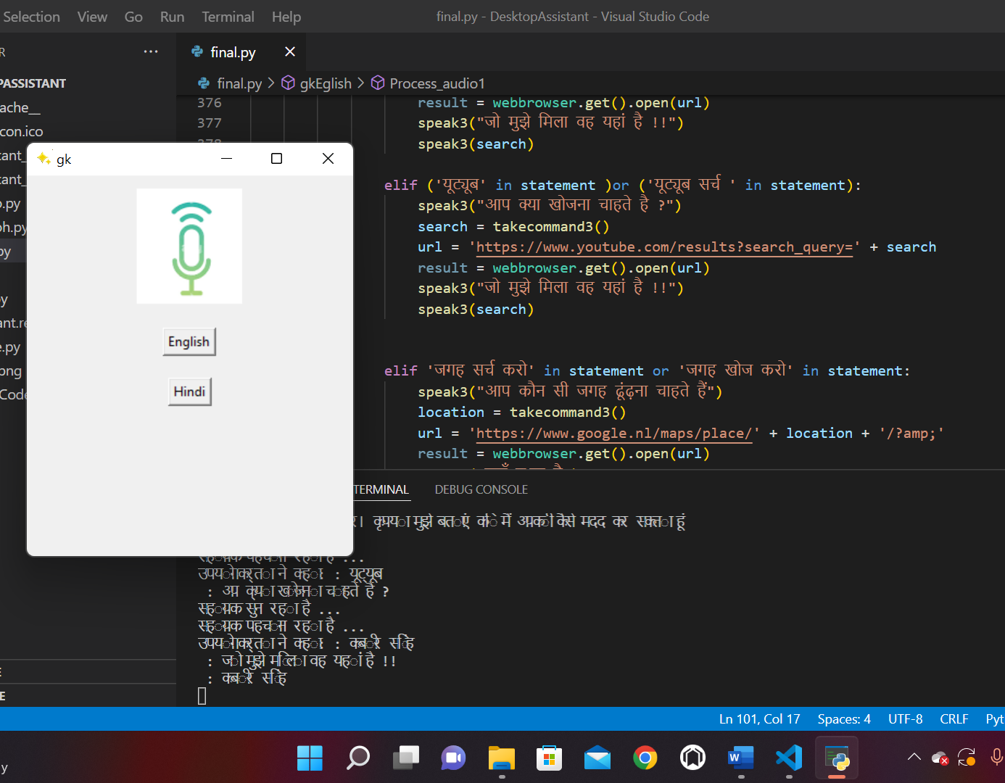
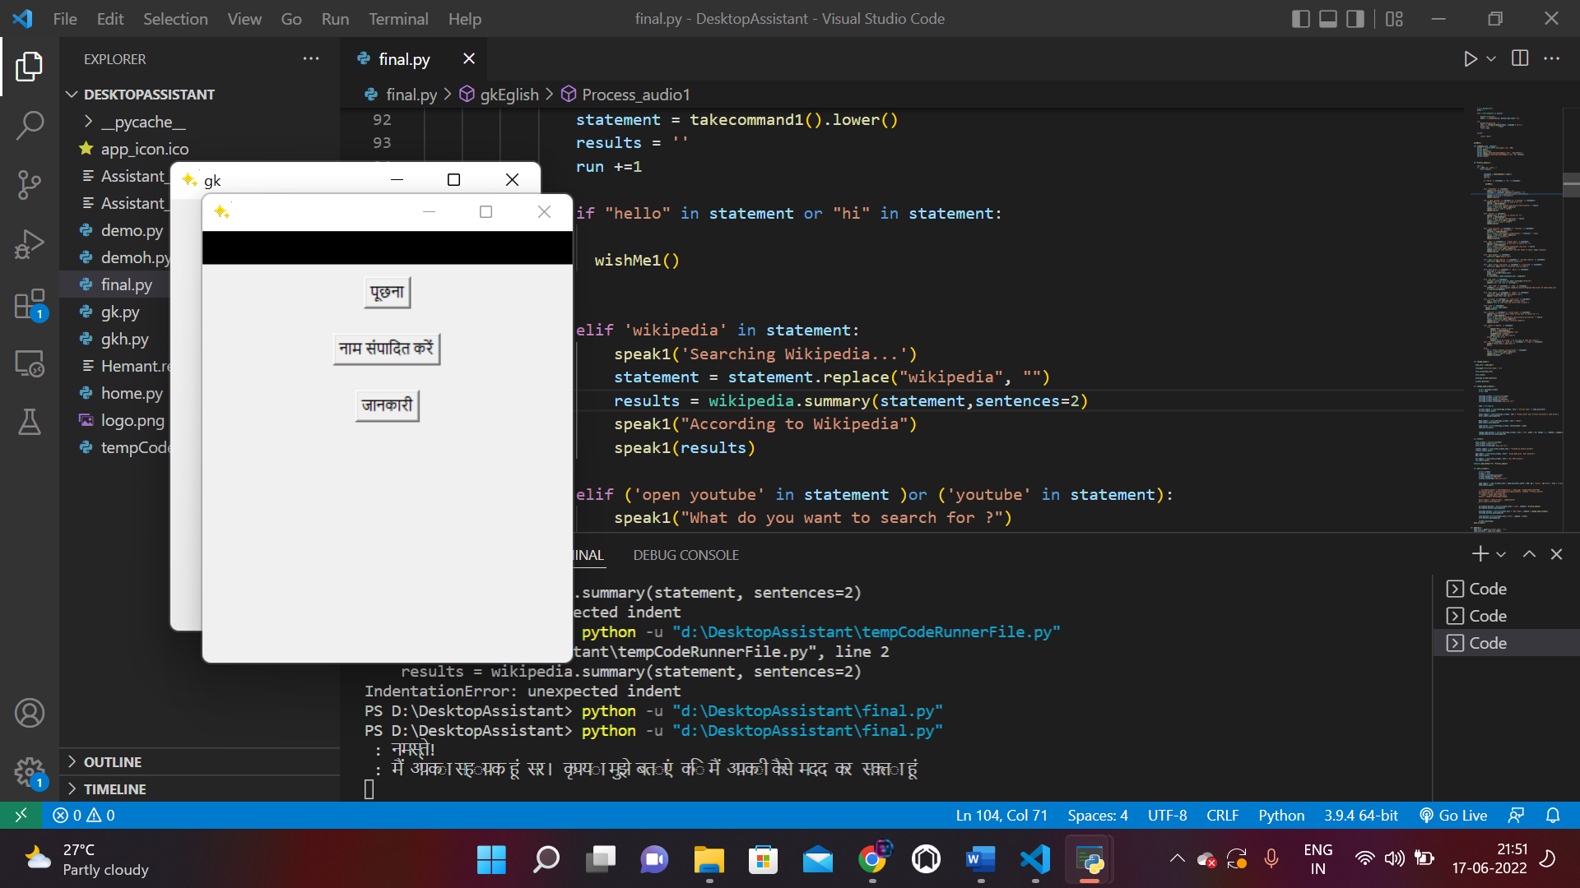
Screenshots of working

Slide 17
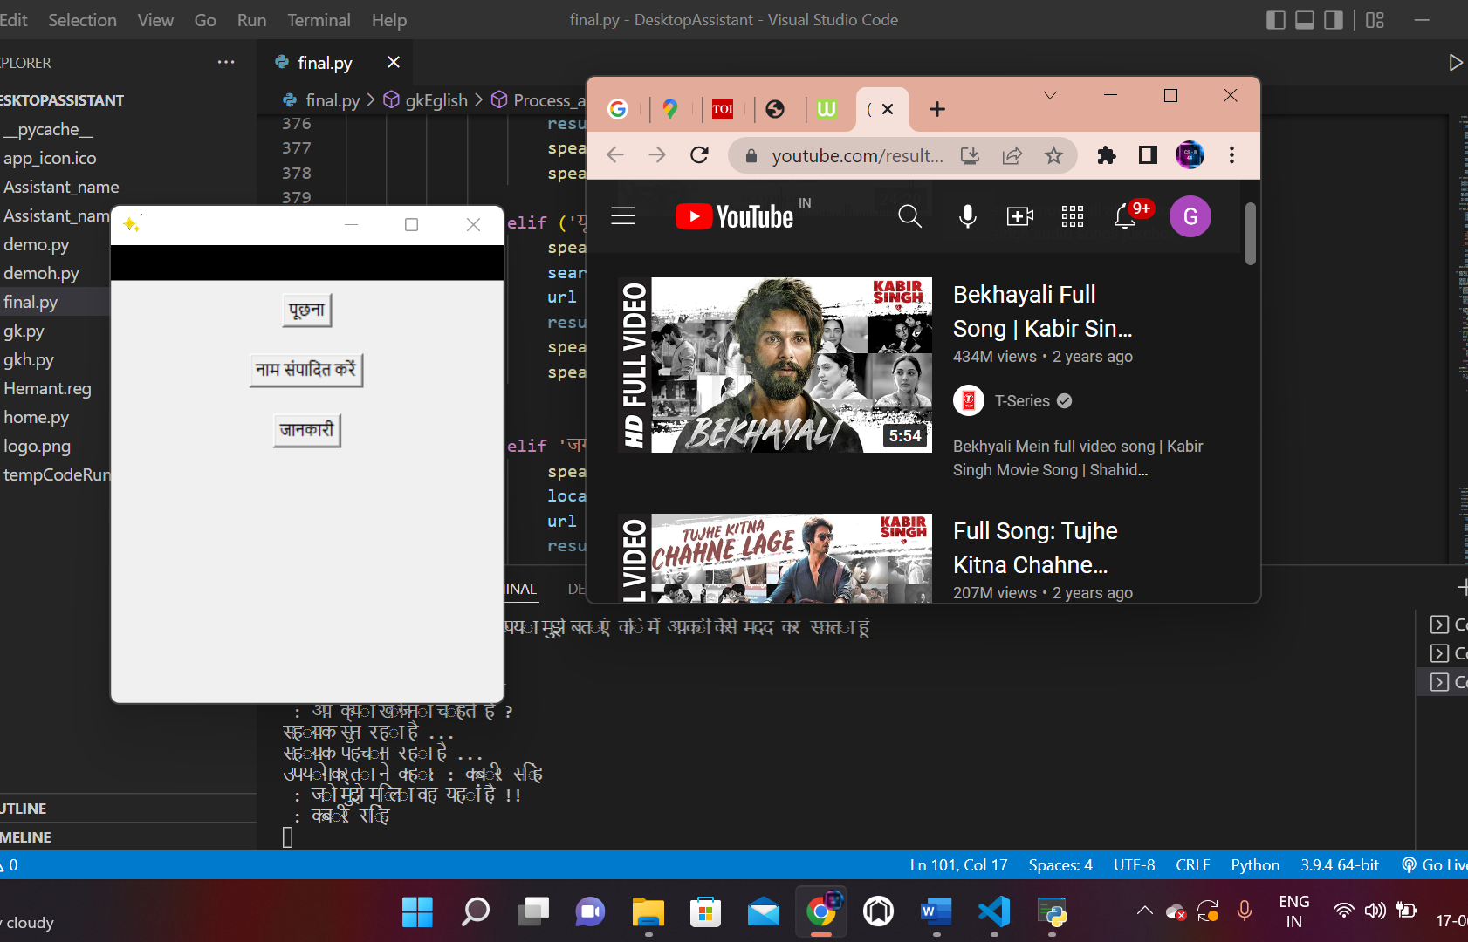
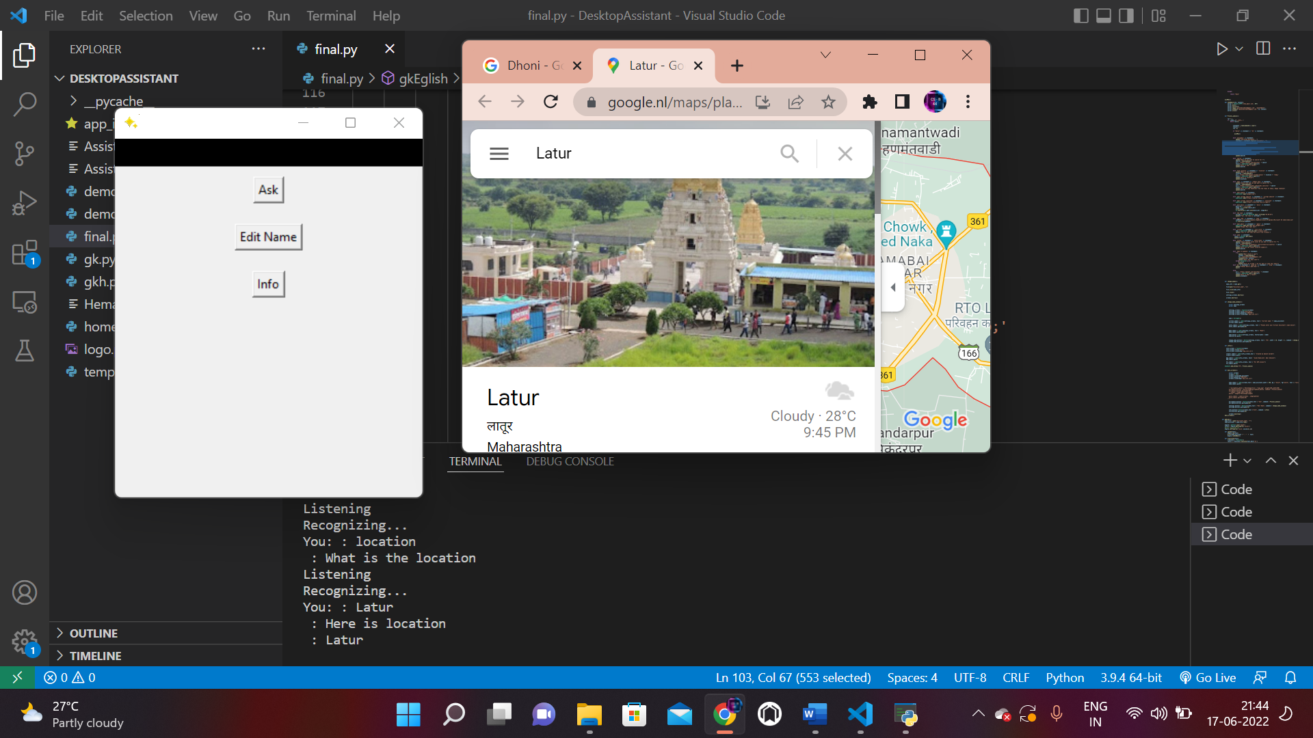
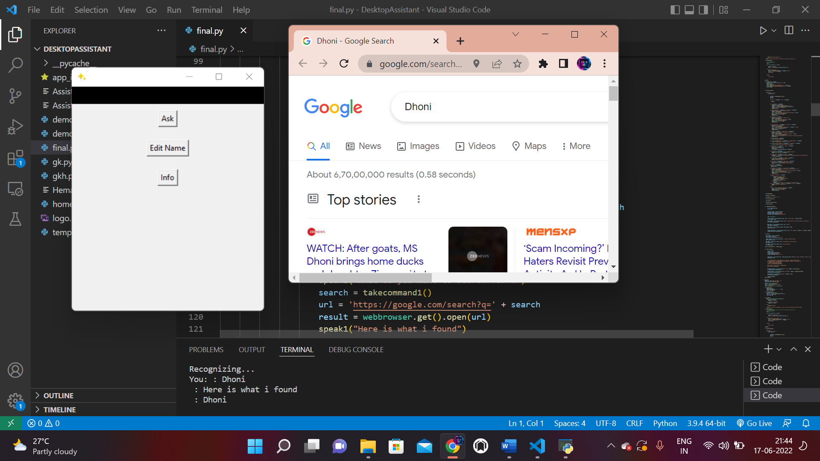
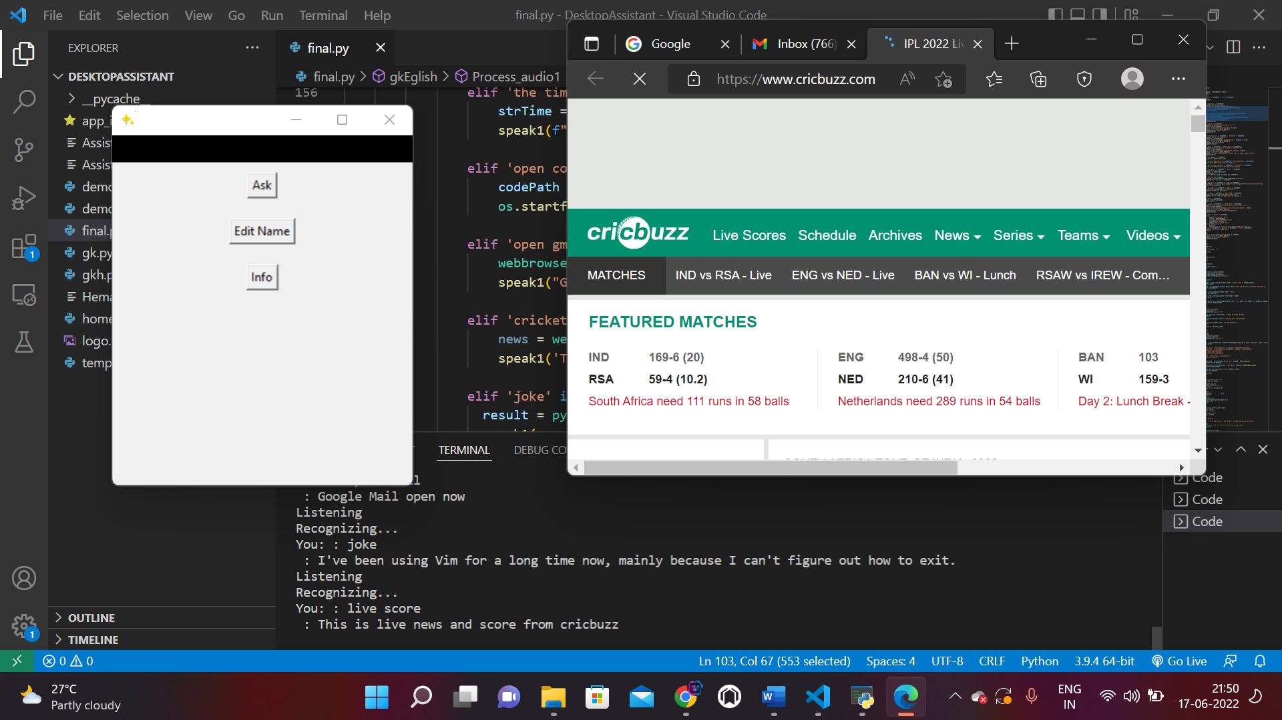

Slide 18
Conclusion
Voice Controlled Personal Assistant System will use the Natural language processing and can be integrated with artificial intelligence techniques to achieve a smart assistant that can control the computer and applications and even solve user queries using web searches.. It can be designed to minimize the human efforts to interact with many other subsystems, which would otherwise have to be performed manually. By achieving this, the system will make human life comfortable

Slide 19
References
[1] V. G.Bohouta, "Comparing speech recognition systems," International journal,
2017.
[2] J. F. Hill, "Real conversations with arti+cial intelligence," International journal,
2015.
[3] A., R. Abdolrahmani, "An empirical investigation of voice activated personal assistant," In proceedings of the 20th international ACM SIGACCESS conference on computers and accessibility, 2018.
[4] Algoufi, "Voice assistant," World journal of education, 2016.
[5] B. R. H. F. Balduf M, "Exploring requirements and opportunities of conversational user interfaces for the cognitively impaired," 20th International conference, 2018.
[6] D. T, "Automatic speech recognition application," International journal, 2018.
[7] Y. D. Yulli, "Using voice assistant Skills," International journal, 2019.

Slide 20
THANK YOU!

