Slide 1
Online Organic Health Food Store website using Django
Guide : Prof Abha Marathe
Name :Ganesh Madhav Karode

Slide 2
INDEX: -
Introduction
Problem Statement
Literature survey
Modules
Result
Conclusion
References

Slide 3
Introduction
Organic food products and other organic ingredients are grown without the use of pesticides, synthetic fertilizers, sewage sludge, or ionizing radiation.
Conventional fruits and vegetables are often sprayed with pesticides. When you buy such fruits and vegetables, these stubborn chemicals remain on the food.
The second big difference between conventional and organic food is that many conventional foods are genetically modified or contain genetically modified organisms.
Organic food is not easily available in the market. There are only some particular shops where organic food is available. To overcome this difficulty I am going developed a organic food shopping website.

Slide 4
Problem statement
Organic food is not easily available in the market. There are only some particular shops where organic food is available. E-commerce is a process of doing business through computer network.
Online shopping is a form of electronic shopping store where the buyer is directly online to the seller’s computer usually via the internet.
To overcome the difficulty of organic food shopping. I have proposed a best online organic store which provides organic foods by just sitting at home and follows E-commerce mode of shopping.
This system has two modules namely, Admin and Customers. Admin has authority to add organic food list on the website, view products uploaded, view customers and view the customer’s order. Customers can register and login using credentials. Customers has authority to view products, desire products and can add to cart and do payment for it, they can view their previous order history and also can track their order.

Slide 5
Literature Survey
SR. NO | Author(s) and Year | Explanation of Study | Important Feature Examined in the Study
1 | Khurana, A. and Mehra, J. (2015) | E-commerce opportunities and challenges | The concept of ecommerce, ecommerce scenario in India, and opportunities and various challenges in e-commerce
2 | Bhalekar , P., Ingle, S. and Pathak, K. (2014) | Study of ecommerce | Benefits and limitations of ecommerce
3 | Belkhamza, Z. and Wafa, S. (2014) | E-commerce impact on global market | Global influence of e-commerce and its benefits
4 | Dan, C. (2014) | Electronic commerce | Discussed the historical and current activities in e- commerce process

Slide 6
Modules
The system comprises of 2 major modules with their sub-modules . In online Food Ordering System Features for Admin Side.
Dashboard – For the admin dashboard, you will be able to all the basic access in the whole system. Such as cart items orders, items, users and categories.
Manage Items– The admin has access to the item management information system. He can add, update and delete the items.
Manage Orders – As the main functions of the admin, the admin can reject or accept from the customers on a case to case basis.
Manage Categories – For the categories, the admin has the features of managing the category. The example category used in this system is best selling foods, spicy, and new foods.
Manage Users – The admin can manage the user’s account. Admin can add, update and delete users in the system.
Login and Logout – By default one of the security features of this system is the secure login and logout system.

Slide 7
Modules
The frontend of this Online Food Ordering System using Django has these basic features of the website.
Home Page – On the home page, you can see directly the list of foods for sale, login, logout, .
Viewing Products – by default on the frontend, the customer can automatically view all the foods, the price and description of foods.
Checkout Order – The customer can checkout order in the frontend that can confirmed by the admin in the backend.
Login and Logout – The customer need to login in the system before they can add to cart their orders and they can also logout after they finish their order.
Sign up – the customer need to register or sign up first before they can login into the system.
Add to Cart– One of the features of this system is that, wherein the customer can temporarily add their order in the add to cart.

Slide 8
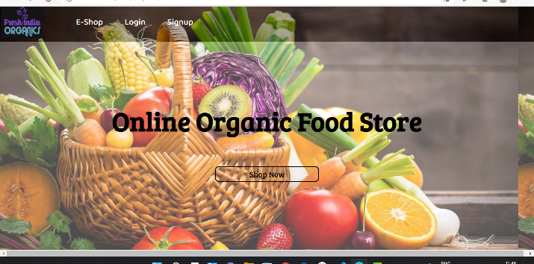
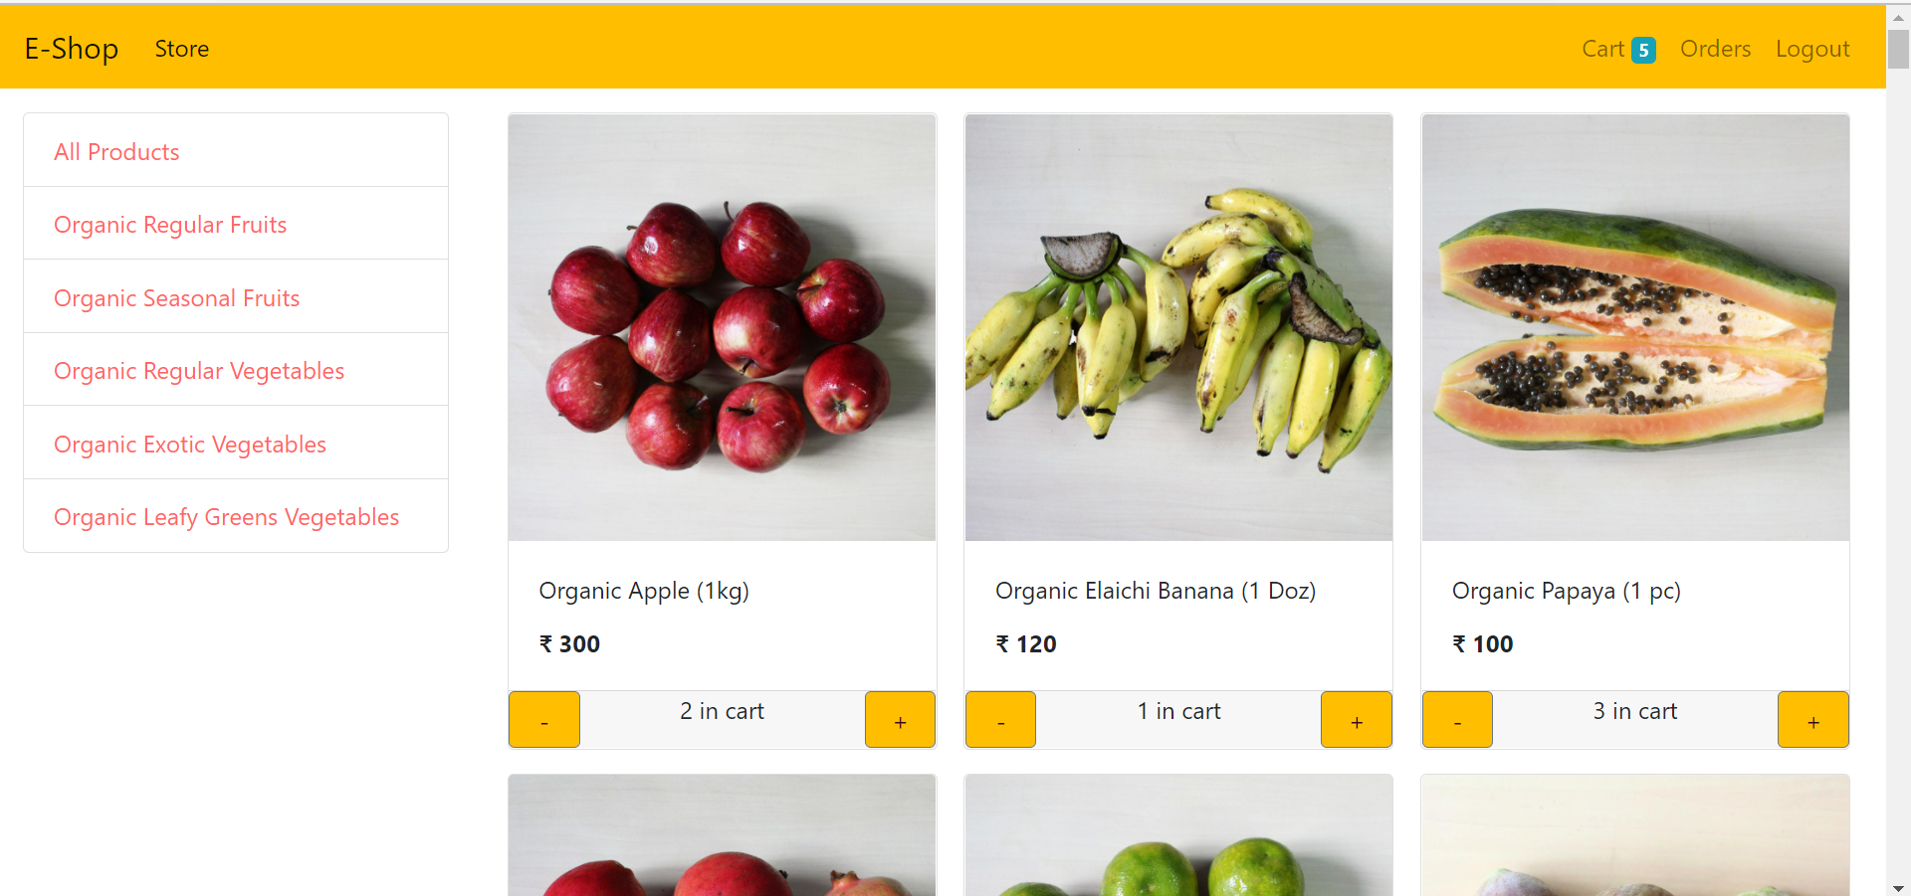
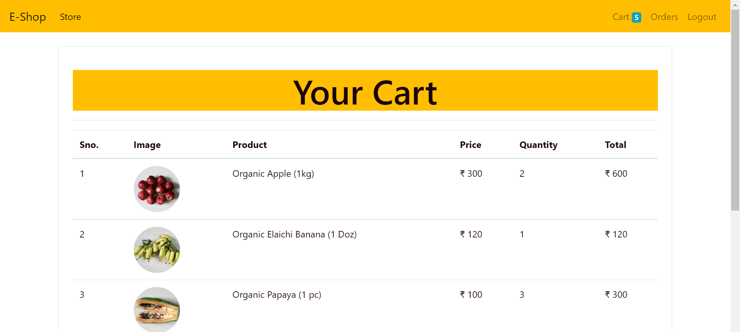
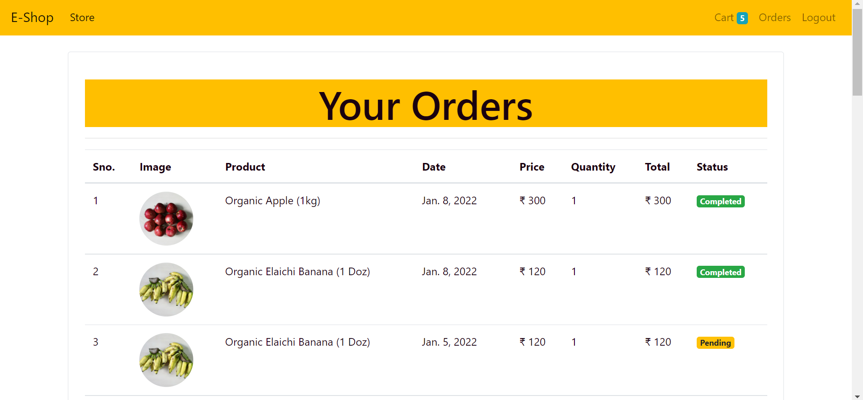
Result
User module:

Slide 9
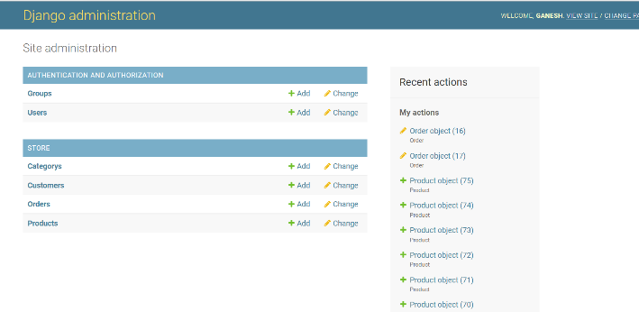
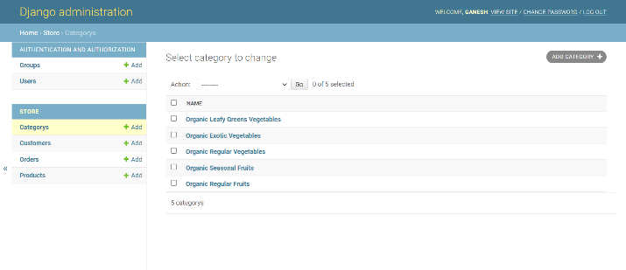
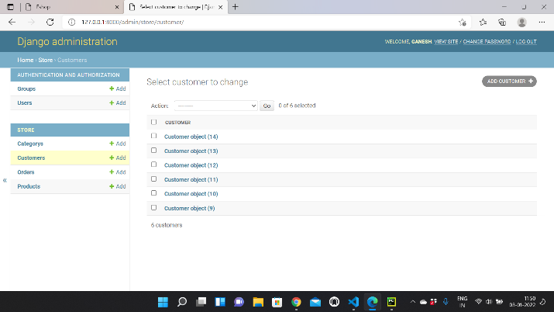
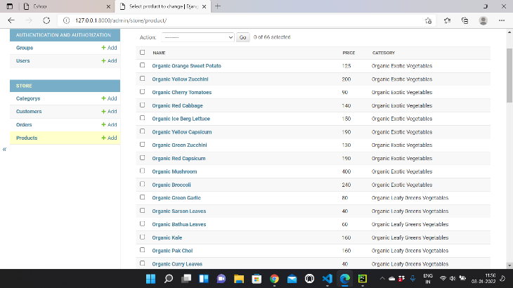
Result
Admin module:

Slide 10
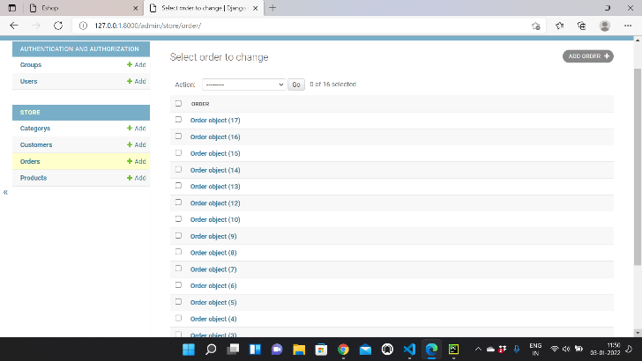
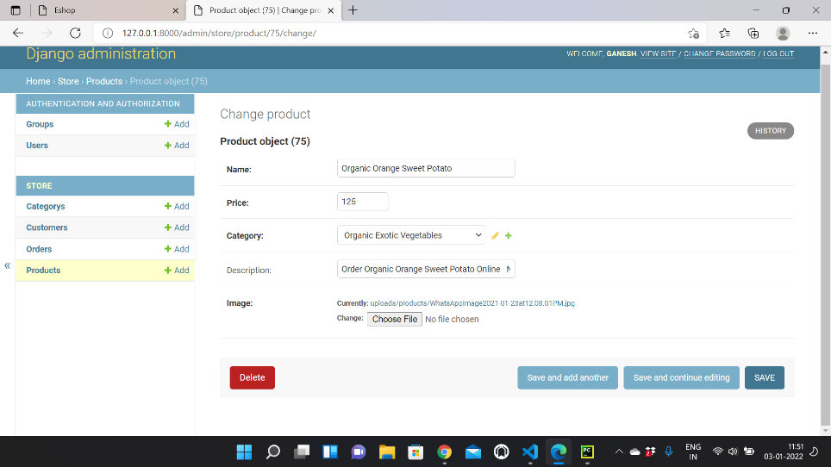
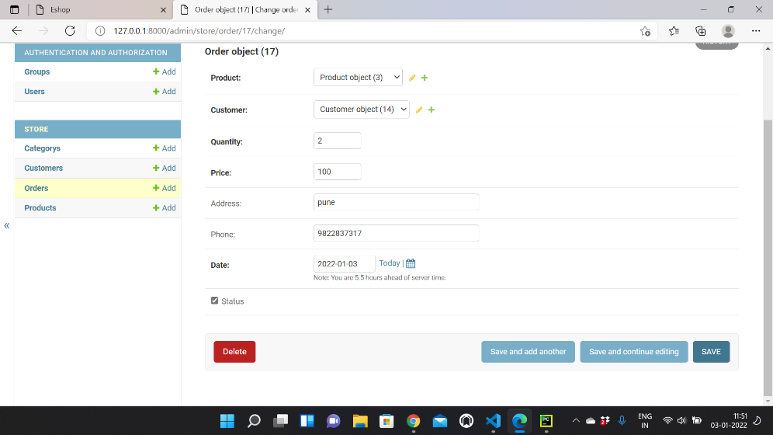
Result

Slide 11
conclusion This website provides an electronic version of the store cheating system that will benefit users and the store visitor. It makes the whole process online where users can search for a product, and purchase a variety of products. It also has a general user location by logging into the system where the user can log in and view the status of the ordered item and request items. It provides an administrator access point where administrators can add a variety of items, review user activity and add information about various customer events.

Slide 12
References 1.Khurana, A. and Mehra, J. (2015) ‘E-commerce: Opportunities and challenges.’ The International Journal Of Business & Management . 2.Bhalekar, P., Ingle, S. and Pathak, K. (2014) ‘The study of ecommerce.’ Asian Journal of Computer Science And Information Technology. 3.Belkhamza, Z. and Wafa, S. (2014) ‘The role of uncertainty avoidance on E-commerce acceptance across cultures.’ International Business Research. 4.Dan, C. (2014) ‘Electronic commerce: State-of-the-art.’ American Journal of Intelligent Systems.

Slide 13
Thank you

