Slide 1
Linux Process Management
28-Feb-2025

Slide 2
What is a process?
A process is an instance of a computer program being executed using code and instructions
Each process uses system resources like CPU and RAM to complete the specific tasks

Slide 3
Process Descriptors
The kernel maintains info about each process in a process descriptor, of type task_struct.
  See include/linux/sched.h
  Each process descriptor contains info such as run-state of process, address space, list of open files, process priority etc…

Slide 4
struct task_struct {
volatile long state; /* -1 unrunnable, 0 runnable, >0 stopped */
unsigned long flags; /* per process flags */
mm_segment_t addr_limit; /* thread address space:
0-0xBFFFFFFF for user-thead
0-0xFFFFFFFF for kernel-thread */
struct exec_domain *exec_domain;
long need_resched;
long counter;
long priority;
/* SMP and runqueue state */
struct task_struct *next_task, *prev_task;
struct task_struct *next_run, *prev_run;
...
/* task state */
/* limits */
/* file system info */
Contents of process descriptor
/* ipc stuff */
/* tss for this task */
/* filesystem information */
/* open file information */
/* memory management info */
/* signal handlers */
...
};

Slide 5
Process State
Consists of an array of mutually exclusive flags*
  *at least true for 2.2.x kernels.
  *implies exactly one state flag is set at any time.
state values:
  TASK_RUNNING (executing on CPU or runnable).
  TASK_INTERRUPTIBLE (waiting on a condition: interrupts, signals and releasing resources may “wake” process).
  TASK_UNINTERRUPTIBLE (Sleeping process cannot be woken by a signal).
  TASK_STOPPED (stopped process e.g., by a debugger).
  TASK_ZOMBIE (terminated before waiting for parent).

Slide 6
Process Identification
Each process, or independently scheduled execution context, has its own process descriptor.
Process descriptor addresses are used to identify processes.
  Process ids (or PIDs) are 32-bit numbers, also used to identify processes.
  For compatibility with traditional UNIX systems, LINUX uses PIDs in range 0..32767.
Kernel maintains a task array of size NR_TASKS, with pointers to process descriptors. (Removed in 2.4.x to increase limit on number of processes in system).

Slide 7
Several dozen fields
Dozens of separate items of information are kept in a Linux ‘task_struct’; e.g.:
  pid; // process ID-number
  state; // current task-state
  priority; // current task-priority
  start_time; // time when task was created
  sleep_time; // time when task began sleeping
  . . . // … many more items …
This info is used by the Linux ‘scheduler’

Slide 8
state-transition diagram
UNINTERRUPTIBLE
INTERRUPTIBLE
RUNNING
create
event
schedule
signal
wait
preempt
CPU
signal
terminate
STOPPED
ZOMBIE

Slide 9
A process needs ‘resources’
Each task may acquire ownership of some system resources while it is executing
For example, a task needs to use some system memory (code, data, heap, stack)
And a task typically needs to read or write to some disk-files or to peripheral devices
Usually a task will want to call subroutines which belong to a shared runtime library
Every task needs to use some CPU time

Slide 10
The OS is a ‘resource manager’
Sometimes a task is temporarily granted ‘exclusive’ access to a system resource (e.g., each task has its own private stack)
But often a task will be allowed to ‘share’ access to a system resource (e.g., many processes call the same runtime libraries)
Acquisition of resources by a task is kept track of within the task’s ‘task_struct’

Slide 11
Examples: memory and files
The ‘task_struct’ record has fields (named ‘mm’ and ‘files’) which hold pointers to OS structures (‘mm_struct’ and ‘files_struct’) that describe the particular memory-areas and files which the task currently ‘owns’
task_struct
mm_struct
mm
files
files_struct

Slide 12
Backgrounrd & Foreground Processes
A foreground process is any process which is not continuously running and it waiting on something like user input
A background process is something that is continually running and does not require any additional input
Can someone name examples of each?

Slide 13
Moving a Process to the Background
When executing commands on the command line, there is usually some output that is displayed on the terminal
If you move a process to the background, the output will not be shown

Slide 14
Background Process Example
Usually, when you download a file from the command line, the status is displayed on the terminal
To move a process to the background all you have to do is add an ampersand (&) at the end of the command
wget <URL> &
Now this will be moved to the background

Slide 15
Moving back to the Foreground
To move a process back to the foreground, use the following steps:
Use the jobs command to identify the job number of the background process
Then use the fg command to bring it back with the following syntax
fg [job number]

Slide 16
How do Processes Actually Work?
In the Unix operating environment, processes are created by a method called “forking”
Forking is when the OS duplicated a process
The original process is called the parent process
And the new process is the child process

Slide 17
Different Types of Processes
There are four types of processes:
  Running: current process that is being executed in the operating system
  Waiting: process which is waiting for system resources to run
  Stopped: process that is not running
  Zombie: process whose parent processes has ended, but the child process is still in the process table

Slide 18
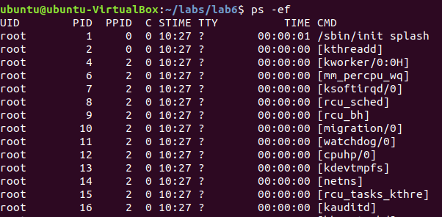
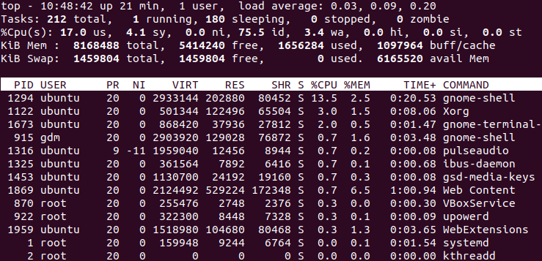
Viewing Processes
Two commands you can use to view the process from the command line: ps and top
To view all the processes with ps, use ps -ef
ps -ef
top

Slide 19
Ending a Process In Linux
Sometimes you need to end a program or process from the command line. Use the following steps:
  Locate the process id [PID] of the process/program you want to kill
  Use the kill command with the following syntax: kill [PID]
  If the process is still running, do the following: kill -9 [PID]
  The -9 is a SIGKILL signal telling the process to terminate immediately

Slide 20
Ending All Process
You can use the killall command to kill multiple processes at the same time
Syntax: killall [options] PIDs
Or you can use pkill –u [username] to kill all processes started by [username]

Slide 21
Walk-through of /proc filesystem

Slide 22
The /proc filesystem
The /proc filesystem (also called the procfs) is a virtual filesystem in Linux that provides a mechanism to access kernel and process information in real time. It is mounted at /proc and does not contain actual files but rather kernel-generated information.
Key Features of /proc
Virtual Filesystem: It is not stored on a disk but dynamically generated by the kernel.
Real-Time Information: Provides up-to-date information about processes and system performance.
Interface to Kernel Data Structures: Used for retrieving and modifying kernel parameters.
User & Kernel Space Interaction: Allows processes to communicate with the kernel.

Slide 23
File | Description
cmdline | Command-line arguments of the process
cwd | Symlink to the process's current working directory
environ | Environment variables of the process
exe | Symlink to the executable file of the process
fd/ | Directory containing file descriptors opened by the process
status | General information about the process (state, memory, etc.)
stat | Detailed process statistics (CPU time, memory usage, etc.)
limits | Resource limits for the process
Process-Specific Directories (/proc/<PID>/)
Each running process has a directory named after its Process ID (PID).
/proc/1/ → Information about process with PID 1 (usually init or systemd).
/proc/self/ → Represents the current process accessing it.
Common Files in /proc/<PID>/

Slide 24
System-Wide Information (/proc/ Top-Level Files)
File | Description
/proc/cpuinfo | Detailed information about the CPU
/proc/meminfo | Memory usage statistics
/proc/uptime | System uptime (time since last boot)
/proc/loadavg | System load averages
/proc/partitions | List of recognized partitions
/proc/mounts | Mounted filesystems information
/proc/filesystems | Supported filesystems
/proc/net/ | Network-related details (interfaces, connections)
/proc/sys/ | Kernel tunable parameters (modifiable via sysctl)

Slide 25
Kernel Configuration (/proc/sys/)
This allows runtime configuration of the kernel parameters.
/proc/sys/kernel/ → General kernel settings (e.g., hostname, pid_max).
/proc/sys/vm/ → Virtual memory settings (swappiness, dirty_ratio).
/proc/sys/net/ → Networking settings (ipv4, ipv6, firewall tuning).
/proc/sys/fs/ → Filesystem settings (file-max, inode-max).

