Slide 1
Managing Services and Daemons

Slide 2
Linux systemd: Managing and Monitoring Services
What to learn:
- Why are services in Linux required to be managed?
- What is systemd, its features and advantages over previous methods.
- Understanding systemd in detail.
- Best Practices.

Slide 3
What are Services in Linux?
Definition: A service is a background process that runs continuously or on demand to provide system functionality.
Examples of services:
sshd – Secure Shell server
cron – Task scheduler
nginx / apache2 – Web server
mysqld – Database server
Why Manage Services?
- Ensure essential system components are always running
- Automate service startup and recovery
- Optimize resource usage and system performance
- Improve security by controlling unwanted services
Notes:
How are Services Managed in Linux?
Linux services were traditionally managed by SysVinit (older init system) but are now primarily managed by systemd, which provides:
Faster service startup with parallel execution.
Better dependency management.
Automatic service recovery and logging.

Slide 4
Introduction to systemd
What is systemd?
  A modern init system that manages system startup, services, and dependencies.
  systemd provides parallel execution, dependency management, and monitoring.
Key Features:
  Boot process orchestration – It initializes system components and services.
  Service management – Starts, stops, and monitors background services.
  Dependency resolution – Ensures services start in the correct order.
  Logging and monitoring – Provides built-in logging with journalctl.
Notes:
systemd-analyze plot > unit_chain.svg

Slide 5
Understanding systemd Units
What is a Unit?
A configuration file that defines how a system resource behaves.
Common Unit Types:
.service – Manages system services (e.g., nginx.service)
.target – Defines boot stages (e.g., multi-user.target)
.mount – Manages mount points
.timer – Alternative to cron jobs
.socket – Listens for network connections
Unit File Locations:
/etc/systemd/system/ (User-defined or custom services)
/lib/systemd/system/ (Default system services)

Slide 6
Managing Services with systemctl
Starting and Stopping Services:
systemctl start <service>
systemctl stop <service>
Enabling and Disabling Services:
systemctl enable <service>
systemctl disable <service>
Checking Service Status:
systemctl status <service>
Restarting Services:
systemctl restart <service>
Checking if a Service is Enabled at Boot:
systemctl is-enabled <service>

Slide 7
Service Monitoring & Logging
Viewing Logs with journalctl:
journalctl -u <service>
Filtering logs:
Logs from the last: journalctl --since "1 hour ago"
Logs from a specific boot session: journalctl -b -1
Following logs in real time (like tail -f):
journalctl -u <service> -f

Slide 8
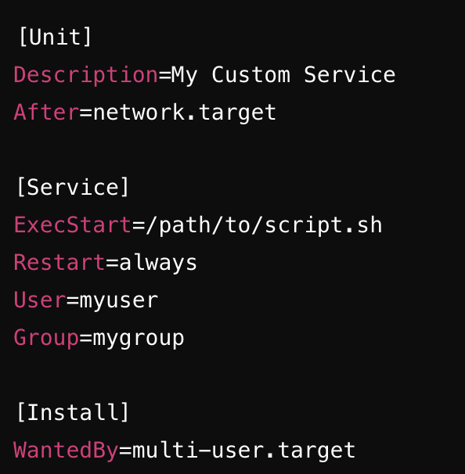
Creating Custom systemd Services
Create a service file:
sudo vim /etc/systemd/system/myapp.service
Add the following content:
Reload systemd:
systemctl daemon-reload
Enable and start the service:
systemctl enable --now myapp.service

Slide 9
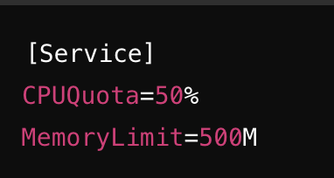

System Performance & Resource Limits
Controlling CPU and Memory Usage:
Limiting I/O Priority:

Slide 10
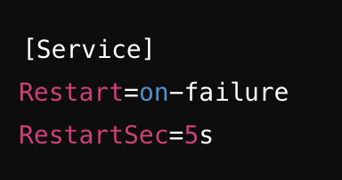
Troubleshooting & Debugging Services
Checking for Failed Services:
systemctl list-units --failed
Investigating a Service Failure:
journalctl -xe
Automatically Restarting a Service on Failure:

Slide 11
Best Practices
Use systemctl for managing services efficiently.
Monitor logs with journalctl for troubleshooting.
Define custom services using unit files.
Set resource limits for better performance and security.
Automate service recovery using “Restart=“ options.

Slide 12
Secure Remote Access in Linux

Slide 13
Introduction to OpenSSH
What is OpenSSH?
- Open-source implementation of the Secure Shell (SSH) protocol.
- Provides encrypted remote login, file transfers, and tunneling.
Why is SSH important?
- Secure remote administration of Linux servers.
- Prevents password sniffing and man-in-the-middle attacks.
- Supports authentication, encryption, and port forwarding.

Slide 14
Installing OpenSSH
Check if OpenSSH is already installed
ssh -V
Install based on the OS falvour
apt install openssh-server (debian)
yum install openssh-server (RHEL)
pacman -S openssh (Arch Linux)
Enable and start the service
systemctl enable --now ssh

Slide 15
Basic SSH Usage
Connecting to a remote server:
ssh username@remote_host
Specifying a custom port:
ssh -p 2222 username@remote_host
Running a single command remotely:
ssh username@remote_host "uptime"
Copying files with scp:
scp file.txt username@remote_host:/destination/path/

Slide 16
Configuring OpenSSH Server (sshd_config)
Location of SSH configuration file:
/etc/ssh/sshd_config
Some common configuration opetions:
Port
PermitRootLogin
AllowUsers
PasswordAuthentication
Restarting SSH after changes:
systemctl restart sshd

Slide 17
Securing SSH with Key-Based Authentication
Key-based authentication in SSH is a more secure way to log into a remote system without using passwords. Instead of entering a password every time, your computer uses a pair of cryptographic keys to prove your identity.
Generating an SSH key pair:
ssh-keygen -t ed25519 -C "your_email@example.com"
Copying the public key to the remote server:
ssh-copy-id username@remote_host
Manually adding the key to ~/.ssh/authorized_keys:
cat ~/.ssh/id_rsa.pub >> ~/.ssh/authorized_keys
chmod 600 ~/.ssh/authorized_keys
Disabling password authentication (only allowing key-based authentication):
PasswordAuthentication no

Slide 18
Understanding PKI (Public Key Infrastructure)
Public Key Infrastructure (PKI) is a framework that provides a secure way to encrypt, authenticate, and verify digital communications using cryptographic keys. It is widely used in SSH, HTTPS, digital signatures, and secure emails to ensure data integrity, confidentiality, and authentication.
PKI is built around asymmetric encryption, which uses two types of cryptographic keys:
🔑 Public Key – This key is shared with others and is used for encryption or signature verification.
🔒 Private Key – This key is kept secret and is used for decryption or signing messages.
Together, these keys enable secure communication and authentication without exposing private credentials.

Slide 19
PKI in SSH Authentication
SSH also benefits from PKI principles:
The public key is stored on the remote server (~/.ssh/authorized_keys).
The private key is stored on the client and never shared.
When connecting, the client proves ownership of the private key, eliminating the need for passwords.
This makes SSH login more secure and resistant to brute-force attacks.
Further Reading: Authentication, Encryption, Integrity, PKI Handshake

Slide 20
Enhancing SSH Security
Changing the default SSH port to something other than 22
Limiting SSH access to specific IPs
Using Fail2Ban to prevent brute-force attacks
Setting idle timeout for sessions
Setting Up Multi-Factor Authentication (MFA) with SSH

Slide 21
Using SSH Tunneling and Port Forwarding
Use cases:
- Securely accessing internal web apps.
- Bypassing firewalls.
Local port forwarding (Access remote service locally):
ssh -L 8080:localhost:80 username@remote_host
Remote port forwarding (Expose local service to a remote server):
ssh -R 9000:localhost:3000 username@remote_host
Dynamic SOCKS proxy:
ssh -D 8080 username@remote_host

Slide 22
Monitoring and Logging SSH Access
Checking active SSH connections:
- who
- netstat -tnpa | grep sshd
Reviewing SSH authentication logs:
- journalctl -u sshd --since "1 hour ago”
Detecting failed login attempts:
- cat /var/log/auth.log | grep "Failed password"

Slide 23
Best Practices for SSH Security
Always use SSH key authentication instead of passwords.
Use stronger encryption in ssh key generation
As a user, never share private key unless you know what you are doing. Only share public key if asked for (.pub)
Change the default SSH port.
Restrict access with firewall rules (e.g., UFW or iptables).
Regularly audit SSH logs for suspicious activity.

