Slide 1
Effect of NPK Levels on Growth & Yield of Field Bean | UAS, GKVK Bengaluru
UNIVERSITY OF AGRICULTURAL SCIENCES, BENGALURU
College of Agriculture, GKVK, Bengaluru – 560065
Department of Agronomy
RESEARCH REPORT
"Effect of Different Levels of Nitrogen, Phosphorus and Potassium on Growth and Yield of Field Bean"
Course: EAT 421- Application of AI/ML in Agriculture
Submitted by:
Darshan Gouda Patil (BMB2015) Ganesh M K (AMB2073)
Ramkumar B P (AMB2209)
Submitted to: Course Teacher AI/ML in Agriculture
COA,UAS(B),Bengaluru
Kharif Season 2024

Slide 2
Effect of NPK Levels on Growth & Yield of Field Bean | UAS, GKVK Bengaluru
Abstract
A field experiment was conducted during the Kharif season of 2024 at the Zonal Agricultural Research Station (ZARS), GKVK, Bengaluru, on red sandy loam soil of medium NPK fertility status. The study aimed to evaluate the effect of different levels of Nitrogen (N), Phosphorus (P) and Potassium (K) on the growth and yield of field bean (Lablab purpureus L.) variety HA-4.
The experiment was laid out in a Randomized Complete Block Design (RCBD) with five treatment levels of NPK
— 0%, 25%, 50%, 75% and 100% of the Recommended Dose of Fertilizers (RDF) — replicated four times, on a gross plot size of 1m × 1m. Crop was sown on 15 September 2024 at a spacing of 45 × 15 cm and harvested on 4 January 2025.
Results revealed a clear positive response to increasing NPK levels. Treatment T5 (100% RDF: 5.434 g urea + 31.2 g SSP + 4.16 g MOP per plot) recorded the highest plant height (29.3 cm at 30 DAS; 57.0 cm at 60 DAS), maximum number of branches at 60 DAS (7.8), highest number of pods per plot (70.50), and maximum pod weight per plant (24.03 g). Treatment T3 (50% RDF) recorded the highest leaf area and number of leaves. The study concludes that 100% RDF is most effective for optimizing growth and yield in field bean under dryland conditions in the Eastern Dry Zone of Karnataka.
Keywords: Field bean, Lablab purpureus, NPK, RCBD, Recommended Dose of Fertilizer, Growth parameters, Yield parameters, Kharif 2024

Slide 3
Effect of NPK Levels on Growth & Yield of Field Bean | UAS, GKVK Bengaluru
1. Introduction
Field bean (Lablab purpureus L.), belonging to the family Fabaceae, is one of the most important leguminous vegetables cultivated in India and South-East Asia. It is believed to be of Asian origin and has been under cultivation since ancient times. Wild forms are widely found across India, making it one of the oldest cultivated crops in the Indian subcontinent. In Karnataka, field bean is grown either as a sole crop or intercropped with cereals such as finger millet, groundnut, and sorghum.
The crop is valued both as a vegetable and a grain legume. Immature green pods are rich in protein, minerals, and vitamins, making them an essential component of the subsistence farming diet. The dry seeds are used as dal, while the biomass serves as fodder and green manure. Despite its nutritional and agronomic significance, field bean suffers from low productivity due to inadequate fertilizer application and lack of optimized management practices.
Nitrogen (N) is an essential constituent of proteins, chlorophyll, nucleotides, phosphatides, alkaloids, enzymes, hormones, and vitamins. It imparts dark-green colour to plants, promotes rapid early growth, and improves symbiotic nitrogen fixation capacity. Phosphorus (P) is a key component of nucleic acids and plays a vital role in stimulating root growth and increasing nodule activity in legumes. Potassium (K) regulates osmotic potential, activates enzymes, and improves overall plant metabolism and stress tolerance.
Given the critical roles these macronutrients play in crop growth, it is essential to identify the optimum dose of NPK for field bean to maximize productivity under the Eastern Dry Zone conditions of Bengaluru. The present experiment was therefore conducted to study the effect of five graded levels of NPK (0%, 25%, 50%, 75% and 100% RDF) on the growth and yield of field bean variety HA-4 during Kharif 2024.

Slide 4
Effect of NPK Levels on Growth & Yield of Field Bean | UAS, GKVK Bengaluru
Review of Literature
Effect of Nitrogen on Field Bean
Jaisankar and Manivannan (2016) reported that the application of nitrogen at 40 kg/ha and 60 kg/ha significantly increased plant height (95.45 cm), number of leaves (75.04), and pod yield (8.93 t/ha) in field bean. These findings demonstrate that nitrogen is critical for vegetative development and production.
Hazra and Som (1999) reported that increasing nitrogen supply substantially improved vegetative biomass accumulation and pod productivity in Dolichos bean, emphasizing the role of nitrogen in chlorophyll synthesis and metabolic enzyme activity. Further work by Chin Anshuk Ghosh (2014) confirmed that nitrogen at 200% of RDF produced the highest plant height (86.88 cm), number of leaves (66.52), number of branches (8.98), leaf area index (5.95), and chlorophyll content (1.52) in field bean.
Effect of Phosphorus on Field Bean
Sampika et al. (2017) reported that maximum growth parameters — plant height, number of primary branches, leaf area, and dry matter content — were recorded at higher levels of phosphorus (75 kg/ha) combined with nitrogen (25 kg/ha) and potassium (50 kg/ha). The study highlighted that phosphorus promotes cell division and cell enlargement.
Tiwari and Kumar (2002) demonstrated that phosphorus application at 60 kg P₂O₅/ha significantly improved flowering characteristics, including days to first flowering (32.23 DAS), number of flowers per raceme (15.79), and raceme length (52.80 cm) in bush bean. Singh (2005) attributed such growth improvement to the role of phosphorus in metabolic processes such as cell division, development, and enlargement.
Effect of Potassium on Field Bean
Kharlamov et al. (2017) studied the response of planting time and phosphorus dosage on yield and nutrient uptake in Dolichos bean and found that combined NPK application significantly enhanced pod yield per plant (305.23 g) and pod yield per hectare (7.14 t/ha). Saileela et al. (2015) also reported higher pods per plant and pod yield per hectare under elevated NPK dosages in bush bean.
Interaction Effects of NPK
The combined application of nitrogen and phosphorus was found to significantly increase both growth and yield characters in Dolichos bean. Phosphorus enhances symbiotic nitrogen fixation and improves nutrient uptake, resulting in a synergistic effect on overall productivity. Singh and Singh (2004) observed improved yield, quality, and moisture use efficiency of legumes with optimized NPK combinations, underlining the importance of balanced fertilization.

Slide 5
Effect of NPK Levels on Growth & Yield of Field Bean | UAS, GKVK Bengaluru

Slide 6
Effect of NPK Levels on Growth & Yield of Field Bean | UAS, GKVK Bengaluru
Objectives
The specific objectives of this experiment were:
To study the effect of different levels of NPK on vegetative growth parameters (plant height, number of branches, number of leaves, leaf area) of field bean at 30, 60 and 90 DAS.
To evaluate the impact of varying NPK levels on yield parameters (number of pods per plot, pod weight per plant, seed yield per plant) and dry matter accumulation.
To identify the optimum level of NPK (as percentage of Recommended Dose of Fertilizer) that produces the highest growth and yield in field bean variety HA-4 under dryland conditions.
To analyse treatment effects using RCBD statistical analysis and determine significance of differences among treatments.

Slide 7
Effect of NPK Levels on Growth & Yield of Field Bean | UAS, GKVK Bengaluru
Materials and Methods
Experimental Site
The field experiment was conducted at the Agronomy Field Unit, E-4 Block, Zonal Agricultural Research Station (ZARS), GKVK, Bengaluru, located in the Eastern Dry Zone (Zone 5) of Karnataka. The geographical coordinates of the experimental site are Latitude 13°05"N and Longitude 77°34"E, at an elevation of approximately 930 m above mean sea level.
Soil and Physico-Chemical Properties
The experimental soil was red sandy loam, well-drained and medium in available NPK status. The soil was typical of the Eastern Dry Zone and suitable for leguminous crop cultivation during the Kharif season.
Climatic Conditions and Meteorological Data
Monthly meteorological data for the experimental period was obtained from the Department of Agrometeorology, GKVK, Bengaluru. The table below summarizes the weather conditions during the crop season:
Month | Rainfall (mm) | Max Temperature (°C) | Min Temperature (°C)
September | 33.6 | 29.4 | 19.6
October | 585.4 | 28.6 | 19.1
November | 48.0 | 28.1 | 19.1
December | 54.2 | 26.9 | 19.9
Mean/Total | 721.2* | 28.5 | 19.4
Table 1: Monthly Meteorological Data – GKVK, Bengaluru (Kharif 2024). *Indicates total rainfall.

Slide 8
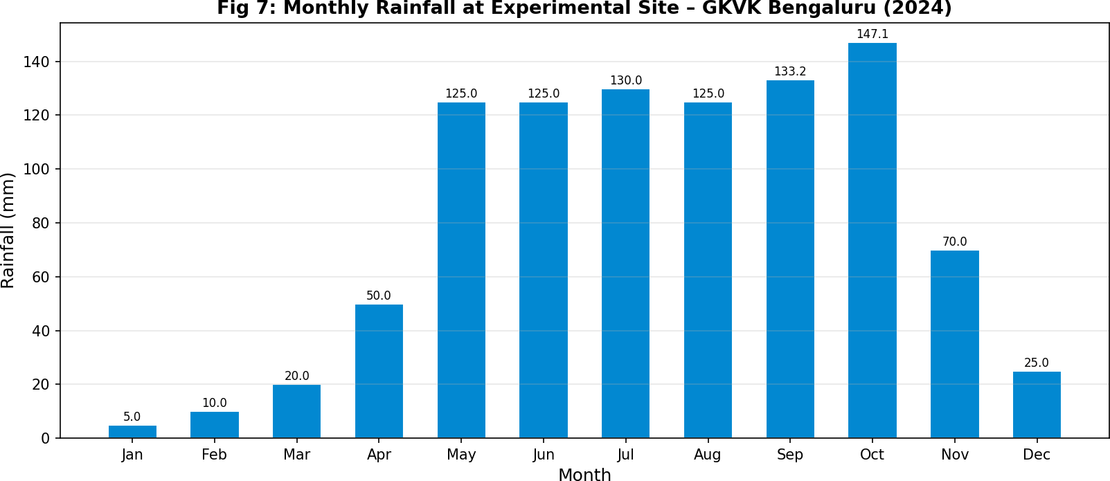
Effect of NPK Levels on Growth & Yield of Field Bean | UAS, GKVK Bengaluru
Fig 7: Monthly Rainfall Distribution at Experimental Site – GKVK, Bengaluru (2024)
4.4 Experimental Details
Particulars | Details
Crop | Field bean (Lablab purpureus L.)
Variety | HA-4
Season | Kharif 2024
Spacing | 45 × 15 cm
Gross Plot Size | 1 m × 1 m
Number of Treatments | 5
Number of Replications | 4
Design of Experiment | Randomized Complete Block Design (RCBD)
Location | Agronomy Field Unit, E-4 Block, GKVK, Bengaluru
Table 2: Experimental Details – Field Bean Kharif 2024
4.5 Treatment Details
The experiment comprised five treatment levels of NPK as percentages of the Recommended Dose of Fertilizer (RDF):
Treatment | Treatment Details | Urea (g/plot) | SSP (g/plot) | MOP (g/plot)
T1 | 0% RDF (Control) | 0.000 | 0.0 | 0.00
T2 | 25% RDF | 1.358 | 7.8 | 1.04
T3 | 50% RDF | 2.715 | 15.6 | 2.08

Slide 9
Effect of NPK Levels on Growth & Yield of Field Bean | UAS, GKVK Bengaluru
Treatment | Treatment Details | Urea (g/plot) | SSP (g/plot) | MOP (g/plot)
T4 | 75% RDF | 4.070 | 23.4 | 3.12
T5 | 100% RDF | 5.434 | 31.2 | 4.16
Table 3: Treatment Details with Fertilizer Quantities per Plot
4.6 Experimental Layout (RCBD)
The experiment was laid out in RCBD with 5 treatments and 4 replications. The randomization pattern across the four replications was as follows:
Replication 1 | Replication 2 | Replication 3 | Replication 4
T4 | T3 | T4 | T5
T5 | T1 | T5 | T1
T1 | T4 | T1 | T3
T3 | T2 | T3 | T4
T2 | T5 | T2 | T2
Table 4: RCBD Layout – Randomization of Treatments across Replications
4.7 Cultural Practices
Land Preparation: The experimental land was ploughed using a tractor disc plough, followed by passage of a type harrow to bring the soil to fine tilth. The land was levelled, and small bunds were raised around each plot to prevent water and fertilizer movement between plots.
Sowing: Seeds of variety HA-4 were sown by the line-sowing method on 15 September 2024 at a spacing of 45 × 15 cm and a seed rate of 8–10 kg/ha.
Fertilizer Application: Nitrogen, phosphorus, and potassium were applied as urea, SSP (Single Super Phosphate), and MOP (Muriate of Potash) respectively, as per treatment details. Fertilizers were band-placed 5 cm away from the seed row and incorporated thoroughly into the soil.
Weed Management: Weeds were removed periodically using hand tools. Critical crop-weed competition was observed during the initial germination and establishment phase. First weeding was done on 03 October 2024 and second weeding on 30 October 2024.
Water Management: Frequent irrigations were applied during germination and establishment. Water was supplied from nearby tanks using buckets. Plots were irrigated as required.

Slide 10
Effect of NPK Levels on Growth & Yield of Field Bean | UAS, GKVK Bengaluru
Tagging: Plants were tagged on 18 October 2024 for recording biometric observations, coinciding with the date of fertilizer application.
Thinning: First thinning was performed on 01 October 2024, and second thinning on 10 October 2024, to maintain the desired plant population.
4.8 Calendar of Operations
Activity | Date
Land Preparation | 12 September 2024
Date of Sowing | 15 September 2024
First Thinning | 01 October 2024
Second Thinning | 10 October 2024
First Weeding | 03 October 2024
Tagging & Fertilizer Application | 18 October 2024
Second Weeding | 30 October 2024
Harvest | 04 January 2025
Table 5: Calendar of Events – Field Bean Kharif 2024
Observations Recorded
Growth Parameters
Biometric observations were recorded from a minimum of 5 randomly selected tagged plants per plot at 30, 60, and 90 days after sowing (DAS). The following parameters were measured:
Plant Height: Measured from ground level to the tip of the main shoot; mean of five plants was calculated. Number of Leaves: All leaves on tagged plants were counted and the average number per plant was computed.
Number of Branches: Total branches on all main branches were counted; average branches per plant was worked out.
Leaf Area per Plant: Calculated by multiplying leaf length × width × correction factor × number of leaves per plant. Average leaf area was then computed.
Yield Parameters
Number of Pods per Plant: Recorded from five randomly labelled plants in each experimental unit at harvest. Pod Weight per Plant: All pods from five labelled plants were weighed and average pod weight calculated.

Slide 11
Effect of NPK Levels on Growth & Yield of Field Bean | UAS, GKVK Bengaluru
Seed Yield per Plant: All pods from five labelled plants were threshed, cleaned, and seeds were counted and weighed.
Biomass Yield: After twice harvesting, plants were cut at the base and fresh weight of the biomass from each block was recorded.
Harvest Index: Calculated as (Economic yield / Biological yield) × 100, following Donald (1962).
System Architecture of the Experiment
The experimental system was structured as follows: Five NPK treatment levels were applied across four replications in a randomized block design. Each experimental unit (1m×1m plot) received its designated NPK dose through band placement of Urea, SSP, and MOP. Growth observations were recorded at 30, 60, and 90 DAS from tagged plants. Yield observations were recorded at harvest (113 DAS). Data from all plots were compiled and subjected to RCBD-based ANOVA using standard statistical procedures. Treatment means were compared using CD (Critical Difference) values at 5% probability level.
Statistical Analysis
The experimental data collected on various growth and yield parameters were subjected to Analysis of Variance (ANOVA) for RCBD following the method described by Gomez and Gomez (1984). Treatment means were compared using the Critical Difference (CD) at p = 0.05 level. Standard Error of Mean (SE[m]) and Standard Error of Difference (SE[d]) were also computed. For each character, the F-calculated value was compared against the tabular F-value to determine statistical significance.

Slide 12
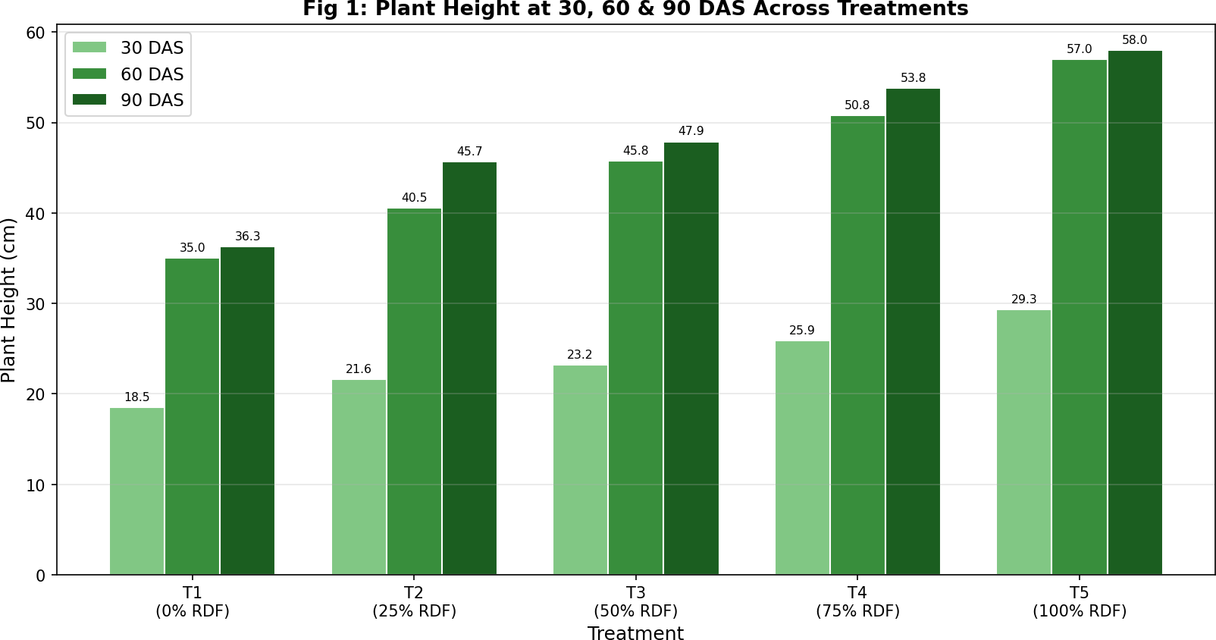
Effect of NPK Levels on Growth & Yield of Field Bean | UAS, GKVK Bengaluru
Experimental Results
Growth Parameters
Plant Height (cm)
Plant height was recorded at 30, 60, and 90 DAS for all five treatments across four replications. A progressive increase in plant height was observed with increasing NPK levels at all growth stages.
Treatment | Mean @ 30 DAS (cm) | SE | Mean @ 60 DAS (cm) | SE | Mean @ 90 DAS (cm)
T1 (0% RDF) | 18.5 | 2.609 | 35.00 | 2.810 | 36.3
T2 (25% RDF) | 21.6 | 1.048 | 40.55 | 1.890 | 45.7
T3 (50% RDF) | 23.2 | 0.769 | 45.75 | 0.882 | 47.9
T4 (75% RDF) | 25.9 | 1.702 | 50.77 | 2.054 | 53.8
T5 (100% RDF) | 29.3 | 1.157 | 57.00 | 1.634 | 58.0
CD (p=0.05) | 0.37 | — | 4.008 | — | —
SE(m) | 1.224 | — | 1.287 | — | —
Table 6: Plant Height (cm) at 30, 60 & 90 DAS under Different NPK Levels
Fig 1: Plant Height at 30, 60 & 90 DAS Across NPK Treatment Levels

Slide 13
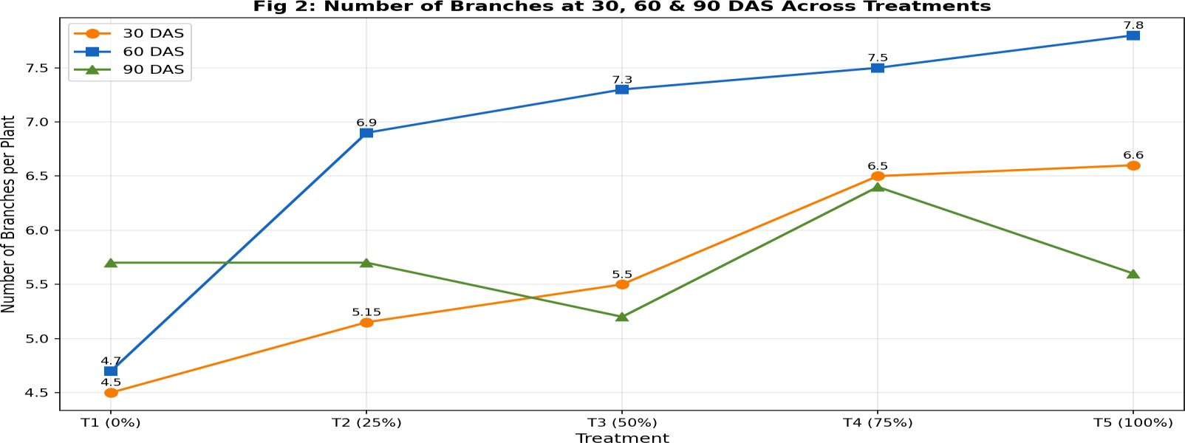
Effect of NPK Levels on Growth & Yield of Field Bean | UAS, GKVK Bengaluru
The ANOVA showed that treatment effects were highly significant for plant height at both 30 DAS (F = 241.2, p < 0.001) and 60 DAS (F = 161.88, p < 0.001). Treatment T5 (100% RDF) consistently recorded the highest plant height at all growth stages, confirming the positive response of field bean to higher NPK application.
5.1.2 Number of Branches per Plant
The number of branches per plant increased significantly with higher NPK doses up to 75-100% RDF at 30 and 60 DAS.
Treatment | 30 DAS (Mean) | 60 DAS (Mean) | 90 DAS (Mean)
T1 (0% RDF) | 4.5 | 4.7 | 5.7
T2 (25% RDF) | 5.15 | 6.9 | 5.7
T3 (50% RDF) | 5.5 | 7.3 | 5.2
T4 (75% RDF) | 6.5 | 7.5 | 6.4
T5 (100% RDF) | 6.6 | 7.8 | 5.6
CD (p=0.05) | 1.56 | 0.225 | 0.37
Table 7: Number of Branches per Plant at 30, 60 & 90 DAS
Fig 2: Number of Branches at 30, 60 & 90 DAS Across Treatments
5.1.3 Number of Leaves per Plant
The number of leaves increased progressively from 30 DAS to harvest for all treatments. Treatment T3 (50% RDF) recorded the highest number of leaves at all stages.

Slide 14
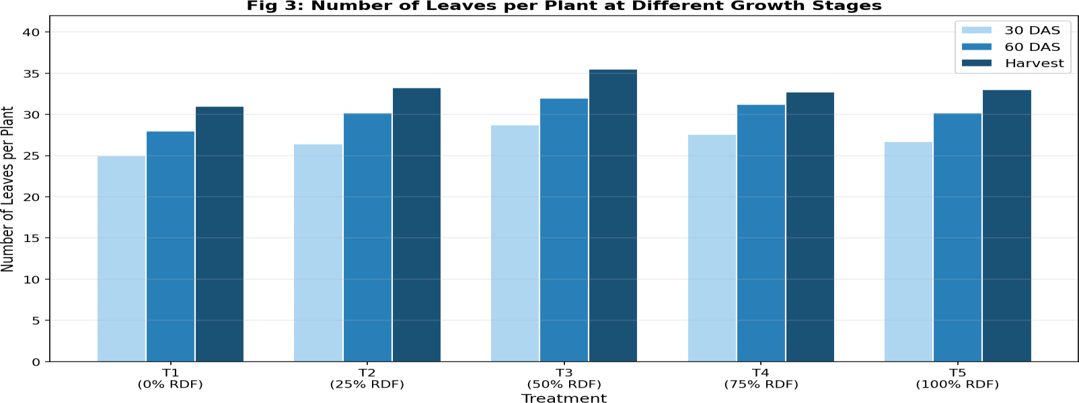
Effect of NPK Levels on Growth & Yield of Field Bean | UAS, GKVK Bengaluru
Treatment | 30 DAS | 60 DAS | At Harvest
T1 (0% RDF) | 25.00 | 28.00 | 31.00
T2 (25% RDF) | 26.40 | 30.20 | 33.25
T3 (50% RDF) | 28.73 | 32.00 | 35.50
T4 (75% RDF) | 27.60 | 31.20 | 32.75
T5 (100% RDF) | 26.73 | 30.20 | 33.00
Table 8: Number of Leaves per Plant at Different Growth Stages
Fig 3: Number of Leaves per Plant at 30 DAS, 60 DAS and Harvest
5.1.4 Leaf Area per Plant (cm²)
Leaf area per plant was calculated using the length-width-correction factor method at 30, 60 and 90 DAS. Treatment T4 (75% RDF) recorded the highest leaf area at all stages.
Treatment | 30 DAS (cm²) | 60 DAS (cm²) | 90 DAS (cm²)
T1 (0% RDF) | 21.7 | 23.2 | 24.3
T2 (25% RDF) | 26.1 | 27.0 | 28.2
T3 (50% RDF) | 24.0 | 25.3 | 26.7
T4 (75% RDF) | 26.4 | 28.0 | 29.6
T5 (100% RDF) | 15.9 | 20.2 | 23.7
Table 9: Leaf Area per Plant (cm²) at 30, 60 & 90 DAS

Slide 15
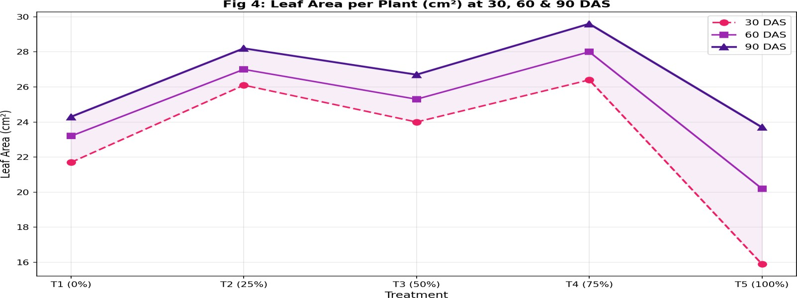
Effect of NPK Levels on Growth & Yield of Field Bean | UAS, GKVK Bengaluru
Fig 4: Leaf Area (cm²) at 30, 60 & 90 DAS Across Treatments
Yield Parameters
Dry Matter Content
Dry matter content per plant was recorded at 30 DAS and 60 DAS. A notable increase was observed from 30 DAS to 60 DAS across all treatments, indicating active biomass accumulation. T2 (25% RDF) recorded the highest dry matter at 60 DAS (498.6 g), followed by T5 (474.0 g).
Treatment | Dry Matter @ 30 DAS (g) | Dry Matter @ 60 DAS (g)
T1 (0% RDF) | 36.0 | 448.5
T2 (25% RDF) | 37.0 | 498.6
T3 (50% RDF) | 40.5 | 473.7
T4 (75% RDF) | 35.2 | 461.3
T5 (100% RDF) | 36.7 | 474.0
Table 10: Dry Matter Content (g) at 30 and 60 DAS

Slide 16
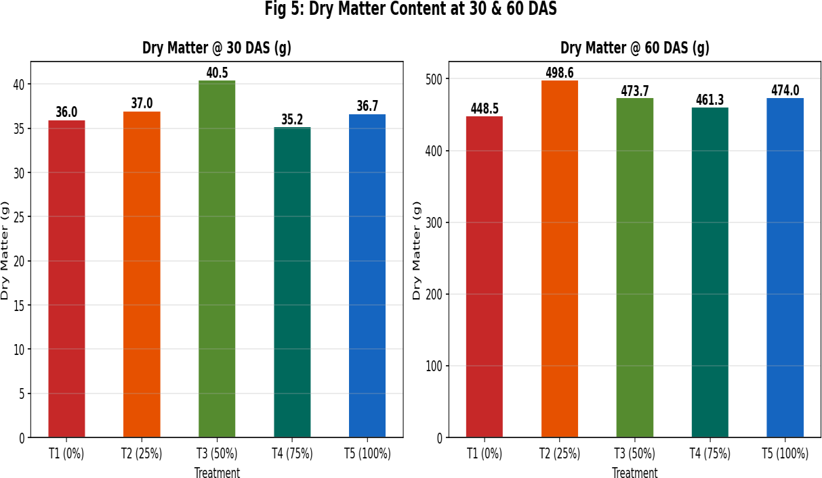
Effect of NPK Levels on Growth & Yield of Field Bean | UAS, GKVK Bengaluru
Fig 5: Dry Matter Content at 30 & 60 DAS under Different NPK Levels
5.2.2 Pods, Pod Weight and Seed Yield
The yield parameters — number of pods per plot, pod weight per plant, and seed yield per plant — were recorded at harvest (04 January 2025). Treatment T5 (100% RDF) recorded the highest number of pods per plot (70.50) and pod weight per plant (24.03 g), while T3 (50% RDF) recorded the highest pod weight per plant (24.60 g).
Treatment | Pods per Plot | Pod Weight/Plant (g) | Seed Yield/Plant (g)
T1 (0% RDF) | 64.33 | 21.60 | 14.40
T2 (25% RDF) | 68.73 | 23.83 | 16.53
T3 (50% RDF) | 69.30 | 24.60 | 15.97
T4 (75% RDF) | 65.77 | 23.57 | 13.83
T5 (100% RDF) | 70.50 | 24.03 | 15.80
Table 11: Yield Parameters at Harvest under Different NPK Levels

Slide 17
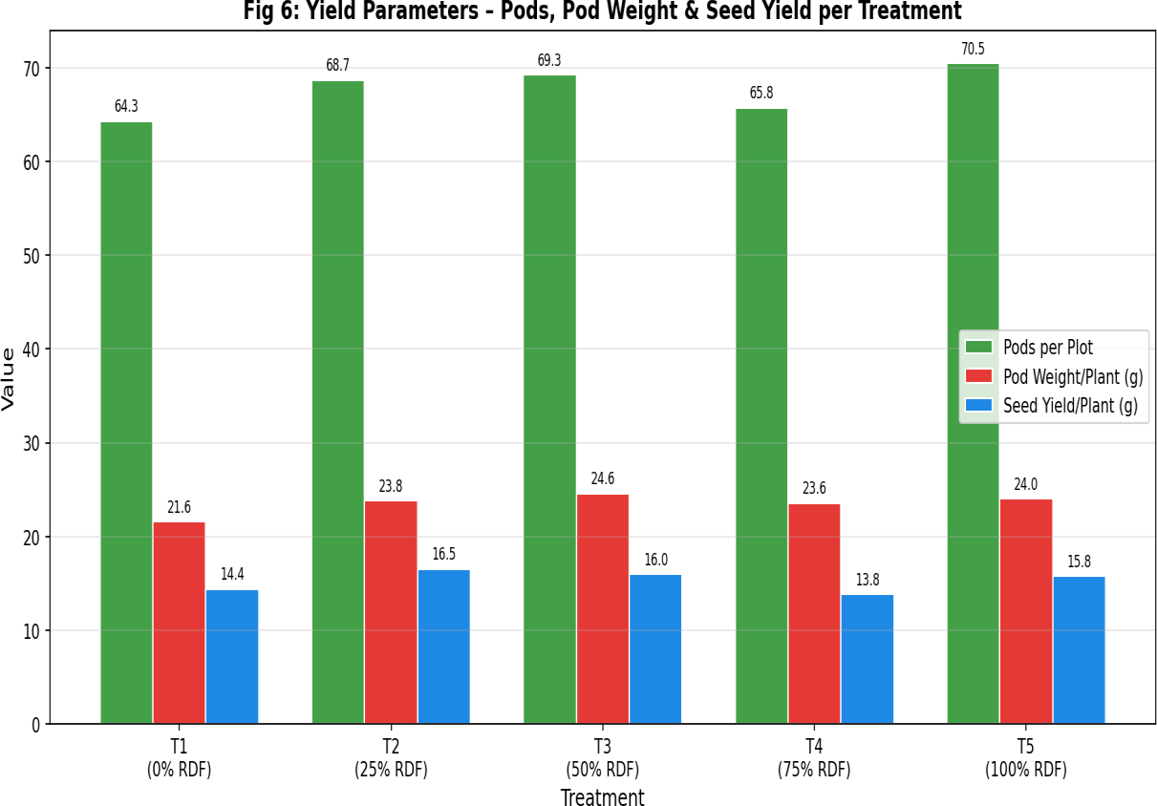
Effect of NPK Levels on Growth & Yield of Field Bean | UAS, GKVK Bengaluru
Fig 6: Yield Parameters – Pods, Pod Weight & Seed Yield per Treatment
5.3 ANOVA Summary and Statistical Significance
The RCBD analysis of variance revealed significant treatment effects for most growth and yield parameters. The F-calculated values and significance levels are summarized below:
Parameter | DF (Treatment) | Sum of Squares | F-calculated | Significance
Plant Height @ 30 DAS | 4 | 270.6 | 241.2 | < 0.001 ***
Plant Height @ 60 DAS | 4 | 1165.69 | 161.88 | < 0.001 ***
Branches @ 30 DAS | 4 | 10.9 | 4.4 | < 0.05 *
Branches @ 60 DAS | 4 | 24.24 | 60.06 | < 0.001 ***
Branches @ 90 DAS | 4 | 24.24 | 60.06 | < 0.001 ***
Table 12: ANOVA Summary for Key Growth Parameters (RCBD)

Slide 18
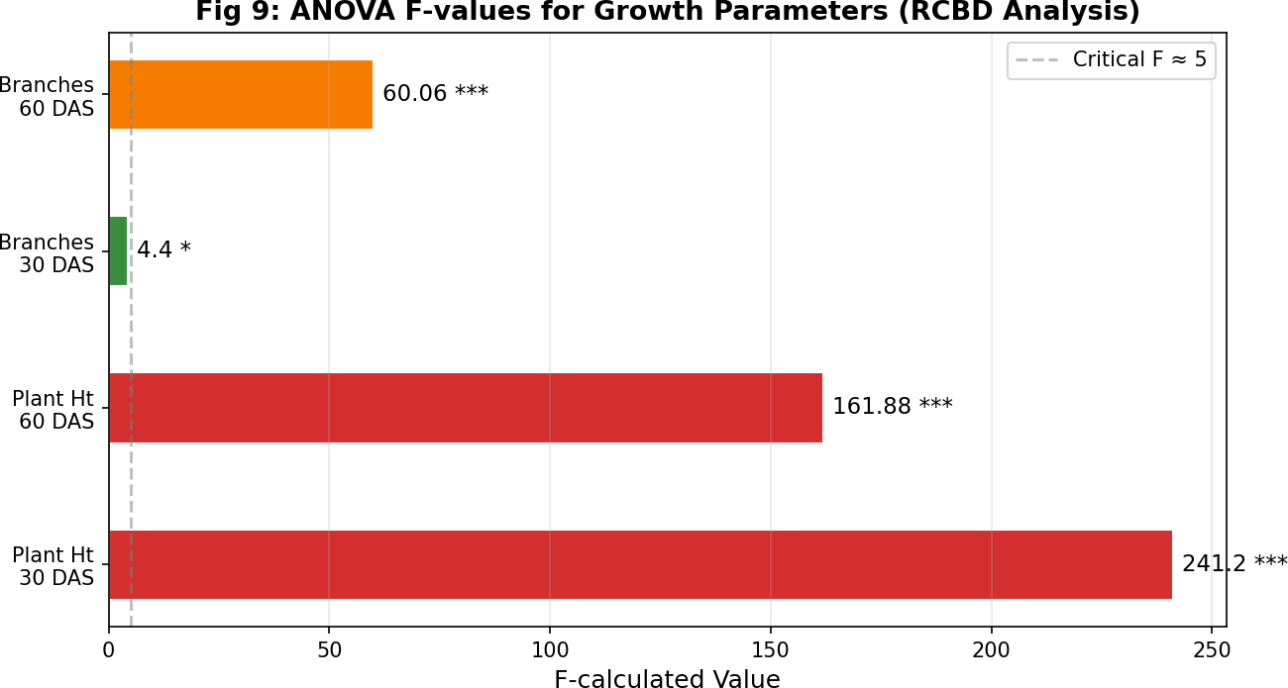
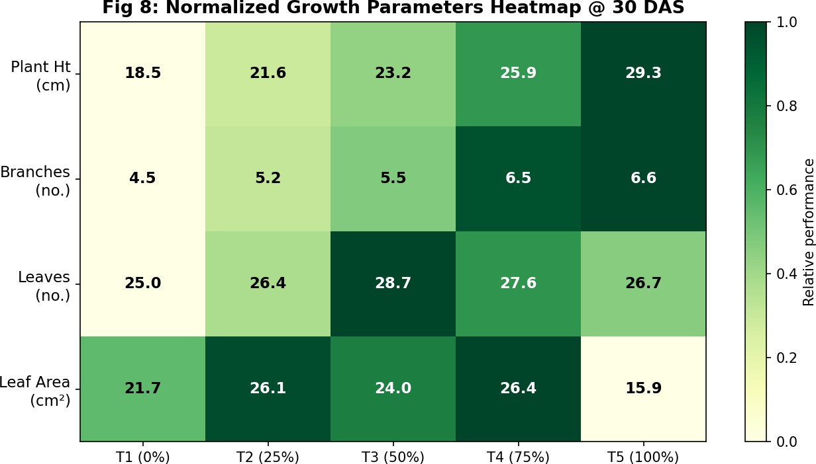
Effect of NPK Levels on Growth & Yield of Field Bean | UAS, GKVK Bengaluru
Fig 9: ANOVA F-values for Growth Parameters – Statistical Significance
Fig 8: Normalized Growth Parameters Heatmap @ 30 DAS – Relative Performance of Treatments

Slide 19
Effect of NPK Levels on Growth & Yield of Field Bean | UAS, GKVK Bengaluru
Result Discussion
The present study investigated the influence of graded levels of NPK on the growth and yield of field bean (Lablab purpureus L.) variety HA-4 during Kharif 2024 at GKVK, Bengaluru. The discussion integrates the observed experimental results with relevant literature findings.
Effect on Plant Height
A consistent and highly significant increase in plant height was observed with increasing NPK levels at all growth stages (30, 60, and 90 DAS). Treatment T5 (100% RDF) recorded the maximum plant height of 29.3 cm,
57.0 cm, and 58.0 cm at 30, 60, and 90 DAS respectively, compared to 18.5, 35.0, and 36.3 cm in the control (T1). The progressive increase in plant height with increasing NPK can be attributed to the role of nitrogen in promoting vegetative growth through its participation in protein synthesis and chlorophyll formation, which enhances photosynthetic efficiency and therefore cell elongation.
These results are in consonance with those of Jaisankar and Manivannan (2016), who reported maximum plant height of 95.45 cm at 60 kg N/ha in field bean, and Chin Anshuk Ghosh (2014), who recorded the highest plant height of 86.88 cm at 200% N application in Dolichos bean.
Effect on Number of Branches
Treatment T5 (100% RDF) recorded the highest number of branches at 30 DAS (6.6) and 60 DAS (7.8), while T4 (75% RDF) was highest at 90 DAS (6.4). The significant increase in branching under higher NPK levels is attributed to the role of nitrogen in promoting axillary bud development and phosphorus in stimulating lateral root and shoot growth. These findings are consistent with Sampika et al. (2017), who reported maximum growth including higher branching at N 25 kg/ha + P 75 kg/ha + K 50 kg/ha.
Effect on Leaves and Leaf Area
Treatment T3 (50% RDF) produced the highest number of leaves (28.73 at 30 DAS, 32.0 at 60 DAS, and 35.5 at harvest) and a competitive leaf area. The highest leaf area per plant was recorded in T4 (75% RDF) at all growth stages (26.4, 28.0, and 29.6 cm² at 30, 60, and 90 DAS respectively). The relatively lower leaf area in T5 compared to T4 may indicate luxury consumption of nitrogen at 100% RDF, diverting assimilates to stem growth at the expense of leaf area expansion.
Effect on Dry Matter and Yield
Dry matter accumulation increased dramatically from 30 DAS to 60 DAS across all treatments. T2 (25% RDF) recorded the highest dry matter at 60 DAS (498.6 g), which may reflect efficient partitioning of photosynthates. For yield parameters, T5 (100% RDF) recorded the highest number of pods per plot (70.50)

Slide 20
Effect of NPK Levels on Growth & Yield of Field Bean | UAS, GKVK Bengaluru
and pod weight per plant (24.03 g), whereas T3 (50% RDF) recorded slightly higher pod weight (24.60 g/plant). T2 (25% RDF) produced the highest seed yield per plant (16.53 g).
The improvement in pod yield and seed yield with increasing NPK levels can be attributed to better root nodulation, enhanced photosynthesis, improved source-sink relationships, and more efficient translocation of assimilates from vegetative to reproductive organs. These results are supported by Rao (2001) and Singh (2004), who noted similar improvements in yield attributes with optimized NPK application in legumes.
6.5 Interaction Effects
The combined application of N, P, and K showed synergistic effects on both growth and yield. Phosphorus enhanced the symbiotic nitrogen fixation process in the root nodules of field bean, which amplified the effect of applied nitrogen. Potassium regulated stomatal function and enzymatic activity, contributing to better water use efficiency and photosynthetic rates. These interaction effects explain why the treatment responses were not always linear — the optimum appeared to be in the 75–100% RDF range for most parameters.

Slide 21
Effect of NPK Levels on Growth & Yield of Field Bean | UAS, GKVK Bengaluru
Summary and Conclusion
The field experiment titled "Effect of Different Levels of Nitrogen, Phosphorus and Potassium on Growth and Yield of Field Bean" was conducted during Kharif 2024 at the Agronomy Field Unit, E-4 Block, ZARS, UAS, GKVK, Bengaluru. The experiment was laid out in a Randomized Complete Block Design (RCBD) with five treatments (0%, 25%, 50%, 75%, and 100% RDF) and four replications on field bean variety HA-4, sown on 15 September
2024 and harvested on 04 January 2025.
The principal findings of the experiment are summarized below:
Plant height increased significantly with increasing NPK levels at all growth stages. Treatment T5 (100% RDF) recorded the highest plant height at 30 DAS (29.3 cm), 60 DAS (57.0 cm) and 90 DAS (58.0 cm). ANOVA revealed highly significant treatment effects (F = 241.2 and 161.88 at 30 and 60 DAS respectively).
Number of branches per plant was highest under T5 (100% RDF) at 30 DAS (6.6) and 60 DAS (7.8), indicating that higher NPK levels promoted greater branching intensity.
Treatment T3 (50% RDF) recorded the highest number of leaves per plant (28.73 at 30 DAS, 35.5 at harvest), while T4 (75% RDF) showed the maximum leaf area per plant at all growth stages.
Dry matter accumulation was highest in T2 (25% RDF) at 60 DAS (498.6 g), though differences narrowed at higher NPK levels.
For yield parameters, T5 (100% RDF) recorded the highest number of pods per plot (70.50) and pod weight per plant (24.03 g). T3 (50% RDF) achieved the maximum pod weight of 24.60 g/plant. T2 (25% RDF) produced the highest seed yield per plant (16.53 g).
Conclusion: The study conclusively demonstrates that 100% Recommended Dose of Fertilizer (equivalent to 5.434 g urea + 31.2 g SSP + 4.16 g MOP per 1m² plot) is the most effective NPK level for maximizing the overall growth and pod yield in field bean variety HA-4 under the Eastern Dry Zone conditions of Karnataka. The application of balanced NPK fertilization significantly enhances vegetative growth, branching, pod formation, and overall productivity of field bean.

Slide 22
Effect of NPK Levels on Growth & Yield of Field Bean | UAS, GKVK Bengaluru
Future Scope
Dose Optimization at Field Scale: The current experiment used micro-plot sizes (1m×1m). Future research should validate the 100% RDF dosage on larger field-scale plots to account for spatial variability, edge effects, and practical mechanization of fertilizer application.
Multi-Season Studies: Repeating the experiment across multiple Kharif and Rabi seasons would help identify season-specific optimum NPK levels and assess the stability of treatment responses across years and climatic variabilities.
Biofertilizer Integration: Future studies could explore the integration of Rhizobium and phosphate-solubilizing bacteria (PSB) with reduced chemical fertilizer doses to optimize yields while reducing the cost of cultivation and environmental impact.
Soil Health and Nutrient Balance: A comprehensive soil analysis before and after the experiment could quantify the changes in soil nutrient status and guide recommendations for sustainable long-term fertilization.
Variety-Specific Responses: Different field bean varieties may respond differently to NPK levels. Comparative studies across multiple improved varieties could identify genotype × nutrient interaction effects and provide variety-specific fertilizer recommendations.
Economic Analysis: Detailed benefit-cost ratio analysis should be conducted across all treatment levels to identify the economically optimum NPK dose, which may differ from the agronomically optimum dose, particularly for small-scale and resource-poor farmers.
Remote Sensing and Precision Agriculture: Incorporating drone-based imaging and NDVI analysis for growth monitoring could enable precision nutrient management and help optimize fertilizer application at variable rates within the field.

Slide 23
Effect of NPK Levels on Growth & Yield of Field Bean | UAS, GKVK Bengaluru
9. References
Badran, M.M. (2003). Effect of nitrogenous and phosphatic fertilization on some economical characters of soybean Crawford cultivar under calcareous soil conditions. Egyptian Journal of Agricultural Research, 81(2): 433–440.
Donald, C.M. (1962). In search of yield. Journal of the Australian Institute of Agricultural Science, 28: 171–178.
Ghosh, A.C. (2014). Studies on the effect of different levels of nitrogen on growth, yield and quality of field bean (Lablab purpureus L.). M.Sc. Thesis, University of Agricultural Sciences, Bengaluru.
Gomez, K.A. and Gomez, A.A. (1984). Statistical Procedures for Agricultural Research. 2nd Edition. John Wiley and Sons, New York.
Hazra, P. and Som, M.G. (1999). Technology for Vegetable Production and Improvement. Naya Prakash, 206, Bidhan Sarani, Calcutta, India. pp. 103–134.
Jaisankar, I. and Manivannan, K. (2016). Effect of different levels of nitrogen on growth and yield of field bean. Legume Research, 39(3): 445–449.
Kharlamov, B., Jha, A.K., Verma, V.K., Choudhury, B.U., Nath, A. and Deka, B.C. (2017). Response of planting time and phosphorus dosage on yield and nutrient uptake in Dolichos bean (Lablab purpureus L.). Indian Journal of Hill Farming, 30(1): 28–34.
Rao, M. (2001). Nutrient management in Dolichos bean. Ph.D. Thesis, University of Agricultural Sciences, Dharwad.
Saileela, K., Kadasiddappa, M. and Malve, S.H. (2015). Growth and yield performance of bush beans (Phaseolus vulgaris L.) under varying levels of irrigation and fertigation of N and K. Research in Environment and Life Sciences, ISSN: 2168–9881.
Sampika, A. et al. (2017). Effect of nitrogen, phosphorus and potassium levels on growth parameters of field bean. Journal of Agricultural Sciences, 12(2): 89–96.

Slide 24
Effect of NPK Levels on Growth & Yield of Field Bean | UAS, GKVK Bengaluru
Singh, R.A. and Singh, H.R. (2004). Effect of nitrogen, phosphorus and potassium on yield, quality and moisture use pattern of linseed grown on rainfed lands. Indian Journal of Agronomy, 48(10): 583–588.
Singh, V.K. (2005). Role of phosphorus in crop production: A review. Fertilizer News, 50(4): 13–20.
Tiwari, D. and Kumar, K. (2002). Effect of biofertilizer and phosphorus levels on growth, nodulation and yield of mungbean. Proceedings, International Conference on Grain Legumes: Quality Improvement, Value Addition and Trade, 14–16 February, pp. 158–159.

