Slide 1

Smart Water Tank Level Monitoring and Automatic Pump Control System to Prevent Overflow and Water Shortage
Smart water management uses connected monitoring and control technologies to manage water resources efficiently. This project automatically monitors water levels and controls pumps to prevent water wastage while ensuring continuous water availability.
KONDETI GANESH
323129520074

Slide 2
Problem Statement
Time-Consuming Manual Monitoring
Overflow and Water Wastage
Water Shortages
Delayed monitoring causes dry-tank conditions and disrupts continuous water availability.
Traditional manual water tank monitoring is unreliable and demands constant human attention.
Manual pump operation frequently leads to tank overflow, wasting significant water resources.
Excess Energy Consumption
Need for Intelligent Management
Unnecessary pump operation drives up electricity costs without delivering any benefit.
Real-time, automated water management is essential for modern facilities.

Slide 3

Proposed Solution
The Smart Water Tank Level Monitoring and Automatic Pump Control System delivers fully automated water management through IoT technology.
IoT technology enables continuous water-level monitoring without manual intervention.
The pump is controlled automatically using predefined water-level thresholds.
A secure, user-friendly interface enables centralized remote monitoring.
Eliminates overflow, water shortage, and unnecessary energy consumption.

Slide 4
System Components
Level Sensors
IoT Communication Module
Ultrasonic or water-level sensors continuously measure the water level inside the tank.
Transfers real-time sensor data to the connected system for processing.
Cloud Connectivity
Pump Control Mechanism
Supports remote access and centralized data monitoring from any location.
Automatically switches the pump ON or OFF based on threshold comparisons.
Water Tank and Pump
Monitoring Dashboard
Physical infrastructure for storing and supplying water to the facility.
Displays system status, alerts, and real-time data through a centralized interface.

Slide 5
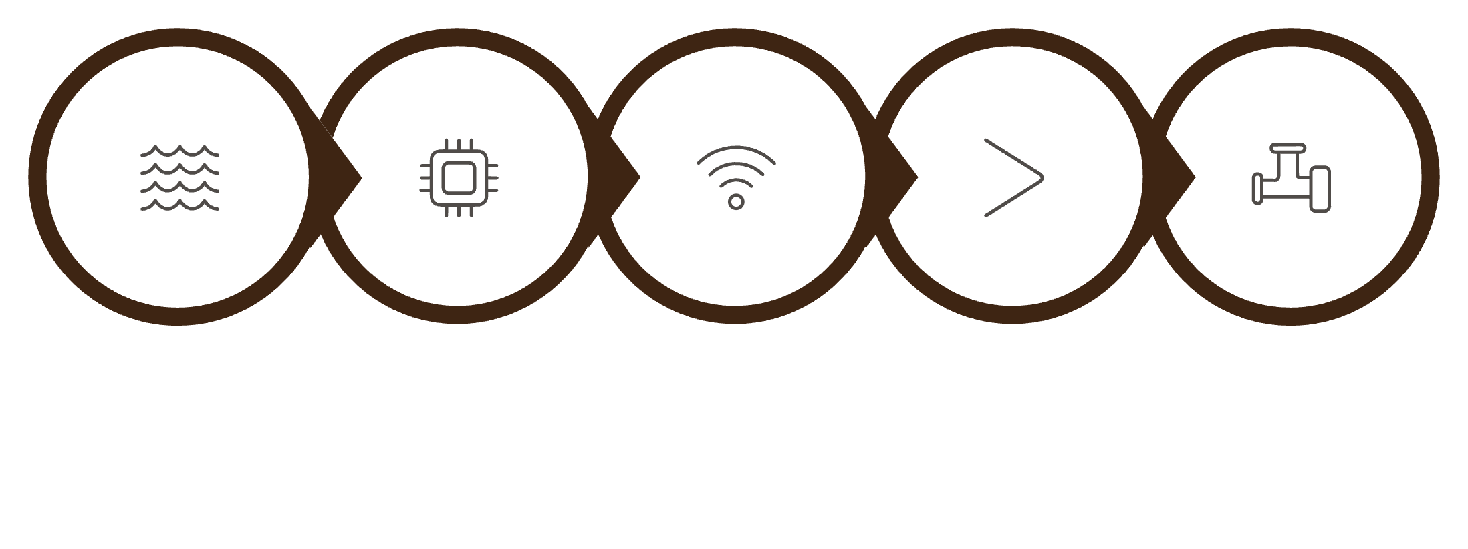
Working Principle
01
Sense
Sensors continuously measure the water level in real time.
02
Process
Sensor data is processed by the IoT system.
03
Transmit
Water-level information is transmitted through IoT communication.
04
Compare
Sensing
Processing
Transmit
Compare
Actuate
The system compares the measured level with predefined thresholds.
05
The system operates as a closed-loop automation cycle — from continuous sensing through intelligent decision-making to remote user oversight.
Control
The pump is automatically switched ON or OFF accordingly.
06
Monitor
Users monitor the tank remotely through the dashboard interface.

Slide 6
Real-Time Monitoring Dashboard
The dashboard helps users make informed water-management decisions through centralized, real-time system information.
Water Level
Pump Status
Usage History
Current tank fill status displayed in real time.
Live ON/OFF indicator for the pump.
Historical water consumption trends and logs.
Alert Notifications
System Performance
Instant alerts for overflow, shortage, or faults.
Operational metrics and system health indicators.

Slide 7
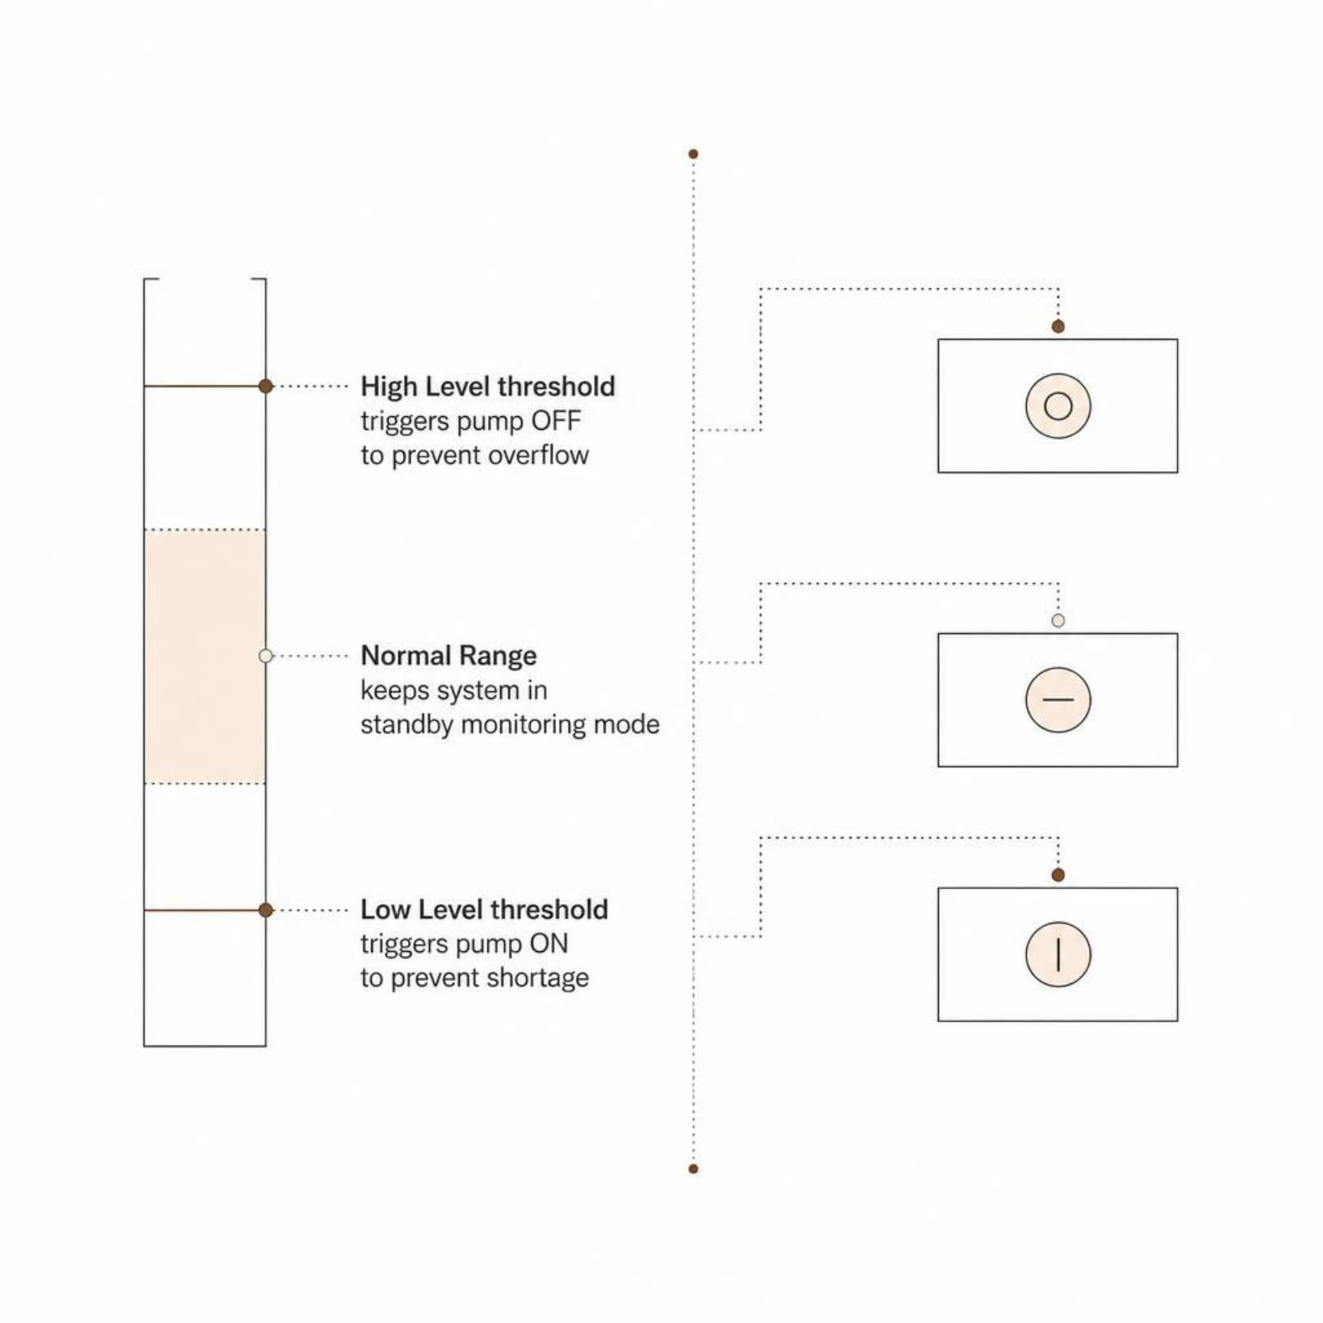
Automatic Pump Control and Alerts
The pump switches automatically according to predefined water-level thresholds.
A high-level threshold prevents tank overflow and water wastage.
Low-level monitoring prevents dry-tank and water-shortage conditions.
Alert notifications inform users about critical tank and pump conditions.
Automation reduces the need for continuous manual supervision.

Slide 8
Key Benefits
Reduces Water Wastage
Improves Energy Efficiency
Prevents overflow and unnecessary water loss.
Eliminates unnecessary pump operation and lowers electricity costs.
Continuous Water Availability
Reduces Manual Effort
Ensures water is always available by preventing dry-tank conditions.
Automation removes the need for constant human monitoring.
Real-Time Monitoring
Intelligent Resource Management
Centralized dashboard provides instant visibility into system status.
Supports efficient, data-driven water-resource decision-making.

Slide 9
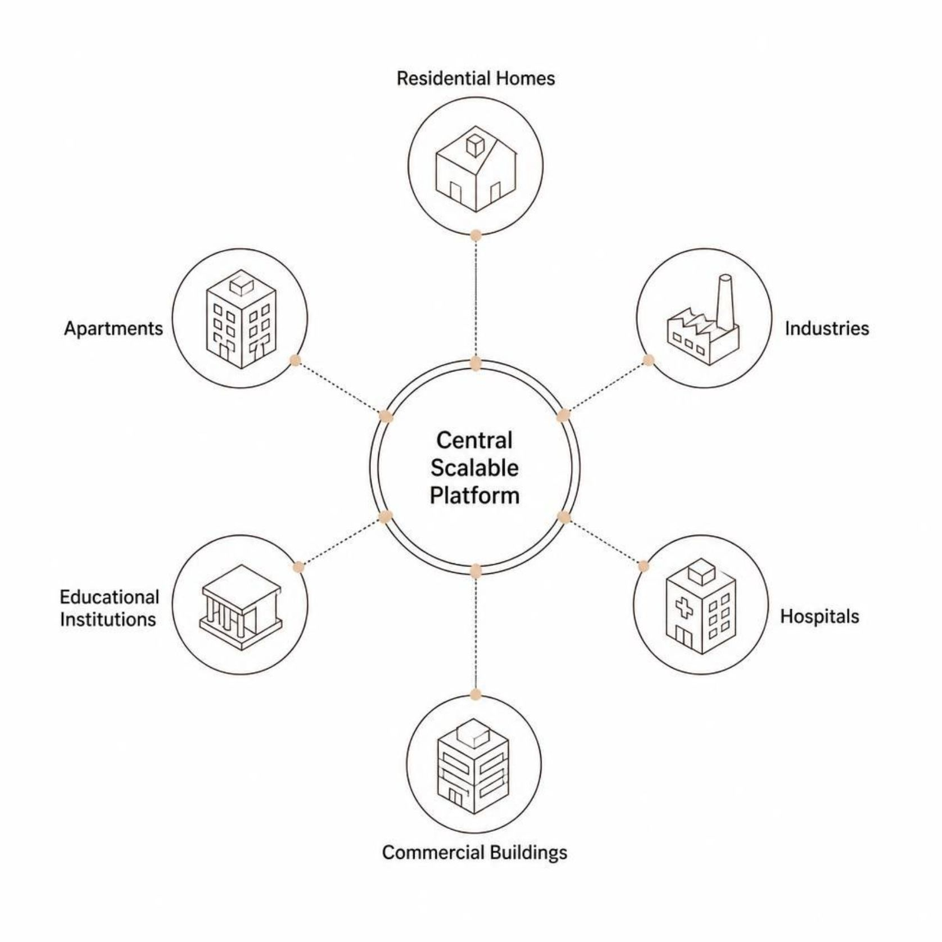

Applications and Scalability
Designed for Every Facility
The system is engineered to be secure and scalable, adapting to the unique water-management demands of diverse facility types and sizes.
Residential homes and apartments benefit from hands-free daily water management.
Industries and commercial buildings gain operational efficiency and cost savings.
Hospitals and educational institutions ensure uninterrupted water supply for critical operations.
The modular architecture allows the system to scale from a single tank to multi-tank, multi-site deployments without redesign.

Slide 10

Conclusion and Future Impact
Solves Core Water-Management Problems
IoT-based monitoring and automatic pump control directly address overflow, water shortage, and energy waste.
Automation Drives Efficiency
Intelligent threshold-based control improves energy efficiency and eliminates unnecessary water wastage.
Centralized Real-Time Oversight
A unified dashboard supports smart, data-driven resource management from anywhere.
Modern, Scalable, and Secure
The system provides a future-ready, intelligent, and scalable approach to water management for any facility.

