Slide 1
gRPC

Slide 2
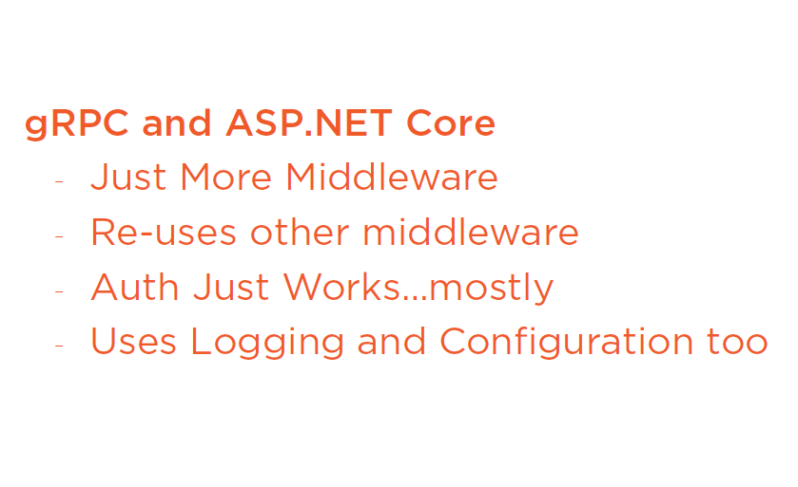

Slide 3
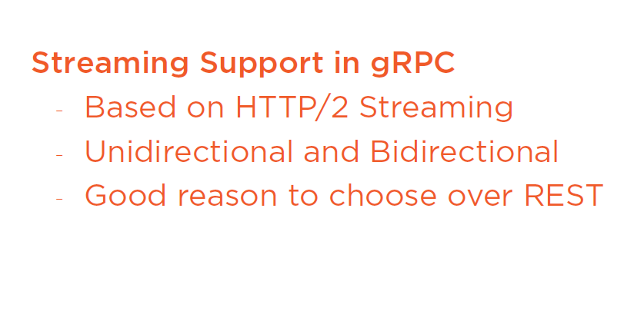

Slide 4
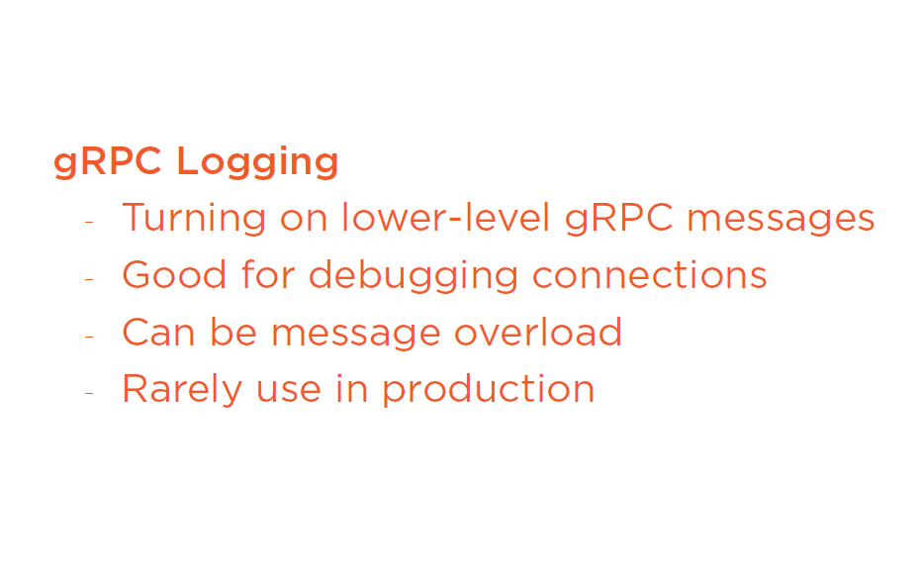

Slide 5
Error handling in gRPC
Demo

Slide 6
Optional values : By default values are initialized with their default values. We need to implement the optional values/ Use library defined types. To get optional values.

Slide 7
Links
Getting started with .net core.
Pluralsight course.

