Slide 1

MOBILE APP DEVELOPMENT
Name : GANESHKUMAR KARRI
Student id : S3217219

Slide 2
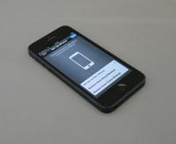
| Text Detection |
Scan-Master
Scan-Master: An easy-to-use mobile app that turns text into digital text in just a few steps.
Notes:
Good morning, everyone! Let me introduce you to Scan-Master, an app designed to turn text in images into editable digital text. For example, imagine seeing important notes on a board or a book and needing to copy them quickly. With Scan-Master, you just take a photo, and it works for you. This app is great for students, professionals, or anyone dealing with text regularly. It’s simple to use, saves time, and eliminates manual typing. By combining smart features with an intuitive design, Scan-Master makes text extraction a seamless part of everyday tasks.

Slide 3

Project Overview
A Look at Text Extraction Project
Objective
Technologies Used
Core Features
The goal of this project is to make it easy to extract text from images so users can quickly access and use the text found in pictures.
This project uses modern tools like Kotlin for building the app, Jetpack Compose for designing the UI, Firebase for backend services, and Google ML Kit for machine learning features.
The app lets users upload or capture images, extract text from them, erase unwanted text, and copy the text easily.
Notes:
The main goal of this project is to make text extraction from images quickly and easily. Instead of spending time typing text from physical documents or notes, users can upload or capture a photo and get the text instantly. It’s especially useful for tasks like saving lecture notes, archiving documents, or even translating text. The focus is on creating an app that is easy to use while delivering accurate results. It’s about combining technology with convenience to solve a common problem for students, researchers, and professionals.

Slide 4
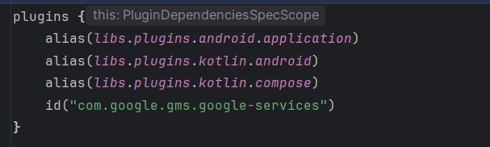
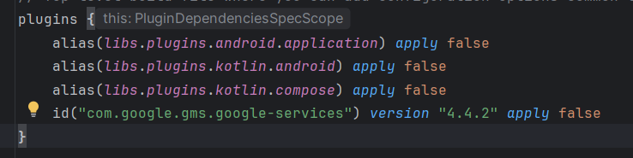
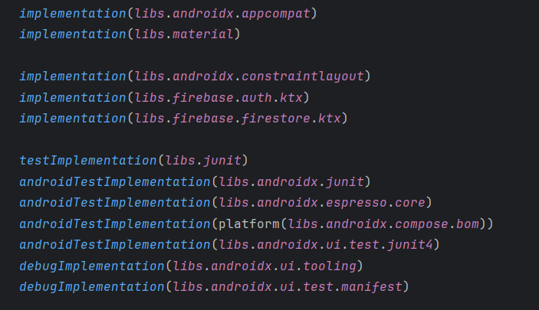
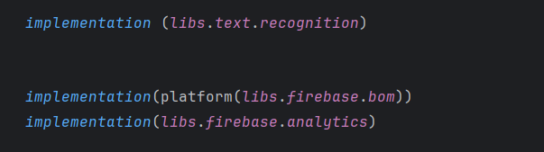
dependencies and plugins used in the project
App Level Plugin
Project Level Plugin
App Level Dependencies
Notes:
These are the screenshots of the dependencies and plugins used to make the application Scan Master.

Slide 5

Application Architecture
Exploring the Core Components and Their Functionalities
Frontend Development
Backend Infrastructure
It uses Jetpack Compose to create a user interface that adjusts and looks great on any device. Jetpack Compose helps developers build UIs with less code and provides tools to create attractive, interactive apps more easily.
It uses Firebase to handle user authentication and securely store data. Firebase makes it easy to manage user accounts and store data safely with simple APIs.
Machine Learning Integration
Data Handling Techniques
It uses Google ML Kit to enable advanced text recognition. This helps the app scan and process text right from the user’s device, adding powerful features like scanning and recognising text.
It supports local storage and clipboard management, so users can store important data and access it easily. This makes it simple to save information locally and share it between different apps.
Notes:
The app’s architecture is built around three main components. The front end, developed with Jetpack Compose, ensures a user-friendly interface that looks great on any device. Firebase powers the backend, handling secure user authentication and real-time data updates. Finally, Google ML Kit adds machine learning capabilities for accurate text recognition. By combining these technologies, the app delivers a seamless experience. This design shows how an intuitive frontend and a robust backend can work together to create a reliable and efficient tool.

Slide 6
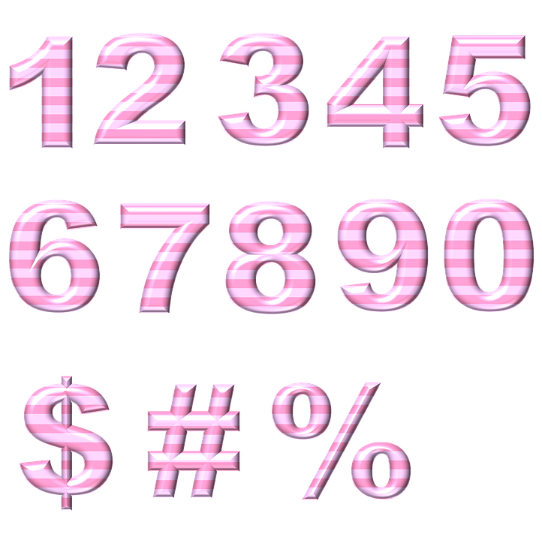
Key Features
Exploring the Functionalities of Text Detection APP
Upload Images from Gallery
Users can easily upload images from their device’s gallery, making it simple to work with existing photos. This feature improves the user experience by giving more flexibility in choosing images already saved on their device.
Capture Images Using Device Camera
The app lets users take real-time pictures with their device’s camera. This is handy for quickly extracting text from physical documents or signs, so users can get the information they need while on the move.
Display Extracted Text
After processing, the app shows the extracted text, letting users view and interact with the content easily. This instant feedback is important for users who need quick access to information.
Options to Erase and Copy Detected Text
The app lets users erase or copy the detected text, giving them the flexibility to use the extracted information however they want. This makes it easy to edit or share content as needed.
Notes:
Scan-Master’s features are simple yet powerful. Users can upload an image or capture a new one directly in the app. The app processes the image and extracts the text, which is displayed on the results screen. From there, users can copy the text to their clipboard or erase the text. These features make the app versatile and practical, especially for tasks like sharing notes, editing text, or saving important information. By keeping things user-friendly.

Slide 7

Application Flow
A complete guide to how users interact with the app and how data is processed
Home Screen Functionality
Image Processing with ML Kit
The main interface lets users choose between two options: uploading an image or capturing text directly with the camera. This gives users flexibility and helps improve their overall experience based on their preferences.
After an image is uploaded or taken, the ML Kit processes it to detect text. This screen uses advanced machine learning to recognize and extract text from the image, ensuring accurate and efficient results.
Results Screen Overview
Secure User Authentication
The results screen clearly shows the detected text, giving users options to copy it, edit it for corrections, or erase it if needed. This makes the experience simple and flexible for users.
User data is securely managed through Firebase, keeping all personal information safe. This helps build trust with users and ensures compliance with data protection regulations.
Notes:
The app’s flow is designed to be straightforward. When you open the home screen, you’ll see options to upload an image or capture the image with the camera. Once you select an image, it’s processed using Google ML Kit to extract the text. The results screen then displays the text, with options to copy, edit, or erase it. This simple flow makes the app easy to use, even for those who aren’t very tech-friendly. The goal is to provide a smooth and efficient user experience at every step.

Slide 8
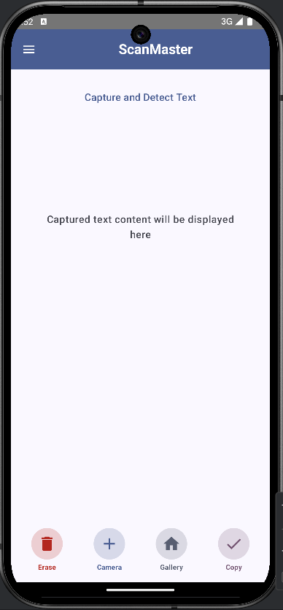
Home Screen Design
An Overview to the Home Screen
Top App Bar
The top bar on the home screen clearly identifies the app by showing the title "ScanMaster." It also has a dropdown menu for logging out, making it easy and secure for users to exit their sessions.
Main Area
The main area includes a text display card that clearly shows extracted text. It has a scrollable view, making it easy for users to read and navigate through longer text, improving the overall experience and accessibility.
Bottom Bar
At the bottom of the screen, there’s a bar with key action buttons: Erase, Camera, Gallery, and Copy. These buttons help users interact with the app, making it easier to manage the extracted content and improve overall usability.
Notes:
This is a screenshot of the Scan Master App's Home Screen. It looks exactly like the one we discussed in the previous slide.

Slide 9
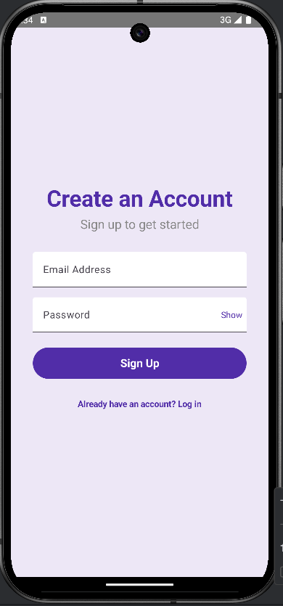
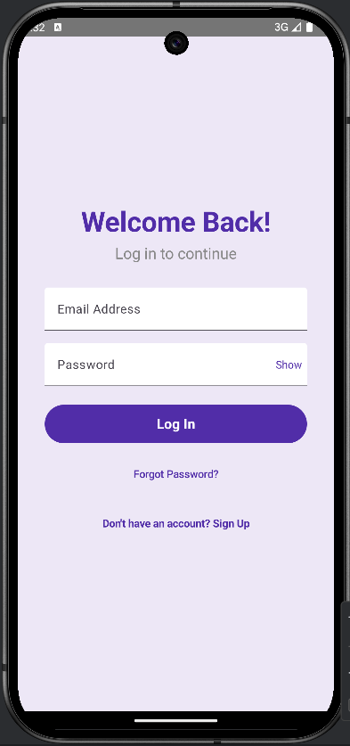
Firebase Integration
Enhancing Application Security and Performance
Secure User Authentication
Firebase Authentication offers a secure way to manage user login and signup. It ensures that only authorised users can access the app, helping protect user data and build trust.
Scalability and Reliability
Firebase ensures scalability and reliability, handling more users without problems.
Real-time Data Storage
User data is securely stored in the Firebase Realtime Database, ensuring real-time updates and syncing across devices. This keeps users updated with the latest information at all times (Firebase, 2024).
Notes:
Firebase is used for the app’s backend. It manages user authentication, ensuring that only authorized users can access the app. Firebase’s Realtime Database securely stores data and keeps it updated instantly, so users always have the latest information. It also scales well, so the app remains reliable as more users join. By using Firebase, it ensured that the app delivers high performance and security. This allows users to trust the app while enjoying its features without worrying about their data’s safety. And these are the screen shots of the login and signup screens of the Scan Master App.

Slide 10
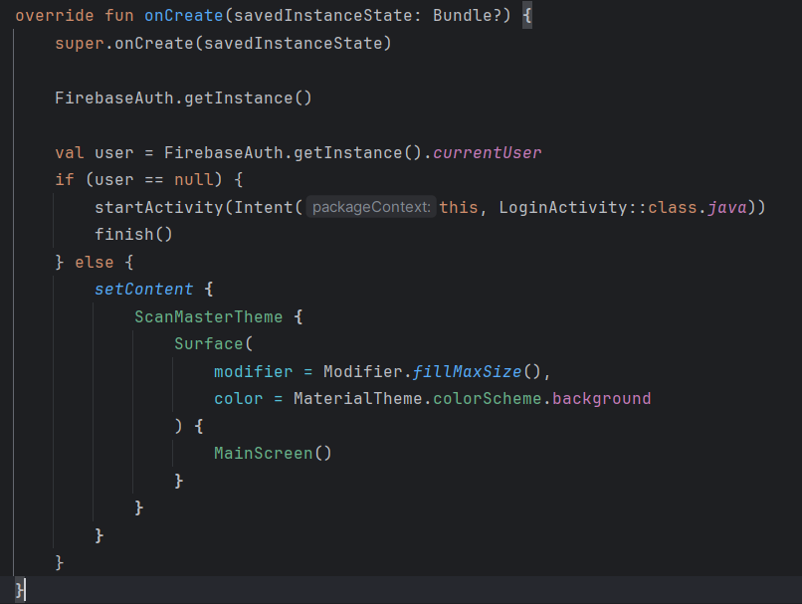
Firebase auth integration
Notes:
This is the code for the integration of Firebase in the app’s main activity.
This code is part of the app’s main activity and handles user authentication. When the app starts, it checks if a user is logged in using Firebase Authentication. If no user is logged in, it redirects them to the LoginActivity to sign in. If the user is already logged in, the app launches the main interface by displaying the MainScreen using Jetpack Compose. The ScanMasterTheme ensures a consistent app theme, while the Surface sets up the base UI with a full-screen layout and background color. This flow ensures users have a secure and seamless experience when accessing the app.

Slide 11


Google ML Kit Integration
Key features of Google ML Kit’s Text Recognition API.
High Accuracy in Text Detection
The Text Recognition API offers high accuracy in detecting both printed and handwritten text.
Seamless Integration into App Workflow
The Text Recognition API integrates smoothly into the app’s workflow. This makes it easy for developers to add text recognition features without major changes to the app, saving time and improving efficiency (Google For Developers, 2024).
Notes:
Google ML Kit is what makes the app smart. It uses machine learning to detect both printed and handwritten text with high accuracy. The integration is seamless, so users don’t experience any delays or complications. ML Kit processes text quickly and reliably, making the app suitable for a variety of use cases, like saving notes or capturing text from signs or documents. This advanced technology is key to the app’s success, as it handles complex tasks while keeping the experience simple for the user.

Slide 12
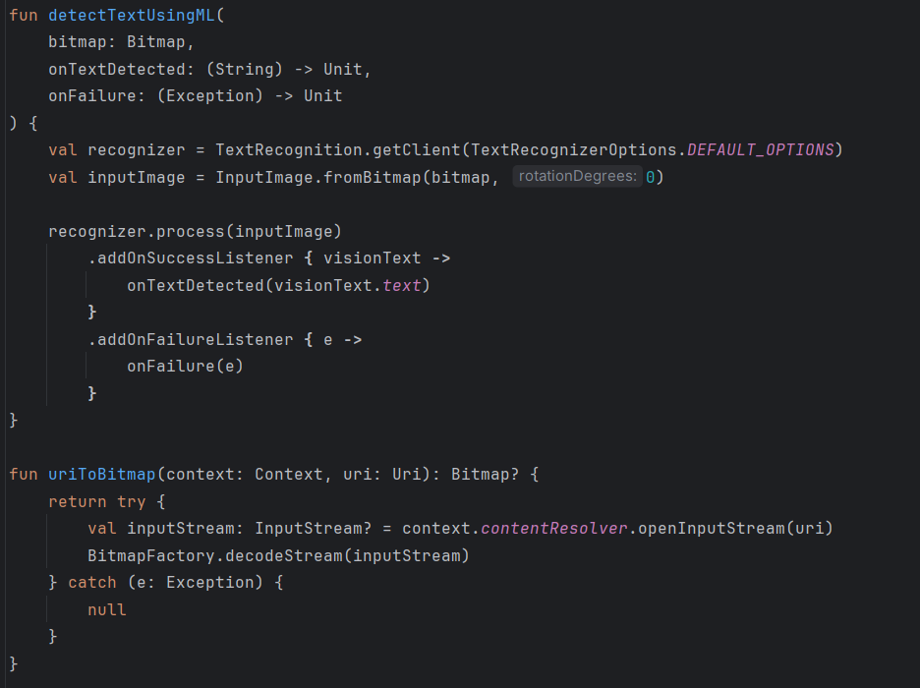
Text Detection using ml kit
Notes:
This code consists of two important functions for text detection in this app. The first function, detectTextUsingML, uses Google ML Kit to detect text from an image. It takes a bitmap image, processes it, and extracts text using a recognizer. If it’s successful, the extracted text is passed to onTextDetected. If it fails, the onFailure function handles the error. The second function, uriToBitmap, converts an image URI into a bitmap format. It opens the image file and decodes it into a bitmap that the text recognizer can process. Together, these functions enable accurate text detection in the app.

Slide 13
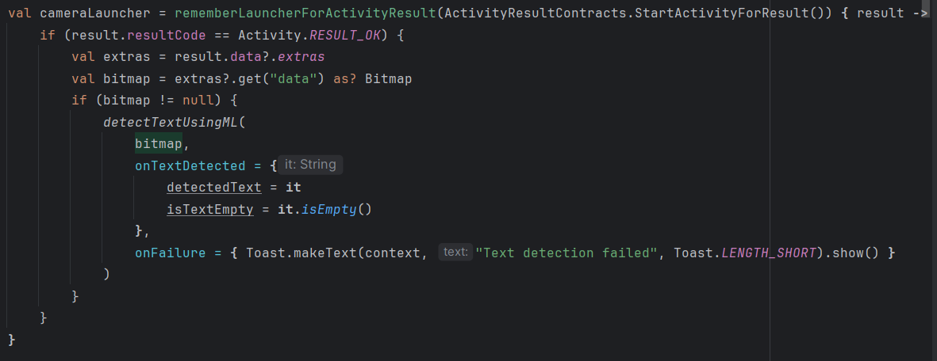
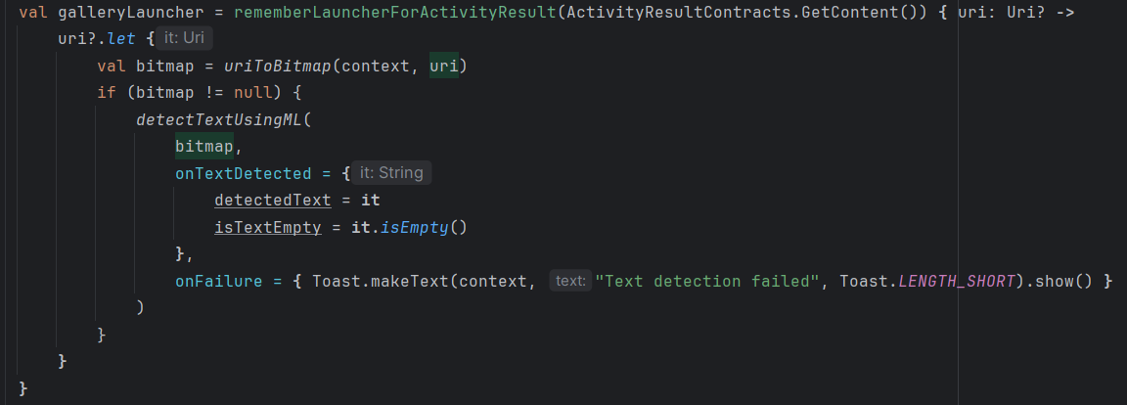
Integration of ml kit showcasing the image capture and upload logic
Notes:
This is the code of integration of the ML kit while launching the camera and gallery.
This code handles two ways of selecting images for text detection in our app. The cameraLauncher lets users take a photo using the camera. If the photo is successfully captured, it retrieves the image as a bitmap and processes it using the detectTextUsingML function. Similarly, the galleryLauncher allows users to select an image from their gallery. Once an image is chosen, it converts the URI into a bitmap using uriToBitmap and processes it. If text detection is successful, it updates the detectedText variable; otherwise, it shows an error message using a Toast. These launchers make the app user-friendly.

Slide 14

Key Benefits
Explore the benefits of using advanced text detection technology
Accuracy
Uses advanced Machine Learning algorithms to accurately detect both printed and handwritten text. This reduces errors and improves the reliability of extracting data.
Convenience
The interface is easy to use and straightforward, so users can navigate the app without problems. This makes it convenient to find quick solutions in their workflows.
Security
Using Firebase, user data is secured with strong security measures. This keeps sensitive information safe from unauthorised access.
Adaptability
This app can detect both printed and handwritten text, making it useful for different applications. Whether in education, business, or personal use, it adapts to the user’s needs.
Notes:
Scan-Master offers several benefits that make it stand out. First, its text recognition is highly accurate, thanks to machine learning. Second, the app is simple to use so that anyone can navigate it easily. Third, Firebase ensures strong data security so users can trust the app with their information. Lastly, the app is adaptable, handling both printed and handwritten text for various tasks. Whether for school, work, or personal use, Scan-Master saves time and effort. It’s a practical tool designed to make life easier.

Slide 15

Conclusion
Makes text extraction easy with a simple design and strong backend.
Uses Jetpack Compose, Firebase, and Google ML Kit to ensure speed and safety.
Designed to be flexible and easy to use with modern technology.
Combines advanced tools smoothly for better efficiency.
Shows how technology can simplify daily tasks.
Notes:
In summary, Scan-Master is a tool that simplifies text extraction using modern technologies. Jetpack Compose ensures a smooth interface, Firebase provides security, and Google ML Kit adds smart text recognition. This app is designed to save time and make tasks like note-taking or sharing information easier. It’s perfect for students, professionals, or anyone who deals with text frequently.

Slide 16
References
Google For Developers. (2024). Recognize text in images with ML Kit on Android. [online] Available at: https://developers.google.com/ml-kit/vision/text-recognition/v2/android.
Google (2023). Firebase. [online] Firebase. Available at: https://firebase.google.com/.
Android (2024). Kotlin and Android. [online] Android Developers. Available at: https://developer.android.com/kotlin.
Android Developers. (2024). Jetpack Compose UI App Development Toolkit. [online] Available at: https://developer.android.com/compose.
Android Developers. (2024). UI Design. [online] Available at: https://developer.android.com/design/ui.

Slide 17

Notes:
Thank you for your attention, and I’d be happy to answer any questions about the app.

