Slide 1

Flip Robo Technologies
HOUSING: PRICE PREDICTION
Submitted By -
Ganesh kumbhar

Slide 2
The problem
Introduction
Problem statement
Challenges
Houses are one of the necessary needs of each and every person around the globe and therefore housing and real estate market is one of the markets which is one of the major contributors in the world’s economy. It is a very large market and there are various companies working in the domain.
You are required to build a model using Machine Learning in order to predict the actual value of the prospective properties and decide whether to invest in them or not. For this company wants to know:
Which variables are important to predict the price of a variable?
How do these variables describe the price of the house

Slide 3
Mathematical/ Analytical Modeling of the Problem
Outliers
NaN Values
Grouping
Dropping Columns
Challenge 2
We cannot remove data through Z-score To remove the outliers we chose a top 12 feature selected the boundary condition after looking at the scatter plot and removed the row.
There are many features which have more than 50% data missing so we removed thode columns but the columns which have NaN value less then 50% we imputed the value with mean
The target data is given to us in continuous format and it will be very hard for us to classify continuous variables, so we divided the target
variable into 6 bins.
We dropped the columns on basis of their
Uniqueness
Zero Variance
Parent column after adding to other column.

Slide 4
We remove outliers of 12 highly correlated features by setting the boundary condition.
The data set has very high skewness and we removed it by using a Squae root method.
Data Pre Processing
START
1
2
3
4
We Checked the statistical summary of data.
We merged various columns as made new feature

Slide 5
We did encoding of categorical data by one hot encoding
To make data in standard scale we used the Robust Scaling method
5
6
7
8
END
We removed all the data which has 0 variance as they provide no value
to machine learning
We used train_test_split to split data for machine learning.

Slide 6
Visualization

Slide 7
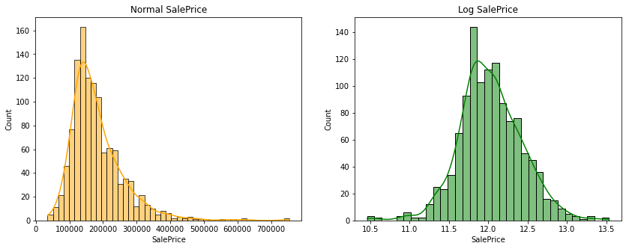
Label
Using Logarithms helps us to have a normal distribution which could help us in a number of different ways such as outlier detection.
In this data We have a right skewed distribution in which most Sales are between 0 and 340K

Slide 8
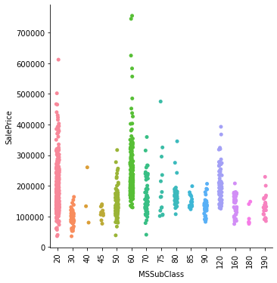
Discrete Feature Analysis
We plot various graphs of continuous Discrete data and its relationship with Sale Price, Below we will see strips in various graphs, and more the range of the srtip and denser the srtip more sales price depend on it.

Slide 9
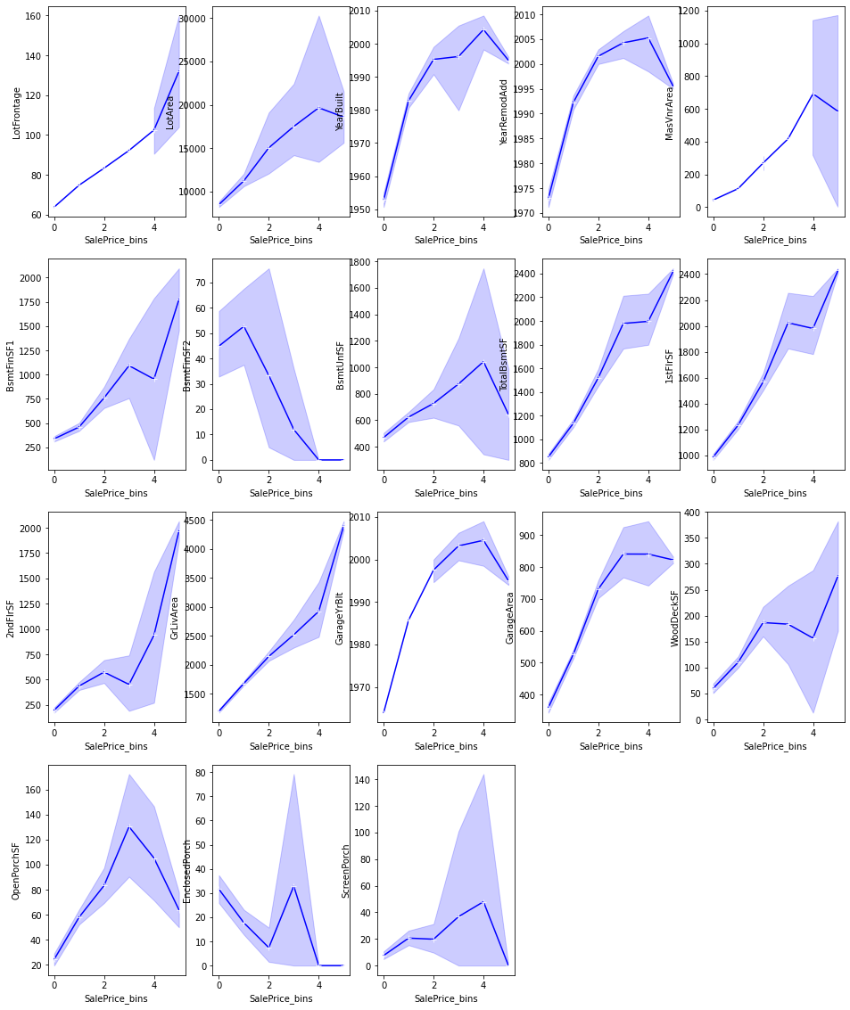
Continuous Data Analysis
We put divided the price into 6 bins to compare the continuous data, When the slope is positive that means at that Element of feature will effect that range of price

Slide 10
Machine Learning Model

Slide 11
Problem Solving Approaches
Feature Selection
Pipeline
Scaling
Skewness
Challenge 2
We used two approaches to select the feature first selection of feature by 0 variance and Merging Various columns.
We made pipeline to remove the chance of any data leakage.
The scale of data has high variance and to put data in in one scale which will increase the efficiency of our model for that we use Robust scaler library.
The data is very much skewed and to remove the skewness we used square root method this method is capable of dealing with high skewness

Slide 12
Models Used
Models
Normal Models
Bagging/Boosting
LinearRegressor
KNeighborsRegressor
ElasticNet
Lasso
Ridge
Decision Tree Regressor
SVR
RandomForestRegressor
AdaBoostClassRegressor
GradientBoostingRegressor
BaggingRegressor
ExtraTreesRegressor

Slide 13
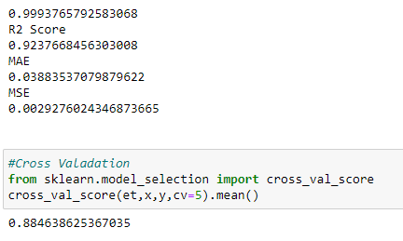
When we see the result of matrices we see that the we see that Gradient Boosting Regressor has best R2 , MAE , MSE and cross val score
R2 Score = 92%
MSE = 0.03
MAE = 0.002
Cross Val Score = 88%
Final Model
Gradient Boosting Regressor

Slide 14
Conclusion
Limitation
When we introduce the model people can pay for actual price and company will be able to find the property according to customer requirement.
Most of the Continuous Feature have positive overall positive relation with sale price
By altering some features like unfinished floor etc, which can increase the price
.
The high skewness of data reduces the effectivity
Many features have NaN value more than 50%, and imputation of them can decrease the effectiveness. And dropping them had the loss of data
we can increase the efficiency of a model by selecting a better method to remove outliers and skewness also how to make the search of perfect model in a way that if we want to change some parameters in model then we don't have to run all the model again

Slide 15
Thank You

