Slide 1
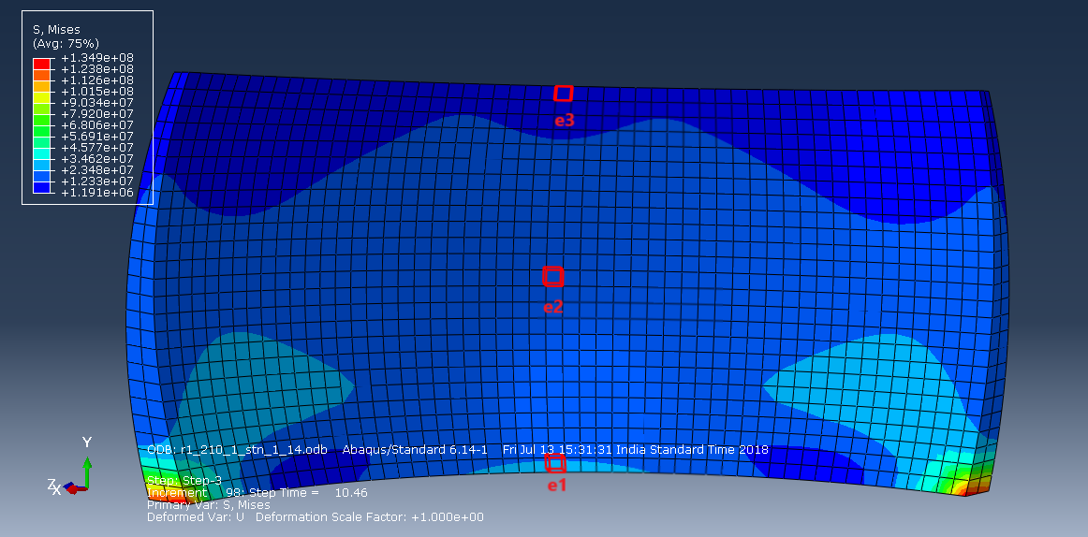
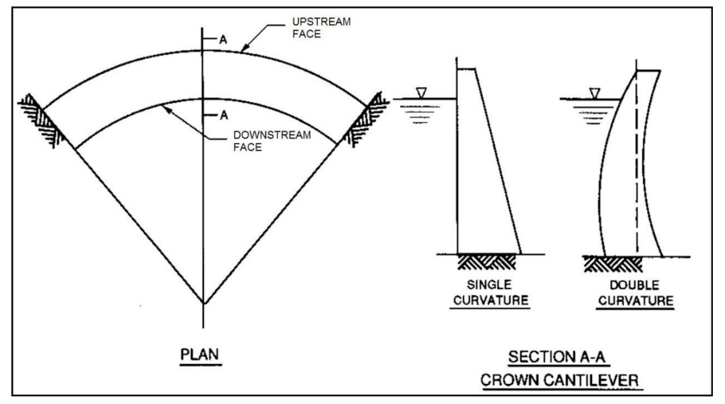
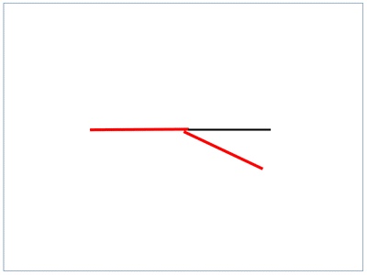
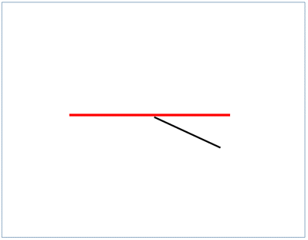
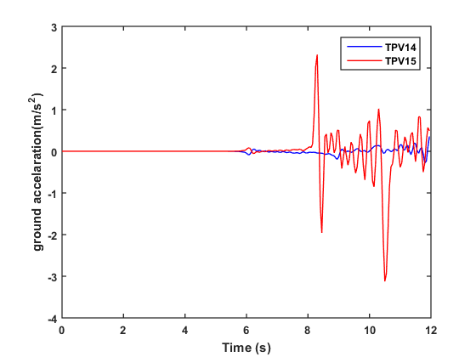
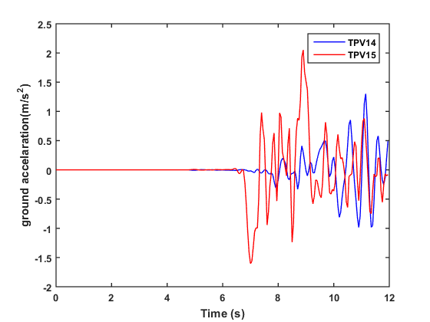
Seismic analysis of double curvature arch dams
Author¹, Author², …
Introduction:
Mesh size is 7m. We considered hexagonal element with 8-nodes (C3D8R).
A double curvature arch dams are curved in plan(horizontally) and in elevation(vertically).
In double curvature dams the radius of the curve of the circular arch in plan view and that of the abutments arches are changed. Both the arches are single centred and the thickness of the dam changes from the bottom to top.
We considered the dimensions of the idukki dam which is a double curvature dam in Kerala. Height: 168.91 meters; Length of the dam on its top: 365.85 meters; Bottom width: 19.81 meters; Top width: 7.62 meters.
The geometry of the dam we are considering is a simplified geometry as the detailed topographic information is not taken for the study and considered wide-U valley as the geographical condition.
Methodology:
We observed the maximum stress on the dam at three different points e1, e2 and e3.
Where e1 being the bottom point at the centre of the dam, e2 at the middle part in the same plane and e3 at top part of the dam in the same plane.
For a arch dam located at a branch fault, seismic analysis is done for different models of arch dams with varying radius of curvature.
We kept the radius r1 of the plan view arch constant at 210m and changed the abutment side arch radius r2 with ratios r1/r2 at 0.8, 1 and 1.2
Figure 1. single and double
curvature arch dam
Results:
Click here to insert your Conclusions text. Type it in or copy and paste from your Word document or other source.
Earthquake data:
You can change the size of the table and can adjust the text pattern.
Avoid changing font size and text style.
Labeling for table has to be on the top of the table as shown.
Table 1. Label in 24pt
We considered a earthquake rupture for branched fault system
Where the TPV14 is the situation where the earthquake wave propagates in straight path and in TPV15 the maximum wave propagation is into the branch fault.
The station 1 is situated at 20 km from the centre of the fault in x-direction and station 2 is at 20 km from centre at angle of 30°.
We only considered the horizontal acceleration data (i.e. in X-direction).
 | Heading | Heading | Heading
Item | 800 | 790 | 4001
Item | 356 | 856 | 290
Item | 228 | 134 | 238
Item | 954 | 875 | 976
Conclusions:
(a) Right-lateral strike slip rupture(TPV14)
(b) Left-lateral strike slip rupture(TPV15)
Station 1
Station 2
Model Characteristics:
Due to computational effort we considered only density of the concrete and elastic properties for the model.
Gravity load is applied to the whole model. Reservoir and dam interactions are considered as hydrostatic interactions.
The bottom part of the dam is fixed with no translations and rotations in any directions. The abutment sides are fixed with no displacements.
The earthquake boundary condition is applied for station 1 at tpv14 and tpv15; station 2 at tpv14 and tpv15. For the earthquake boundary condition step the bottom fixed boundary condition is deactivated.
Important References:
An Interactive Tool for Automatic Predimensioning and Numerical Modelling of Arch Dams
D. J . Vicente, J. San Mauro, F. Salazar and C. M. Baena
Design of Double-Curvature Arch Dams in Terms of Geometric and Stress Constraints by Using Script-Based Finite Element Modelling - Goulas, E
Design of Double-Curvature Arch Dams Planning, Appraisal, Feasibility Level
U.S. Department of the Interior Bureau of Reclamation Technical Service Centre Denver, Colorado
Arch Dams: Designing and Monitoring for Safety edited by Jose O. Pedro, National laboratory of civil engineering
Seismic analysis of a concrete gravity dam - An example in SIMULIA User Assistance 2017
ganesh15065@mechyd.ac.in
Internship/research carried at IIT HYDERABAD

