Slide 1
Operating Systems
Before apps, games, or code—there’s the OS.
Core Computer Science Subject.
Open-Source vs Closed Source.

Slide 2
What is an Operating System?
OS is a program that manages a computer’s hardware.
It also provides a basis for application programs and acts as an Intermediary between the computer user and the computer hardware.

Slide 3
Functions of OS
Process Management
Manages execution of processes (programs in execution)
Handles multitasking, process scheduling, creation, and termination
Memory Management
Allocates and deallocates memory space to programs
Maintains memory hierarchy (RAM, cache, etc.)
Ensures no overlap between processes (protection)
File System Management
Organizes data in files and directories
Controls reading, writing, access permissions, and storage
Device Management
Manages input/output devices (keyboard, printer, disk drives)
Uses device drivers and handles I/O operations efficiently
User Interface (UI)
Provides interface for user interaction: CLI (Command-Line Interface) or GUI (Graphical User Interface)
Security and Access Control
Protects data and system resources from unauthorized access
Implements user authentication, permissions, and encryption

Slide 4
Functions of OS contd…
Resource Allocation
Allocates CPU time, memory, and I/O resources to various programs and users
System Performance Monitoring
Tracks system performance, logs usage stats, and helps in optimization
Networking
Manages data exchange between computers in a network
Provides support for network protocols and communication
Error Detection and Handling
Detects system errors or malfunctions and takes corrective actions
Job Scheduling (in Batch Systems)
Schedules batch jobs for efficient processing in large-scale systems

Slide 5
Goals of OS
Convenience (Primary)
Execute user programs and make solving user problems easier.
Make the computer system convenient to use
Efficiency (Secondary)
Use the computer hardware in an efficient manner
Both

Slide 6
Computer System Structure
Computer system can be divided into four components
Hardware – provides basic computing resources
CPU, memory, I/O devices
Operating system
Controls and coordinates use of hardware among various applications and users
Application programs – define the ways in which the system resources are used to solve the computing problems of the users
Word processors, compilers, web browsers, database systems, video games
Users
People, machines, other computers

Slide 7
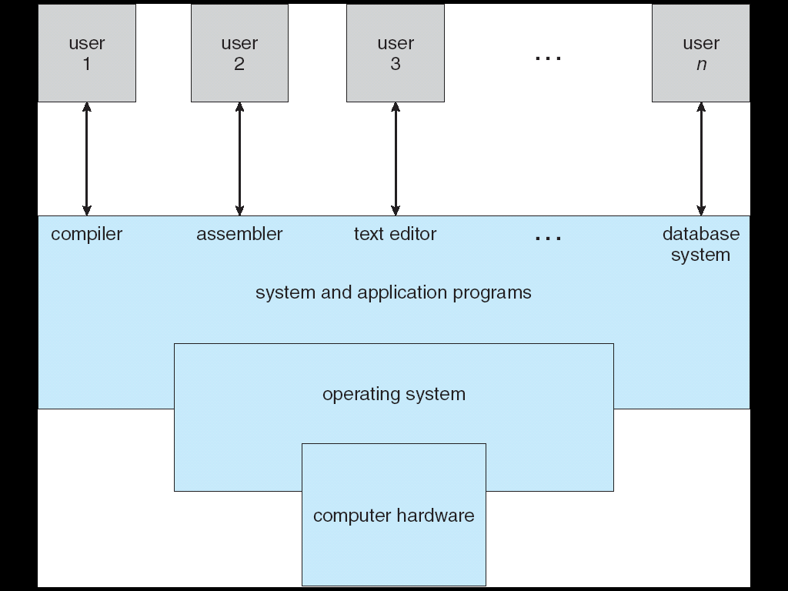
Components of a Computer System
Fig. Abstract View of the components of a computer system.

Slide 8
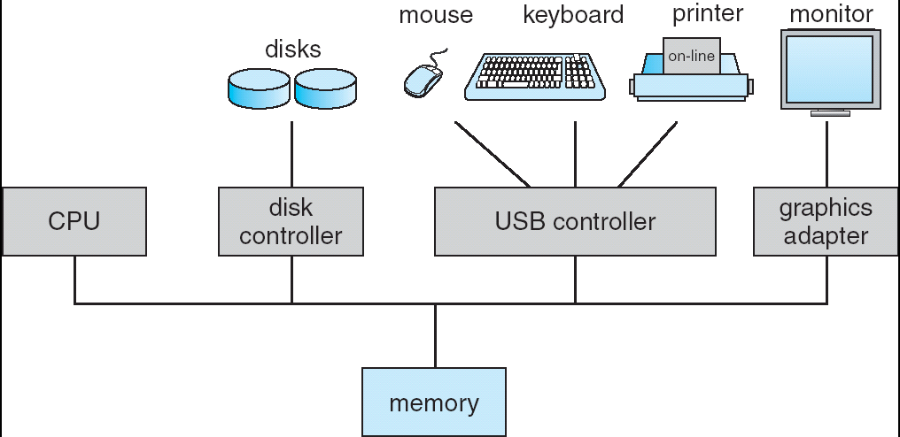
Computer System Organization
Computer-system operation
One or more CPUs, device controllers connect through common bus providing access to shared memory
Concurrent execution of CPUs and devices competing for memory cycles
Fig. A modern computer system

Slide 9
What happens when you power on the computer?
Power On
↓
BIOS/UEFI
↓
Boot Loader (GRUB / Bootmgr)
↓
Kernel (Linux, Windows, macOS)
↓
Init/Systemd (user-space setup)
↓
Login Screen → Desktop → User Environment

Slide 10
The Booting Process – Step by Step
Step 0: You Press the Power Button
Power is supplied to the motherboard.
All hardware components (CPU, RAM, disks) are energized and reset.
Step 1: CPU starts executing firmware – BIOS/UEFI
The CPU is wired to begin execution from a predefined memory address (usually in the firmware chip).
This chip contains BIOS (Basic Input/Output System) or UEFI (Unified Extensible Firmware Interface).
BIOS/UEFI Responsibilities:
Run POST (Power-On Self-Test): Checks CPU, RAM, keyboard, disk, etc.
Initialize basic hardware (keyboard, video, storage).
Detect connected bootable devices (e.g., SSD, HDD, USB, DVD).
Locate the Boot Loader on the bootable device.

Slide 11
Step 2: Boot Loader is loaded into RAM
A boot loader is a small program located in the Master Boot Record (MBR) or EFI partition of the boot disk.
GRUB (Linux)
LILO (legacy Linux)
Windows Boot Manager (bootmgr)
Boot Loader's Job:
Initialize low-level system components further.
Load the Operating System kernel from disk into RAM.
Pass control to the kernel.
Note: Boot loader is like a bridge between firmware and the OS.

Slide 12
Step 3: The Kernel is loaded into RAM
Now the kernel of the operating system (e.g., vmlinuz in Linux, ntoskrnl.exe in Windows) is loaded.
What the Kernel Does:
Initializes memory management
Sets up CPU scheduling
Initializes hardware drivers (via kernel modules)
Mounts the root file system
Starts system services
Note: Once the kernel is loaded, it takes full control of the system.
Step 4: User Space Initialization (init/systemd)
After the kernel finishes setting up low-level tasks, the first user-space process starts:
In Linux: init or systemd
In Windows: wininit.exe and then services.exe
In this stage:
Starts system services (like networking, GUI, printers)
Starts the login screen (TTY or GUI login manager)
Allows users to interact with the system

Slide 13
Step 5: User Login and GUI
After all services are up:
The GUI appears (like GNOME, KDE, or Windows desktop).
The user logs in.
The OS starts with user-specific applications.
Now the system is fully booted and ready to use.

Slide 14
Storage Structure
Main memory – only large storage media that the CPU can access directly.
Secondary storage – extension of main memory that provides large nonvolatile storage capacity.
Magnetic disks – rigid metal or glass platters covered with magnetic recording material
Disk surface is logically divided into tracks, which are subdivided into sectors.
The disk controller determines the logical interaction between the device and the computer.

Slide 15
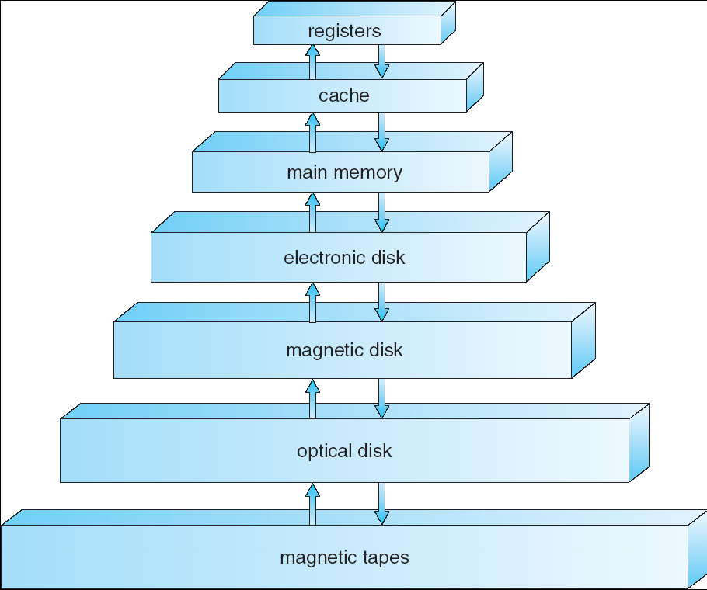
Storage Hierarchy
Storage systems organized in hierarchy.
Speed
Cost
Volatility
Caching – copying information into faster storage system; main memory can be viewed as a last cache for secondary storage.
Fig: Storage-device hierarchy

Slide 16
Types of OS
Batch OS (Non-Preemptive)
Time Sharing OS
Distributed OS
Network OS
Real Time OS
Multiprogramming/Multiprocessing/Multi Tasking OS

Slide 17
Multiprogramming
Single user cannot always keep CPU and I/O devices busy
Multiprogramming organizes jobs (code and data) so CPU always has one to execute
A subset of total jobs in system is kept in memory
One job selected and run via job scheduling
When job has to wait (for I/O for example), OS switches to another job

Slide 18
Multitasking (Timesharing)
A logical extension of Batch systems– the CPU switches jobs so frequently that users can interact with each job while it is running, creating interactive computing
Response time should be < 1 second
Each user has at least one program executing in memory  process
If several jobs ready to run at the same time  CPU scheduling
If processes don’t fit in memory, swapping moves them in and out to run
Virtual memory allows execution of processes not completely in memory

Slide 19
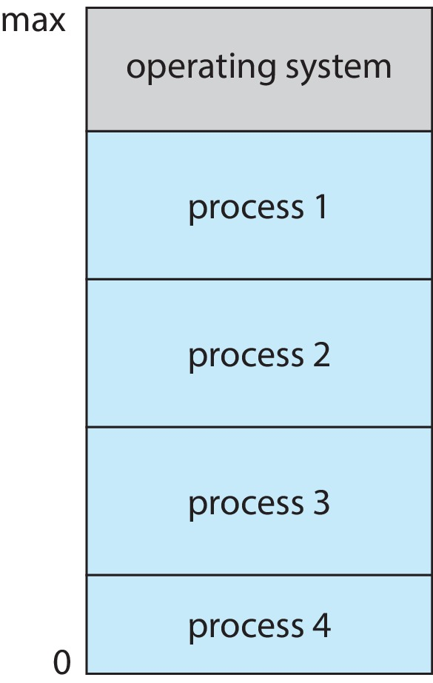
Memory Layout for Multiprogrammed System

Slide 20
Dual-mode Operation
Dual-mode operation allows OS to protect itself and other system components
User mode and kernel mode
Mode bit provided by hardware
Provides ability to distinguish when system is running user code or kernel code.
When a user is running  mode bit is “user”
When kernel code is executing  mode bit is “kernel”
How do we guarantee that user does not explicitly set the mode bit to “kernel”?
System call changes mode to kernel, return from call resets it to user
Some instructions designated as privileged, only executable in kernel mode

Slide 21
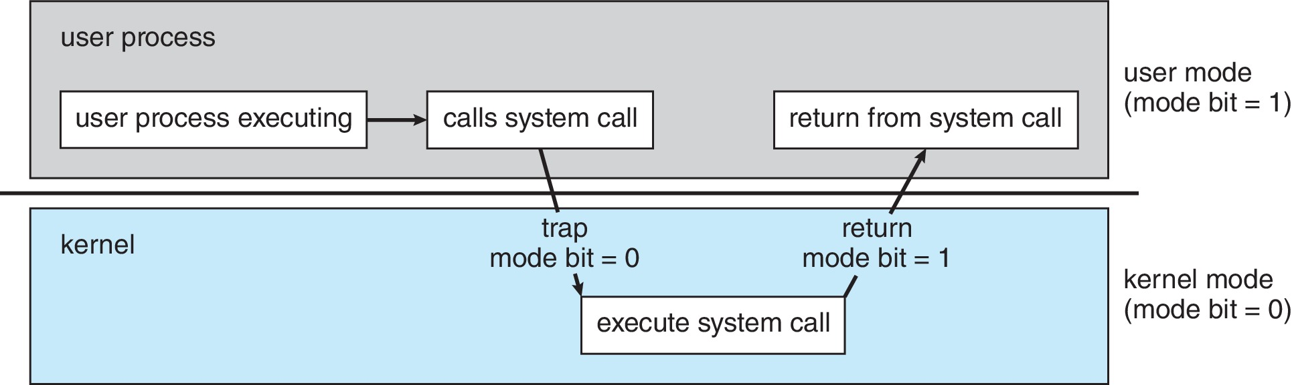
Transition from User to Kernel Mode

Slide 22
Timer
Timer to prevent infinite loop (or process hogging resources)
Timer is set to interrupt the computer after some time period
Keep a counter that is decremented by the physical clock
Operating system set the counter (privileged instruction)
When counter zero generate an interrupt
Set up before scheduling process to regain control or terminate program that exceeds allotted time

Slide 23
Computer System Environments

Slide 24
Computing Environments
Traditional
Mobile
Client Server
Peer-to-Peer
Cloud computing
Real-time Embedded

Slide 25
Traditional
Stand-alone general-purpose machines
But blurred as most systems interconnect with others (i.e., the Internet)
Portals provide web access to internal systems
Network computers (thin clients) are like Web terminals
Mobile computers interconnect via wireless networks
Networking becoming ubiquitous – even home systems use firewalls to protect home computers from Internet attacks

Slide 26
Mobile
Handheld smartphones, tablets, etc.
What is the functional difference between them and a “traditional” laptop?
Extra feature – more OS features (GPS, gyroscope)
Allows new types of apps like augmented reality
Use IEEE 802.11 wireless, or cellular data networks for connectivity
Leaders are Apple iOS and Google Android

Slide 27
Client Server
Client-Server Computing
Dumb terminals supplanted by smart PCs
Many systems now servers, responding to requests generated by clients
Compute-server system provides an interface to client to request services (i.e., database)
File-server system provides interface for clients to store and retrieve files

Slide 28
Peer-to-Peer
Another model of distributed system
P2P does not distinguish clients and servers
Instead all nodes are considered peers
May each act as client, server or both
Node must join P2P network
Registers its service with central lookup service on network, or
Broadcast request for service and respond to requests for service via discovery protocol
Examples include Napster and Gnutella, Voice over IP (VoIP) such as Skype

Slide 29
Cloud Computing
Delivers computing, storage, even apps as a service across a network
Logical extension of virtualization because it uses virtualization as the base for its functionality.
Amazon EC2 has thousands of servers, millions of virtual machines, petabytes of storage available across the Internet, pay based on usage

Slide 30
Cloud Computing (Cont.)
Many types
Public cloud – available via Internet to anyone willing to pay
Private cloud – run by a company for the company’s own use
Hybrid cloud – includes both public and private cloud components
Software as a Service (SaaS) – one or more applications available via the Internet (i.e., word processor)
Platform as a Service (PaaS) – software stack ready for application use via the Internet (i.e., a database server)
Infrastructure as a Service (IaaS) – servers or storage available over Internet (i.e., storage available for backup use)

Slide 31
Cloud Computing (cont.)
Cloud computing environments composed of traditional OSes, plus VMMs, plus cloud management tools
Internet connectivity requires security like firewalls
Load balancers spread traffic across multiple applications

Slide 32
Real-Time Embedded Systems
Real-time embedded systems most prevalent form of computers
Vary considerable, special purpose, limited purpose OS, real-time OS
Use expanding
Many other special computing environments as well
Some have OSes, some perform tasks without an OS
Real-time OS has well-defined fixed time constraints
Processing must be done within constraint
Correct operation only if constraints met

Slide 33
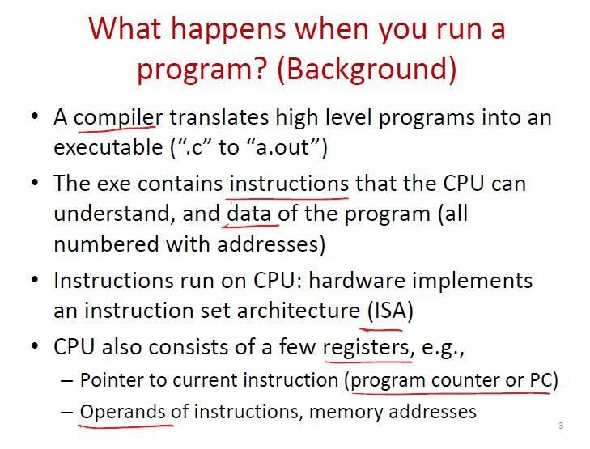
KABhat (Asst. Prof. SoCS UPES)
Operating System
August 12, 2025

Slide 34
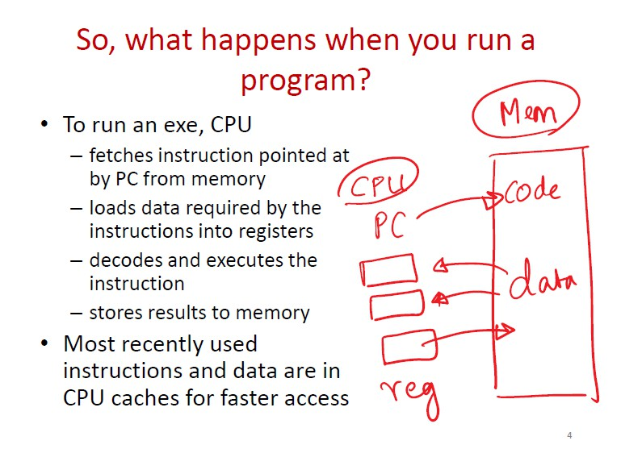
KABhat (Asst. Prof. SoCS UPES)
Operating System
August 12, 2025
7 / 35

Slide 35
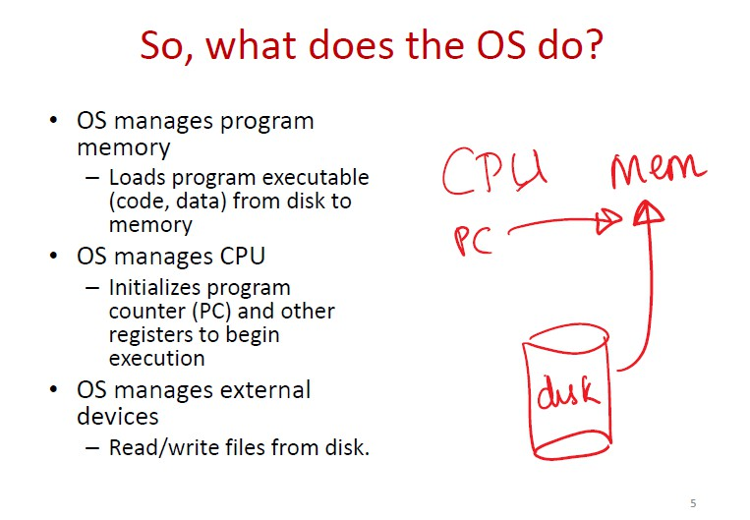
KABhat (Asst. Prof. SoCS UPES)
Operating System
August 12, 2025
8 / 35

Slide 36
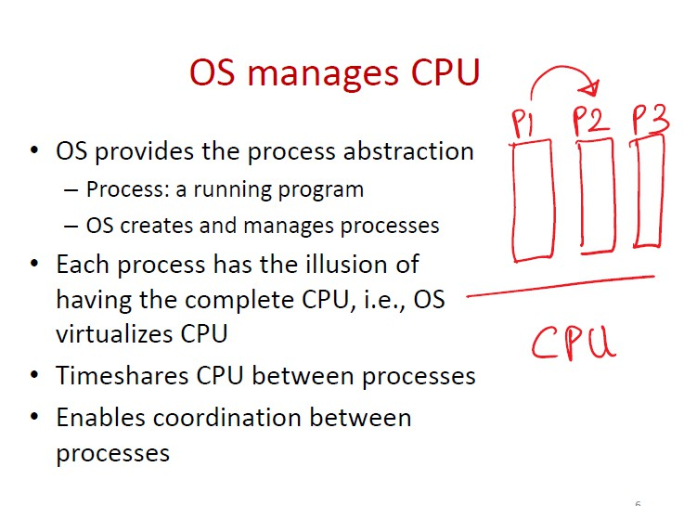
KABhat (Asst. Prof. SoCS UPES)
Operating System
August 12, 2025
9 / 35

Slide 37
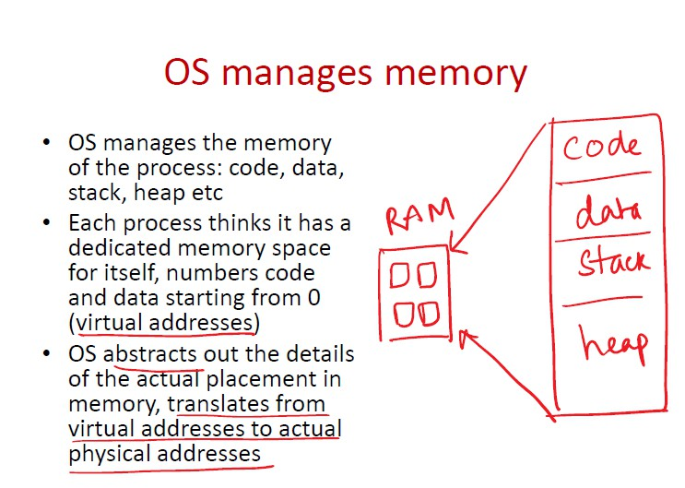
KABhat (Asst. Prof. SoCS UPES)
Operating System
August 12, 2025
10 / 35

Slide 38
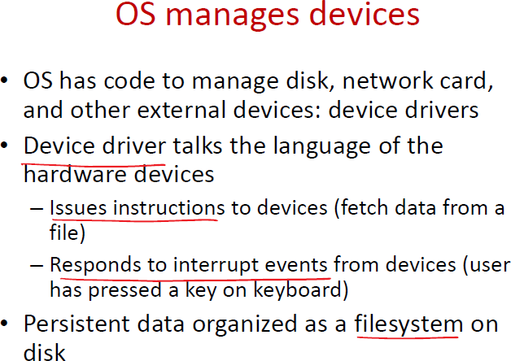
KABhat (Asst. Prof. SoCS UPES)
Operating System
August 12, 2025
11 / 35

Slide 39
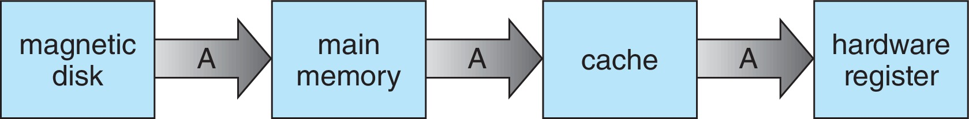
Migration of data “A” from Disk to Register
Multitasking environments must be careful to use most recent value, no matter where it is stored in the storage hierarchy
Multiprocessor environment must provide cache coherency in hardware such that all CPUs have the most recent value in their cache
Distributed environment situation even more complex
Several copies of a datum can exist
Various solutions covered in Chapter 19

Slide 40
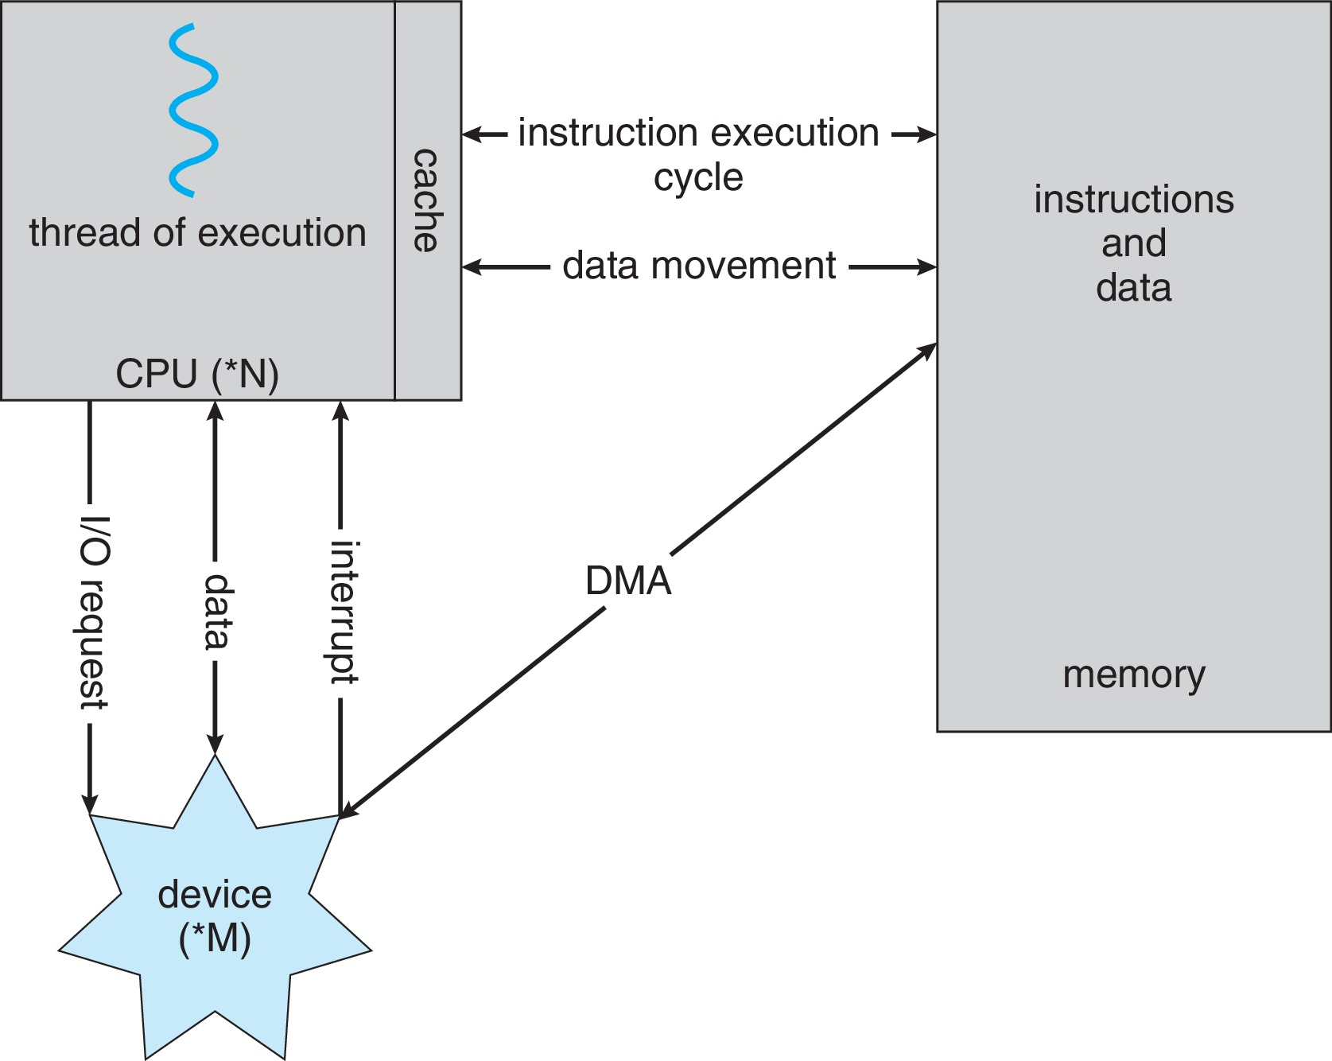
How a Modern Computer Works
A von Neumann architecture

Slide 41
Direct Memory Access Structure
Used for high-speed I/O devices able to transmit information at close to memory speeds
Device controller transfers blocks of data from buffer storage directly to main memory without CPU intervention
Only one interrupt is generated per block, rather than the one interrupt per byte

Slide 42
Operating-System Operations
Bootstrap program – simple code to initialize the system, load the kernel
Kernel loads
Starts system daemons (services provided outside of the kernel)
Kernel interrupt driven (hardware and software)
Hardware interrupt by one of the devices
Software interrupt (exception or trap):
Software error (e.g., division by zero)
Request for operating system service – system call
Other process problems include infinite loop, processes modifying each other or the operating system

Slide 43
Free and Open-Source Operating Systems
Operating systems made available in source-code format rather than just binary closed-source and proprietary
Counter to the copy protection and Digital Rights Management (DRM) movement
Started by Free Software Foundation (FSF), which has “copyleft” GNU Public License (GPL)
Free software and open-source software are two different ideas championed by different groups of people
https://www.gnu.org/philosophy/open-source-misses-the-point.en.html
Examples include GNU/Linux and BSD UNIX (including core of Mac OS X), and many more
Can use VMM like VMware Player (Free on Windows), Virtualbox (open source and free on many platforms - http://www.virtualbox.com)
Use to run guest operating systems for exploration

Slide 44
Virtualization
Allows operating systems to run applications within other OSes
Vast and growing industry
Emulation used when source CPU type different from target type (i.e. PowerPC to Intel x86)
Generally slowest method
When computer language not compiled to native code – Interpretation
Virtualization – OS natively compiled for CPU, running guest OSes also natively compiled
Consider VMware running WinXP guests, each running applications, all on native WinXP host OS
VMM (virtual machine Manager) provides virtualization services

Slide 45
Virtualization (cont.)
Use cases involve laptops and desktops running multiple OSes for exploration or compatibility
Apple laptop running Mac OS X host, Windows as a guest
Developing apps for multiple OSes without having multiple systems
Quality assurance testing applications without having multiple systems
Executing and managing compute environments within data centers
VMM can run natively, in which case they are also the host
There is no general-purpose host then (VMware ESX and Citrix XenServer)

Slide 46
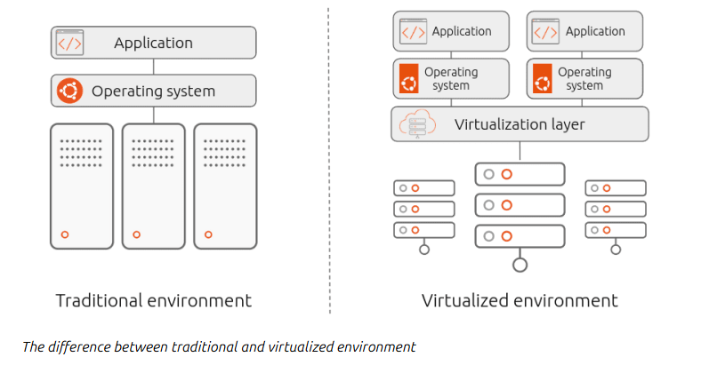
Virtualization vs. Containerization
Virtualization is a technology that creates virtual versions of computer resources such as hardware platforms, operating systems, storage devices, and network resources. It’s like creating a software-based replica of a physical machine, allowing you to run multiple isolated environments on the same hardware or across a distributed system.
Containerization is a lightweight form of virtualization that allows you to run applications and their dependencies in isolated containers. Each container shares the same operating system kernel but is isolated from other containers, providing a portable and consistent runtime environment for applications.

Slide 47
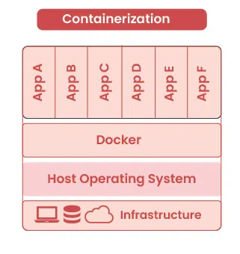
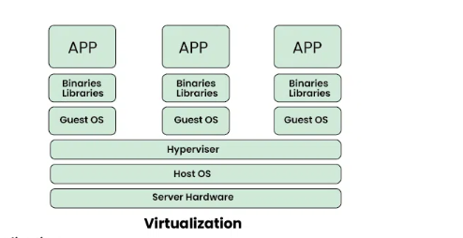
Containerization also allows users to run many instances on a single physical host, but it does so without needing the hypervisor to act as an intermediary. Instead, the functionality of the host system kernel is used to isolate multiple independent instances (containers). By sharing the host kernel and operating system, containers avoid the overhead of virtualization, as there’s no need to provide a separate virtual kernel and OS for each instance. This is why containers are considered a more lightweight solution
Virtualization is the process of creating a virtual version of a resource such as hardware, storage, network, or an entire operating system.
a) Definition
It allows multiple operating systems (called guests) to run on a single physical machine (called the host) using a software layer called a hypervisor.

Slide 48
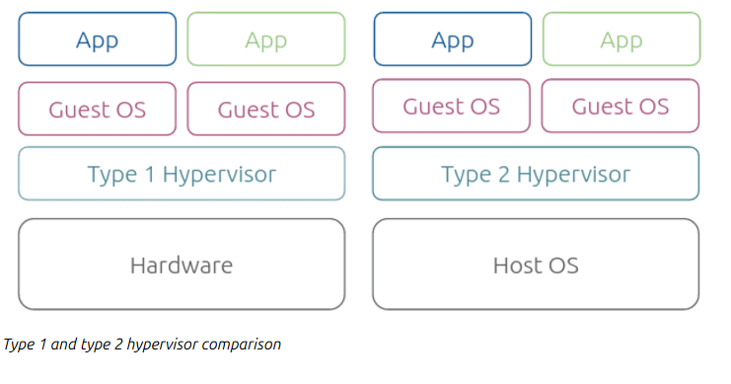
The role of a hypervisor
Virtualization wouldn’t be possible without a hypervisor (also known as a virtual machine monitor) – a software layer enabling multiple operating systems to co-exist while sharing the resources of a single hardware host. The hypervisor acts as an intermediary between virtual machines and the underlying hardware, allocating host resources such as memory, CPU, and storage.
There are two main types of hypervisors: Type 1 and Type 2.
Type 1 hypervisors, also known as bare-metal hypervisors, run directly on the host’s hardware and are responsible for managing the hardware resources and running the virtual machines. Because they run directly on the hardware, they are often more efficient and have a smaller overhead than Type 2 hypervisors. Examples of Type 1 hypervisors include VMware ESXi, Microsoft Hyper-V, and Citrix XenServer.
Type 2 hypervisors, also known as hosted hypervisors, run on top of a host operating system and rely on it to provide the necessary hardware resources and support. Because they run on top of an operating system, they are often easier to install and use than Type 1 hypervisors, but they might be less efficient. Examples of Type 2 hypervisors include VMware Workstation and Oracle VirtualBox.

Slide 49
Evolution/History
1
First Generation
▶ Vacuum Tubes
▶ Machine language
▶ Serial processing
2
Second Generation
▶ Transistors
▶ Batch Operating System
3
Third Generation
▶ IC’s
▶ Multiprogramming + Time sharing
4
Fourth Generation
▶ VLSI
Microprocessors
▶ Graphical User Interface
▶ MS-DOS, Windows-X, N/W OS, Distributed OS
KABhat (Asst. Prof. SoCS UPES)
Operating System
August 12, 2025

Slide 50
Dual-mode Operation
Dual-mode operation allows OS to protect itself and other system components
User mode and kernel mode
Mode bit provided by hardware
Provides ability to distinguish when system is running user code or kernel code.
When a user is running  mode bit is “user”
When kernel code is executing  mode bit is “kernel”
How do we guarantee that user does not explicitly set the mode bit to “kernel”?
System call changes mode to kernel, return from call resets it to user
Some instructions designated as privileged, only executable in kernel mode

Slide 51
Transition from User to Kernel Mode

Slide 52
Terms Discussed
Device Controller vs Device Driver
32bit systems vs 64 bit systems
Kernel (Types)
Cmd (uniprocessor) Single tasking
IPC enables communication between processes
Message Passing
Shared Memory

Slide 53
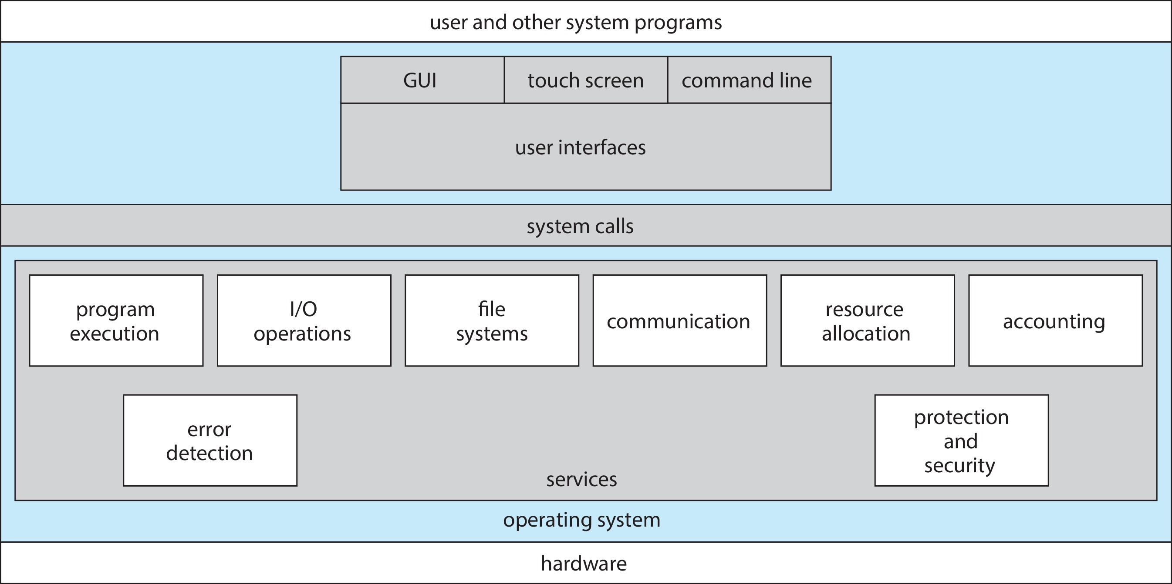
A View of Operating System Services

Slide 54
Operating System Services
Operating systems provide an environment for execution of programs and services to programs and users
One set of operating-system services provides functions that are helpful to the user:
User interface - Almost all operating systems have a user interface (UI).
Varies between Command-Line (CLI), Graphics User Interface (GUI), touch-screen, Batch
Program execution - The system must be able to load a program into memory and to run that program, end execution, either normally or abnormally (indicating error)
I/O operations - A running program may require I/O, which may involve a file or an I/O device
File-system manipulation - The file system is of particular interest. Programs need to read and write files and directories, create and delete them, search them, list file Information, permission management.

Slide 55
Operating System Services (Cont.)
One set of operating-system services provides functions that are helpful to the user (Cont.):
Communications – Processes may exchange information, on the same computer or between computers over a network
Communications may be via shared memory or through message passing (packets moved by the OS)
Error detection – OS needs to be constantly aware of possible errors
May occur in the CPU and memory hardware, in I/O devices, in user program
For each type of error, OS should take the appropriate action to ensure correct and consistent computing
Debugging facilities can greatly enhance the user’s and programmer’s abilities to efficiently use the system

Slide 56
Operating System Services (Cont.)
Another set of OS functions exists for ensuring the efficient operation of the system itself via resource sharing
Resource allocation - When multiple users or multiple jobs running concurrently, resources must be allocated to each of them
Many types of resources - CPU cycles, main memory, file storage, I/O devices.
Logging - To keep track of which users use how much and what kinds of computer resources
Protection and security - The owners of information stored in a multiuser or networked computer system may want to control use of that information, concurrent processes should not interfere with each other
Protection involves ensuring that all access to system resources is controlled
Security of the system from outsiders requires user authentication, extends to defending external I/O devices from invalid access attempts

Slide 57
Types of Kernels
Monolithic kernel
Microkernel
Hybrid kernel

Slide 58
Interrupt Handling
The operating system preserves the state of the CPU by storing the registers and the program counter
Determines which type of interrupt has occurred:
Separate segments of code determine what action should be taken for each type of interrupt

Slide 59
System Calls
Programming interface to the services provided by the OS
Typically written in a high-level language (C or C++)
Mostly accessed by programs via a high-level Application Programming Interface (API) rather than direct system call use
Three most common APIs are Win32 API for Windows, POSIX API for POSIX-based systems (including virtually all versions of UNIX, Linux, and Mac OS X), and Java API for the Java virtual machine (JVM)

Slide 60

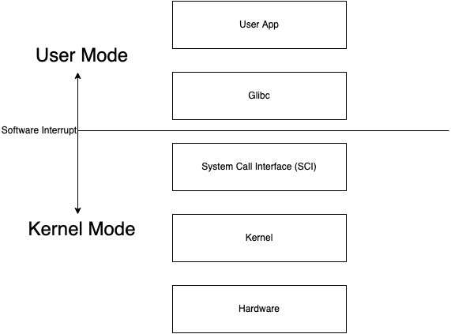
System Calls
A system call is a mechanism using which a user program can request a service from the kernel for which it does not have the permission to perform.
User programs typically do not have permission to perform operations like accessing I/O devices and communicating other programs.
System Calls are the only way through which a process can go into kernel mode from user mode.

Slide 61
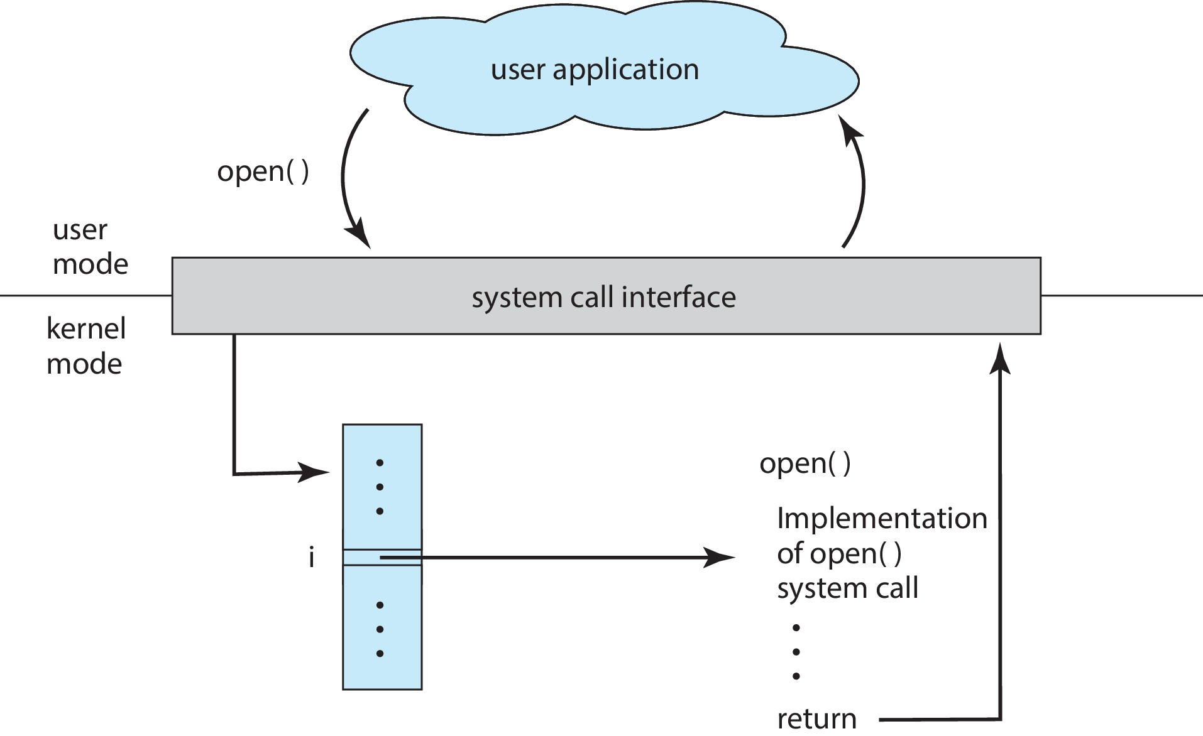
API – System Call – OS Relationship

Slide 62
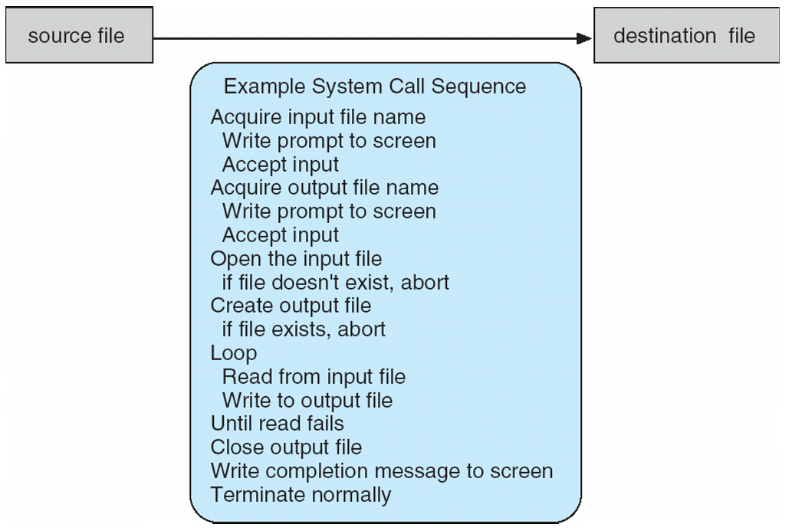
Example of System Calls
System call sequence to copy the contents of one file to another file

Slide 63
System Calls
How do apps interact with Kernel? -> using system calls.
Eg. Mkdir dummyfolder
Mkdir indirectly calls kernel and asked the file mgmt. module to create a new
directory.
Mkdir is just a wrapper of actual system calls.
Mkdir interacts with kernel using system calls.
Eg. Creating a process.
User executes a process. (User space)
Gets system call. (US)
Exec system call to create a process. (KS)
Return to US.
Transitions from US to KS done by software interrupts. System calls are implemented in C.

Slide 64
Types of System Calls:
Process Control
end, abort
load, execute
create process, terminate process
get process attributes, set process attributes
wait for time
wait event, signal event
allocate and free memory
File Management
create file, delete file
open, close
read, write, reposition
get file attributes, set file attributes
Device Management
request device, release device
read, write, reposition
get device attributes, set device attributes
logically attach or detach devices

Slide 65
Types of System Calls (contd):
Information maintenance
get time or date, set time or date
get system data, set system data
get process, file, or device attributes
set process, file, or device attributes
Communication Management
create, delete communication connection
send, receive messages
transfer status information
attach or detach remote devices

Slide 66
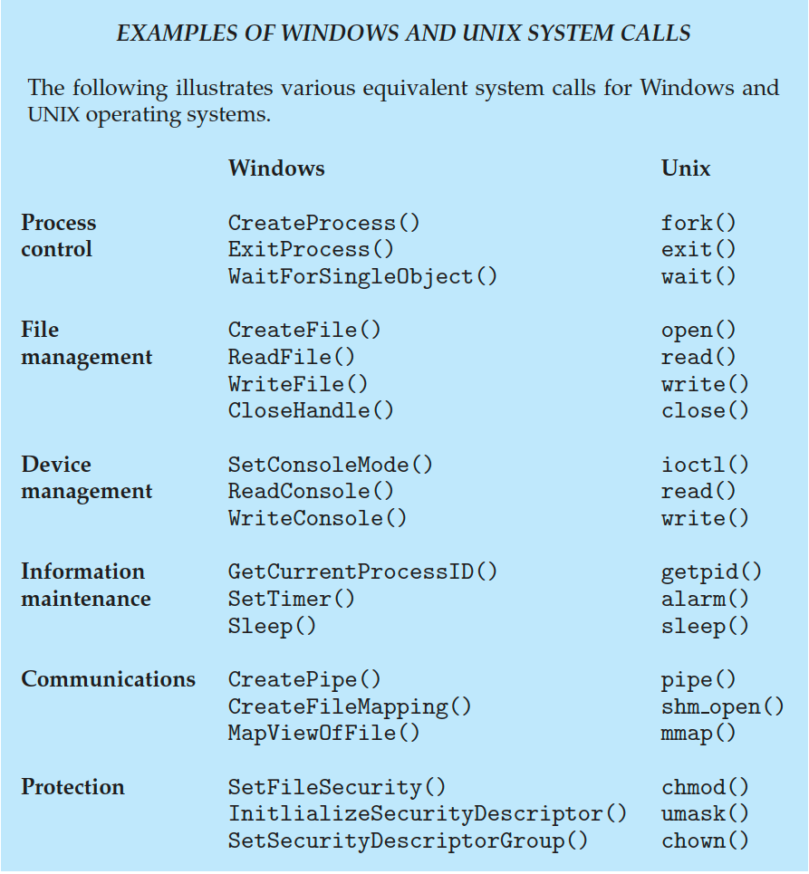
Examples of Windows and Unix System Calls

Slide 67
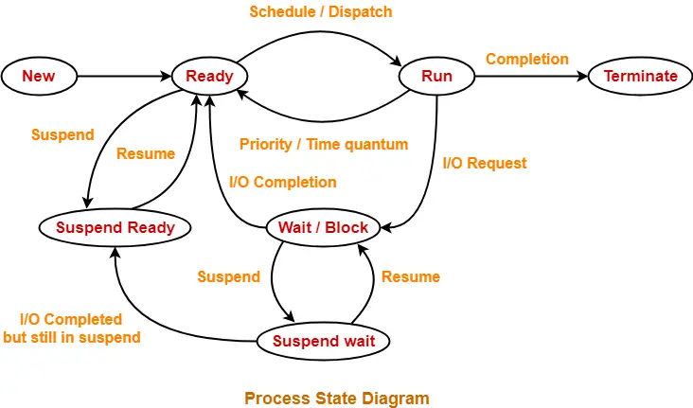
Process States

