Slide 1

Unit #3 IPC and Synchronization
Presented By
Dr. Khursheed Ahmad Bhat
Assistant Professor
SoCS
UPES

Slide 2
Inter Process Communication (IPC)
Inter-process communication (IPC) is a mechanism that allows processes to communicate with each other and synchronize their actions.
A process can be of two types:
Independent process.
Cooperating process.
A process is independent if it does not share data with any other processes executing in the system.
A process is cooperating if it can affect or be affected by the other processes executing in the system.

Slide 3
Need for IPC
There are several reasons for providing an environment that allows process cooperation:
Information sharing: Several applications may be interested in the same piece of information (for instance, copying and pasting), we must provide an environment to allow concurrent access to such information.
Computation speedup (Parallelism): If we want a particular task to run faster, we must break it into subtasks, each of which will be executing in parallel with the others. Such a speedup can be achieved only if the computer has multiple processing cores.
Modularity. Large systems are divided into smaller, manageable processes for easier design and maintenance.
Convenience :Users can run multiple applications that interact seamlessly (e.g., copy–paste, pipelines)

Slide 4
Inter Process Communication (IPC)
Cooperating processes require an interprocess communication (IPC) mechanism that will allow them to exchange data— that is, send data to and receive data from each other. There are two fundamental models of interprocess communication: shared memory and message passing.
Cooperative Processes may share the following:
Variable
Memory
Code
Resources
CPU
Printer

Slide 5
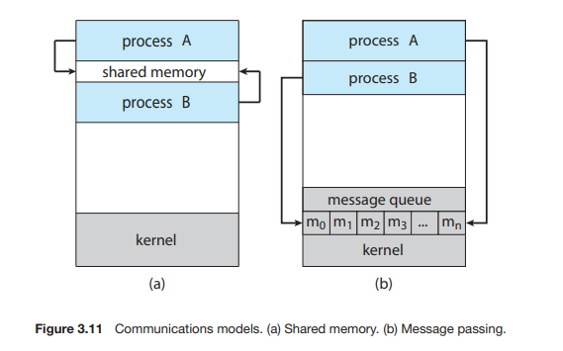
Inter Process Communication (IPC)
Shared Memory: In the shared-memory model, a region of memory that is shared by the cooperating processes is established. Processes can then exchange information by reading and writing data to the shared region.
Message passing: In the message-passing model, communication takes place by means of messages exchanged between the cooperating processes

Slide 6
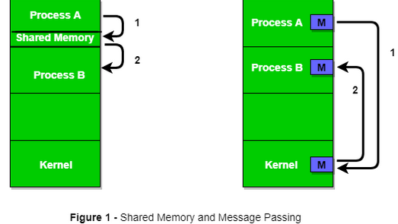

Slide 7
Shared Memory
Suppose process1 and process2 are executing simultaneously, and they share some resources or use some information from another process. Process1 generates information about certain computations or resources being used and keeps it as a record in shared memory. When process2 needs to use the shared information, it will check in the record stored in shared memory and take note of the information generated by process1 and act accordingly.
Ex: Producer-Consumer problem

Slide 8
Message Passing Systems
Message passing provides a mechanism to allow processes to communicate and to synchronize their actions without sharing the same address space.
It is particularly useful in a distributed environment, where the communicating processes may reside on different computers connected by a network.
For example, an Internet chat program could be designed so that chat participants communicate with one another by exchanging messages.
A message-passing facility provides at least two operations:
send(message) and receive(message

Slide 9
Message Passing – Design Aspects
If processes P and Q want to communicate, they must send messages to and receive messages from each other: a communication link must exist between them.
Naming: Direct vs Indirect (mailboxes)
Synchronization: Blocking (sync) vs Non-blocking (async)
Buffering: Zero, Bounded, Unbounded capacity

Slide 10
Naming (How processes identify each other)
Direct communication → processes name each other explicitly. Example: send(P2, message) sends to process P2.
Indirect communication → processes use a shared object (mailbox/port). Example: send(MailboxA, message) and receive(MailboxA, message).
2. Synchronization (When do sender and receiver proceed?)
Blocking (Synchronous)
send blocks until message is received.
receive blocks until a message arrives.
Non-blocking (Asynchronous)
send returns immediately.
receive may return immediately, possibly with “no message.”

Slide 11
3. Buffering (Where are messages stored while waiting?) [Automatic or Explicit Buffering]
Zero capacity → no buffer; sender and receiver must rendezvous immediately.
Bounded capacity → fixed-size queue; sender blocks if queue is full.
Unbounded capacity → infinite queue (theoretical, not practical).

Slide 12
Message Passing Systems contd..
If processes P and Q want to communicate, they must send messages to and receive messages from each other: a communication link must exist between them.
Here are several methods for logically implementing a link and the send()/receive() operations:
1. Direct or indirect communication
2. Synchronous or asynchronous communication
3. Automatic or explicit buffering

Slide 13
Message Passing Systems contd..
Naming
Processes that want to communicate must have a way to refer to each other. They can use either direct or indirect communication.
Under direct communication, each process that wants to communicate must explicitly name the recipient or sender of the communication. In this scheme, the send() and receive() primitives are defined as:
• send(P, message)—Send a message to process P.
• receive(Q, message)—Receive a message from process Q

Slide 14
Message Passing Systems contd..
This scheme exhibits symmetry in addressing;
that is, both the sender process and the receiver process must name the other to communicate.
A variant of this scheme employs asymmetry in addressing. Here, only the sender names the recipient; the recipient is not required to name the sender.
In this scheme, the send() and receive() primitives are defined as follows:
• send(P, message)—Send a message to process P.
• receive(id, message)—Receive a message from any process. The variable id is set to the name of the process with which communication has taken place.

Slide 15
Message Passing Systems contd..
With indirect communication, the messages are sent to and received from mailboxes, or ports. A mailbox can be viewed abstractly as an object into which messages can be placed by processes and from which messages can be removed.
A process can communicate with another process via a number of different mailboxes, but two processes can communicate only if they have a shared mailbox.
The send() and receive() primitives are defined as follows:
• send(A, message)—Send a message to mailbox A.
• receive(A, message)—Receive a message from mailbox A

Slide 16
Mechanisms / implementations of the Message Passing IPC model.
Pipes, RPC, and Sockets
Pipes:
A pipe acts as a conduit allowing two processes to communicate. Pipes were one of the first IPC mechanisms in early UNIX systems. They typically provide one of the simpler ways for processes to communicate with one another.
Two types:
Ordinary pipes
Named pipes

Slide 17
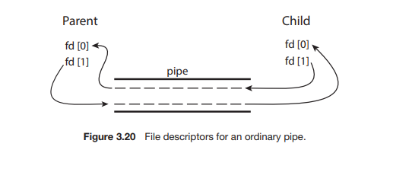
Ordinary Pipes or Unnamed Pipe:
Ordinary pipes allow two processes to communicate in standard producer– consumer fashion: the producer writes to one end of the pipe (the write end) and the consumer reads from the other end (the read end). As a result, ordinary pipes are unidirectional, allowing only one-way communication.
On UNIX systems, ordinary pipes are constructed using the function pipe(int fd[])
This function creates a pipe that is accessed through the int fd[] file descriptors:
fd[0] is the read end of the pipe, and fd[1] is the write end.
UNIX treats a pipe as a special type of file. Thus, pipes can be accessed using ordinary read() and write() system calls.

Slide 18
An ordinary pipe cannot be accessed from outside the process that created it. Typically, a parent process creates a pipe and uses it to communicate with a child process that it creates via fork().
Since a pipe is a special type of file, the child inherits the pipe from its parent process. Figure 3.20 illustrates the relationship of the file descriptors in the fd array to the parent and child processes.
As this illustrates, any writes by the parent to its write end of the pipe—fd[1]—can be read by the child from its read end—fd[0]—of the pipe.
Ordinary pipes on Windows systems are termed anonymous pipes
Example: ls | grep ".c"

Slide 19
Named Pipes: Named pipes are referred to as FIFOs in UNIX systems. Once created, they appear as typical files in the file system. A FIFO is created with the mkfifo() system call.
Ordinary pipes exist only while the processes are communicating with one another.
On both UNIX and Windows systems, once the processes have finished communicating and have terminated, the ordinary pipe ceases to exist.
Communication can be bidirectional, and no parent–child relationship is required.

Slide 20
Once a named pipe is established, several processes can use it for communication.
Additionally, named pipes continue to exist after communicating processes have finished.
Named pipes (FIFOs) → live in the filesystem, so any processes, related or not, can use them.
Example: mkfifo mypipe
echo "Hello" > mypipe
cat < mypipe

Slide 21
Message Passing (Communication link)
If two processes p1 and p2 want to communicate with each other, they proceed as follows:
Establish a communication link (if a link already exists, no need to establish it again.)
Start exchanging messages using basic primitives.
We need at least two primitives: – send(message, destination) or send(message) – receive(message, host) or receive(message)

Slide 22
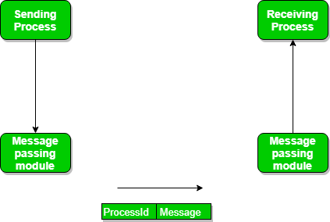
Direct Communication links are implemented when the processes use a specific process identifier for the communication, but it is hard to identify the sender ahead of time. Example: Print Server
In-direct Communication is done via a shared mailbox (port), which consists of a queue of messages. The sender keeps the message in mailbox and the receiver picks them up.

Slide 23
Message Passing (Exchanging the messages)
There are basically three preferred combinations:
Blocking send and blocking receive (Synchronous)
Non-blocking send and Non-blocking receive (Asynchronous)
Non-blocking send and Blocking receive
In Direct message passing, The process which wants to communicate must explicitly name the recipient or sender of the communication. e.g. send(p1, message) means send the message to p1. Similarly, receive(p2, message) means to receive the message from p2.
In Indirect message passing, processes use mailboxes (also referred to as ports) for sending and receiving messages. Each mailbox has a unique id and processes can communicate only if they share a mailbox.

Slide 24
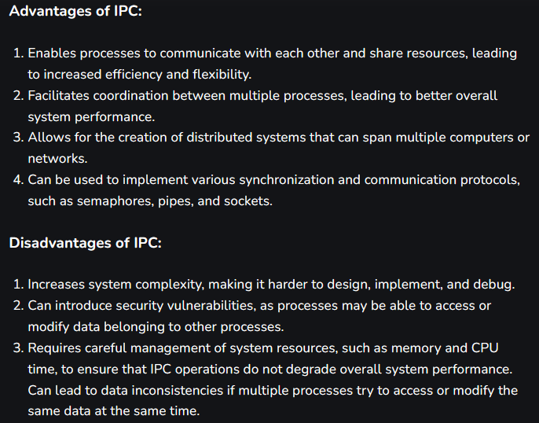

Slide 25
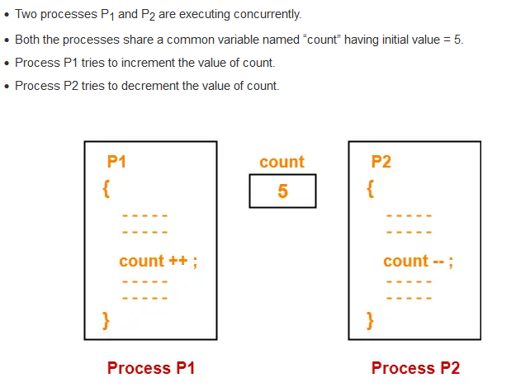
Inconsistency: Without Synchronization

Slide 26
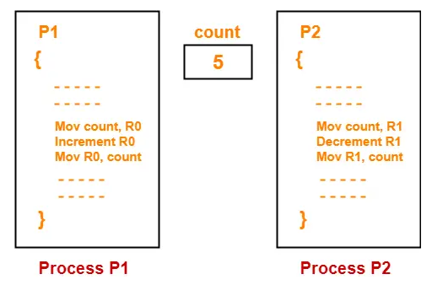

Slide 27
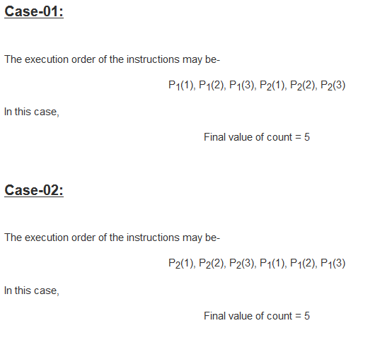

Slide 28


Slide 29
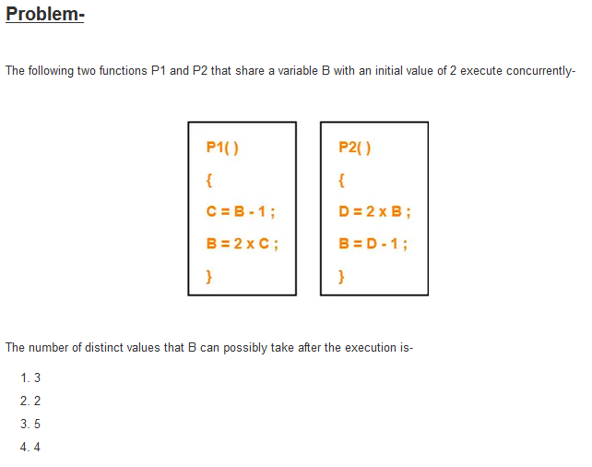

Slide 30
RACE CONDITION
Race condition is situation where:
The final output produced depends on the execution order of instructions of different processes.
Several processes compete with each other.

Slide 31
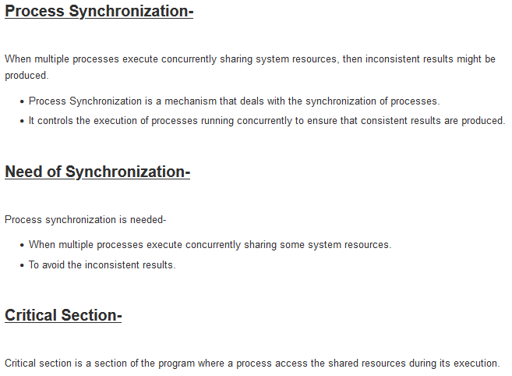

Slide 32
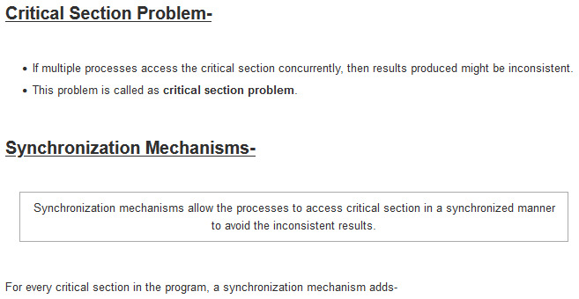


Slide 33
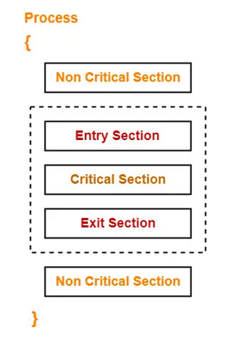
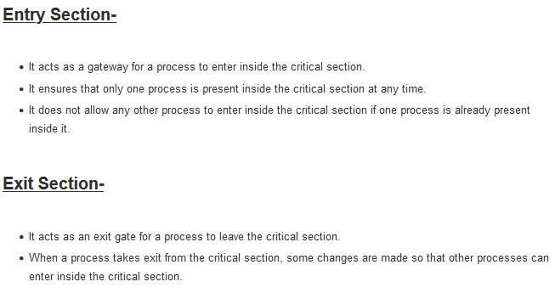

Slide 34

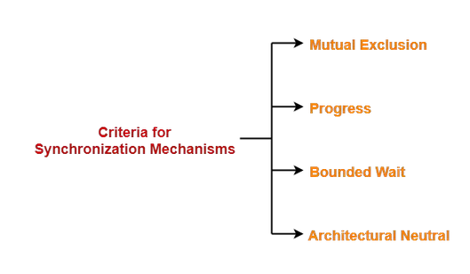

Slide 35
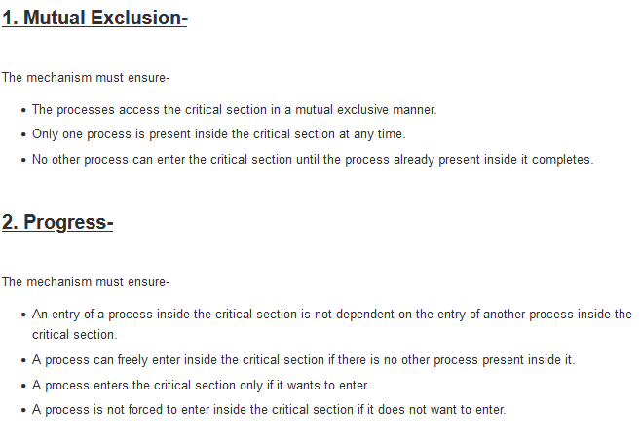

Slide 36
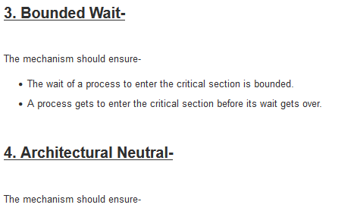
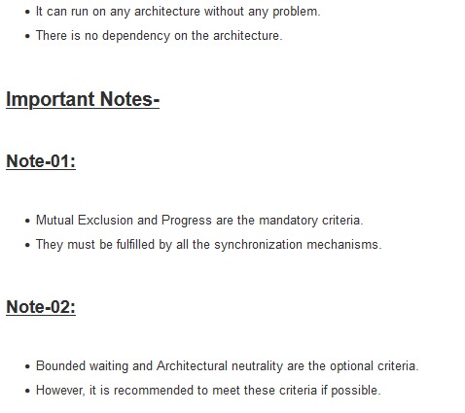

Slide 37


Slide 38


