Slide 1
UNIT-4: Classification: Basic Concepts
Classification: Basic Concepts
Decision Tree Induction
Bayes Classification Methods
Rule-Based Classification
Support Vector machine
Random Forest
Logistic Regression

Slide 2
Supervised vs. Unsupervised Learning
Supervised learning (classification)
  Supervision: The training data (observations, measurements, etc.) are accompanied by labels indicating the class of the observations
  New data is classified based on the training set
Unsupervised learning (clustering)
  The class labels of training data is unknown
  Given a set of measurements, observations, etc. with the aim of establishing the existence of classes or clusters in the data

Slide 3
Prediction Problems: Classification vs. Numeric Prediction
Classification
  predicts categorical class labels (discrete or nominal)
  classifies data (constructs a model) based on the training set and the values (class labels) in a classifying attribute and uses it in classifying new data
Numeric Prediction
  models continuous-valued functions, i.e., predicts unknown or missing values
Typical applications
  Credit/loan approval:
  Medical diagnosis: if a tumor is cancerous or benign
  Fraud detection: if a transaction is fraudulent
  Web page categorization: which category it is

Slide 4
Classification—A Two-Step Process
Model construction: describing a set of predetermined classes
  Each tuple/sample is assumed to belong to a predefined class, as determined by the class label attribute
  The set of tuples used for model construction is training set
  The model is represented as classification rules, decision trees, or mathematical formulae
Model usage: for classifying future or unknown objects
  Estimate accuracy of the model
    The known label of test sample is compared with the classified result from the model
    Accuracy rate is the percentage of test set samples that are correctly classified by the model
    Test set is independent of training set (otherwise overfitting)
  If the accuracy is acceptable, use the model to classify new data
Note: If the test set is used to select models, it is called validation (test) set

Slide 5



Process (1): Model Construction
Classification
Algorithms
Training
Data
Classifier
(Model)
IF rank = ‘professor’
OR years > 6
THEN tenured = ‘yes’

Slide 6




Process (2): Using the Model in Prediction
Classifier
Testing
Data
Unseen Data
(Jeff, Professor, 4)
Tenured?

Slide 7
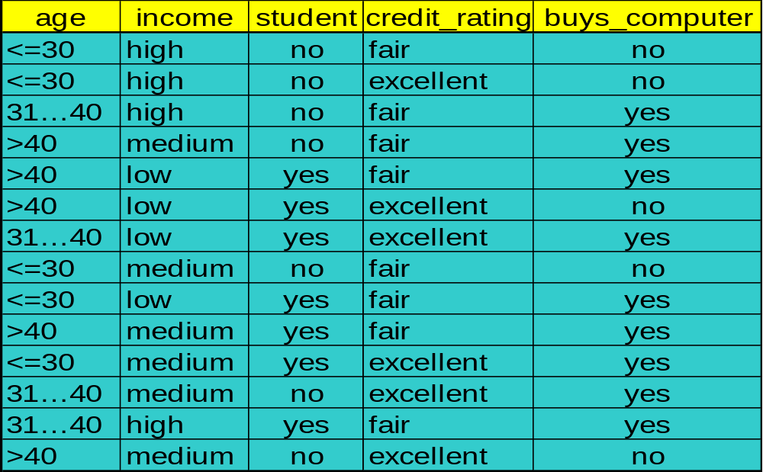
Decision Tree Induction: An Example
Training data set: Buys_computer
The data set follows an example of Quinlan’s ID3 (Buys_computer)
Resulting tree:
age?
<=30
overcast
>40
31..40
student?
yes
credit rating?
no
yes
excellent
fair
no
yes
no
yes

Slide 8
Decision Tree Induction: An Example
age?
<=30
overcast
>40
31..40
student?
yes
credit rating?
no
yes
excellent
fair
no
yes
no
yes

Slide 9
Algorithm for Decision Tree Induction
Basic algorithm (a greedy algorithm)
  Tree is constructed in a top-down recursive divide-and-conquer manner
  At start, all the training examples are at the root
  Attributes are categorical (if continuous-valued, they are discretized in advance)
  Examples are partitioned recursively based on selected attributes
  Test attributes are selected on the basis of a heuristic or statistical measure (e.g., information gain)
Conditions for stopping partitioning
  All samples for a given node belong to the same class
  There are no remaining attributes for further partitioning – majority voting is employed for classifying the leaf
  There are no samples left

Slide 10



Attribute Selection Measure: Information Gain (ID3/C4.5)
Select the attribute with the highest information gain
Let p_{i} be the probability that an arbitrary tuple in D belongs to class C_{i}, estimated by |C_{i, D}|/|D|
Expected information (entropy) needed to classify a tuple in D:
Information needed (after using A to split D into v partitions) to classify D:
Information gained by branching on attribute A
Notes:
I : the expected information needed to classify a given sample
E (entropy) : expected information based on the partitioning into subsets by A

Slide 11




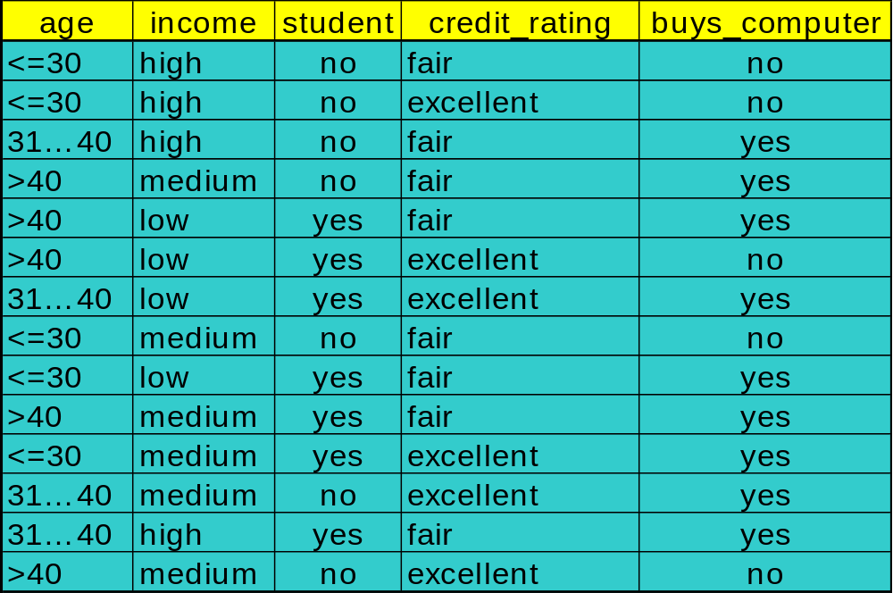

Attribute Selection: Information Gain
Class P: buys_computer = “yes”
Class N: buys_computer = “no”
means “age <=30” has 5 out of 14 samples, with 2 yes’es and 3 no’s. Hence
Similarly,

Slide 12
Attribute Selection: Information Gain
Class P: buys_computer = “yes”
Class N: buys_computer = “no”
means “age <=30” has 5 out of 14 samples, with 2 yes’es and 3 no’s. Hence
Similarly,

Slide 13
Decision Tree
https://www.youtube.com/watch?v=coOTEc-0OGw
age?
<=30
overcast
>40
31..40
student?
yes
credit rating?
no
yes
excellent
fair
no
yes
no
yes

Slide 14
Bayesian Classification: Why?
A statistical classifier: performs probabilistic prediction, i.e., predicts class membership probabilities
Foundation: Based on Bayes’ Theorem.
Performance: A simple Bayesian classifier, naïve Bayesian classifier, has comparable performance with decision tree and selected neural network classifiers
Incremental: Each training example can incrementally increase/decrease the probability that a hypothesis is correct — prior knowledge can be combined with observed data
Standard: Even when Bayesian methods are computationally intractable, they can provide a standard of optimal decision making against which other methods can be measured

Slide 15


Bayes’ Theorem: Basics
Total probability Theorem:
Bayes’ Theorem:
  Let X be a data sample (“evidence”): class label is unknown
  Let H be a hypothesis that X belongs to class C
  Classification is to determine P(H|X), (i.e., posteriori probability): the probability that the hypothesis holds given the observed data sample X
  P(H) (prior probability): the initial probability
    E.g., X will buy computer, regardless of age, income, …
  P(X): probability that sample data is observed
  P(X|H) (likelihood): the probability of observing the sample X, given that the hypothesis holds
    E.g., Given that X will buy computer, the prob. that X is 31..40, medium income

Slide 16
Prediction Based on Bayes’ Theorem
Given training data X, posteriori probability of a hypothesis H, P(H|X), follows the Bayes’ theorem
Informally, this can be viewed as
  posteriori = likelihood x prior/evidence
Predicts X belongs to C_{i} iff the probability P(C_{i}|X) is the highest among all the P(C_{k}|X) for all the k classes
Practical difficulty: It requires initial knowledge of many probabilities, involving significant computational cost

Slide 17


Classification Is to Derive the Maximum Posteriori
Let D be a training set of tuples and their associated class labels, and each tuple is represented by an n-D attribute vector X = (x₁, x₂, …, x_{n})
Suppose there are m classes C₁, C₂, …, C_{m}.
Classification is to derive the maximum posteriori, i.e., the maximal P(C_{i}|X)
This can be derived from Bayes’ theorem
Since P(X) is constant for all classes, only
  needs to be maximized

Slide 18

Naïve Bayes Classifier: Training Dataset
Class:
C1:buys_computer = ‘yes’
C2:buys_computer = ‘no’
Data to be classified:
X = (age <=30,
Income = medium,
Student = yes
Credit_rating = Fair)

Slide 19
Naïve Bayes Classifier: An Example
P(C_{i}): P(buys_computer = “yes”) = 9/14 = 0.643
P(buys_computer = “no”) = 5/14= 0.357
Compute P(X|C_{i}) for each class
  P(age = “<=30” | buys_computer = “yes”) = 2/9 = 0.222
  P(age = “<= 30” | buys_computer = “no”) = 3/5 = 0.6
  P(income = “medium” | buys_computer = “yes”) = 4/9 = 0.444
  P(income = “medium” | buys_computer = “no”) = 2/5 = 0.4
  P(student = “yes” | buys_computer = “yes) = 6/9 = 0.667
  P(student = “yes” | buys_computer = “no”) = 1/5 = 0.2
  P(credit_rating = “fair” | buys_computer = “yes”) = 6/9 = 0.667
  P(credit_rating = “fair” | buys_computer = “no”) = 2/5 = 0.4
X = (age <= 30 , income = medium, student = yes, credit_rating = fair)
P(X|C_{i}) : P(X|buys_computer = “yes”) = 0.222 x 0.444 x 0.667 x 0.667 = 0.044
P(X|buys_computer = “no”) = 0.6 x 0.4 x 0.2 x 0.4 = 0.019
P(X|C_{i})*P(C_{i}) : P(X|buys_computer = “yes”) * P(buys_computer = “yes”) = 0.028
P(X|buys_computer = “no”) * P(buys_computer = “no”) = 0.007
Therefore, X belongs to class (“buys_computer = yes”)

Slide 20
Naïve Bayes Classifier: Comments
Advantages
  Easy to implement
  Good results obtained in most of the cases
Disadvantages
  Assumption: class conditional independence, therefore loss of accuracy
  Practically, dependencies exist among variables
    E.g., hospitals: patients: Profile: age, family history, etc.
      Symptoms: fever, cough etc., Disease: lung cancer, diabetes, etc.
    Dependencies among these cannot be modeled by Naïve Bayes Classifier

Slide 21
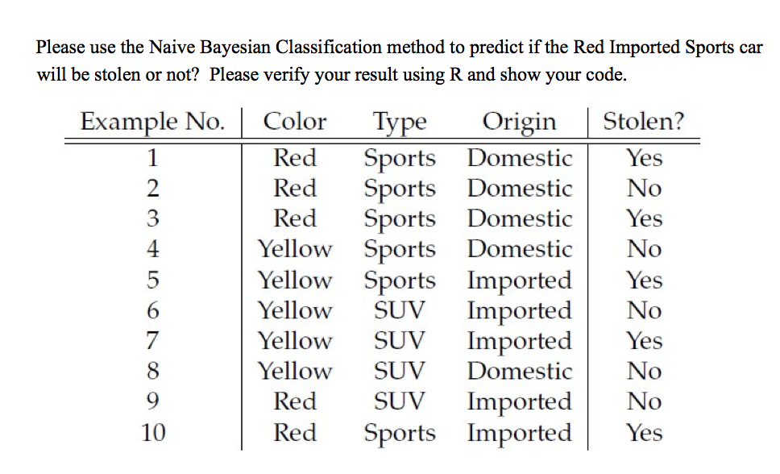
Practice Question
Classify the tuple X= {Color=”RED”, Type= “SUV”, Origin=”Domestic”} using Naïve Bayesian classification. Training data is given in the following table where class label is STOLEN.

Slide 22
Using IF-THEN Rules for Classification
Represent the knowledge in the form of IF-THEN rules
  R: IF age = youth AND student = yes THEN buys_computer = yes
  Rule antecedent/precondition vs. rule consequent
Assessment of a rule: coverage and accuracy
  n_{covers} = # of tuples covered by R
  n_{correct} = # of tuples correctly classified by R
  coverage(R) = n_{covers} /|D| /* D: training data set */
  accuracy(R) = n_{correct} / n_{covers}
If more than one rule are triggered, need conflict resolution
  Size ordering: assign the highest priority to the triggering rules that has the “toughest” requirement (i.e., with the most attribute tests)
  Class-based ordering: decreasing order of prevalence or misclassification cost per class
  Rule-based ordering (decision list): rules are organized into one long priority list, according to some measure of rule quality or by experts

Slide 23
Rule Extraction from a Decision Tree
Rules are easier to understand than large trees
One rule is created for each path from the root to a leaf
Each attribute-value pair along a path forms a conjunction: the leaf holds the class prediction
Rules are mutually exclusive and exhaustive
age?
<=30
31..40
>40
student?
yes
credit rating?
no
yes
excellent
fair
no
yes
no
yes
Example: Rule extraction from our buys_computer decision-tree
  IF age = young AND student = no THEN buys_computer = no
  IF age = young AND student = yes THEN buys_computer = yes
  IF age = mid-age THEN buys_computer = yes
  IF age = old AND credit_rating = excellent THEN buys_computer = no
  IF age = old AND credit_rating = fair THEN buys_computer = yes

Slide 24
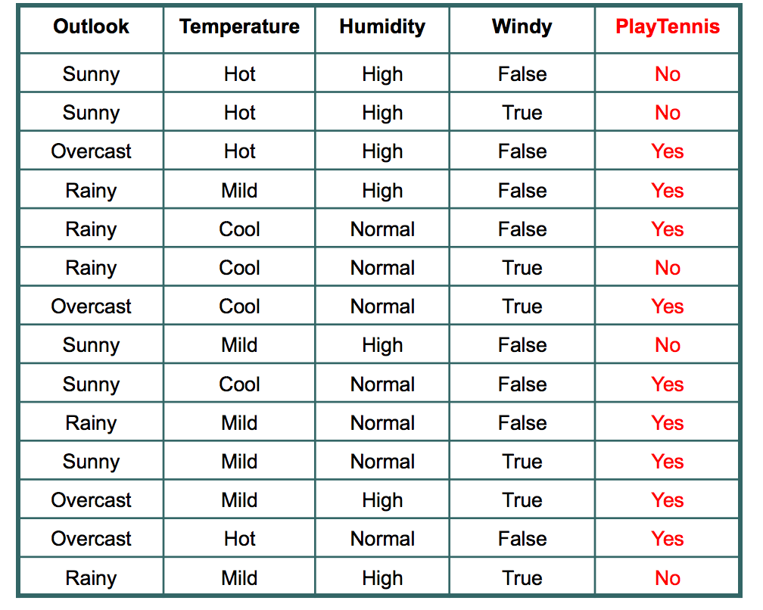
Question: Classify sample X- An unseen = X= <rainy, hot, high, false> ??????

Slide 25
Support Vector Machines
https://www.analyticsvidhya.com/blog/2017/09/understaing-support-vector-machine-example-code/
https://www.javatpoint.com/machine-learning-support-vector-machine-algorithm

Slide 26
Random Forest
https://www.javatpoint.com/machine-learning-random-forest-algorithm
https://www.datacamp.com/community/tutorials/support-vector-machines-r (Refer this)

Slide 27
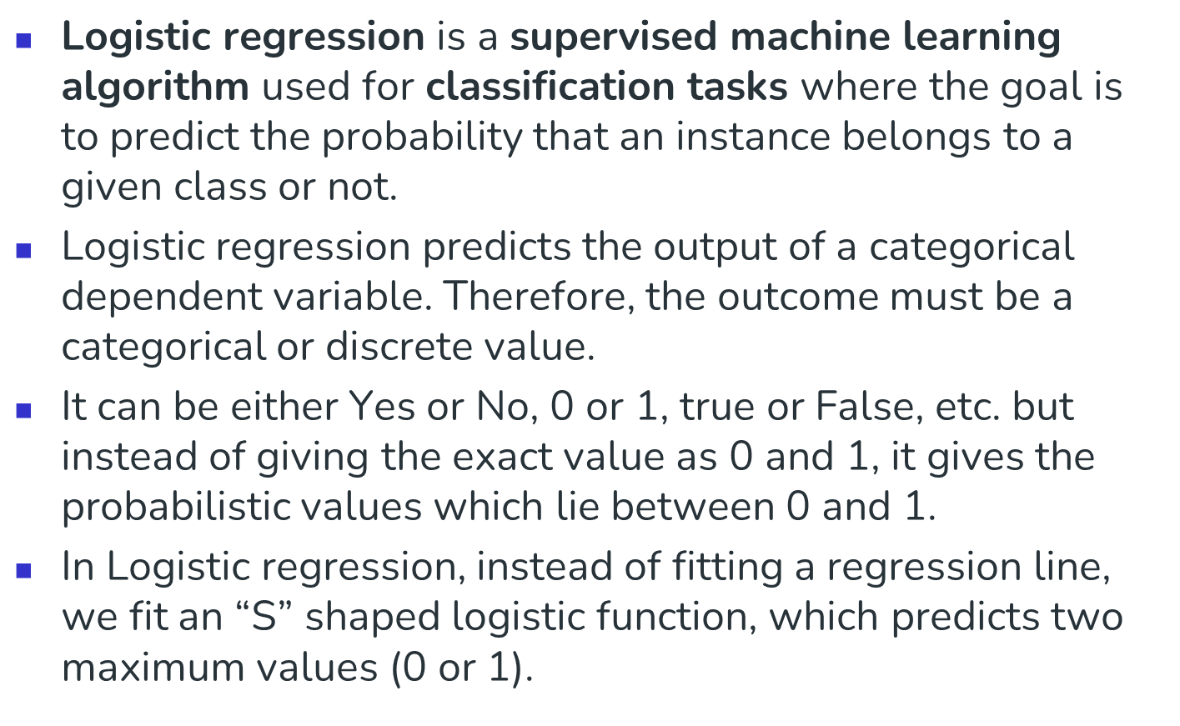
Logistic Regression

Slide 28
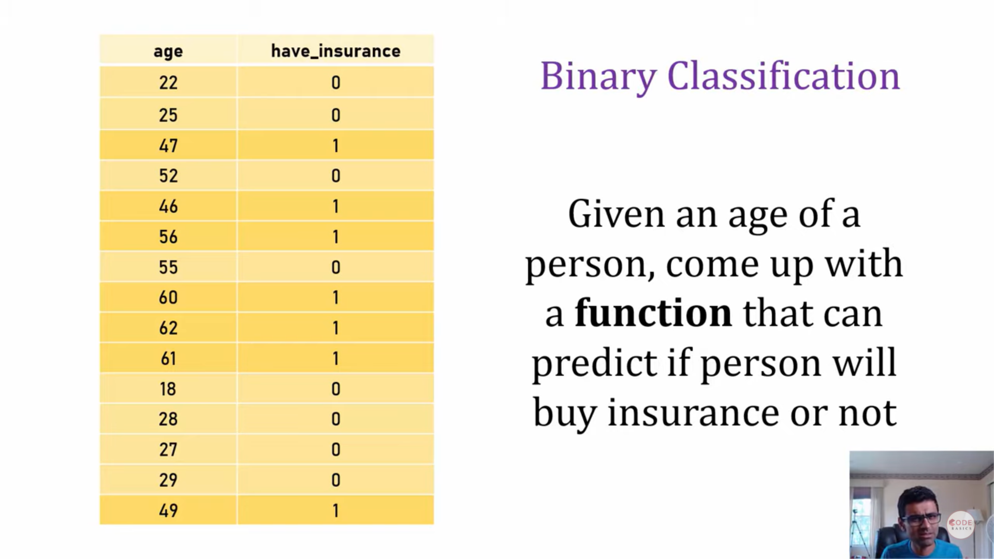

Logistic Regression

Slide 29
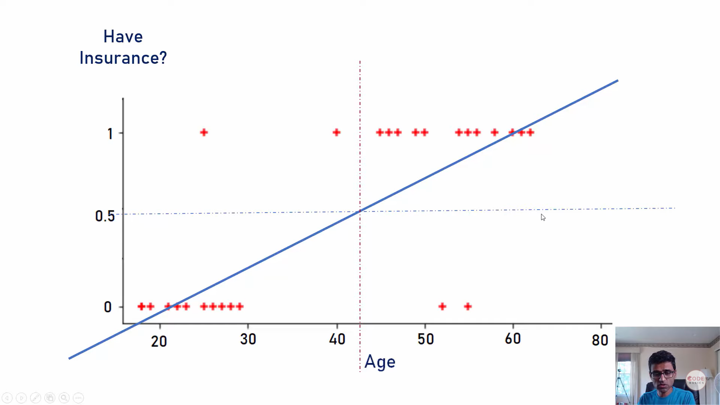
Logistic Regression

Slide 30
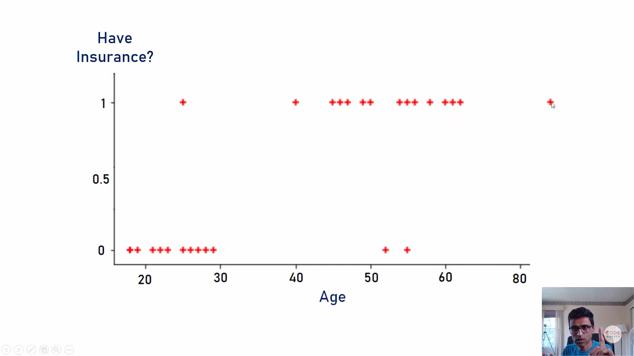
Logistic Regression

Slide 31
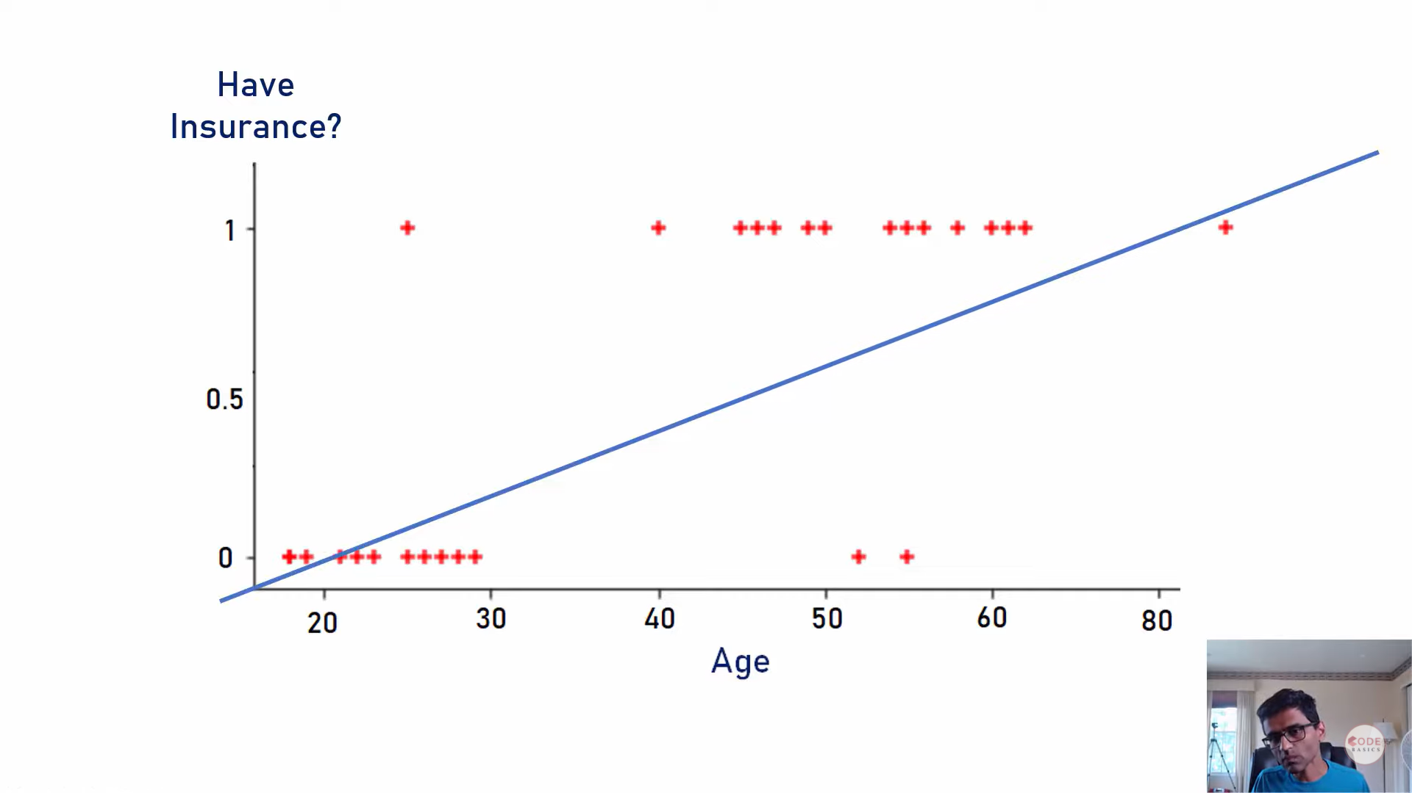
Logistic Regression

Slide 32
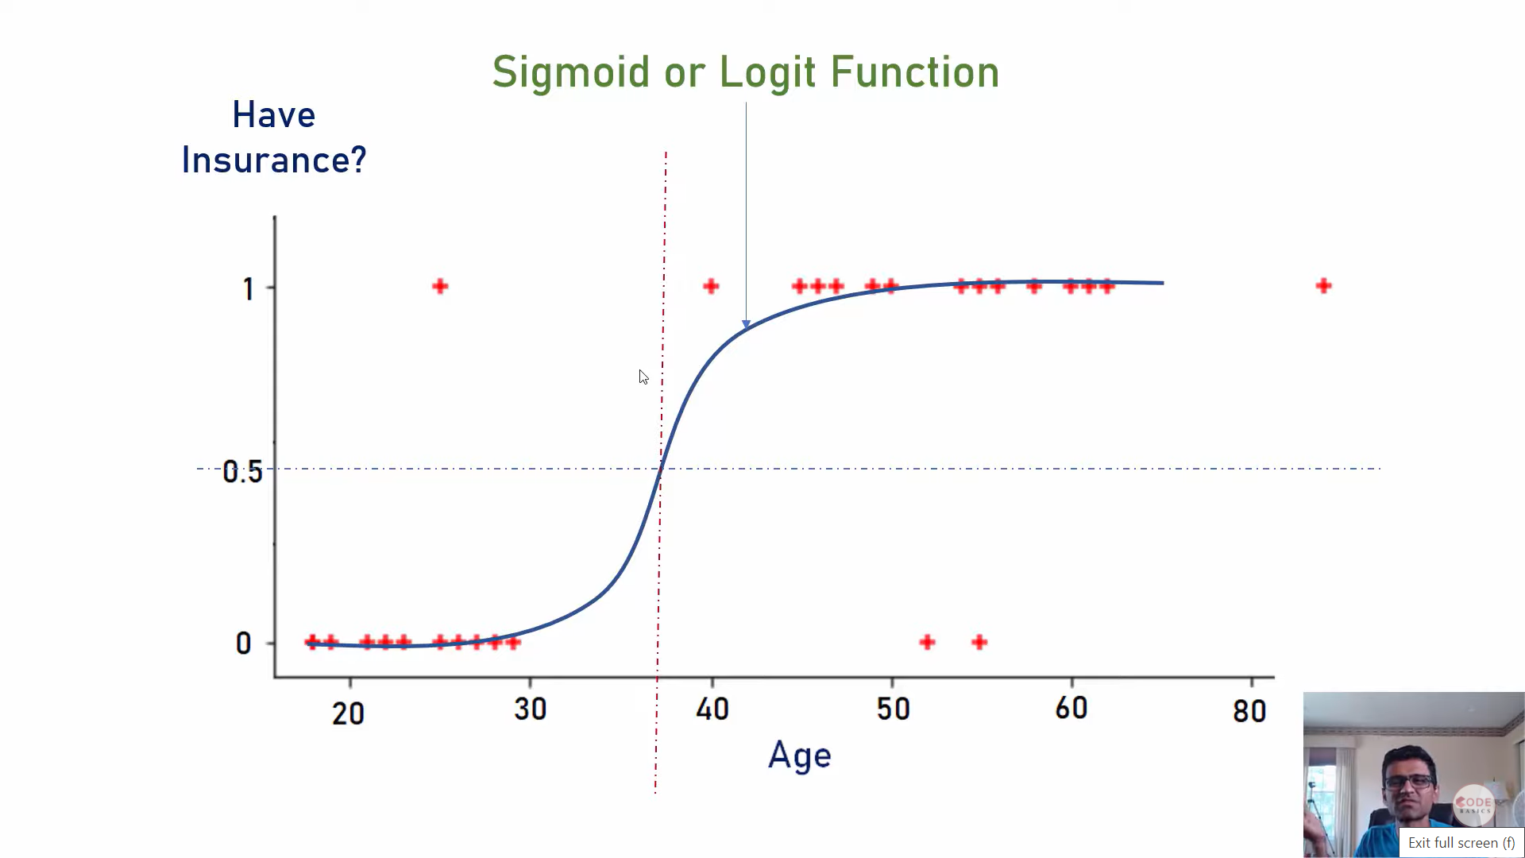
Logistic Regression

Slide 33
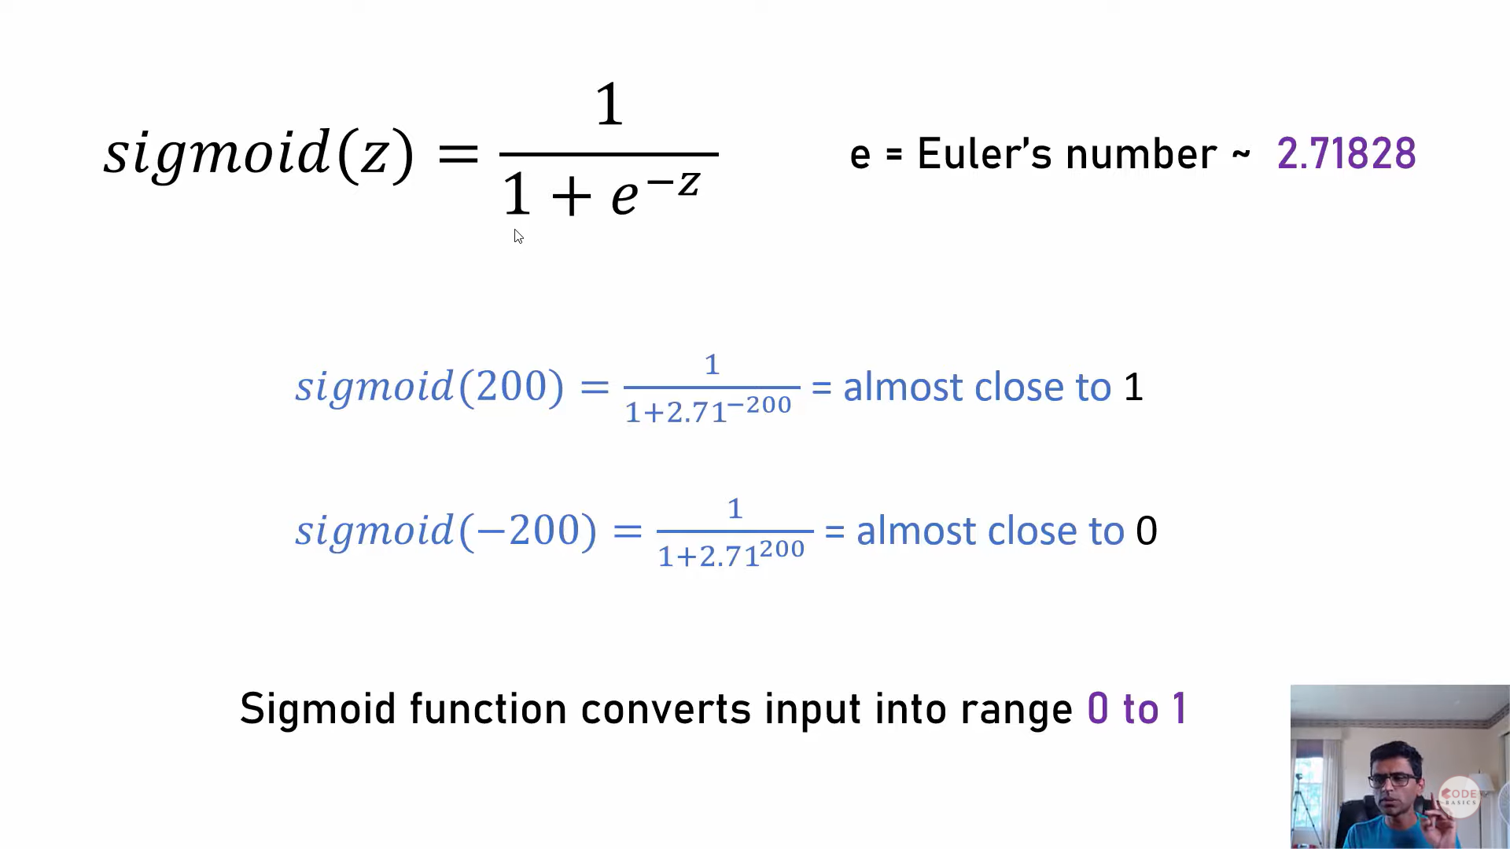
Logistic Regression

Slide 34
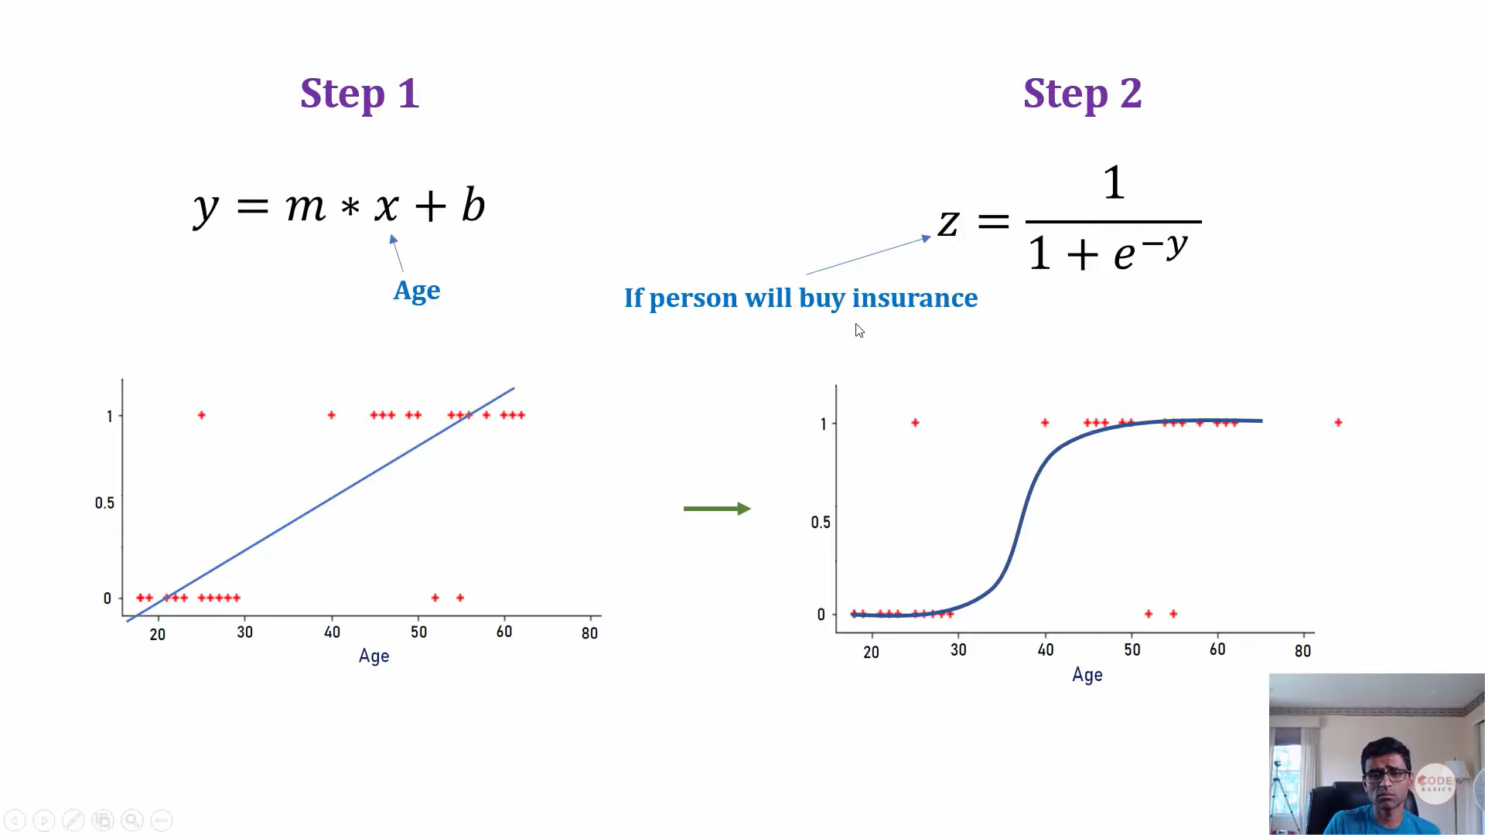
Logistic Regression

Slide 35
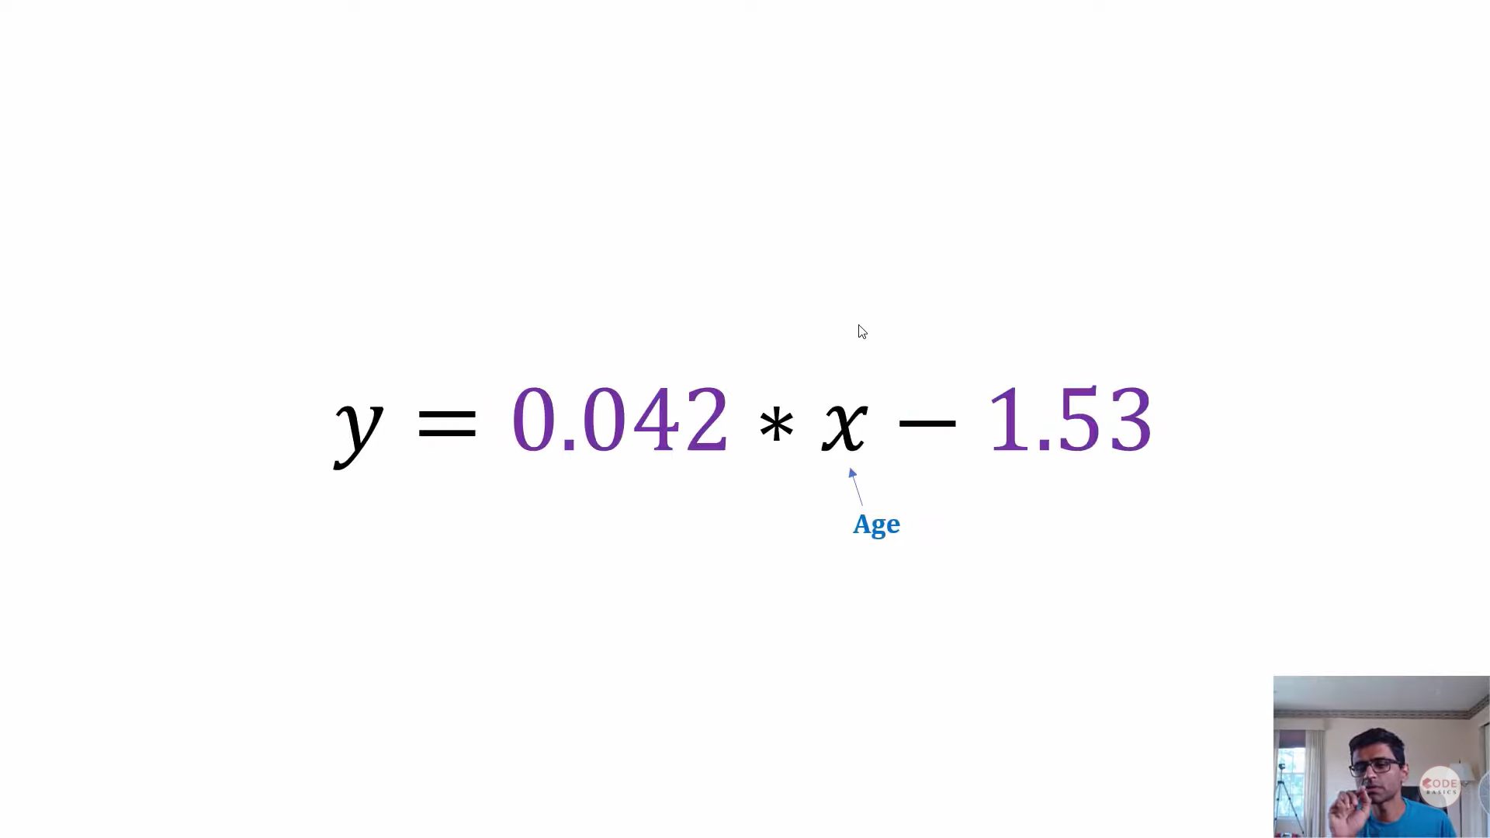
Logistic Regression

Slide 36
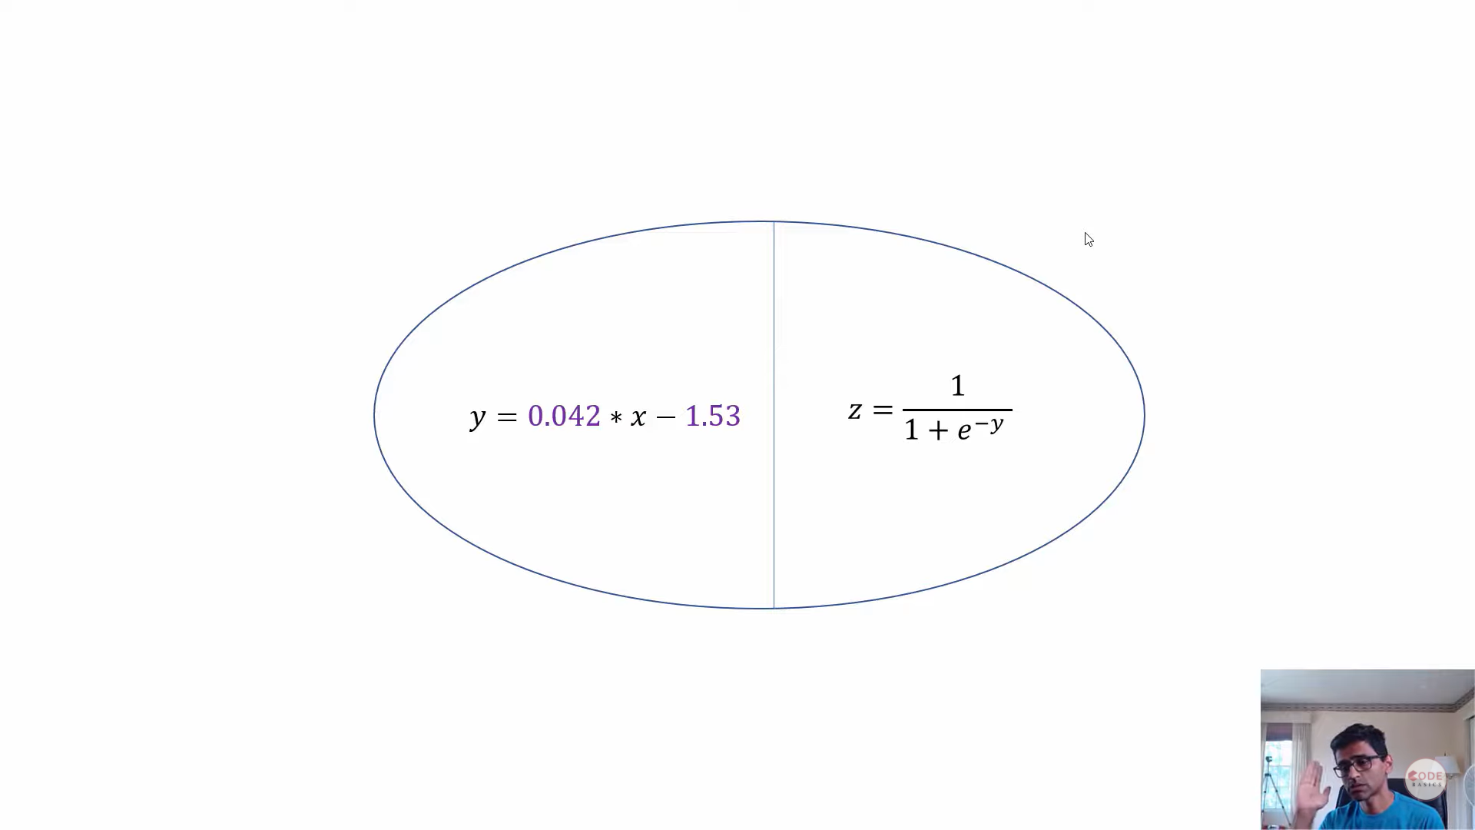
Logistic Regression

