Slide 1
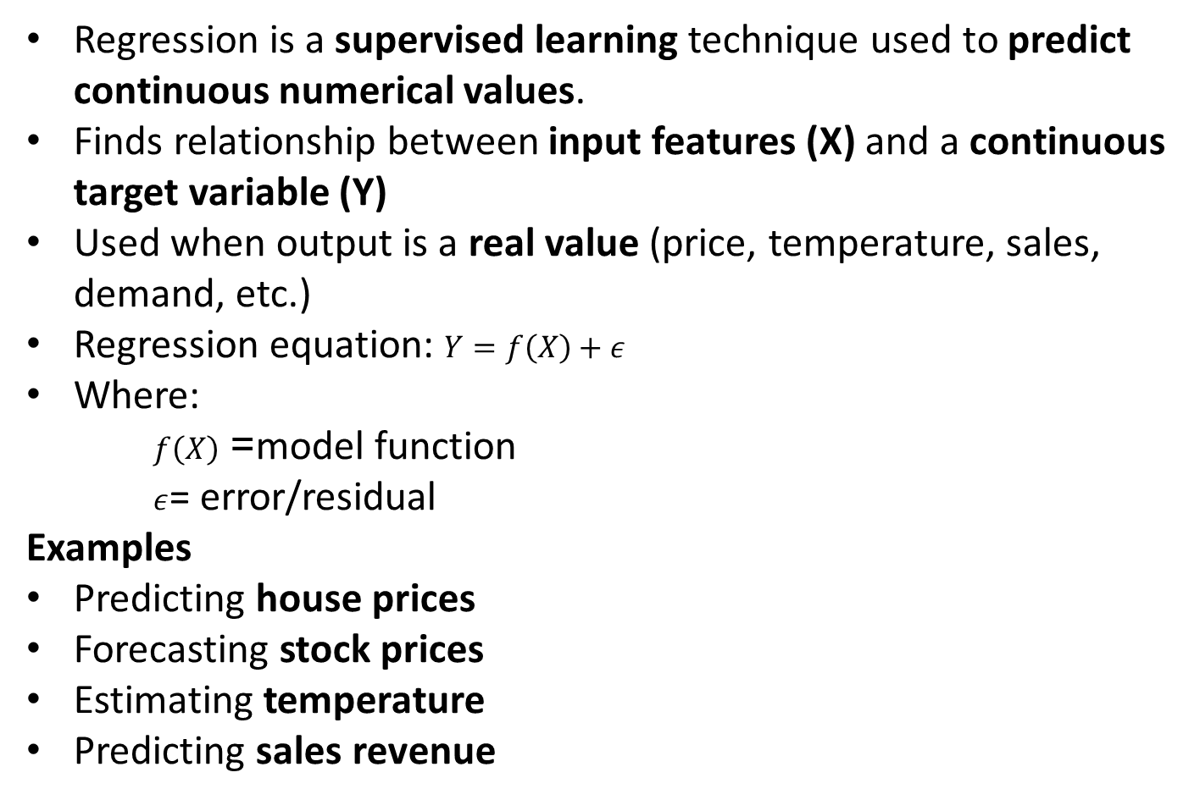
Regression Analysis in Machine learning
Regression is a supervised learning technique used to predict continuous numerical values.
Finds relationship between input features (X) and a continuous target variable (Y)
Used when output is a real value (price, temperature, sales, demand, etc.)
Regression equation: $Y=f\left(X\right)+ε$
Where:
$f\left(X\right)$= model function
$ε$= error/residual
Examples
Predicting house prices
Forecasting stock prices
Estimating temperature
Predicting sales revenue

Slide 2
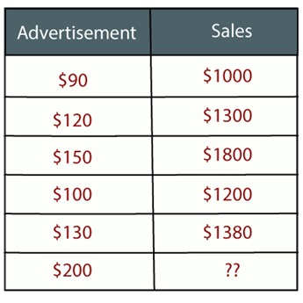
Regression Analysis
Example: Suppose there is a marketing company A, who does various advertisement every year and get sales on that. The below list shows the advertisement made by the company in the last 5 years and the corresponding sales:
Now, the company wants to do the advertisement of $200 in the year 2021 and wants to know the prediction about the sales for this year.
So to solve such type of prediction problems in machine learning, we need regression analysis.

Slide 3
Types of Regression Models
Linear Regression (Simple & Multiple)
Polynomial Regression
Ridge Regression
Lasso Regression
Elastic Net Regression
Logistic Regression (For classification)

Slide 4
Regression Analysis
"Regression shows a line or curve that passes through all the datapoints on target-predictor graph in such a way that the vertical distance between the datapoints and the regression line is minimum."
The distance between datapoints and line tells whether a model has captured a strong relationship or not.
Some examples of regression can be as:
Prediction of rain using temperature and other factors
Determining Market trends
Prediction of road accidents due to rash driving.

Slide 5
Terminology related to Regression Analysis
Dependent Variable: The main factor in Regression analysis which we want to predict is called the dependent variable. It is also called target variable.
Independent Variable: The factors which affect the dependent variables or which are used to predict the values of the dependent variables are called independent variable, also called as a predictor.
Outliers: Outlier is an observation which contains either very low value or very high value in comparison to other observed values. An outlier may hamper the result, so it should be avoided.
Multicollinearity: If the independent variables are highly correlated with each other than other variables, then such condition is called Multicollinearity. It should not be present in the dataset, because it creates problem while ranking the most affecting variable.
Underfitting and Overfitting: If our algorithm works well with the training dataset but not well with test dataset, then such problem is called Overfitting. And if our algorithm does not perform well even with training dataset, then such problem is called underfitting.

Slide 6
Linear Regression
Linear regression is a statistical regression method which is used for predictive analysis.
It is one of the very simple and easy algorithms which works on regression and shows the relationship between the continuous variables.
It is used for solving the regression problem in machine learning.
Linear regression shows the linear relationship between the independent variable (X-axis) and the dependent variable (Y-axis), hence called linear regression.
If there is only one input variable (x), then such linear regression is called simple linear regression. And if there is more than one input variable, then such linear regression is called multiple linear regression.
The relationship between variables in the linear regression model can be explained using the below image. Here we are predicting the salary of an employee on the basis of the year of experience.

Slide 7
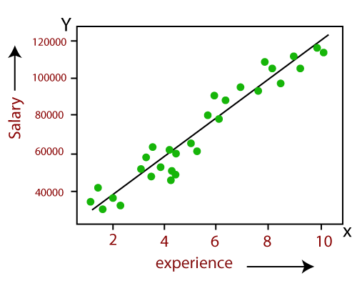
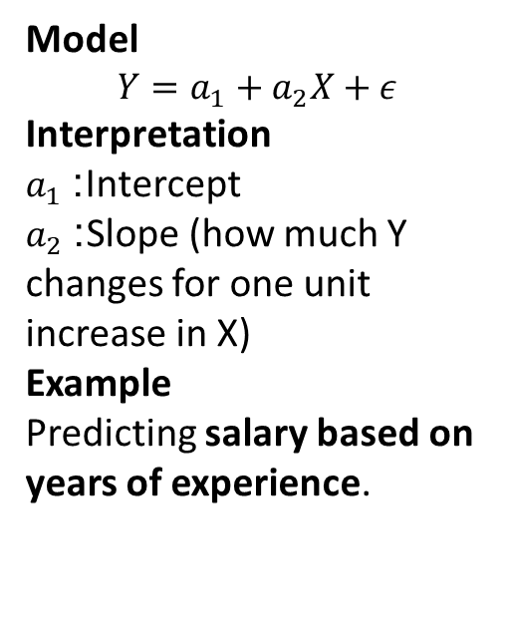
Linear Regression
Model
$$Y=a_{1}+a_{2}X+ε$$
Interpretation
$a_{1}$: Intercept
$a_{2}$: Slope (how much Y changes for one unit increase in X)
Example
Predicting salary based on years of experience.

Slide 8
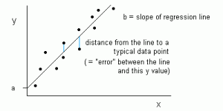
Linear Regression
Linear Regression model can be represented using the below equation:
Y= a1 + a2 X + ε
Where,
a1 = It is the intercept of the Regression line (can be obtained putting x=0)
a2 = It is the slope of the regression line, which tells whether the line is increasing or decreasing.
ε = The error term. (For a good model it will be negligible)

Slide 9
Multiple Linear Regression
Multiple linear regression is used to estimate the relationship between two or more independent variables and one dependent variable. You can use multiple linear regression when you want to know:
How strong the relationship is between two or more independent variables and one dependent variable (e.g. how rainfall, temperature, and amount of fertilizer added affect crop growth).
The value of the dependent variable at a certain value of the independent variables (e.g. the expected yield of a crop at certain levels of rainfall, temperature, and fertilizer addition).
Predicting an employee's job satisfaction using their hours of unpaid work, age, and income. The regression equation would use these three independent variables to predict the dependent variable, job satisfaction, providing insights into how each factor influences the outcome and creating a predictive model.

Slide 10
Assumptions of multiple linear regression
Multiple linear regression makes all of the same assumptions as simple linear regression:
Homogeneity of variance (homoscedasticity): the size of the error in our prediction doesn’t change significantly across the values of the independent variable.
Independence of observations: the observations in the dataset were collected using statistically valid methods, and there are no hidden relationships among variables.
In multiple linear regression, it is possible that some of the independent variables are actually correlated with one another, so it is important to check these before developing the regression model. If two independent variables are too highly correlated (r2 > ~0.6), then only one of them should be used in the regression model.
Normality: The data follows a normal distribution.
Linearity: the line of best fit through the data points is a straight line, rather than a curve or some sort of grouping factor.

Slide 11

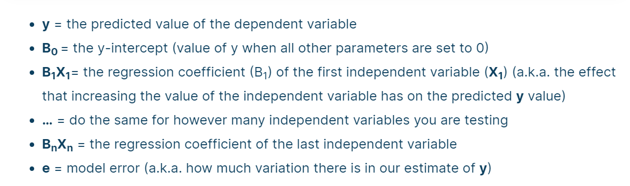
How to perform a multiple linear regression?
Multiple linear regression formula

Slide 12
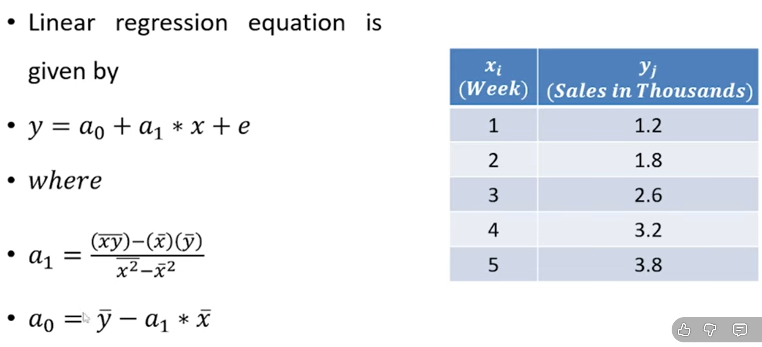

Slide 13
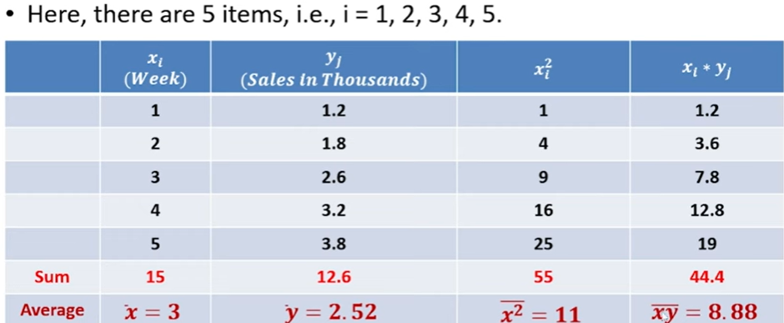

Slide 14
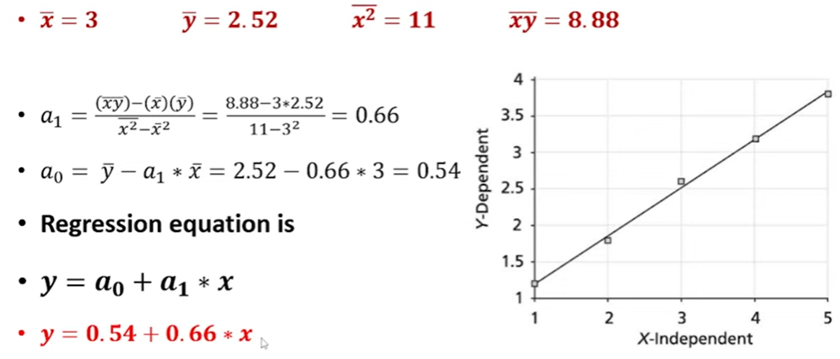

Slide 15
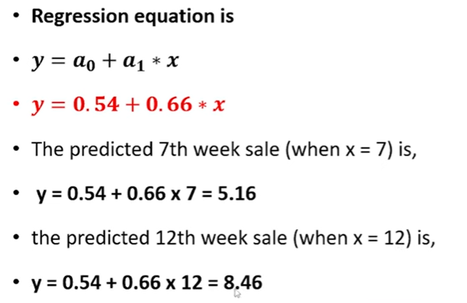

Slide 16
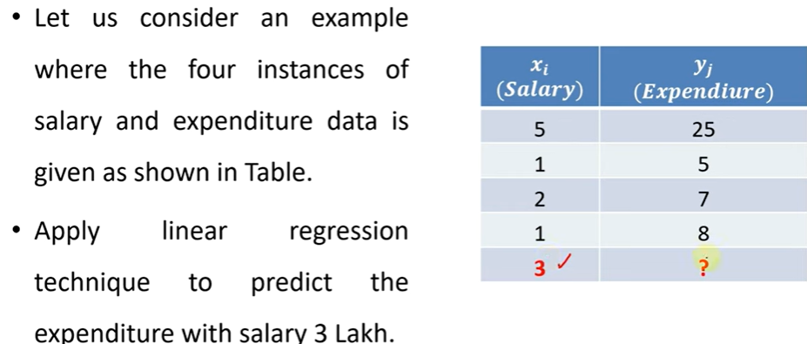

Slide 17
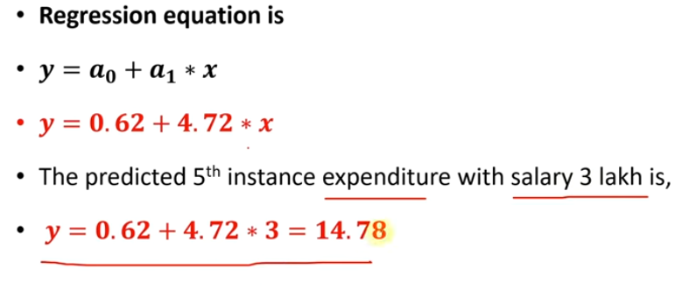

Slide 18
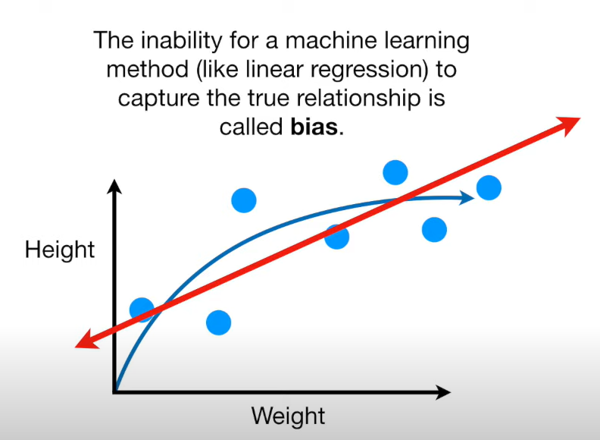
Bias
Biases are the underlying assumptions that are made by data to simplify the target function.
Bias does help us generalize the data better and make the model less sensitive to single data points.
It also decreases the training time because of the decrease in complexity of target function High bias suggest that there is more assumption taken on target function.
This leads to the underfitting of the model sometimes.
Examples of High bias Algorithms include Linear Regression, Logistic Regression etc.
Khushboo Jain CSF344 and ML Unit -2

Slide 19
Variance
Variance is a type of error that occurs due to a model’s sensitivity to small fluctuations in the dataset.
The high variance would cause an algorithm to model the outliers/noise in the training set.
This is most commonly referred to as overfitting.
In this situation, the model basically learns every data point and does not offer good prediction when it tested on a novel dataset. Examples of High variance Algorithms include Decision Tree, KNN etc.

Slide 20
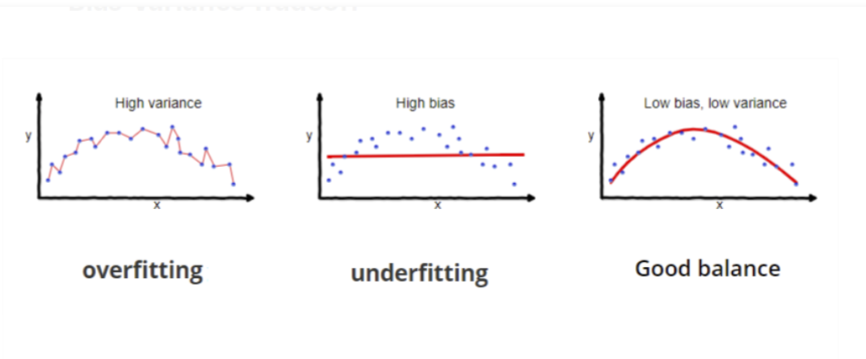

Slide 21
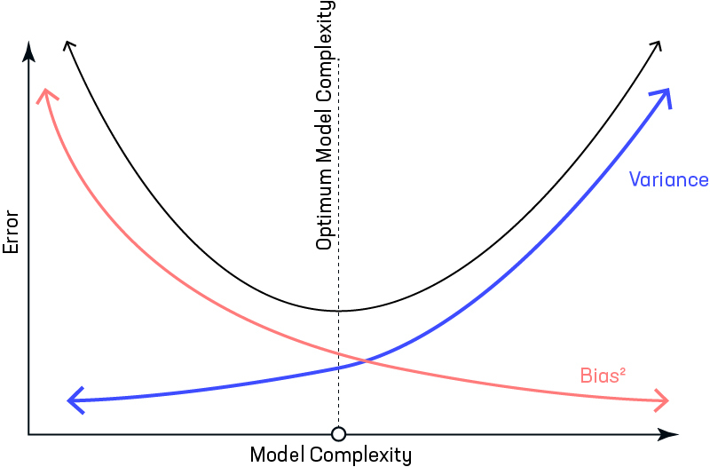

Slide 22
Performance in Regression Models
To calculate the performance of regression models, we utilize mathematical formulas that will compare the plotted graph to the points that we are predicting.
A good regression model should focus on minimizing the difference between the observation and the predicted value, while being unbiased. (Unbiased means that we try to find a balance between over-estimation and under-estimation)
There are 3 main metrics for model evaluation in regression:
Mean Absolute Error(MAE)
Mean Square Error(MSE)/Root Mean Square Error(RMSE)
R Square

Slide 23
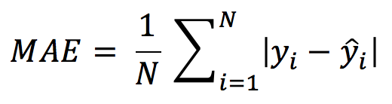
Mean Absolute Error(MAE)
Mean Absolute Error(MAE) is similar to Mean Square Error(MSE). However, instead of the sum of square of error in MSE, MAE is taking the sum of the absolute value of error.
Compare to MSE or RMSE, MAE is a more direct representation of sum of error terms.
MSE gives larger penalization to big prediction error by square it while MAE treats all errors the same.

Slide 24
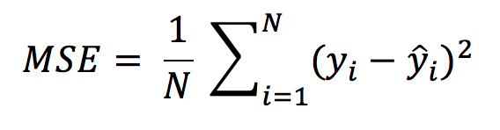
Mean Square Error(MSE)/ Root Mean Square Error(RMSE)
While R Square is a relative measure of how well the model fits dependent variables, Mean Square Error is an absolute measure of the goodness for the fit.
MSE is calculated by the sum of square of prediction error which is real output minus predicted output and then divide by the number of data points. It gives you an absolute number on how much your predicted results deviate from the actual number.
Root Mean Square Error(RMSE) is the square root of MSE.

Slide 25
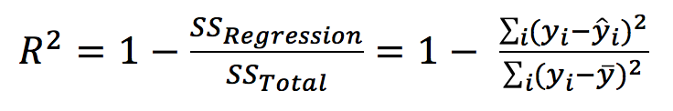
R Square/Adjusted R Square
R Square measures how much variability in dependent variable can be explained by the model. It is the square of the Correlation Coefficient(R) and that is why it is called R Square.
R Square is calculated by the sum of squared of prediction error divided by the total sum of the square which replaces the calculated prediction with mean. R Square value is between 0 to 1 and a bigger value indicates a better fit between prediction and actual value.

