Slide 1
File Allocation Methods
Contiguous
Non-contiguous

Slide 2
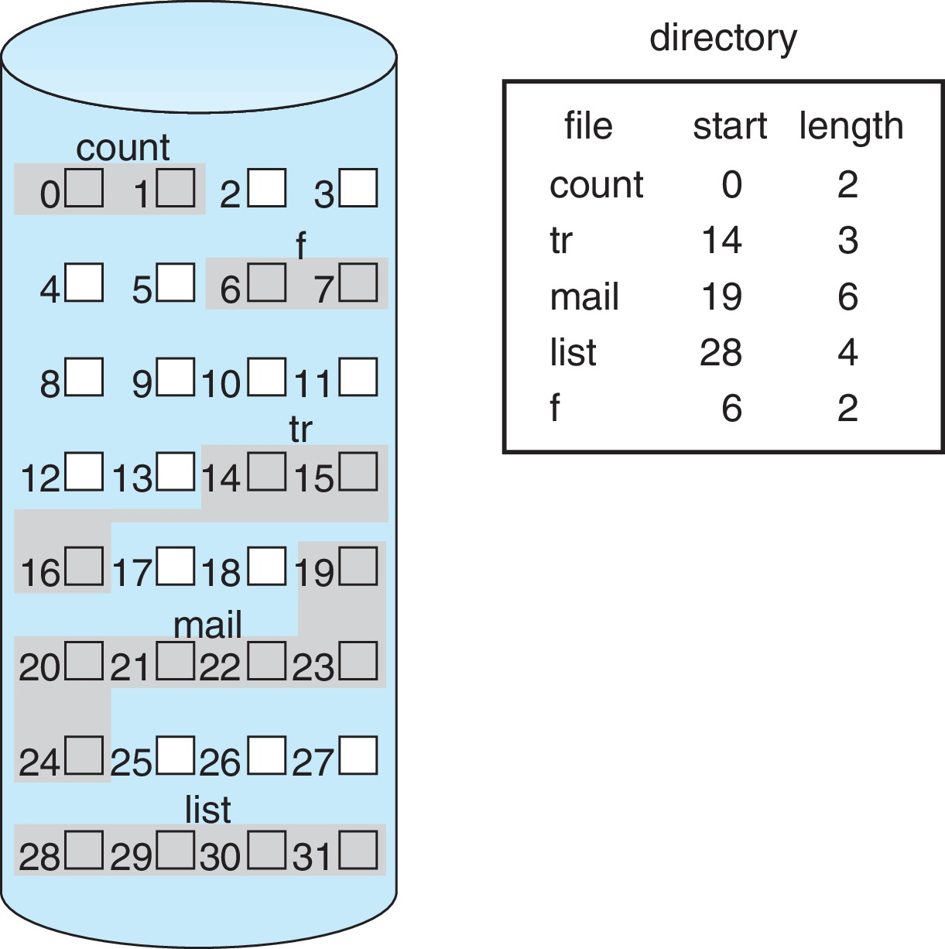
Contiguous Allocation
Advantages and Disadvantages?

Slide 3
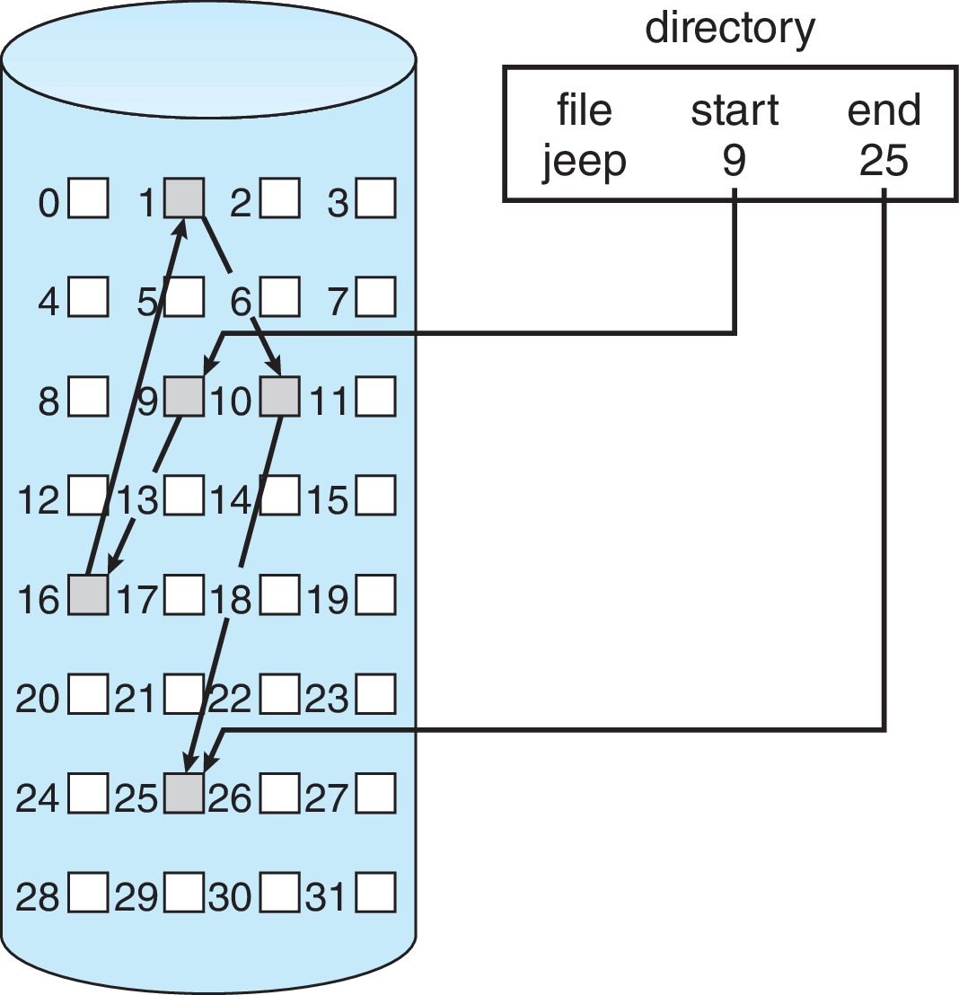
Non-Contiguous (Linked Allocation)
Scheme
Advantages and Disadvantages?

Slide 4
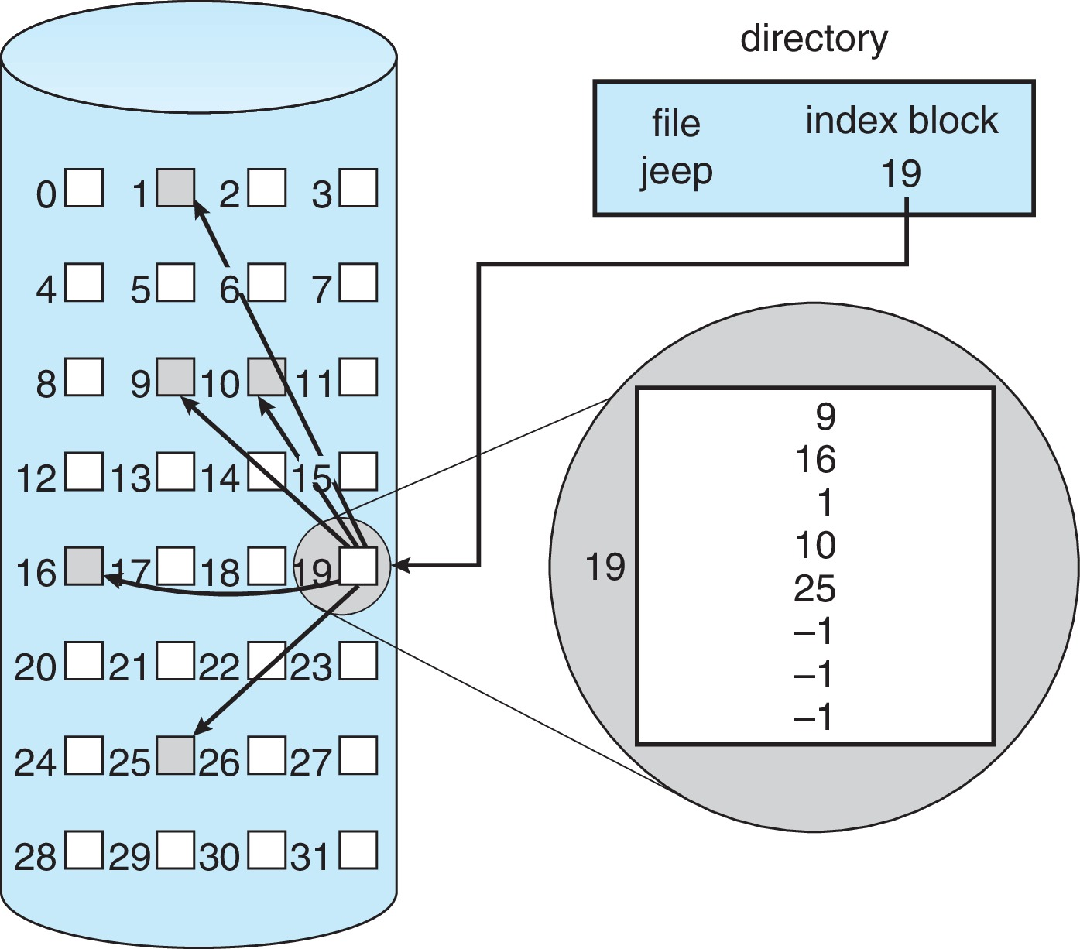
Indexed Allocation (Contiguous + non-Contiguous {linked})
Advantages and Disadvantages?

Slide 5
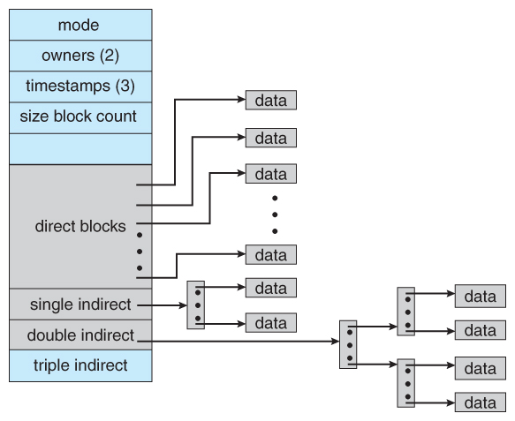
Case study of Unix/Linux {variation of multilevel index or extended allocation} Each file is associated with a block of disk known as i-node(index)
Linux inode

Slide 6
Q: The index node (inode) of a Unix -like file system has 12 direct, one single-indirect and one double-indirect pointers. The disk block size is 4kB, and the disk block address is 32 bits long. The maximum possible file size is (rounded off to decimal place) ____ GB?
Sol: Given 12 direct, 1 single indirect, 1 double indirect pointers Size of Disk block =4kB Disk Block Address =32 bits =4B Number of addresses= Size of disk block/address size = 4kB/4B= 2¹⁰ Maximum possible file size= 12*4kB + 2¹⁰ *4kB + 2¹⁰ * 2¹⁰ *4kB
= 4.00395GB ≈ 4GB
Hence 4GB is the correct answer
For more details, refer to the below link
https://gateoverflow.in/20557/elaborate-unix-inode

