Slide 1
Memory Management Unit V

Slide 2
Need for Multiprogramming & Main Memory (MM)
CPU can directly access Registers, Cache, and Main Memory.
Directly data and instructions can be put in these elements.
Problems are Size and Cost Constraints.

Slide 3
Size of MM vs. CPU Efficiency
Bigger Main Memory means more Processes can be loaded, hence maximum CPU utilization.
Example 1: Main memory 4MB and Process Size 4MB, Assume we have only one process and one processor.
Suppose Process spends fraction of “P” time doing I/O.
Then CPU Utilization = (1-P)

Slide 4
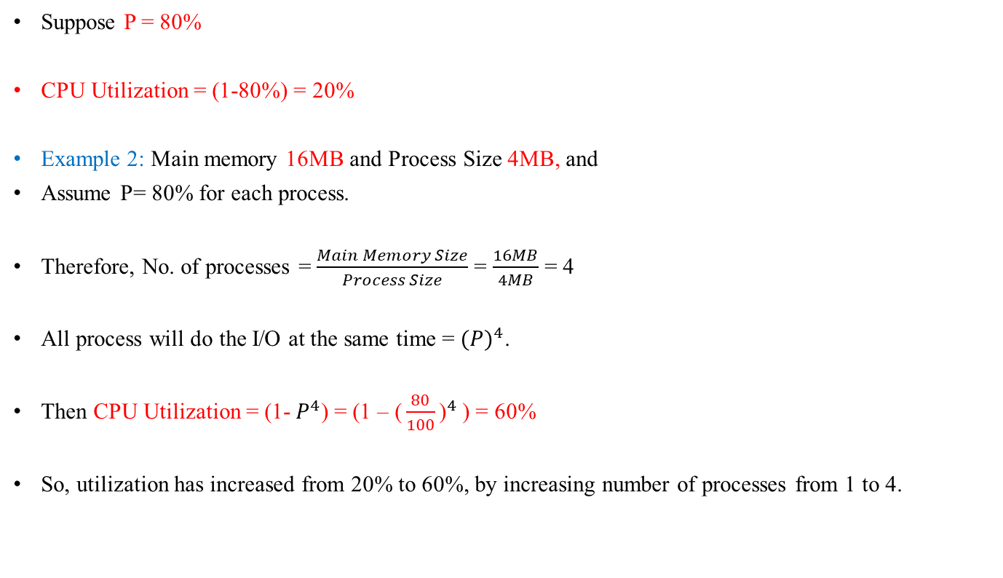
Size of MM vs. CPU Efficiency
Suppose P = 80%
CPU Utilization = (1-80%) = 20%
Example 2: Main memory 16MB and Process Size 4MB, and
Assume P= 80% for each process.
Therefore, No. of processes = $\frac{Main Memory Size}{Process Size}$ = $\frac{16MB}{4MB}$ = 4
All process will do the I/O at the same time = ${(P)}^{4}$.
Then CPU Utilization = (1- $P^{4}$) = (1 – ${\text{(}\frac{80}{100}\text{)}}^{4}$) = 60%
So, utilization has increased from 20% to 60%, by increasing number of processes from 1 to 4.

Slide 5
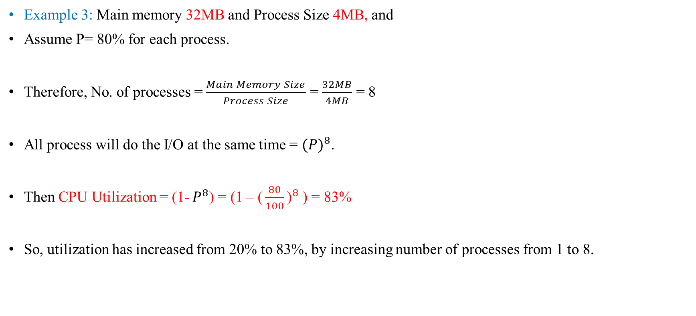
Size of MM vs. CPU Efficiency
Example 3: Main memory 32MB and Process Size 4MB, and
Assume P= 80% for each process.
Therefore, No. of processes = $\frac{Main Memory Size}{Process Size}$ = $\frac{32MB}{4MB}$ = 8
All process will do the I/O at the same time = ${(P)}^{8}$.
Then CPU Utilization = (1- $P^{8}$) = (1 – ${\text{(}\frac{80}{100}\text{)}}^{8}$) = 83%
So, utilization has increased from 20% to 83%, by increasing number of processes from 1 to 8.

Slide 6
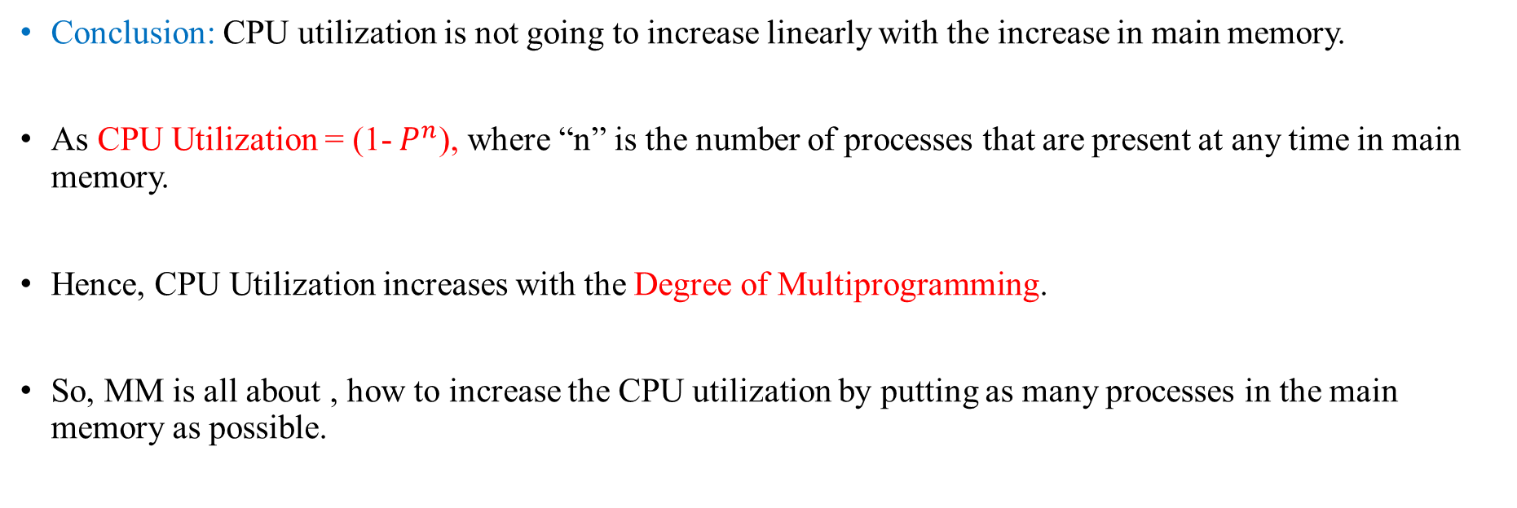
Size of MM vs. CPU Efficiency
Conclusion: CPU utilization is not going to increase linearly with the increase in main memory.
As CPU Utilization = (1- $P^{n}$), where “n” is the number of processes that are present at any time in main memory.
Hence, CPU Utilization increases with the Degree of Multiprogramming.
So, MM is all about , how to increase the CPU utilization by putting as many processes in the main memory as possible.

Slide 7
Problem
When more than one processes are present simultaneously in the Main Memory, then:
How much memory space to be allocated to each process.
How we are going to Allocate that space.
How we are going to De-Allocate that Space.

Slide 8
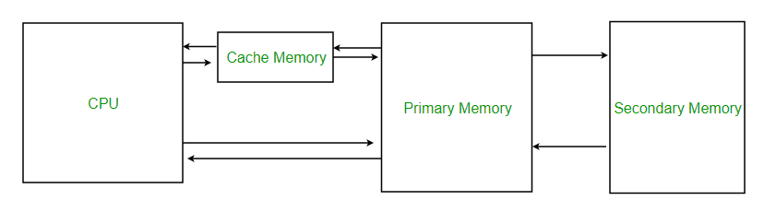
Memory Criteria:
1. Access Time → Less (Fast Access)
2. Memory Size → Large
(when size is increased access time also increases)
3. Cost per Unit area → Low

Slide 9
Multiprogramming benefits
Normally, the instructions are run in a sequential manner.
Next coming possible instructions are shifted from secondary memory & placed in part of main memory.
Hence, for most frequently used instructions we use cache memory.
Average Access time = h x (MM) + (1-h) x (Miss penalty)

Slide 10
Address Binding
Address binding of instructions and data to memory addresses can happen at three different stages
Compile time: If memory location known a priori, absolute code can be generated; must recompile code if starting location changes.
For example, if you know that a user process will reside starting at location R, then the generated compiler code will start at that location and extend up from there. If, at some later time, the starting location changes, then it will be necessary to recompile this code.
Load time: If it is not known at compile time where the process will reside in memory, then the compiler must generate relocatable code. In this case, final binding is delayed until load time. If the starting address changes, we need only reload the user code to incorporate this changed value.
Execution time: Binding delayed until run time if the process can be moved during its execution from one memory segment to another.
Need hardware support for address maps (e.g., base and limit registers)

Slide 11

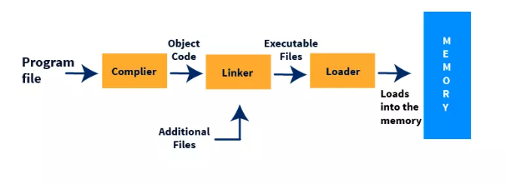
Multistep Processing of a User Program
Figure: The figure shows the process of loading a program into the main memory.

Slide 12
Compile Time vs Load Time vs Execution Time Binding
1️⃣ Compile-time Binding
Compiler already knows the program will start at physical address 10000. So it directly generates physical addresses.
2️⃣ Load-time Binding
Compiler generates logical addresses, OS picks a physical base when the program loads, e.g., 300040, and adds it to the logical addresses.
3️⃣ Execution-time Binding
Logical addresses are converted to physical using hardware (MMU) on every access, so the program can be moved during execution (paging, segmentation).

Slide 13
SUMMARY TABLE
Feature | Compile-Time | Load-Time | Execution-Time
When bound? | Compiler | Loader | Every access (runtime)
Who binds? | Compiler | Loader | MMU hardware
Addresses in program? | Physical | Physical (after loading) | Logical
Can program move after loading? | ❌ No | ❌ No | ✅ Yes
Used today? | ❌ No | Sometimes | ✅ Always (paging, virtual memory)

Slide 14
Logical vs. Physical Address Space
The concept of a logical address space that is bound to a separate physical address space is central to proper memory management
Logical address – generated by the CPU; also referred to as virtual address
Physical address – address seen by the memory unit
Logical and physical addresses are the same in compile-time and load-time address-binding schemes; logical (virtual) and physical addresses differ in execution-time address-binding scheme.
Logical address space is the set of all logical addresses generated by a program.
Physical address space is the set of all physical addresses generated by a program.

Slide 15
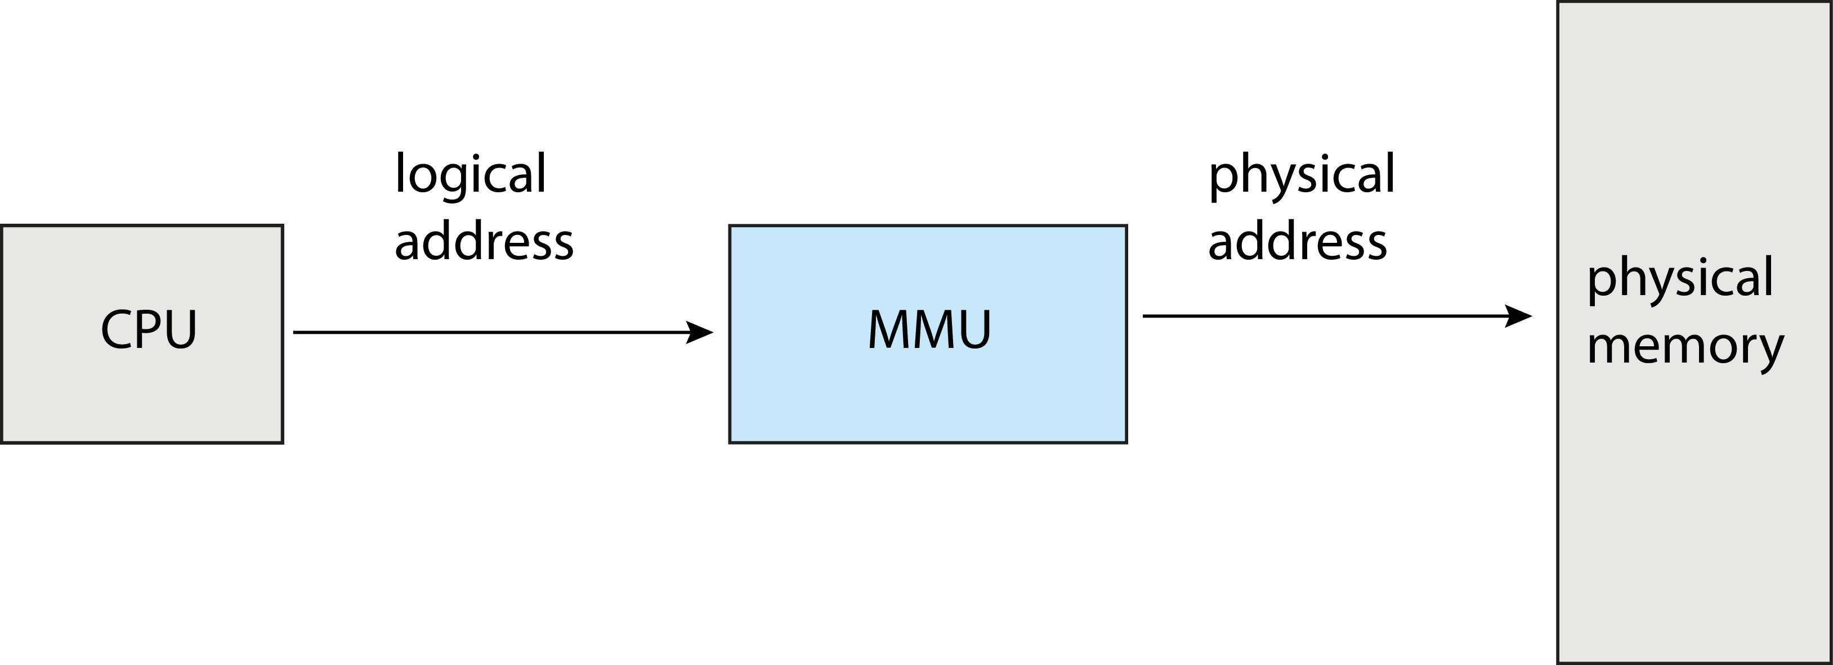
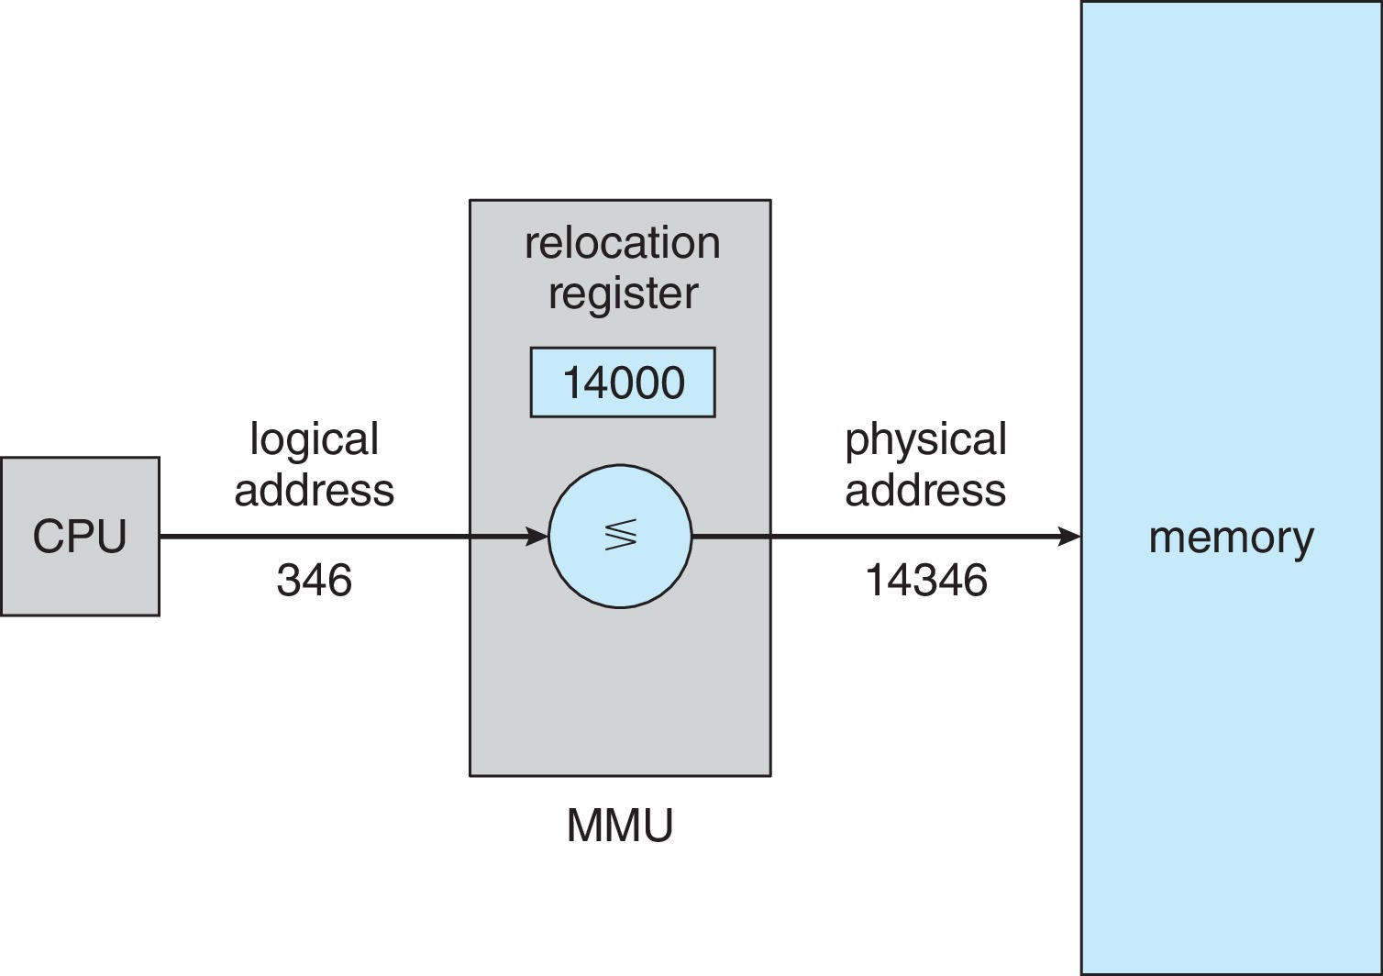

Memory-Management Unit (MMU)
Consider simple scheme. which is a generalization of the base-register scheme.
The base register now called relocation register
The value in the relocation register is added to every address generated by a user process at the time it is sent to memory
Hardware device that at run time maps virtual to physical address

Slide 16

Hardware Support for Relocation and Limit Registers

Slide 17
Dynamic Loading
Dynamic Linking
Dynamically linked libraries (DLLs) are system libraries that are linked to user programs when the programs are run.
Static linking – system libraries and program code combined by the loader into the binary program image.
Dynamic linking –linking postponed until execution time.
Dynamic linking is particularly useful for libraries
DLLs are also known as shared libraries
The entire program does need to be in memory to execute
Routine is not loaded until it is called
Better memory-space utilization; unused routine is never loaded
Useful when large amounts of code are needed to handle infrequently occurring cases
No special support from the operating system is required
Implemented through program design
OS can help by providing libraries to implement dynamic loading

Slide 18
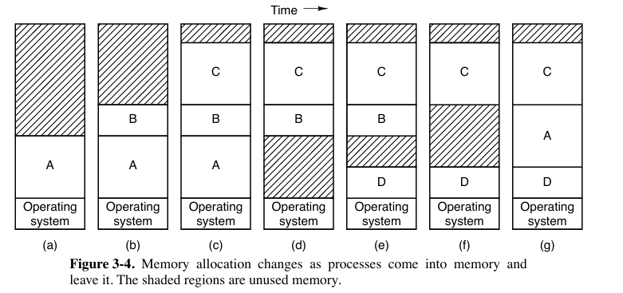
Memory Overload
Two general approaches to dealing with memory overload have been developed over the years.
Swapping
Virtual Memory: allows programs to run even when they are only partially in main memory.
1. Swapping: swapping of processes, consists of bringing in each process in its entirety, running it for a while, then putting it back on nonvolatile storage (disk or SSD).
The operation of a swapping system is illustrated in Fig. 3-4.
Initially, only process A is in memory.
Then processes B and C are created or swapped in from nonvolatile storage.
In Fig. 3-4(d) A is swapped out to nonvolatile storage. Then D comes in and B goes out.
Finally, A comes in again.
Since A is now at a different location, addresses contained in it must be relocated, either by software when it is swapped in or (more likely) by hardware during program execution. For example, base and limit registers would work fine here.

Slide 19
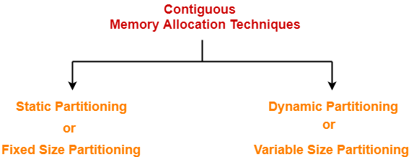
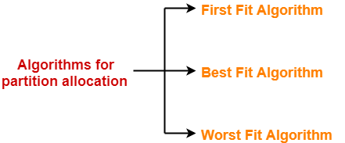
Memory Management Techniques
Contiguous Allocation
Non-Contiguous Allocation
Algorithms for Partition Allocation-
Popular algorithms used for allocating the partitions to the arriving processes are-
1. Static Partitioning-
Static partitioning is a fixed size partitioning scheme.
In this technique, main memory is pre-divided into fixed size partitions.
The size of each partition is fixed and can not be changed.
Each partition is allowed to store only one process.
Note: Contiguous allocation suffers from external fragmentation.
In addition, static partitioning within contiguous allocation also leads to internal fragmentation.

Slide 20
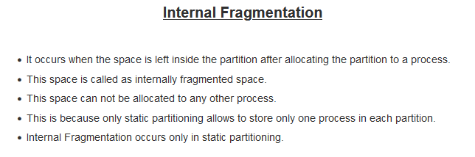
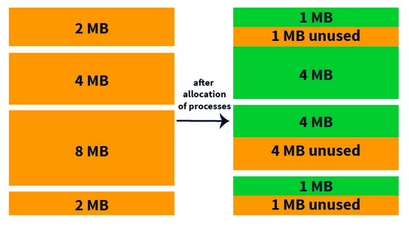
1. Problem with Fixed Partition

Slide 21
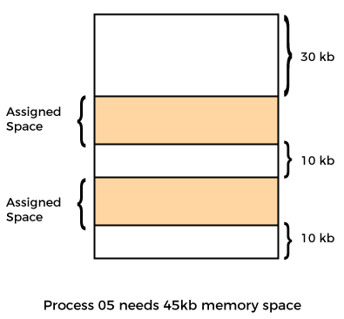
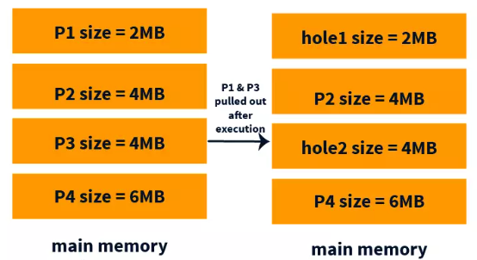
2. Problem with Fixed Partition
External Fragmentation (EF)
There is enough memory space to complete a request, but it is not contiguous. It's known as
external fragmentation.
Note: When IF exists then EF also exists, But if there is no IF, still EF can be there.

Slide 22
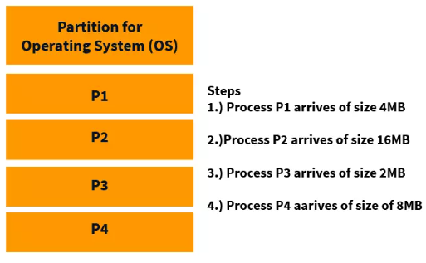
Contiguous Allocation contd…
2. Dynamic Partitioning or Variable Size Partitioning
In Dynamic Partitioning, the main memory is not divided initially. When a process arrives in the main memory it is given that much memory. Here the partition/block size is not fixed initially, instead, the size of partition/block size is equal to the size of the process. This is shown in the diagram below.
Popular partition allocation algorithms are-

Slide 23
Important Points-
Point-01:
For dynamic partitioning,
Worst Fit Algorithm works best.
This is because space left after allocation inside the partition is of large size.
There is a high probability that this space might suit the requirement of arriving processes.
Point-02:
For dynamic partitioning,
Best Fit Algorithm works worst.
This is because space left after allocation inside the partition is of very small size.
There is a low probability that this space might suit the requirement of arriving processes.

Slide 24
Advantages-
The advantages of dynamic partitioning are-
It does not suffer from internal fragmentation.
Degree of multiprogramming is dynamic.
There is no limitation on the size of processes.
Disadvantages-
The disadvantages of dynamic partitioning are-
It suffers from external fragmentation.
Allocation and deallocation of memory is complex.

Slide 25
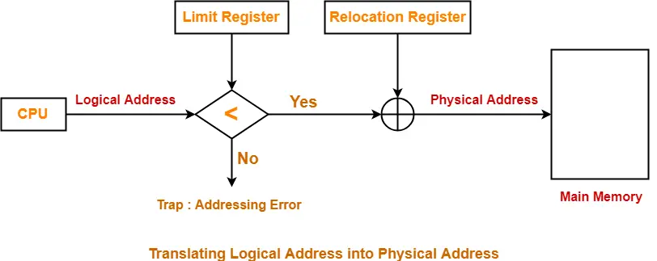
Translating Logical Address into Physical Address

Slide 26
Managing Free Memory
Compaction
Bit Maps
Linked Lists

Slide 27
Compaction
Also called Defragmentation.
Put free spaces together and filled spaces together.
This combined free block can be allocated to new incoming processes (Contiguous Block).
Problem: While shuffling free and occupied blocks, we need to stop the execution of processes, so CPU becomes idle.

Slide 28
Bit Map for Dynamic Partitioning
It is used to keep track of all the empty spaces or free holes.
Bit Map is the least famous data structure to store the details.
In this scheme, the main memory is divided into the collection of allocation units.
One or more allocation units may be allocated to a process according to the need of that process.
However, the size of the allocation unit is fixed that is defined by the Operating System and never changed. Although the partition size may vary but the allocation size is fixed.
“0” if allocation unit is Hole.
“1” if allocation unit is occupied by process.

Slide 29
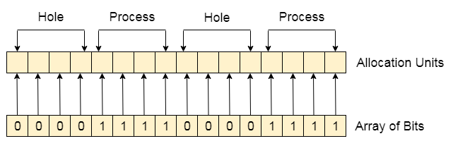
Bit Map for Dynamic Partitioning
Problems:
We need additional memory overhead to store the “Array of Bits”. This reduces Degree of multiprogramming as well.
To identify any hole in the memory, the OS need to search the string of 0s in the bitmap. This searching takes a huge amount of time which makes the system inefficient to some extent

Slide 30
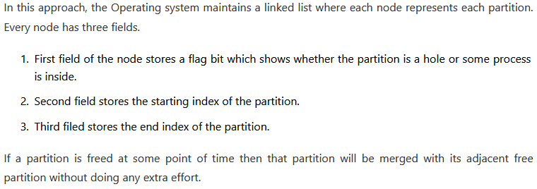
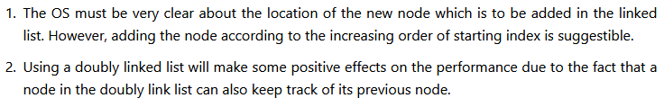
Linked List for Dynamic Partitioning

Slide 31
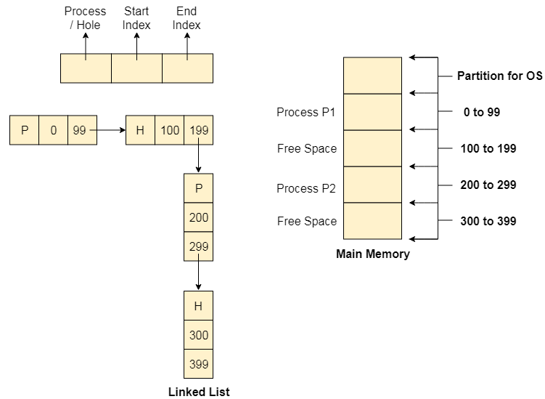
Linked List for Dynamic Partitioning

Slide 32
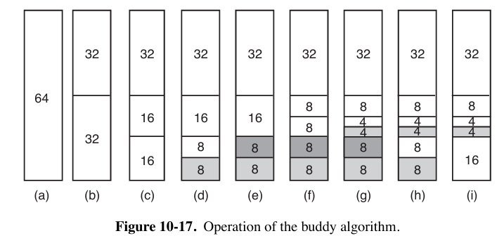
Buddy System
The basic idea for managing a chunk of memory is as follows.
Initially memory consists of a single contiguous piece, 64 pages in the simple example of Fig. 10-17(a).
When a request for memory comes in, it is first rounded up to a power of 2, say eight pages.
The full memory chunk is then divided in half, as shown in (b).
Since each of these pieces is still too large, the lower piece is divided in half again (c) and again (d).
Now we have a chunk of the correct size, so it is allocated to the caller, as shown shaded in (d)
Now suppose that a second request comes in for eight pages. This can be satisfied directly now (e).
At this point, a third request comes in for four pages. The smallest available chunk is split (f) and half of it is claimed (g).
Next, the second of the 8-page chunks is released (h).
Finally, the other eight-page chunk is released. Since the two adjacent just-freed eight-page chunks came from the same 16-page chunk, they are merged to get the 16-page chunk back (i).
This algorithm leads to considerable internal fragmentation because if you want a 65-page chunk, you have to ask for and get a 128-page chunk.
To alleviate this problem, Linux has a second memory allocator, the slab allo cator, which takes chunks using the buddy algorithm but then carves slabs (smaller units) from them and manages the smaller units separately.

Slide 33
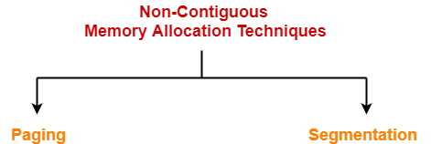
Non-Contiguous Memory Allocation
Non-contiguous memory allocation is a memory allocation technique.
It allows to store parts of a single process in a non-contiguous fashion.
Thus, different parts of the same process can be stored at different places in the main memory.

Slide 34
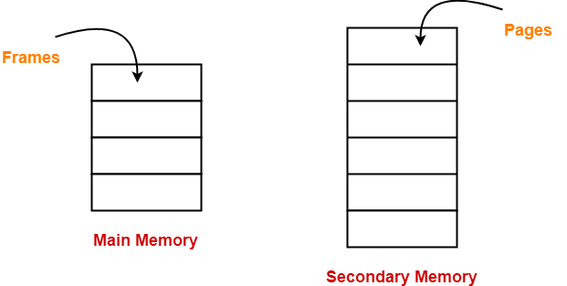
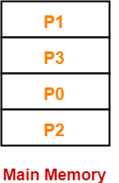
1. Paging-
Paging is a fixed size partitioning scheme.
In paging, secondary memory and main memory are divided into equal fixed size partitions.
The partitions of secondary memory are called as pages.
The partitions of main memory are called as frames.
Each process is divided into parts where size of each part is same as page size.
The size of the last part may be less than the page size.
The pages of process are stored in the frames of main memory depending upon their availability.
Example-
Consider a process is divided into 4 pages P₀, P₁, P₂ and P₃.
Depending upon the availability, these pages may be stored in the main memory frames in a non-contiguous fashion as shown-

Slide 35
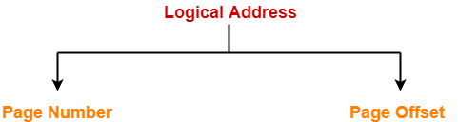
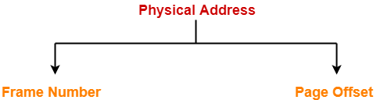
Paging:: Translating Logical Address into Physical Address
CPU always generates a logical address.
A physical address is needed to access the main memory.
Following steps are followed to translate logical address into physical address-
Step-01:
CPU generates a logical address consisting of two parts-
Page Number
Page Offset
Page Number specifies the specific page of the process from which CPU wants to read the data.
Page Offset specifies the specific word on the page that CPU wants to read.
Step-02:
For the page number generated by the CPU,
Page Table provides the corresponding frame number (base address of the frame) where that page is stored in the main memory.
Step-03:
The frame number combined with the page offset forms the required physical address.
Frame number specifies the specific frame where the required page is stored.
Page Offset specifies the specific word that has to be read from that page.

Slide 36
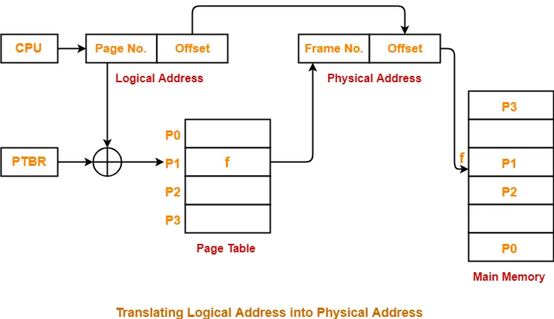
The following diagram illustrates the above steps of translating logical address into physical address-
Advantages-
The advantages of paging are-
It allows to store parts of a single process in a non-contiguous fashion.
It solves the problem of external fragmentation.
Disadvantages-
The disadvantages of paging are-
It suffers from internal fragmentation.
There is an overhead of maintaining a page table for each process.
The time taken to fetch the instruction increases since now two memory accesses are required.

