Slide 1

Memory Management
Presented By
Dr. Khursheed Ahmad Bhat
Assistant Professor
School of Computer Science
University of Petroleum and Energy Studies

Slide 2
Need for Multiprogramming & MM
CPU can directly access Registers, Cache, and Main Memory.
Directly data and instructions can be put in these elements.
Problems are Size and Cost Constraints.

Slide 3
Size of MM vs. CPU Efficiency
Bigger Main Memory means more Processes can be loaded, hence maximum CPU utilization.
Example 1: Main memory 4MB and Process Size 4MB, Assume we have only one process and one processor.
Suppose Process spends fraction of “P” time doing I/O.
Then CPU Utilization = (1-P)

Slide 4
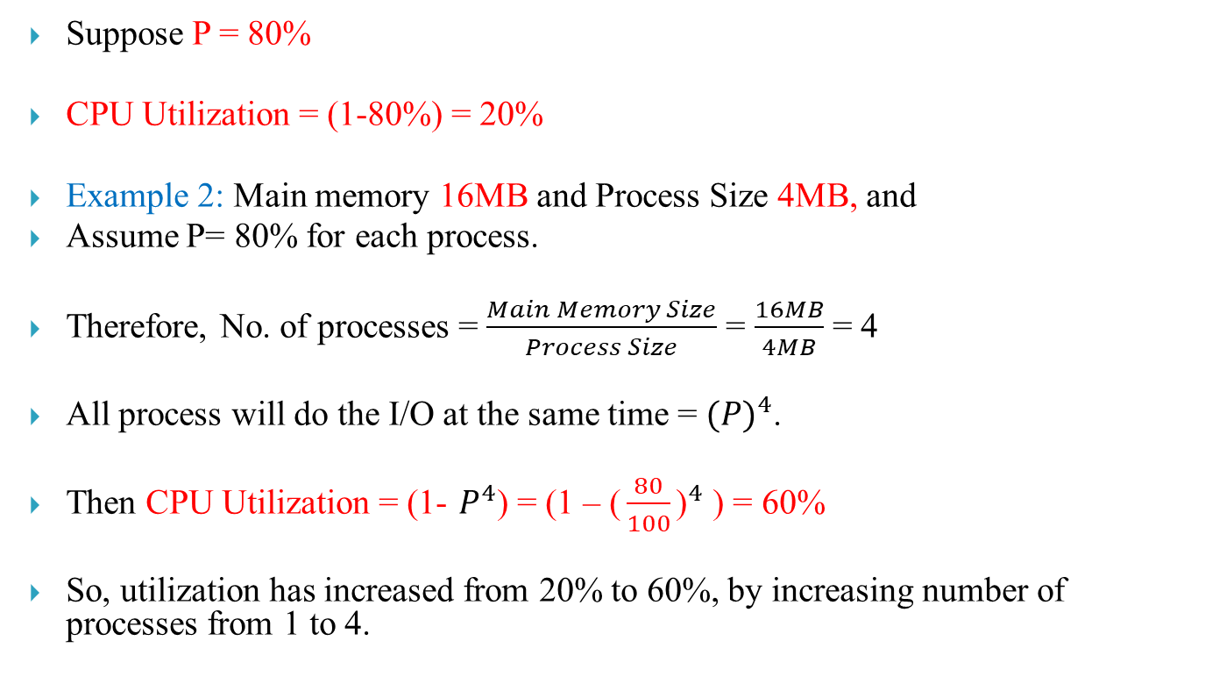
Size of MM vs. CPU Efficiency
Suppose P = 80%
CPU Utilization = (1-80%) = 20%
Example 2: Main memory 16MB and Process Size 4MB, and
Assume P= 80% for each process.
Therefore, No. of processes = $\frac{Main Memory Size}{Process Size}$ = $\frac{16MB}{4MB}$ = 4
All process will do the I/O at the same time = ${(P)}^{4}$.
Then CPU Utilization = (1- $P^{4}$) = (1 – ${\text{(}\frac{80}{100}\text{)}}^{4}$) = 60%
So, utilization has increased from 20% to 60%, by increasing number of processes from 1 to 4.

Slide 5
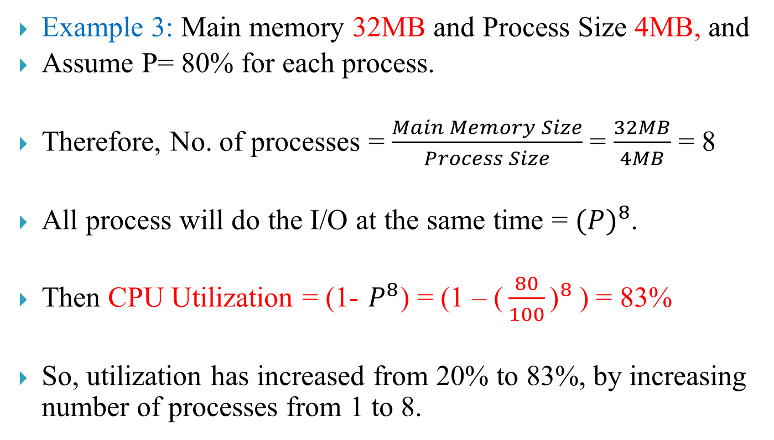
Size of MM vs. CPU Efficiency
Example 3: Main memory 32MB and Process Size 4MB, and
Assume P= 80% for each process.
Therefore, No. of processes = $\frac{Main Memory Size}{Process Size}$ = $\frac{32MB}{4MB}$ = 8
All process will do the I/O at the same time = ${(P)}^{8}$.
Then CPU Utilization = (1- $P^{8}$) = (1 – ${\text{(}\frac{80}{100}\text{)}}^{8}$) = 83%
So, utilization has increased from 20% to 83%, by increasing number of processes from 1 to 8.

Slide 6
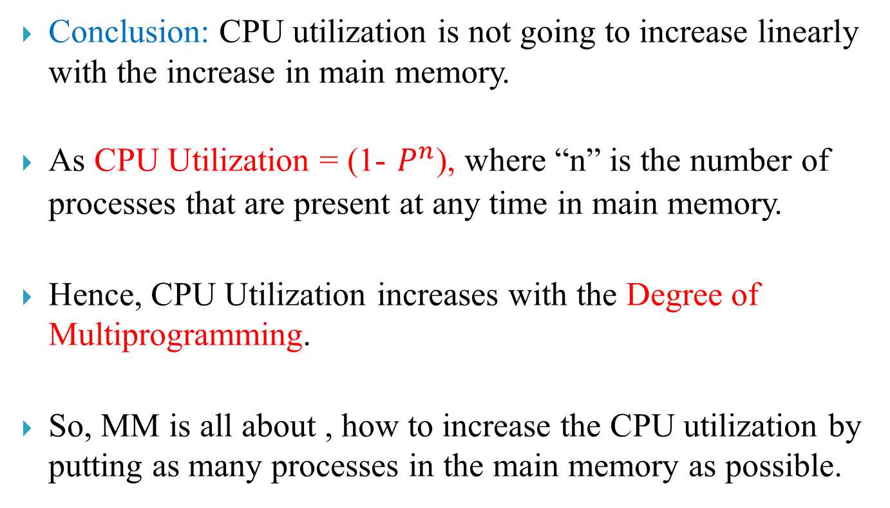
Size of MM vs. CPU Efficiency
Conclusion: CPU utilization is not going to increase linearly with the increase in main memory.
As CPU Utilization = (1- $P^{n}$), where “n” is the number of processes that are present at any time in main memory.
Hence, CPU Utilization increases with the Degree of Multiprogramming.
So, MM is all about , how to increase the CPU utilization by putting as many processes in the main memory as possible.

Slide 7
Problem
When more than one processes are present simultaneously in the Main Memory, then:
How much memory space to be allocated to each process.
How we are going to Allocate that space.
How we are going to De-Allocate that Space.

Slide 8
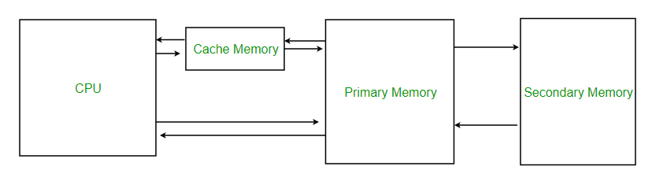
Criteria:
1. Access Time → Less (Fast Access)
2. Memory Size → Large
(when size is increased access time also increases)
3. Cost per Unit area → Low
(When size is increased, Cost also increases )

Slide 9
Criteria:
Normally, the instructions are run in a sequential manner.
Next coming possible instructions are shifted from secondary memory & placed in part of main memory.
Hence, for most frequently used instructions we use cache memory.
Average Access time = h x (MM) + (1-h) x (Miss penalty)

Slide 10
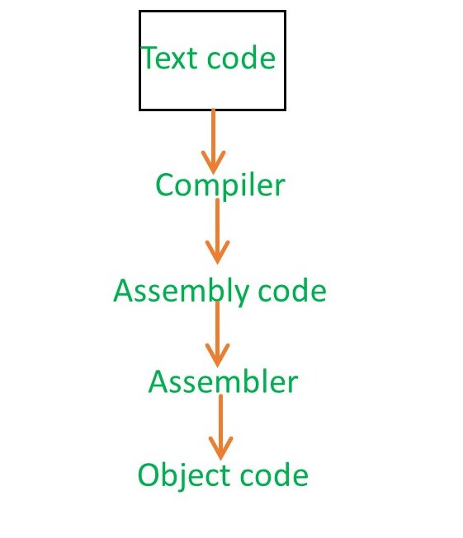
Object Code, Relocation & Linker
Assembler will be different for different platforms.
Different hardware platforms will have different Assemblers.
Once, these steps will be Completed, the object code will be present in the Hard disk.

Slide 11
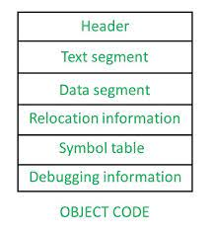
Object Code, Relocation & Linker
Header: Pointers to various parts present in the object code.
Text Seg: Consists of Instructions.
Data Seg: Information about the data that is being used.
Relocation Info: To convert “Relocatable Code” into “Absolute Address Code”.
Symbol Table: Each and every symbol that have been used in the program.
Debugging Info: How a variable keep on changing.

Slide 12
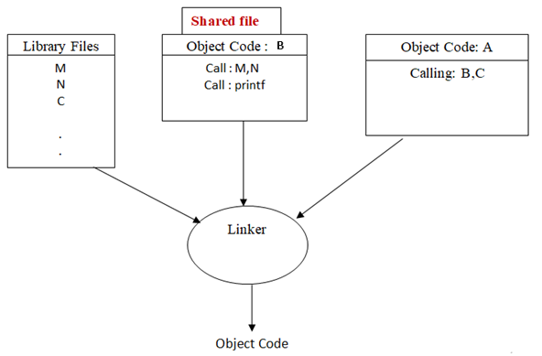
Object Code, Relocation & Linker
Modified object code will be created by Linker.
Linker will figure out what are all the external references we have and where to put all these segments together.
For this Segment table and symbol table are used.

Slide 13
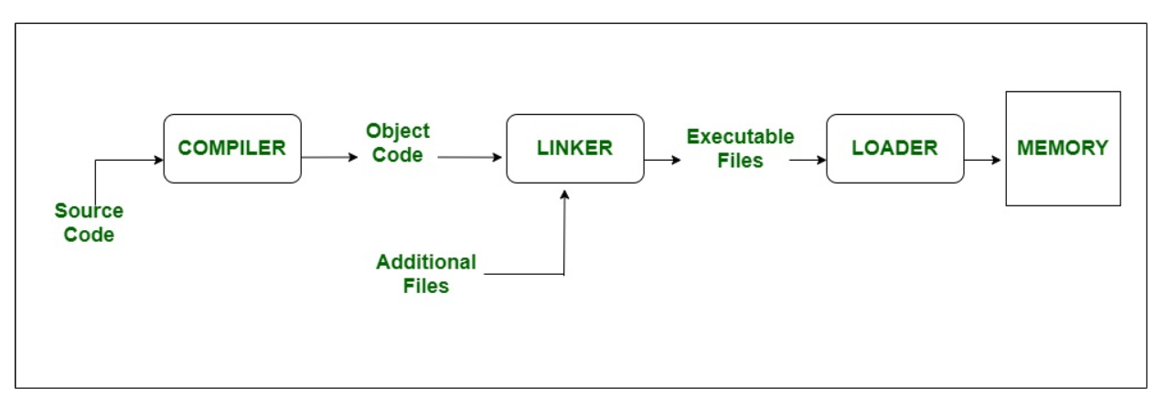
Loader
Loader will try to load the program at a memory address.
Loader will ask the OS to provide the starting address where the program has to be loaded.

Slide 14
Key Terms:
Program Loading: The process of taking the program from the “Hard disk” and putting it in the main memory is called program loading.
Relocation: It means changing the address from one form to another.
Symbol Resolution: Only way we can refer to other programs from our program is using symbols and these symbols have to be resolved.
Traditionally, all the above three aspects are taken care by two softwares:
Linker
Main responsibility is Symbol Resolution
2. Loader
Program Loading
Relocation

Slide 15
Two Important Methods:
The contents (process) are shifted in advance from secondary memory to main memory to have less access time.
This can be done in two ways:
Contiguous Method
Access is Fast
E.g, Array
2. Non Contiguous Method
Access is Slow
E.g, Linked List
CPU generates logical address and Main Memory uses physical addresses, so there must be a “Translator” in between to convert logical address into physical address.

Slide 16
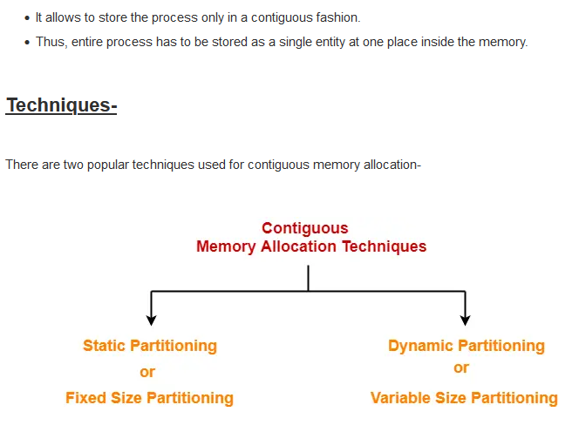
Contiguous Memory Allocation

Slide 17
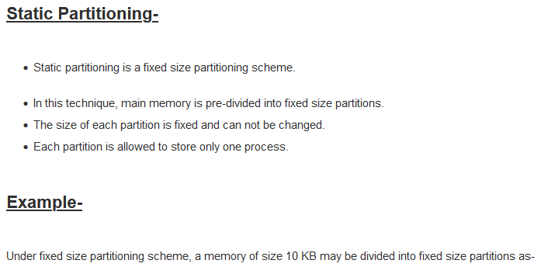
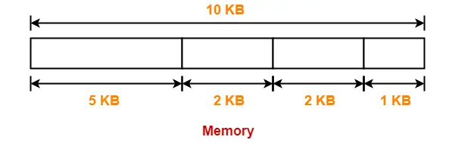
Fixed or Static Partition

Slide 18

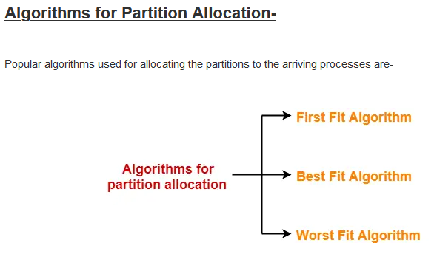
Fixed or Static Partition

Slide 19
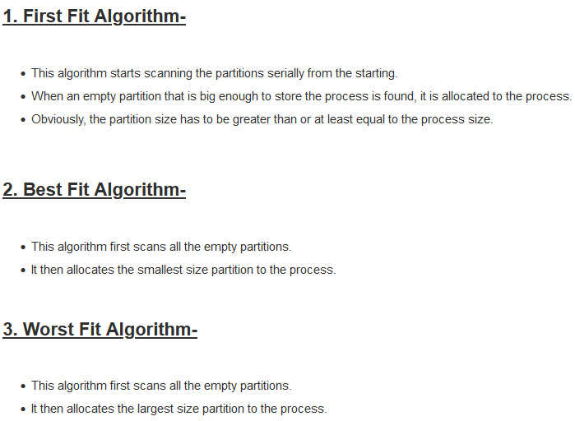
Fixed or Static Partition

Slide 20
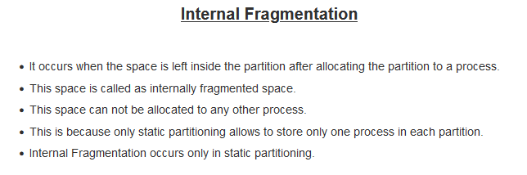
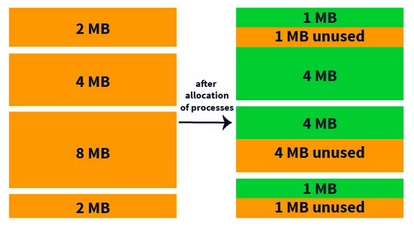
Problem with Fixed Partition

Slide 21
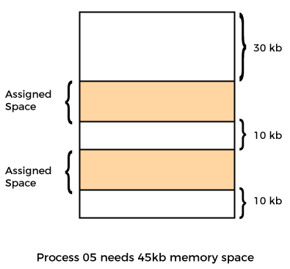
Problem with Fixed Partition
2. What is the maximum size of the process that can be run using this
architecture?
In previous case, process with more than 8MB cannot be run. Or, we can
use virtual memory or Overlays.
3. Number of partitions limits Degree of
Multiprogramming.
4. External Fragmentation (EF)
There is enough memory space to
complete a request, but it is
not contiguous. It's known as
external fragmentation.
When IF exists then EF also exists, But
if there is no IF, still EF can be there.

Slide 22
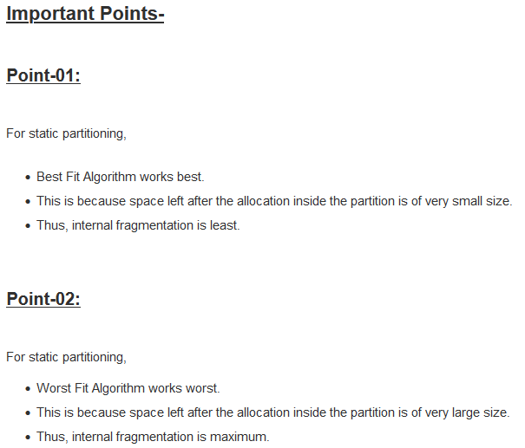
Fixed or Static Partition

Slide 23
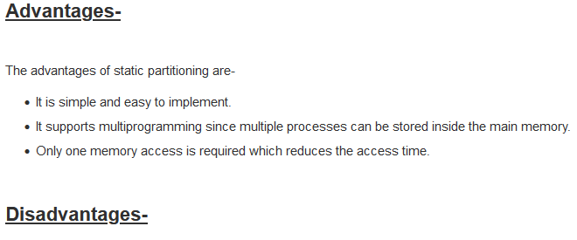
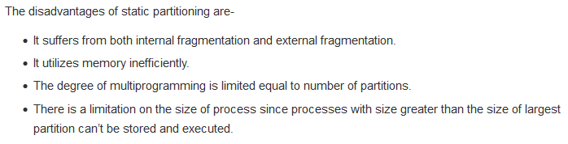
Fixed or Static Partition

Slide 24
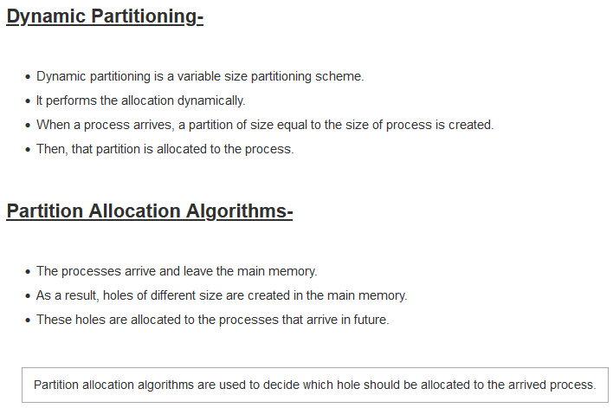
Dynamic or variable Partition

Slide 25
Dynamic Partition

Slide 26
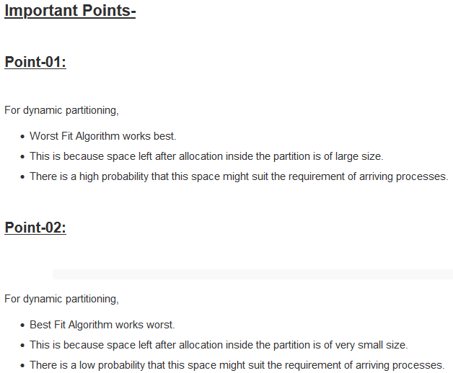
Dynamic or variable Partition

Slide 27
Deallocated Holes: Dynamic Method
Compaction
Bit Maps
Linked Lists

Slide 28
Compaction
Also called Defragmentation.
Put free spaces together and filled spaces together.
This combined free block can be allocated to new incoming processes (Contiguous Block).
Problem: While shuffling free and occupied blocks, we need to stop the execution of processes, so CPU becomes idle.

Slide 29
Bit Map for Dynamic Partitioning
It is used to keep track of all the empty spaces or free holes.
Bit Map is the least famous data structure to store the details. In this scheme, the main memory is divided into the collection of allocation units. One or more allocation units may be allocated to a process according to the need of that process. However, the size of the allocation unit is fixed that is defined by the Operating System and never changed. Although the partition size may vary but the allocation size is fixed.
“0” if allocation unit is Hole.
“1” if allocation unit is occupied by process.

Slide 30
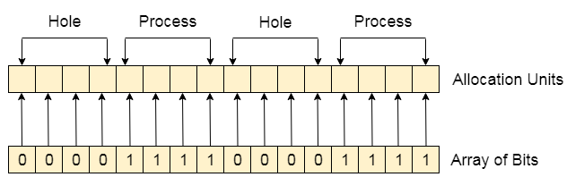
Bit Map for Dynamic Partitioning
Problems:
We need additional memory overhead to store the “Array of Bits”. This reduces Degree of multiprogramming as well.
To identify any hole in the memory, the OS need to search the string of 0s in the bitmap. This searching takes a huge amount of time which makes the system inefficient to some extent

Slide 31
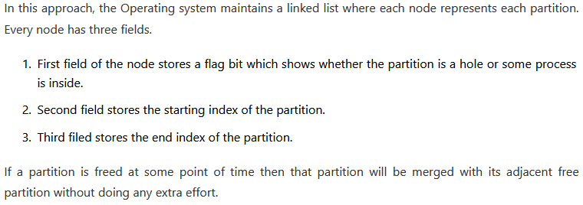
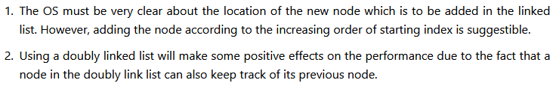
Linked List for Dynamic Partitioning

Slide 32
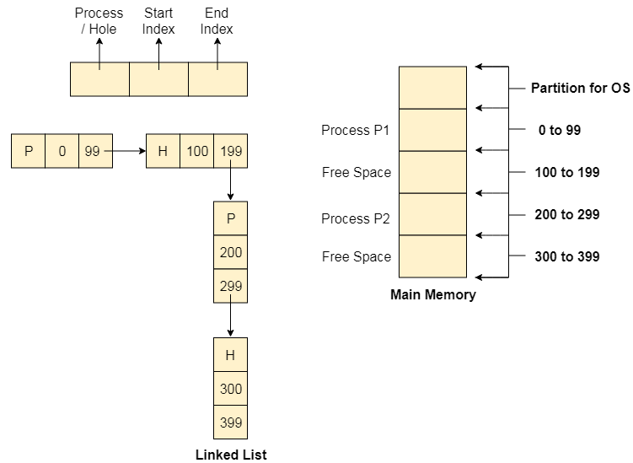
Linked List for Dynamic Partitioning

Slide 33
Algorithms on Linked List
First Fit: Scan the entire list and when you find first hole which is big enough to hold a process.
Next Fit: This is similar to First Fit algorithm, but instead of starting from the first node, we start scanning the list from a point where we have left it earlier.
Best Fit: Among all the holes which are present in the linked list we find the smallest hole which can accommodate the process.
Worst Fit: Scan the entire list from the beginning, then find out the biggest hole possible and assign it to process.
Quick Fit: It says that there are normally some “processes sizes” which are most frequently used, therefore it says that for all the most frequently used sizes we maintain linked list.

Slide 34
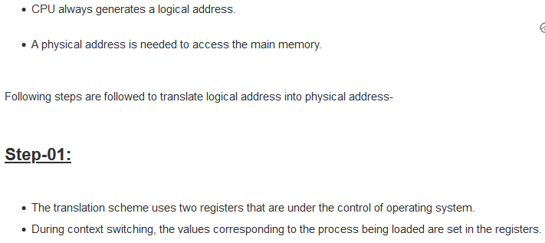
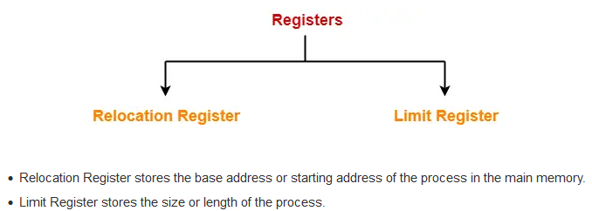
Address Translation in CMA

Slide 35
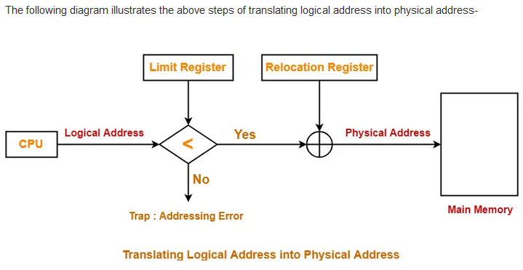
Address Translation in CMA

Slide 36
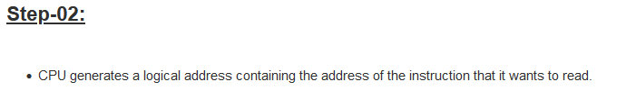
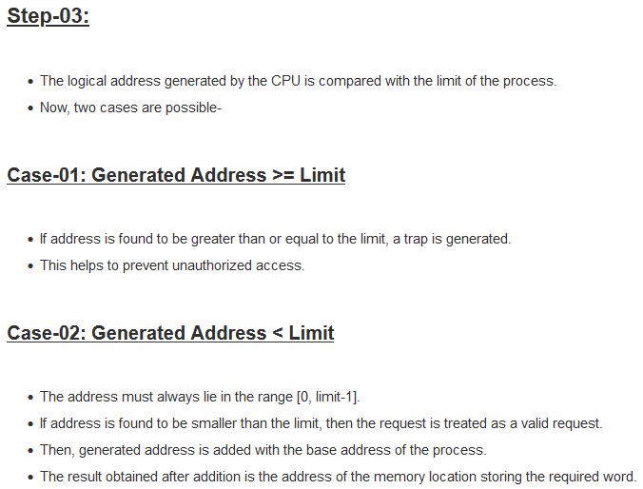
Address Translation in CMA

Slide 37
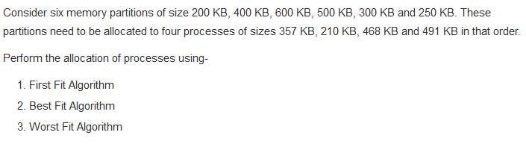
Problem 1:

Slide 38
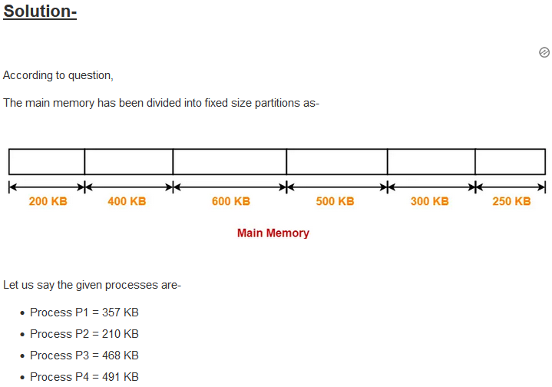
Solution:

Slide 39
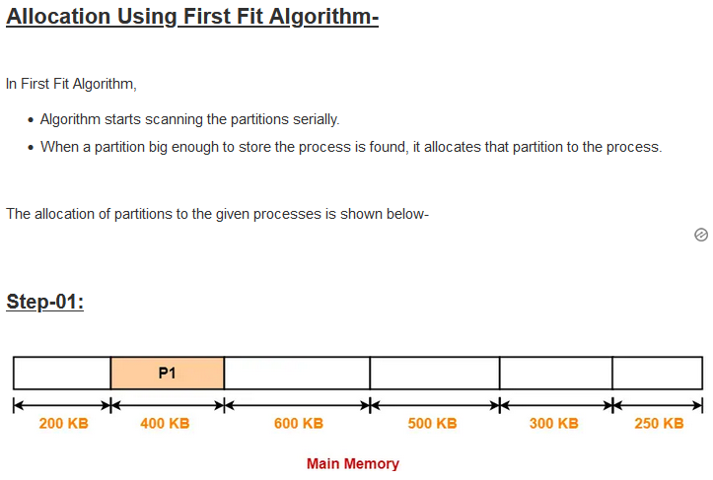

Slide 40
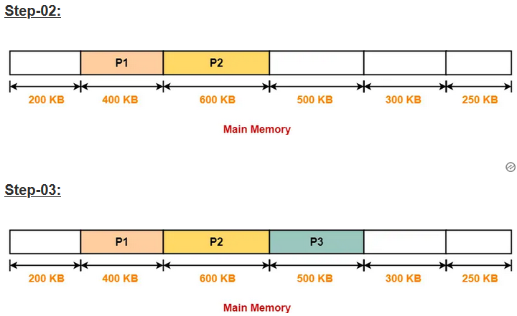

Slide 41
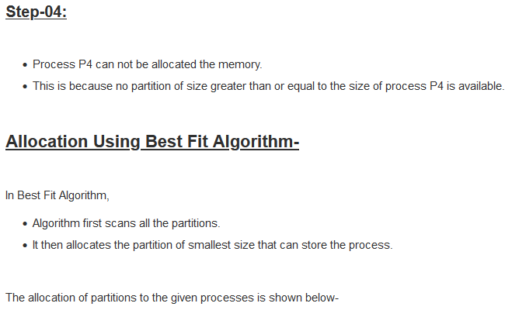
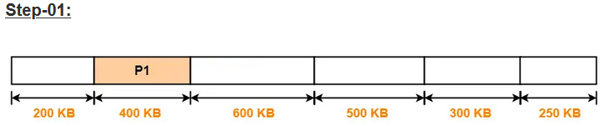

Slide 42
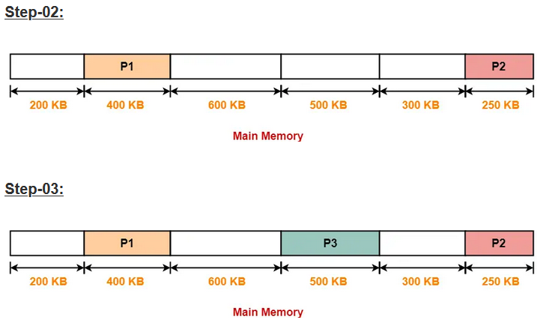
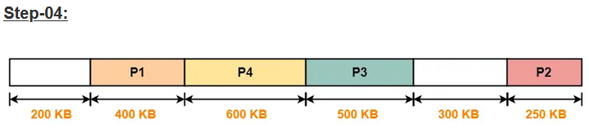

Slide 43
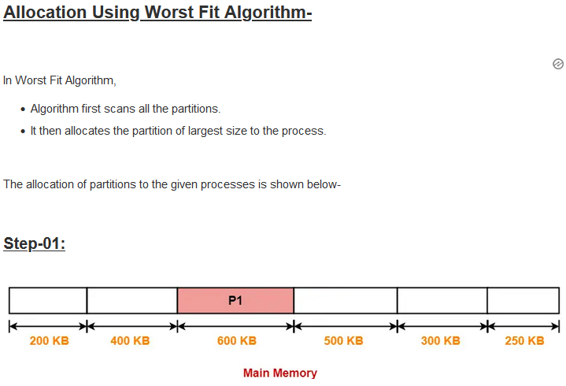

Slide 44
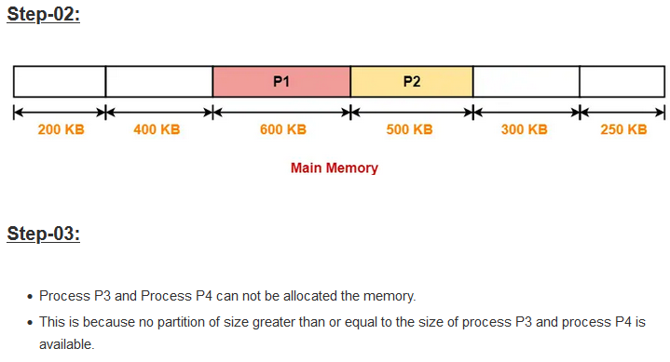

Slide 45
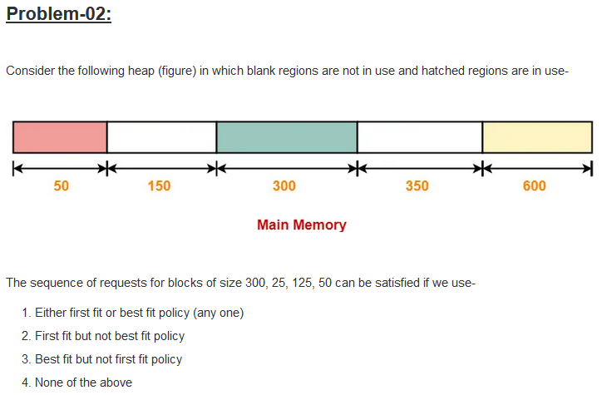

Slide 46


Slide 47


