Slide 1

Memory Management
Presented By
Dr. Khursheed Ahmad Bhat

Slide 2
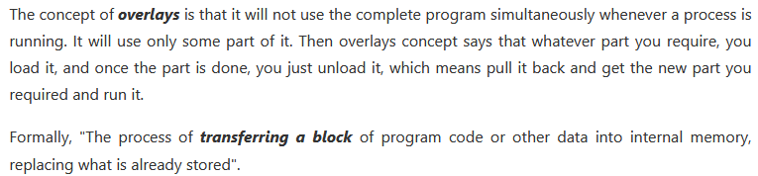
OverLays
It attempts to solve the problem of “Fixed Size Partitioning”. If size of process is more than Main memory or fixed partition.

Slide 3
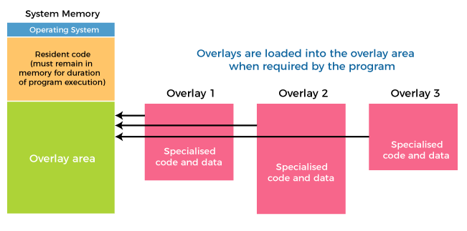
OverLays

Slide 4
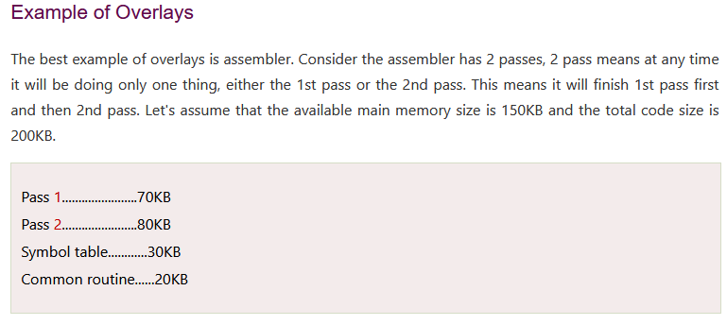
OverLays

Slide 5
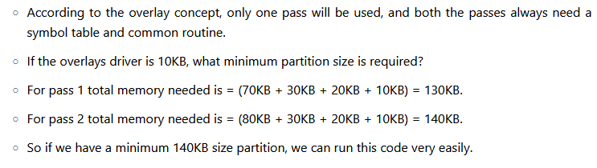
OverLays

Slide 6
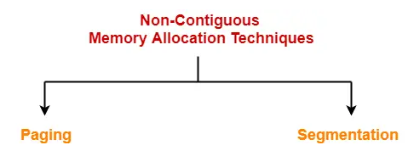
Solve External Fragmentation
There exists two solutions:
Compaction: Pulling all holes together and putting them together.
Fragmentation (Non-Contiguous Allocation): Break the process into small pieces and whenever you have space available put them there.
2.1 Paging
2.2 Segmentation
2.3 Combination of paging & segmentation (Segmented Paging)

Slide 7
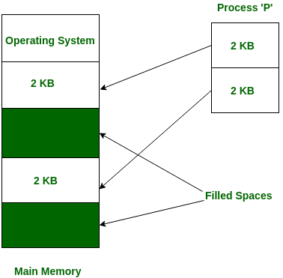
Need for PAGING
Internal Fragmentation has removed completely by dynamic partitioning but still external fragmentation exists there.
Other than Compaction, the only method using which we can remove external fragmentation is by letting the process to be Non-Contiguous.

Slide 8
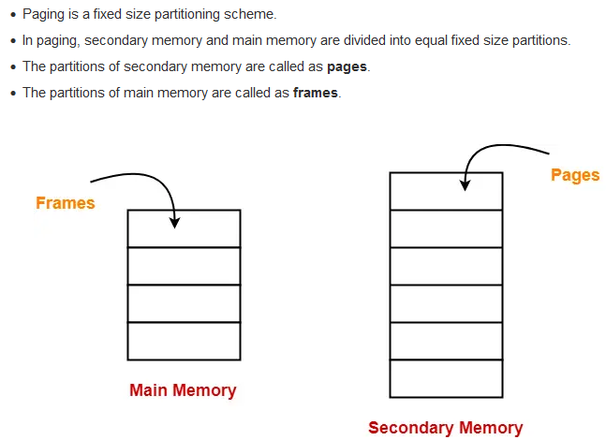
PAGING

Slide 9
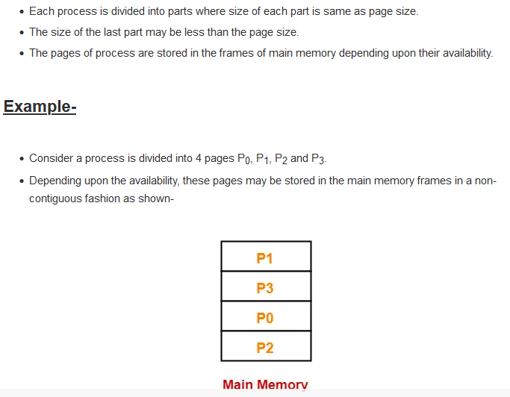
PAGING

Slide 10
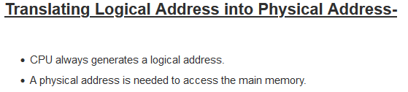
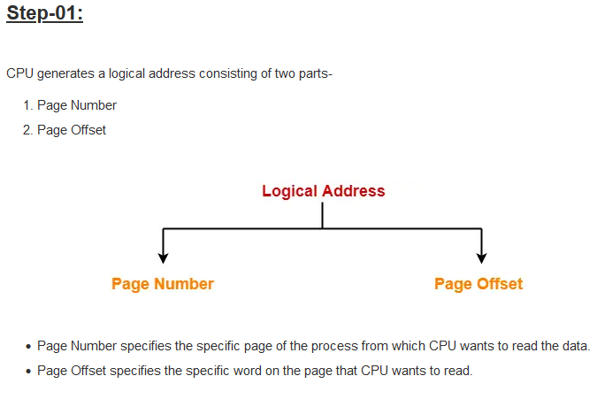

Slide 11
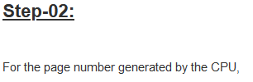
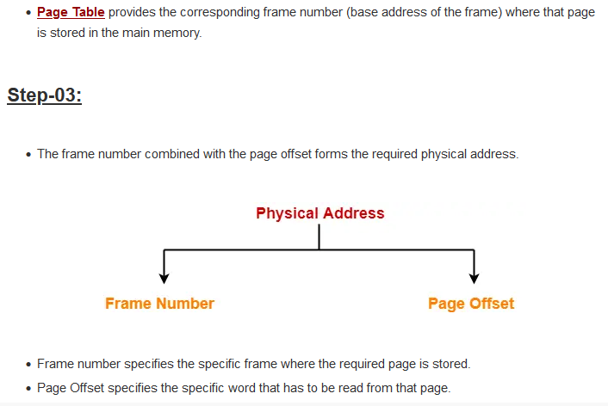

Slide 12
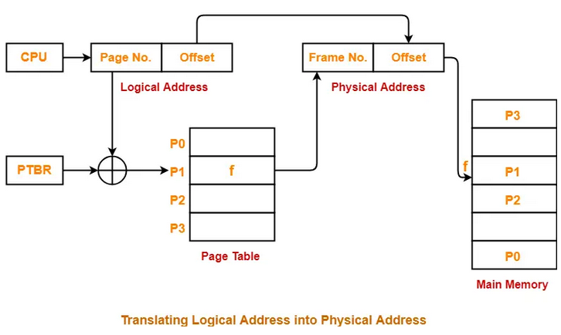

Slide 13
Key Points:
As allocation is non-contiguous, so just adding offset would not work.
New data structure is maintained called Page Table.
Entries of page table will be equal to number of pages a particular process is having inside secondary memory.
4. Alternate Technique (Page Table): Use link list where last point of page 1 contain address of page 2 and so on. Access time is slow (e.g, take 200 pages).
5. Page Table Base Register (PTBR) gives the base address of the page table and is stored in PCB.
6. Each page table entry remembers the offset of every page of process.
7. Internal fragmentation still exists, however, external fragmentation is completely avoided.
8. Main memory is accessed 2 times, so there is time complexity.

Slide 14
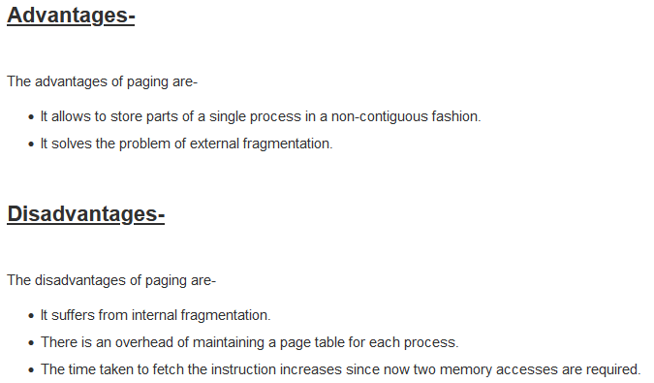

Slide 15
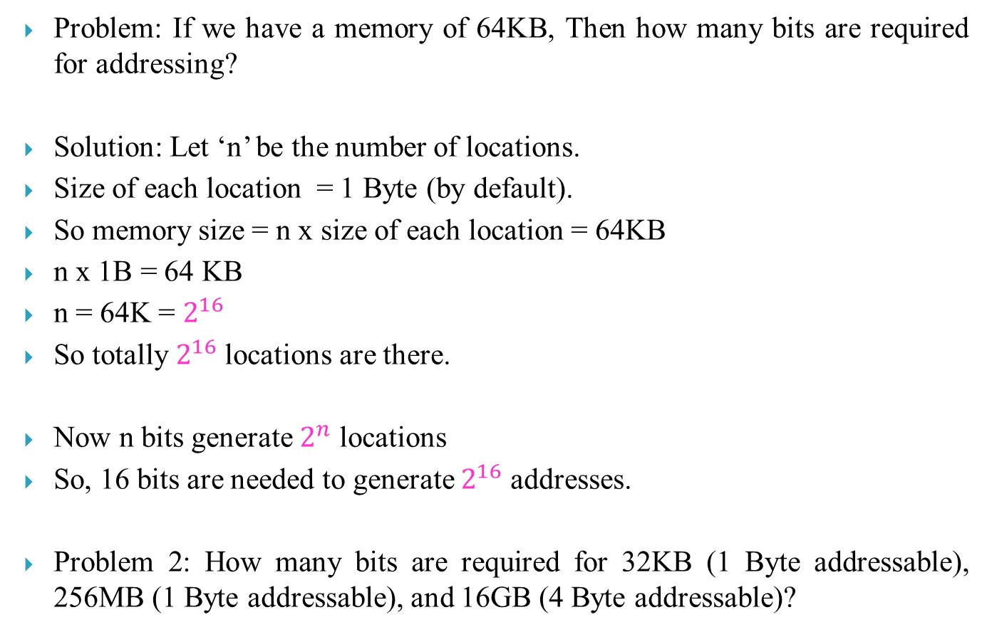
Number of Bits for addressing?
Problem: If we have a memory of 64KB, Then how many bits are required for addressing?
Solution: Let ‘n’ be the number of locations.
Size of each location = 1 Byte (by default).
So memory size = n x size of each location = 64KB
n x 1B = 64 KB
n = 64K = $2^{16}$
So totally $2^{16}$ locations are there.
Now n bits generate $2^{n}$ locations
So, 16 bits are needed to generate $2^{16}$ addresses.
Problem 2: How many bits are required for 32KB (1 Byte addressable), 256MB (1 Byte addressable), and 16GB (4 Byte addressable)?

Slide 16
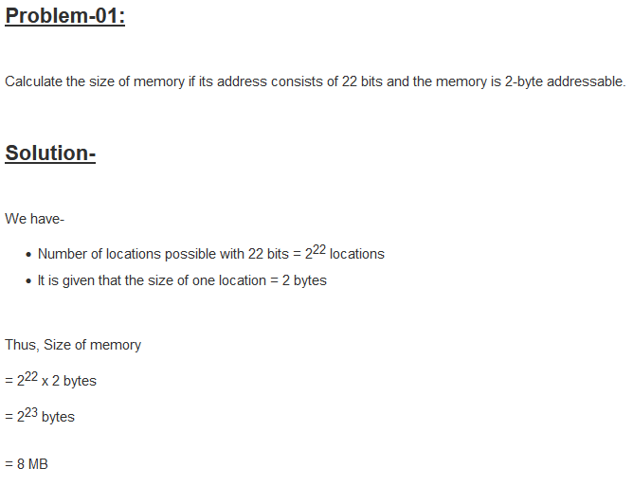

Slide 17
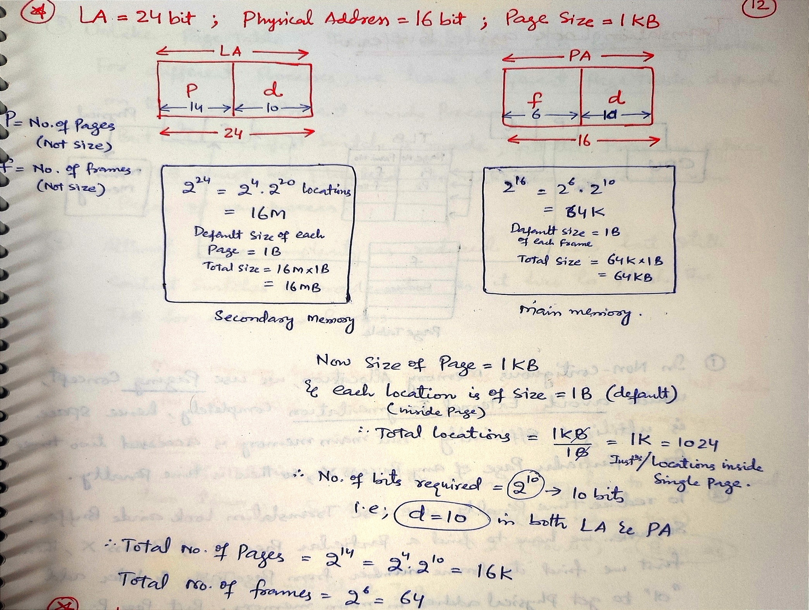

Slide 18
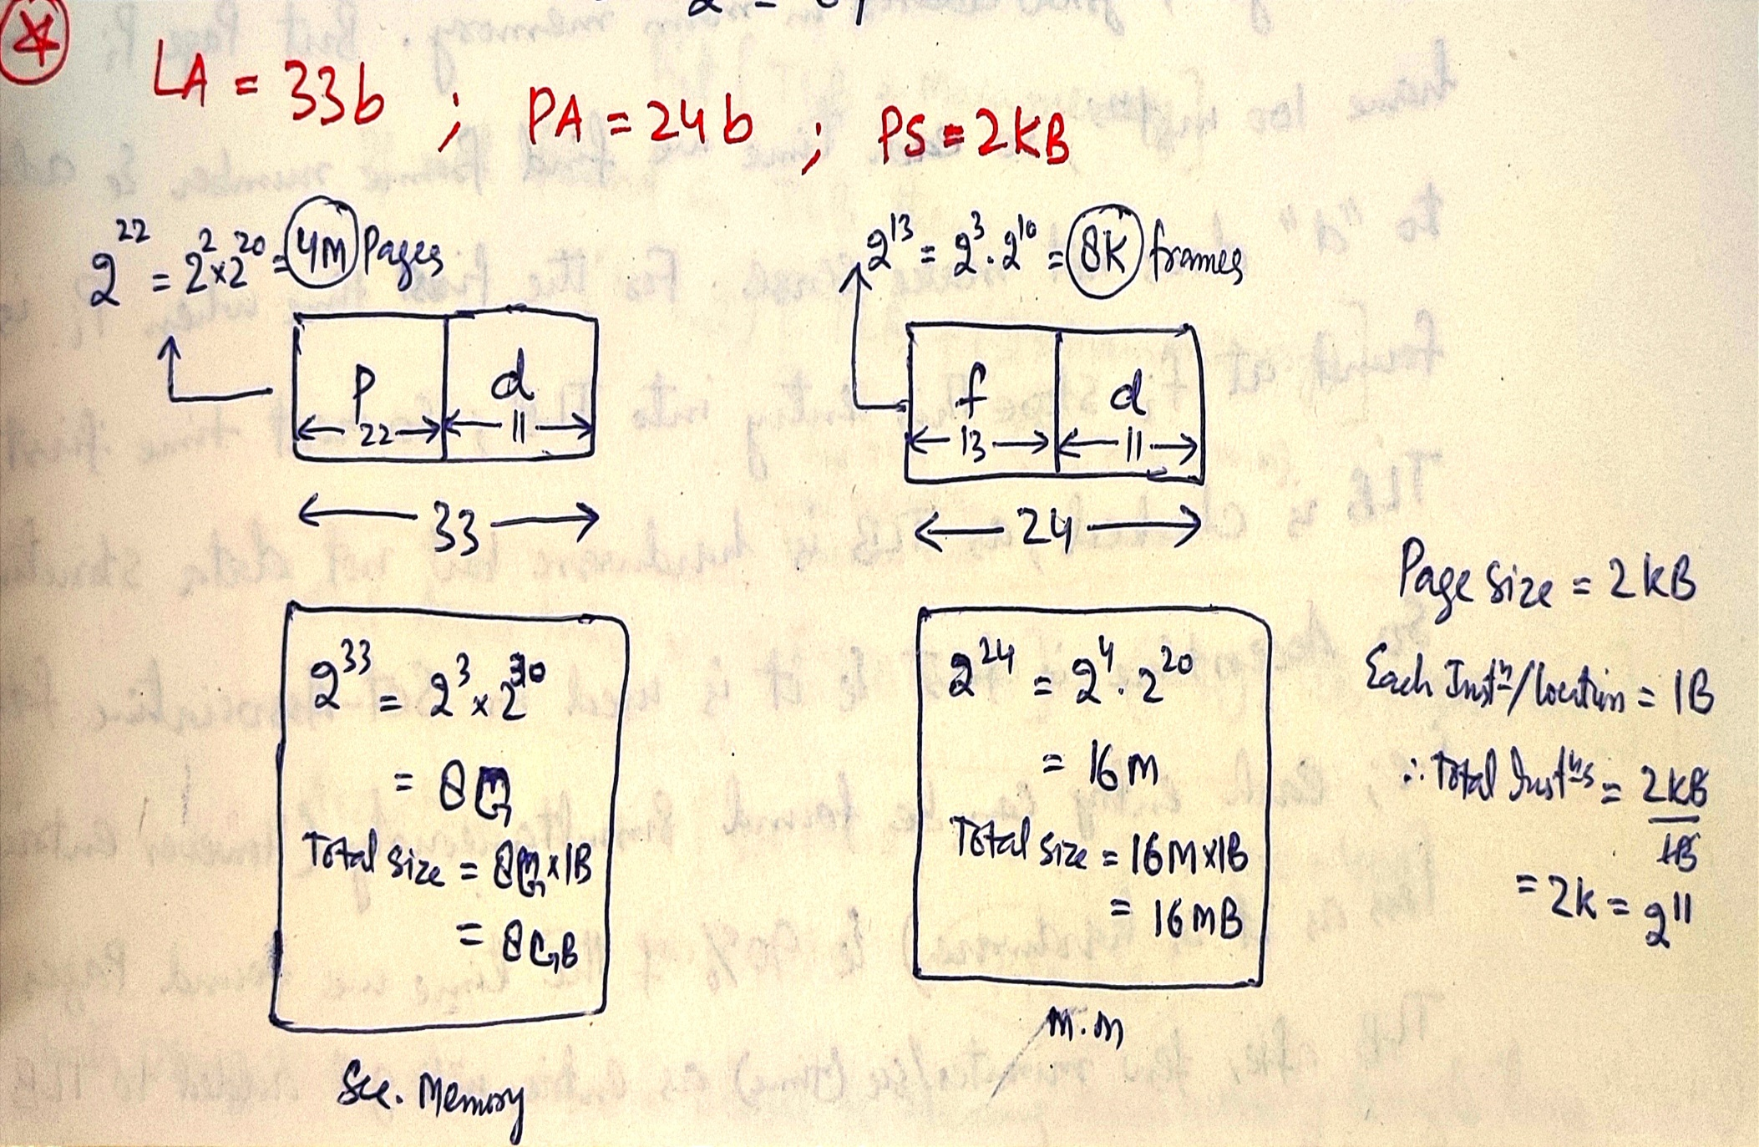

Slide 19
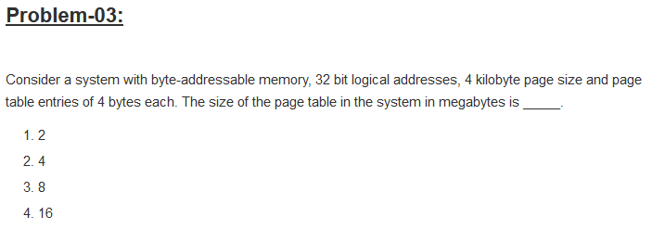

Slide 20
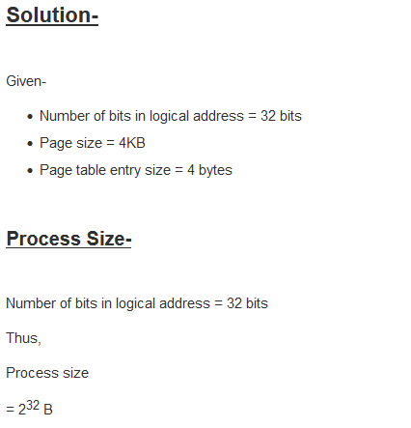
= 4GB

Slide 21
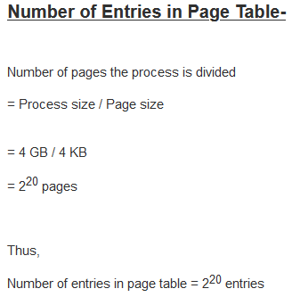
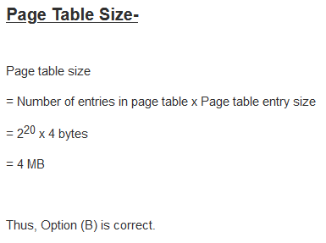

Slide 22
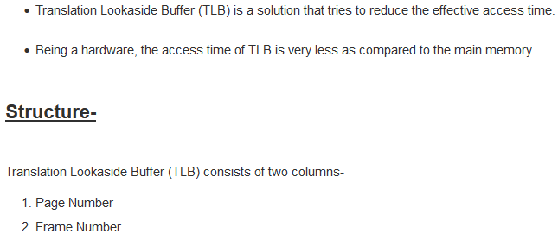
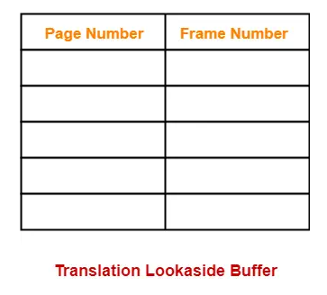
Translation Look Aside Buffer

Slide 23
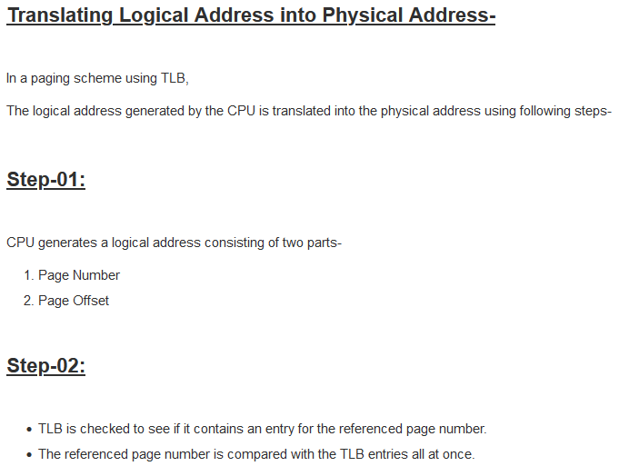

Slide 24
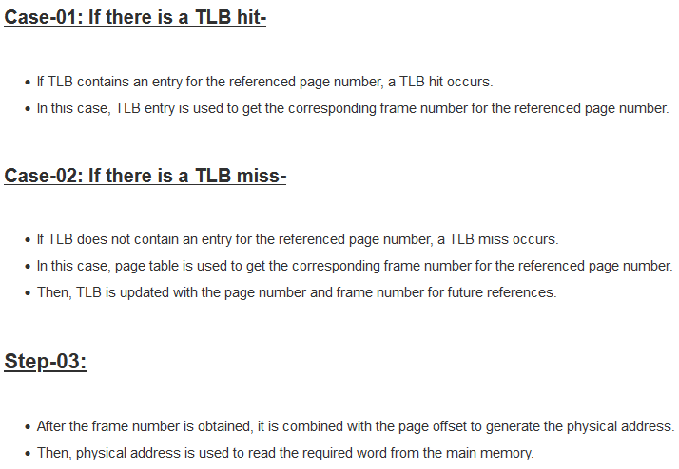

Slide 25
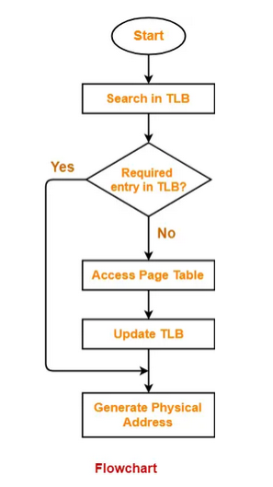

Slide 26
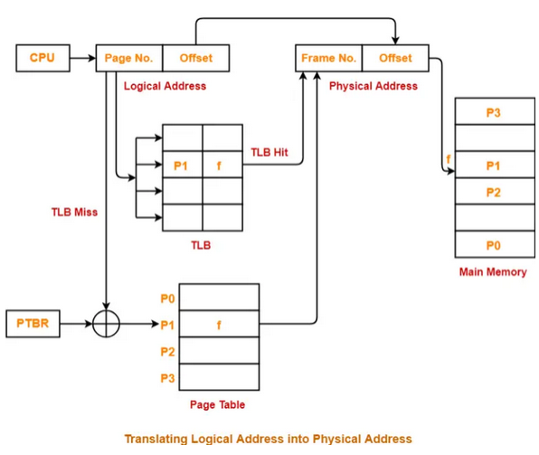

Slide 27
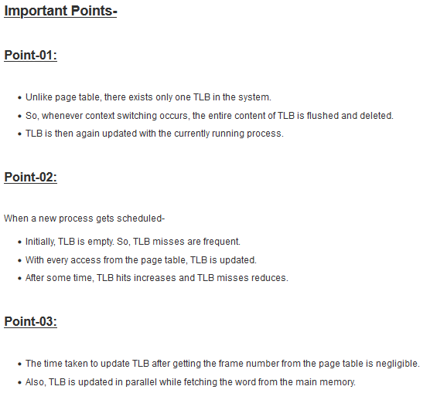

Slide 28
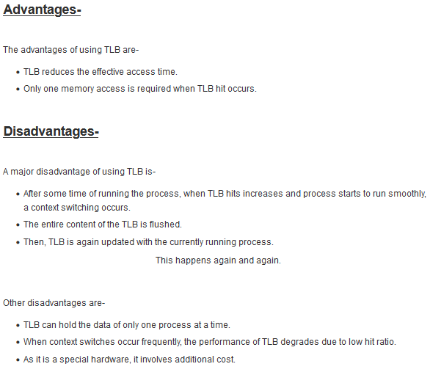

Slide 29
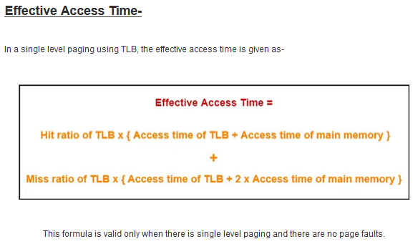

Slide 30
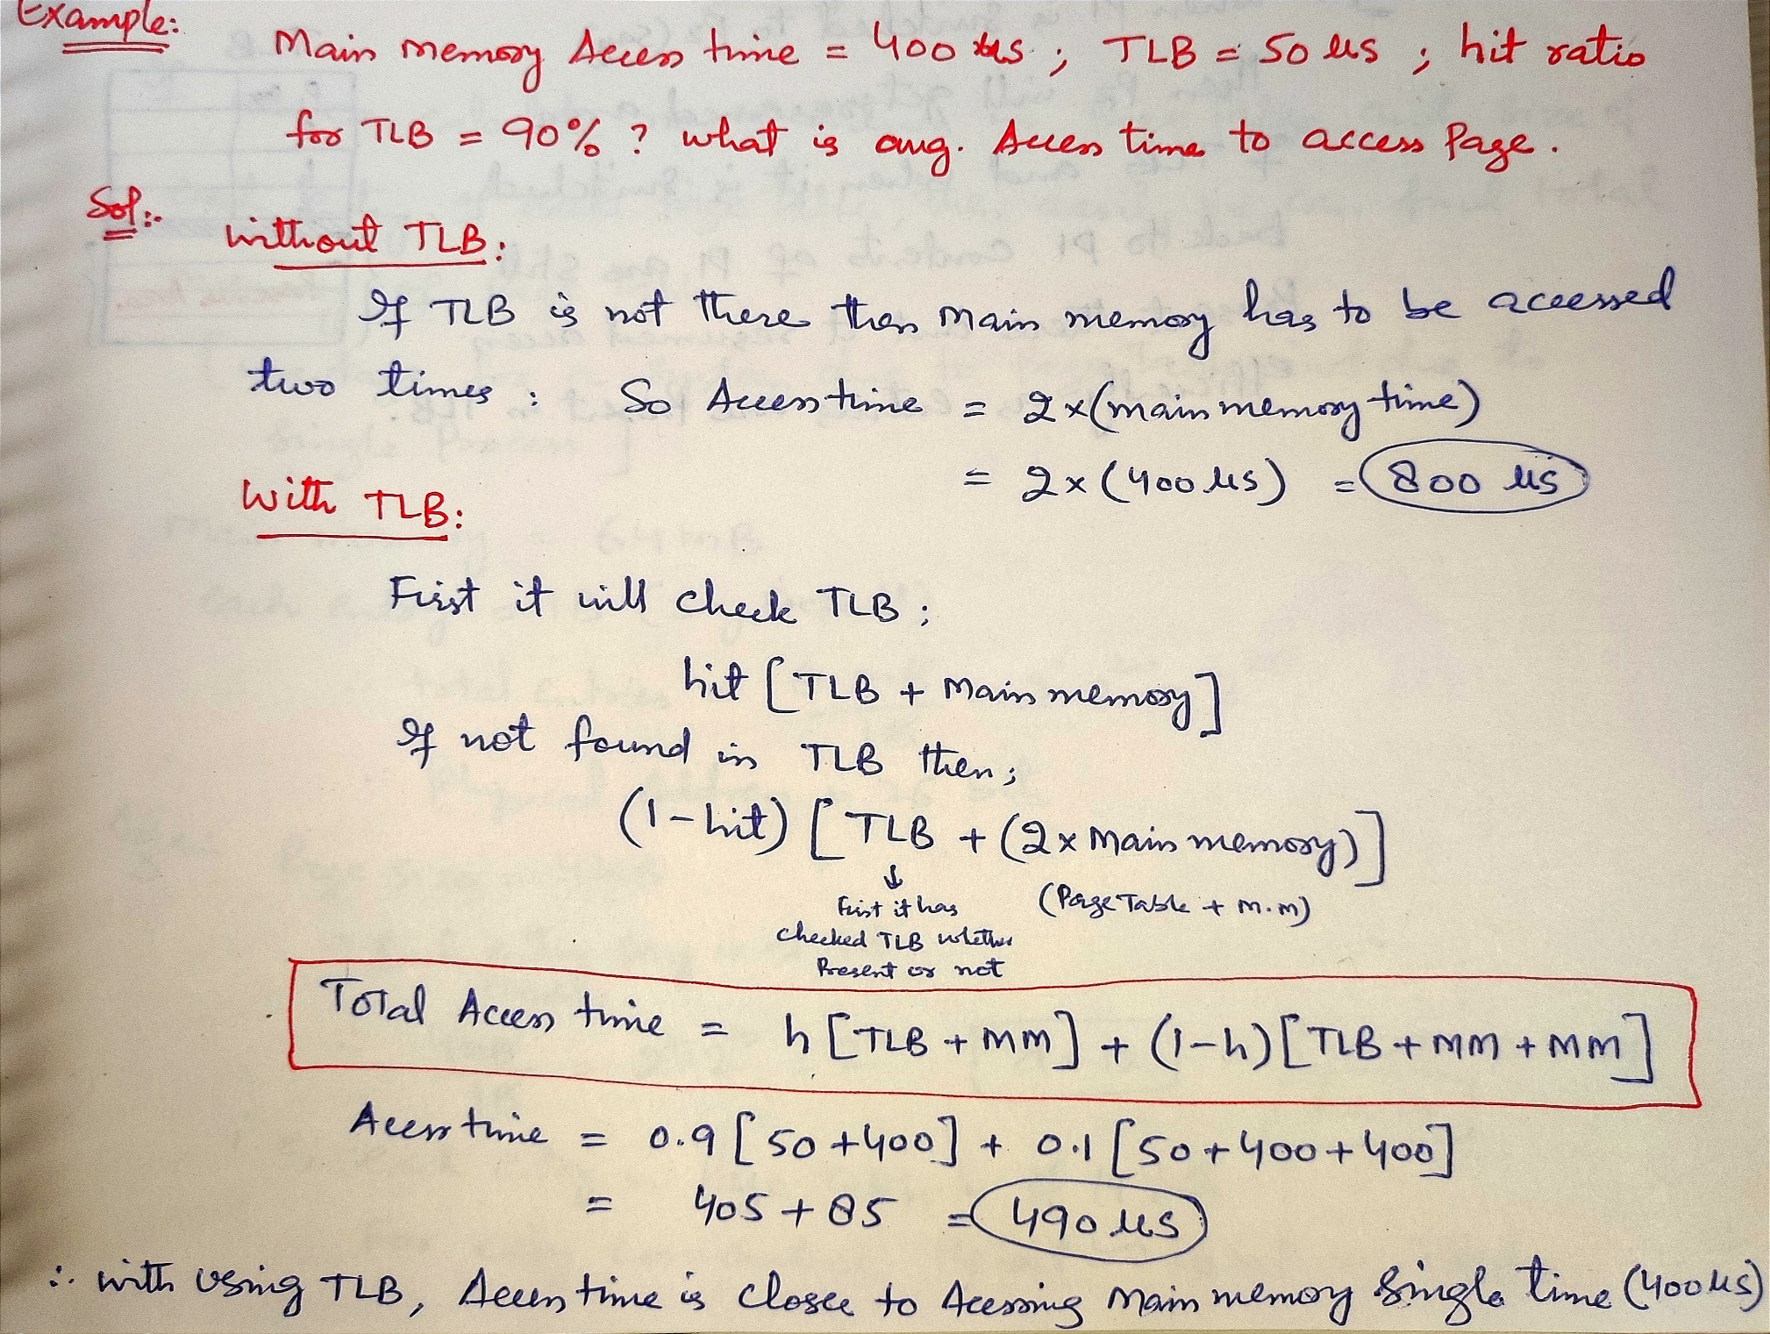

Slide 31
Page Table Entry
1. Caching Disabled: Operating system always wants CPU to access user's data as soon as possible. This bit is set to 1 if the cache is disabled.
2. Referenced: This bit is set to 1 if the page is referred in the last clock cycle otherwise it remains 0.
3. Modified: This bit will be set if the page has been modified otherwise it remains 0.
4. Protection: The protection field represents the protection level which is applied on the page. It can be read only or read & write or execute. We need to remember that it is not a bit rather it is a field which contains many bits.

Slide 32
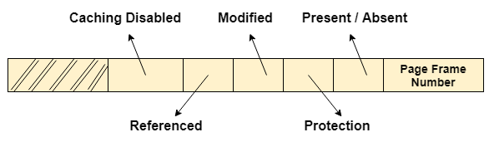
Page Table Entry
5. Present/Absent: In the concept of demand paging, all the pages doesn't need to be present in the main memory Therefore, for all the pages that are present in the main memory, this bit will be set to 1 and the bit will be 0 for all the pages which are absent.
If some page is not present in the main memory then it is called “PAGE FAULT”

Slide 33
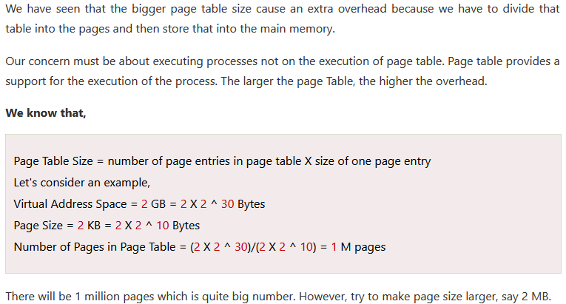
Optimal Page Size

Slide 34

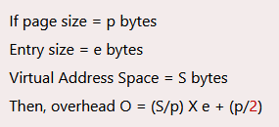
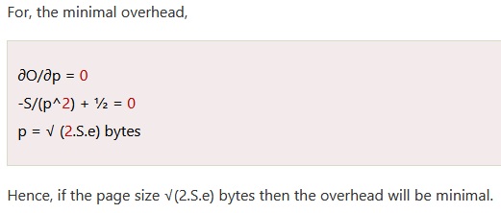
Optimal Page Size
In general:

Slide 35

Virtual Memory

Slide 36
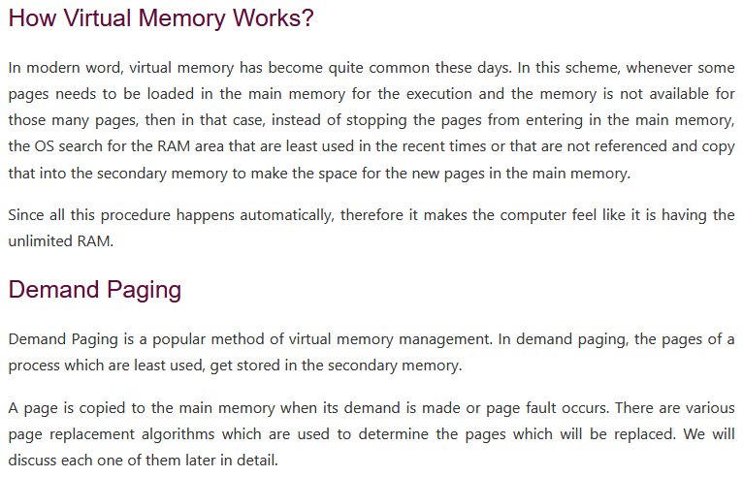

Slide 37
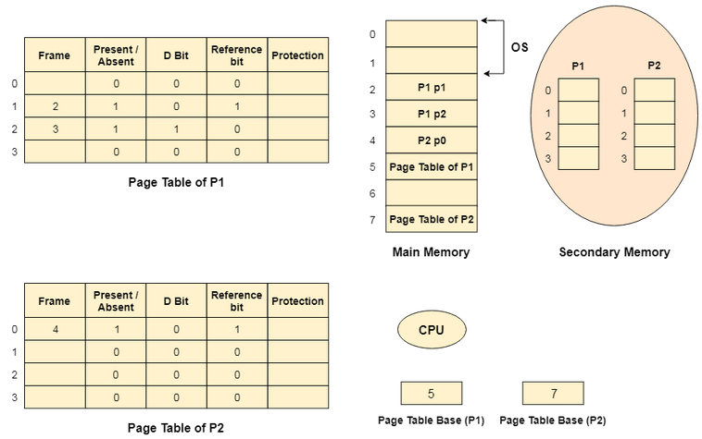
Virtual Memory

Slide 38

Virtual Memory

Slide 39
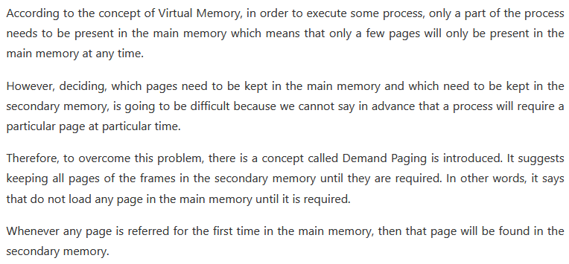
Demand Paging

Slide 40
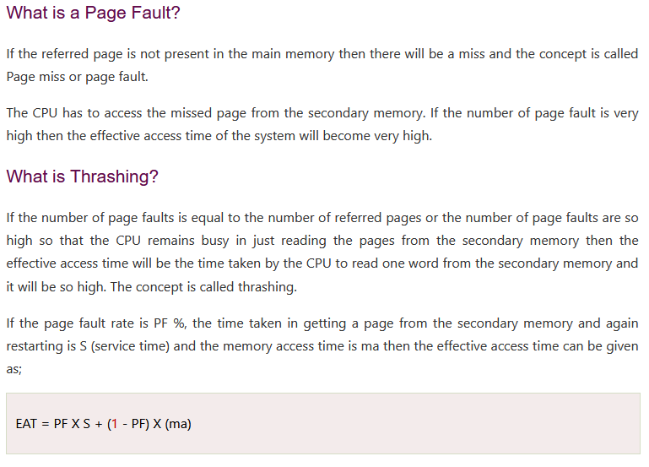

Slide 41
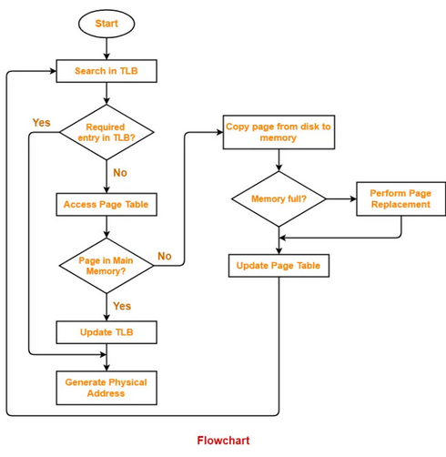

Slide 42


Slide 43


