Slide 1
Git

Slide 2
Git config
$ git config --global user.name prabu ➔ ~/.gitconfig
$ git config --global user.email prabu@example.com
# git config --system ➔ /etc/gitconfig
$ git config --global color.ui true
Color.status auto
Color.branch auto
Color.editor vim
merge.tool vidiff
$ git config --list

Slide 3
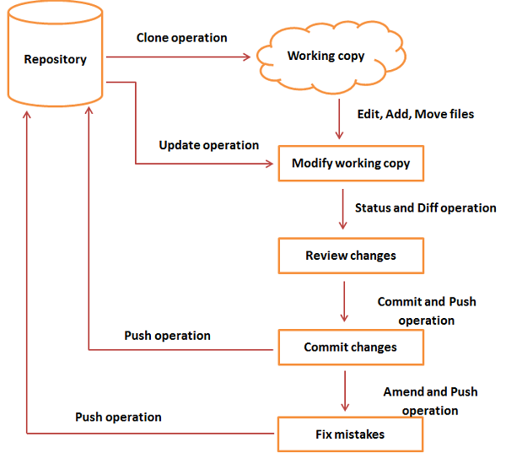
Git Flow

Slide 4
initial git
$ mkdir project.git
$ cd project.git
$ git --bare init → server side
$ git init
$ git add * < file name>
$ git status –s
$ git diff
$ git commit –m ‘initial commit’
$ git log

Slide 5
Push the changes to remote
$ git remote add origin gituser@git.example.com:project.git
$ git push origin master
$ git clone gituser@git.example.com: project.git
$ cd project

Slide 6
Git log
$ git log
commit cbe1249b140dad24b2c35b15cc7e26a6f02d2277
$ git show cbe1249b140dad24b2c35b15cc7e26a6f02d2277
$ git diff

Slide 7
Git commit --amend
To correction last changes and and overwrite the last log
$ git log
commit cbe1249b140dad24b2c35b15cc7e26a6f02d2277
$ git add file.txt
$ git status -s
$ git commit –amend –m “to overwrite the last log”
$ git log
commit d1e19d316224cddc437e3ed34ec3c931ad803958

Slide 8
Git commit –a
$ git commit –a –m “commite message”
-a ➔ automatically detect the modified files.
$ git push origin master

Slide 9
Git Stash
Temporary park current uncommited changes
$ git stash ➔ save the changes
$ git stash list → view
$ git status -s
$ git stash pop → retrieve
$ git stash show → inspect
$ git stash drop
$ git stash clear
$ git stash branch branch_name [stashname]

Slide 10
Git rename
$ git mv file.c newfile.c
$ git status –s
R file.c ➔ newfile.c

Slide 11
Git revert uncommit file
$ rm file.txt
$ git status –s
D file.txt
$ git checkout file.txt
$ ls –l
file.txt
$git checkout HEAD -- file.txt

Slide 12
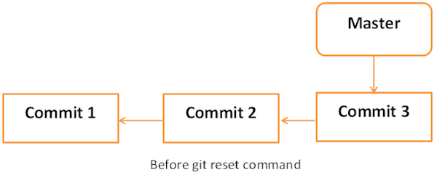
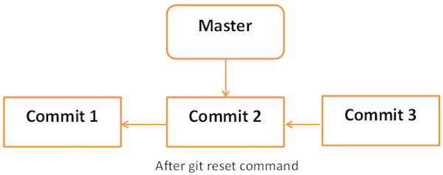
Git reset

Slide 13
Git reset
cat .git/refs/heads/master
git reset --soft HEAD~
git reset --hard 577647211ed44fe2ae479427a0668a4f12ed71a1

Slide 14
Git tag
Create HEAD as tag
$ git tag –a “Release_1_0” -m “taged bus fix 1003” HEAD
$ git push origin tag Relase_1_0
$ git pull
$ git tag –l
$ git show Relase_1_0
$ git tag –d Release_1_0

Slide 15
Git patch
Create patch
$ git format-patch -1
0001-Added-my_strcat-function.patch
Apply patch
$ git apply 0001-Added-my_strcat-function.patch

Slide 16
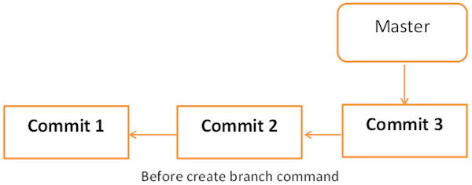
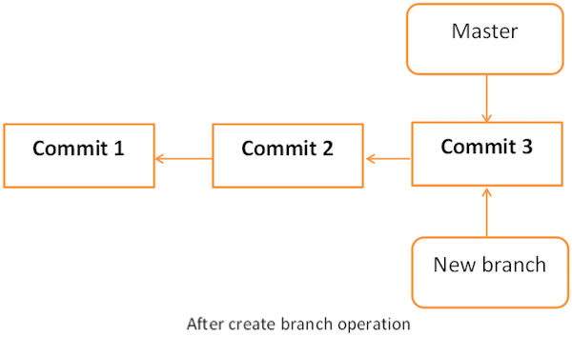
Git branch

Slide 17
Git branch operation
$ git branch new_branch
$ git checkout new_branch
$ git branch [-a]
$ git branch –b new_branch1 → create new branch and switch
$ git branch –D new_branch1 → check current HEAD point master
$ git branch –m new_branch latest_branch → rename branch
$ git push origin new_branch → push to origin from new_branch
$ git log origin/new_branch -2
$ git merge master/new_branch

Slide 18
Git rebase
Git rebase command is a branch merge command, but the difference is that it modifies the order of commits.
Current Branch: A -> B -> C -> D
Merge Branch: A -> B -> X -> Y
Rebase Branch: A -> B -> X -> Y -> C -> D
$ git rebase --onto master server_branch client_branch

