Slide 1
Understand LDAP
AZHAGURPABU J
azhaguprabu@gmail.com
+91 7259111760

Slide 2
What is Directory Service ?
organize and present data in a key-value type format
Lookup, Search and read operations over write operations
Entry like a Key Value pairs describing there contact information , user login, telephone number etc…
to make qualitative, descriptive information accessible

Slide 3
What is LDAP?
Lightweight Directory Access Protocol
open protocol used to store and retrieve data from a hierarchical directory structure
Commonly used to store information about an organization and its assets and users
Since LDAP is an open protocol, there are many different implementations available. The OpenLDAP project is one of the most well supported open source variants.

Slide 4
LDAP Data components
Attributes
LDAP system is mainly stored in elements called attributes
mail: admin@example.com
Entries
An entry is basically a collection of attributes under a name used to describe something
dn: sn=Ellingwood,ou=people,dc=digitalocean,dc=com
objectclass: person
sn: Ellingwood
cn: Justin Ellingwood

Slide 5
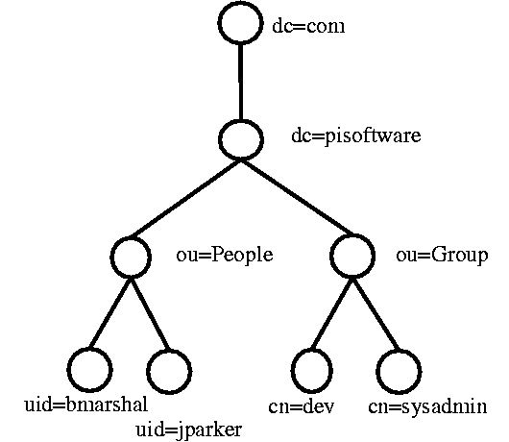
DIT ( Directory information Tree )

Slide 6
Defining LDAP Data Components
Attribute Definitions
attributetype ( 2.5.4.41 NAME 'name' DESC 'RFC4519: common supertype of name attributes' EQUALITY caseIgnoreMatch SUBSTR
caseIgnoreSubstringsMatch SYNTAX 1.3.6.1.4.1.1466.115.121.1.15{32768} )
ObjectClass Definitions
dn: . . .
objectClass: person
objectclass ( 2.5.6.6 NAME 'person' DESC 'RFC2256: a person' SUP top STRUCTURAL MUST ( sn $ cn )
MAY ( userPassword $ telephoneNumber $ seeAlso $ description ) )

Slide 7
Schema
ObjectClass definitions and attribute definitions are, in turn, grouped together in a construct known as a schema
. . .
objectclass ( 2.5.6.6 NAME 'person' DESC 'RFC2256: a person' SUP top STRUCTURAL
MUST ( sn $ cn )
MAY ( userPassword $ telephoneNumber $ seeAlso $ description ))
attributetype ( 2.5.4.4 NAME ( 'sn' 'surname' ) DESC 'RFC2256: last (family) name(s) for which the entity is known by' SUP name )
attributetype ( 2.5.4.4 NAME ( 'cn' 'commonName' ) DESC 'RFC4519: common name(s) for which the entity is known by' SUP name )
. . .

Slide 8
Data Organization
Placing Entries within the DIT
Entries used for organization often use the organizationalUnit objectClass
Naming and Referencing Entries within the DIT
Relative Distingush Name (RDN)
DN ( Dinstingush Name )

Slide 9
LDAP Inheritance
objectclass ( 2.5.6.7 NAME 'organizationalPerson' SUP person STRUCTURAL
. . .
Inherit the Object Class of Person in organizationalPerson Class
Same Way apply the Attribute Type
inetOrgPerson as the sole objectClass for our John Smith entry while still having access to the attributes defined in the person and organizationalPerson objectClasses. The inetOrgPersoninheritance hierarchy looks like this:
inetOrgPerson -> organizationalPerson -> person -> top
Almost all objectClass inheritance trees end with a special objectClass called "top". This is an abstract objectClass whose only purpose is to require that objectClass itself be set. It is used to indicate the top of the inheritance chain.

Slide 10
Attribute Inheritance
Attributes themselves can list a parent attribute during their definition. The attribute will then inherit the properties that were set in the parent attribute.

Slide 11
LDAP protocol variation
ldap://
ldaps://
ldapi://

Slide 12
Installation OpenLDAP
Ansbile Installation via GitHub
# git clone git@github.com:azhaguprabu/tutorials.git
# cd tutorials/LDAP/ansible
Edit the inventory files and group_vars variables and run ansible playbook
#ansible-playbook –i hosts ldap.yml --diff --vvv
-vvv for debug

