Slide 1
Enhancing Security in Ad Hoc Networks through Image Steganography
Name: Amit Kumar And Ganesh Prasad
Enrolment no.: U1951038 And U1951007
Supervisor’s Name: Dr. Vinod Kumar

Slide 2
Objective
1. Explore different types of steganography methods: The project aims to investigate and describe various steganography techniques, such as LSB substitution and DCT in the context of ad hoc network security.
2. Justify the use of steganography over OSI model security: The objective is to provide a rationale for choosing steganography as a security measure in ad hoc networks, considering the limitations of traditional OSI model-based security mechanisms in dynamic and decentralized network environments.
3. Assess the effectiveness of steganography in ad hoc networks: The project aims to evaluate the performance and efficacy of steganography techniques in terms of data concealment, imperceptibility, and robustness against attacks specific to ad hoc network scenarios.
4. Enhance understanding of ad hoc network security: By exploring the application of steganography, the objective is to contribute to the body of knowledge on ad hoc network security and provide insights into how steganography can address the unique challenges posed by ad hoc networks.

Slide 3
Methodology
Explore Steganography: Investigate different types of steganography methods and their applicability in enhancing ad hoc network security.
Compare with OSI Model: Assess the limitations of the OSI model in ad hoc networks and analyze why steganography can be a preferred security approach.
Evaluate Effectiveness: Determine the effectiveness of image steganography in concealing sensitive data and enhancing security in ad hoc network communication.
Highlight Advantages: Identify the advantages of steganography over the traditional OSI model in terms of adaptability, covert communication, lightweight implementation, and resilience against eavesdropping.
Provide Insights: Present insights into the feasibility and potential of using image steganography as a security measure in ad hoc networks, emphasizing its strengths and areas for future research.

Slide 4
Ad hoc Network and security
Ad hoc network: A decentralized wireless network formed by autonomous devices without a fixed infrastructure, enabling dynamic and self-organizing communication.
Security challenges: Ad hoc networks face security vulnerabilities due to their dynamic topology, lack of centralized control, and potential for eavesdropping, requiring specialized security measures.
Key security objectives: Ad hoc network security aims to ensure confidentiality, integrity, availability, authentication, and secure communication in the absence of a centralized authority.
Security mechanisms: Security measures in ad hoc networks include encryption, authentication, key management, intrusion detection, secure routing protocols, and the integration of additional techniques like steganography for covert communication.
Threats and attacks: Ad hoc networks are susceptible to various threats, including eavesdropping, data manipulation, denial-of-service attacks, node impersonation, and routing attacks, necessitating robust security mechanisms to mitigate these risks.

Slide 5
Advantages of Image Steganography over OSI Model in Ad Hoc Networks:
Adaptability: Image steganography is more adaptable to the dynamic topology and decentralized nature of ad hoc networks, providing a flexible security solution that can accommodate changes in network configurations and node mobility.
Covert Communication: Image steganography allows for covert communication channels by concealing data within images, making it harder for adversaries to detect or intercept sensitive information, providing an additional layer of security.
Lightweight Solution: Unlike the complex key management and cryptographic mechanisms of the OSI model, image steganography offers a lightweight alternative for securing communication in ad hoc networks, reducing computational overhead and improving network efficiency.
Resilience against Eavesdropping: Steganography provides enhanced protection against eavesdropping attacks by hiding data within images, making it more challenging for attackers to intercept and understand the transmitted information, ensuring confidentiality in ad hoc network communication.
Complementary Security Measure: Image steganography can complement the traditional security measures of the OSI model by adding an additional layer of security, especially in scenarios where the OSI model's mechanisms may have limitations or face challenges in ad hoc network environments.

Slide 6
Steganography
Covert Communication: Steganography enables secret communication by concealing data within innocent-looking carriers like images, audio, or video files.
Hidden Transmission Channels: It provides hidden channels for transmitting sensitive information, making it difficult for adversaries to detect or intercept the concealed data.
Imperceptibility: Steganographic techniques aim to maintain the original appearance and quality of the carrier while embedding the hidden data, ensuring minimal perceptual changes.
Data Security: Steganography enhances data security by adding an additional layer of protection, complementing encryption and other security measures.

Slide 7
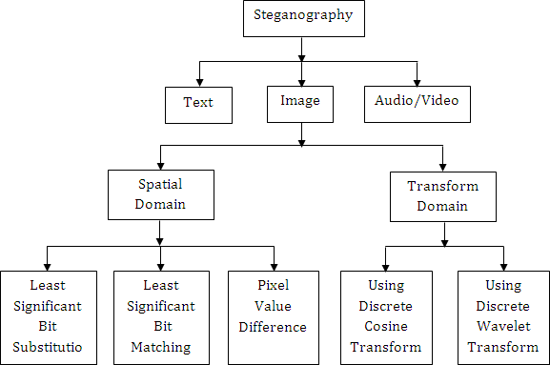

Slide 8
Algorithm (LSB Substitution)
Resize the image if needed
Convert the message to its binary format
Initialize output image same as input image
Traverse through each pixel of the image and do the following:
Convert the pixel value to binary
Get the next bit of the message to be embedded
Create a variable temp
If the message bit and the LSB of the pixel are same, set temp = 0
If the message bit and the LSB of the pixel are different, set temp = 1
This setting of temp can be done by taking XOR of message bit and the LSB of the pixel
Update the pixel of output image to input image pixel value + temp
Keep updating the output image till all the bits in the message are embedded
Finally, write the input as well as the output image to local system.

Slide 9
Applications of Ad Hoc Network Security through Steganography:
Covert Communication: Steganography enables hidden communication channels, protecting sensitive data from unauthorized access in ad hoc networks.
Data Confidentiality: Steganography ensures the confidentiality of information exchanged between network nodes, preventing interception by potential eavesdroppers.
Anti-Tampering Mechanism: Steganography acts as an anti-tampering mechanism, detecting any unauthorized modifications made to transmitted data in the ad hoc network.
Digital Forensics: Steganography aids in forensic investigations by concealing digital evidence within images, enhancing the security and integrity of the evidence.
Military Communication: Steganography plays a crucial role in secure military communication, allowing for covert transmission of sensitive information in ad hoc network scenarios.

Slide 10
CONCLUSION
Enhanced Security: Image steganography provides an effective approach to enhance security in ad hoc networks by concealing sensitive data within images, ensuring confidentiality and covert communication.
Adaptability: Steganography offers flexibility and adaptability, making it suitable for dynamic ad hoc network environments where traditional OSI model security mechanisms may be challenging to implement.
Robustness: Steganography techniques exhibit robustness against attacks and image processing operations, ensuring the hidden data remains intact and secure during transmission.
Covert Communication: Steganography enables covert communication channels, allowing for secure information exchange without raising suspicion or detection by unauthorized entities.
Lightweight Implementation: Compared to the complex layers of the OSI model, steganography provides a lightweight security solution that is easier to implement and integrate into ad hoc network architectures.

