Slide 1

MANNAGUDDE SHIVARAM & SUSHEELA GATTY FOUNDATION
MERIT SCHOLARSHIP AWARDEES 2017
THE FOUNDATION IS PLEASED TO ANNOUNCE,CONSIDERING THE ACADEMIC EXCELLENCE, FAMILY FINANCIAL & ECONOMIC STATUS AND PERFORMANCE IN THE SELECTION TEST, THE FOLLOWING GATTY STUDENT-BENEFICIARIES UNDER
THE MERIT SCHOLARSHIP SCHEME:
Prajna Gatty D/o Babu & Mohini Gatty, Kachar-Kotekar Rs.3000/-
ManvithKumar Gatty S/o Bharathkumar & Vasanthi Gatty, Ambika Road Rs.3000/-
Chethan Gatty S/o (L) Balakrishlna & Vijaya Gatty, Nadar, Kotekar Rs.4000/-
Thripti Gatty D/o Gangadhar & Shashikala Gatty, Gatty Compound, Kotekar Rs.4000/
Harshitha Gatty D/o (L) Jayarama & Laxmi Gatty, Car Street, Mangalore, Rs.4000/-
Pratheeksha Gatty D/o (L) Keshav & Harinakshi Gatty,Pilar, Kotekar Rs.2000/-
Rahul Gatty S/o Suresh &Hemalatha Gatty, Pilar Kotekar Rs.2000/-
ShravanKumar Gatty S/o Vittal &Rashika Gatty,Parakkila, Madhur Rs.2000/-
Kshama Gatty D/o Ramesh & Shobha Gatty, Kodikal,Mangalore Rs.2000/-
Ankitha Gatty D/o Ramesh & Bharathi Gatty, Periyavu, Bantwala Rs.4000/-
Sowjanya Gatty D/o(L) Dinesh & Prafulla Gatty,Vamadapadavu,Bantwala,Rs.3000/-
Vaishnavi Gatty D/o Ramesh & Revathi Gatty,Bhavanthi Street,Mangalore Rs.2000/-
Namithraj Gatty S/o Janardhana & Saraswathi Gatty, Nadar, Kotekar Rs.2000/-
Vinayashree Gatty D/o(L)Vishwanatha &Vishalakshi Gatty, GattyCompound,Kotekar Rs.2000/-
Jeevitha Gatty D/o Manoj Kumar &ChandraprabhaGatty,Kuthar,Munnur Rs.3000/-
Jitheshkumar Gatty S/o Manoj Kumar & ChandraprabhaGatty, Kuthar,Munnur Rs.2000/-
CHEQUES HAVE BEEN DESPATCHED BY POST
,
MGF1521082017

Slide 2
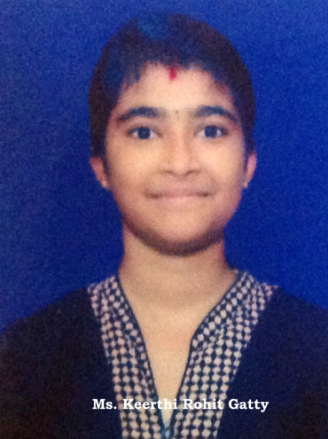
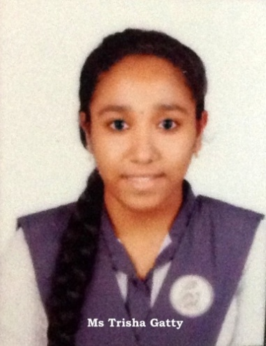
MANNAGUDDE SHIVARAM & SUSHEELA GATTY FOUNDATION
MERIT AWARDS WINNERS 2017
Highest Marks in SSLC Mathematics
Ms Keerthi Gatty – 95%
D/o Mr Rohit Kumar Gatty &Mrs Pramila Gatty,
Mundoli House, Munnur Post,
Someshwar Mangalore.
Highest Marks in SSLC English
Ms Trisha Gatty – 94%
D/o Mr Manoj Kumar Gatty & Mrs Latha Gatty,
“Vaibhava Laxmi”, Kunjathbail Post,
Kavoor, Mangalore.
CONGRATULATIONS
MGF1421082017

