Slide 1
ENTERPRISE ARCHITECTURE · AUGUST 2026
PA Review Copilot
AI
Architecture Review & Design Recommendation
Prepared by: Ganesh Punde
August 2026
Enterprise Architecture
POWERED BY AWS BEDROCK

Slide 2
SESSION OVERVIEW
Agenda
01
Welcome & Context
02
Problem Statement
PA Review Copilot Architecture Review August 2026
03
Architecture Options Overview
04
Spring Boot Microservice Flow
05
Architecture Comparison
06
Recommendation
07
Next Steps
08
Q & A
8 TOPICS

Slide 3
The Challenge We Are Solving
PROBLEM STATEMENT
Prior Authorization (PA) today — four critical pain points blocking efficiency and care
Slow PA Review Cycle
Inconsistent Review Decisions
3–7 Days
avg. review time
~30% Variance
across reviewers
Manual PA reviews take 3–7 business days, creating approval backlogs that directly delay patient care, increase clinician frustration, and risk adverse health outcomes.
No standardized review criteria leads to inconsistent approval/denial decisions across reviewers — creating inequity, compliance risk, and payer disputes.
Fragmented System Integration
Workflow Scalability Crisis
3+ Siloed Systems
no unified access
↑ 40% YoY Volume
PA request growth
Disparate systems — EHR, payer portals, clinical databases — lack unified data access, forcing reviewers to manually cross-reference multiple platforms.
Growing volume of PA requests overwhelms existing manual workflows — headcount cannot scale linearly with demand, creating unsustainable operational costs.
PA Review Copilot · Enterprise Architecture
All pain points addressable with the proposed Copilot architecture

Slide 4
ARCHITECTURE OPTIONS
Architecture Options at a Glance
Option A PA Review Copilot
Option B PA Review System
Multi-Agent AI System
Specialized AI agents collaborate across the review process
Assists nurses with classification, extraction, compliance, and recommendations
Keeps clinical reviewers in control
Delivers faster decisions with minimal workflow disruption
Best for: Rapid AI adoption and human-in-the-loop intelligence
Microservices-Based Platform
Independent Spring Boot services manage each business capability
Automates intake, validation, workflow, integration, and tracking
Scales securely across enterprise workloads
Provides resilience, flexibility, and long-term extensibility
Best for: Scalable, end-to-end prior authorization automation
VS

Slide 5
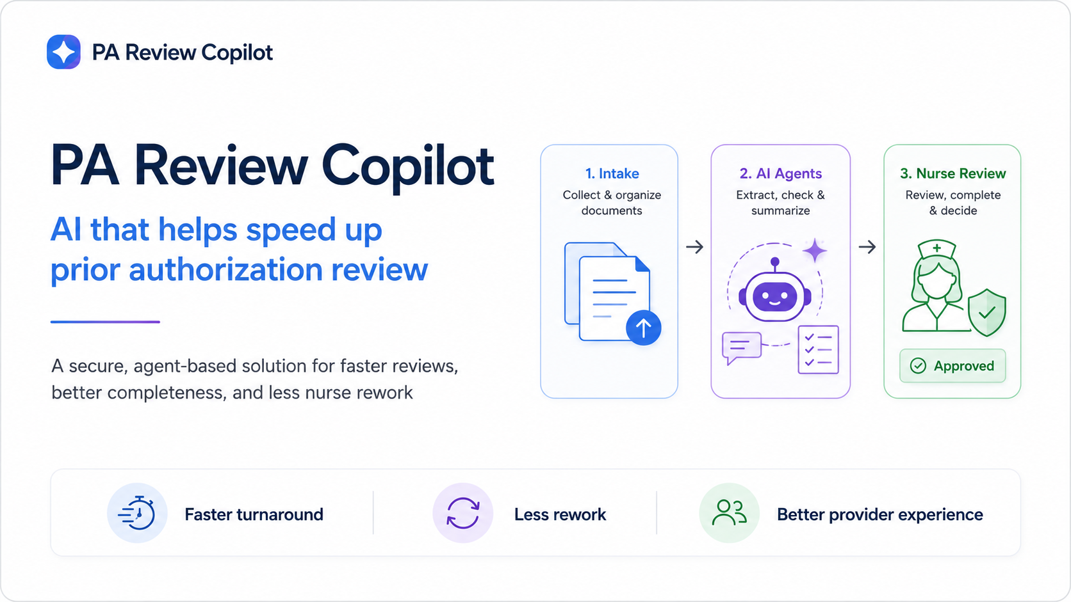
Notes:
Slide: Welcome

Slide 6
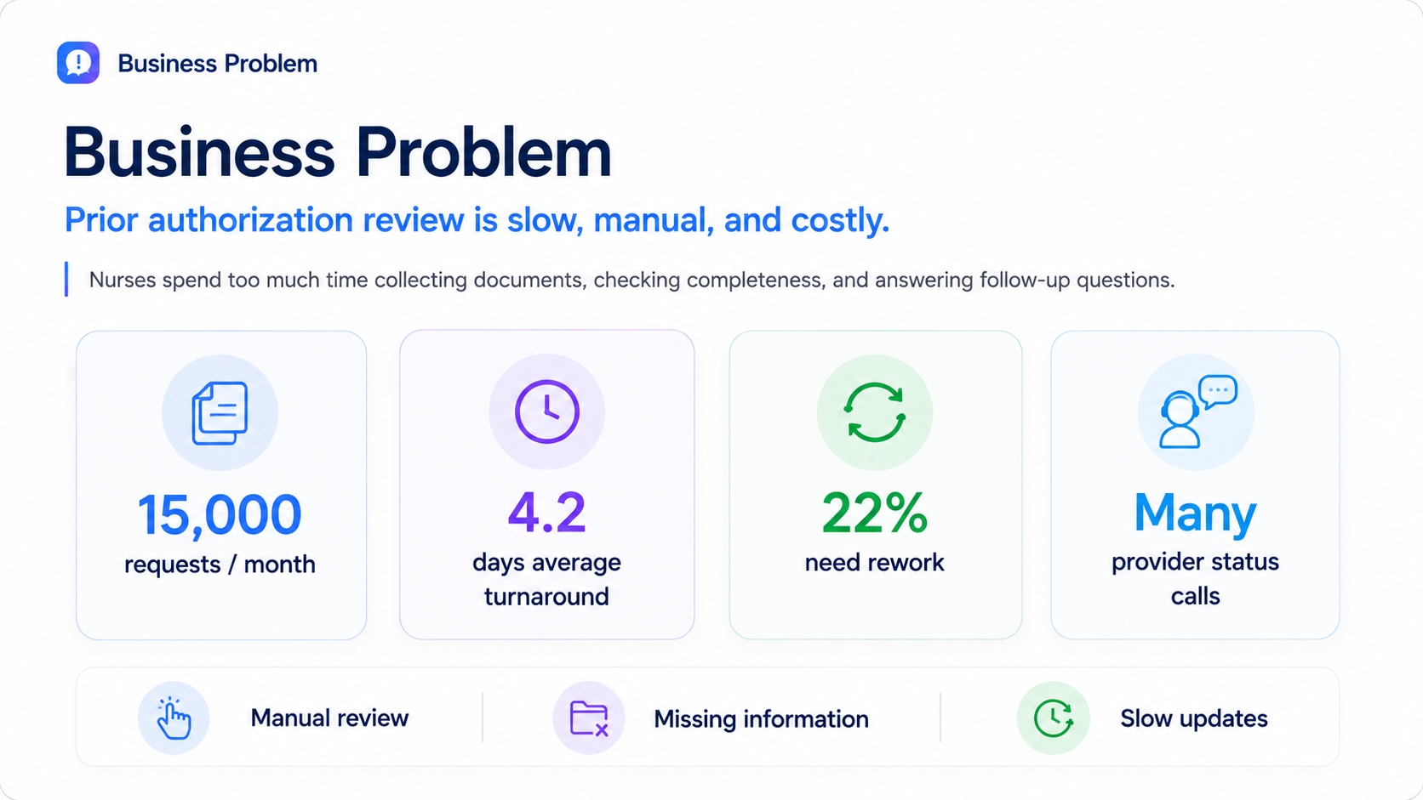
Notes:
Slide: Business Problem

Slide 7
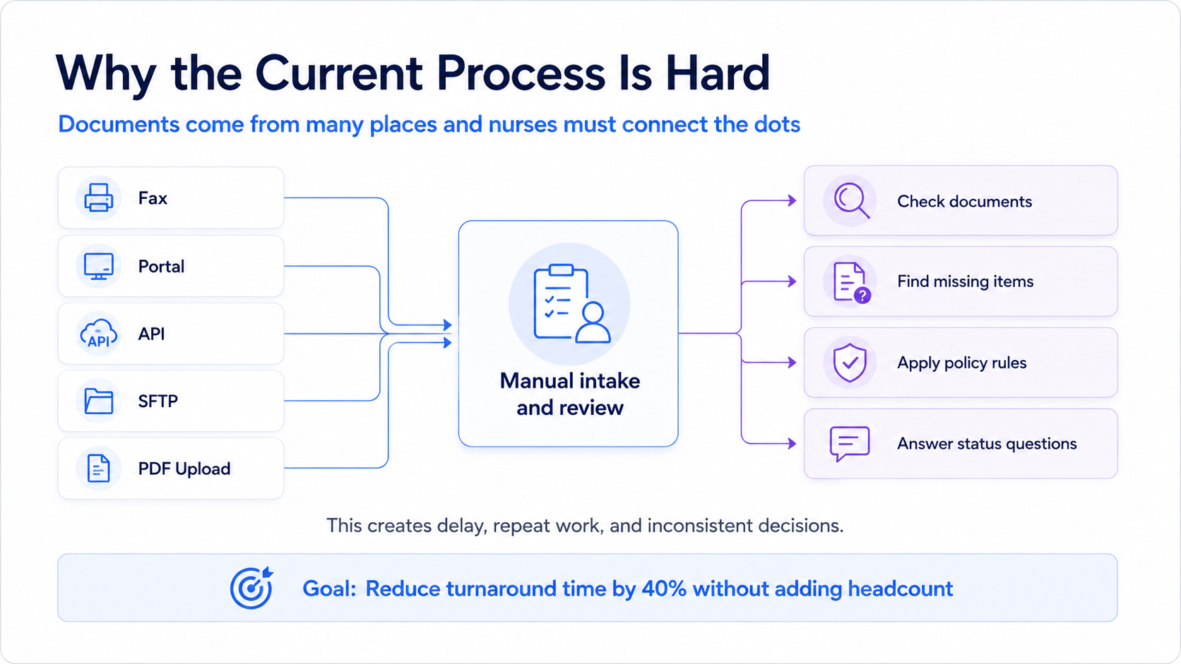
Notes:
Slide: Why Current Process Is Hard

Slide 8
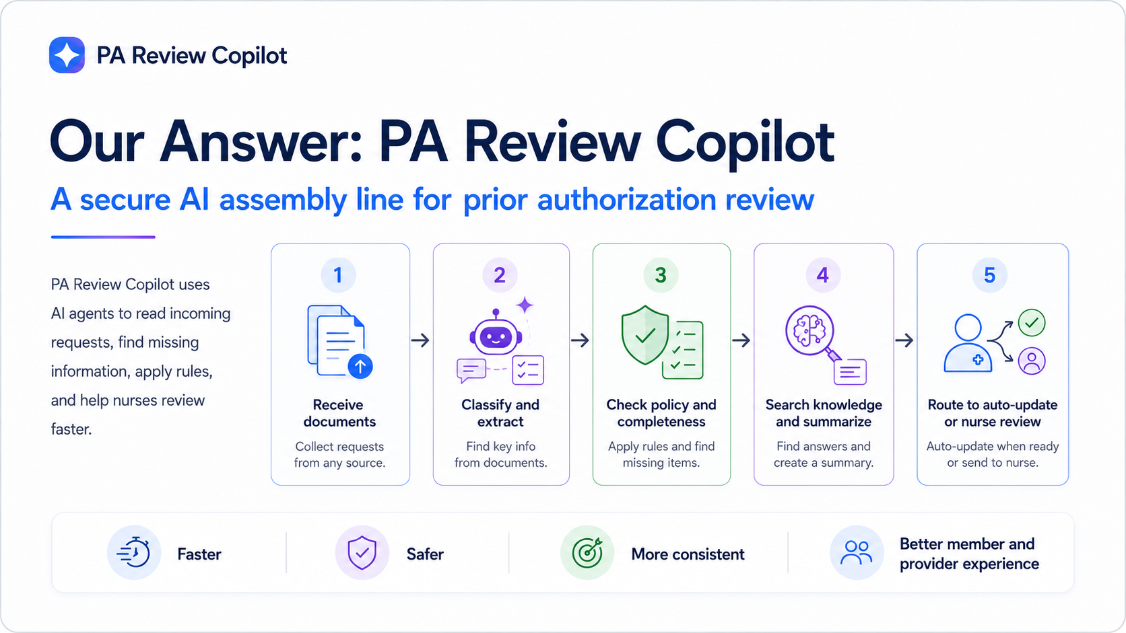
Notes:
Slide: Our Answer: PA Review Copilot

Slide 9
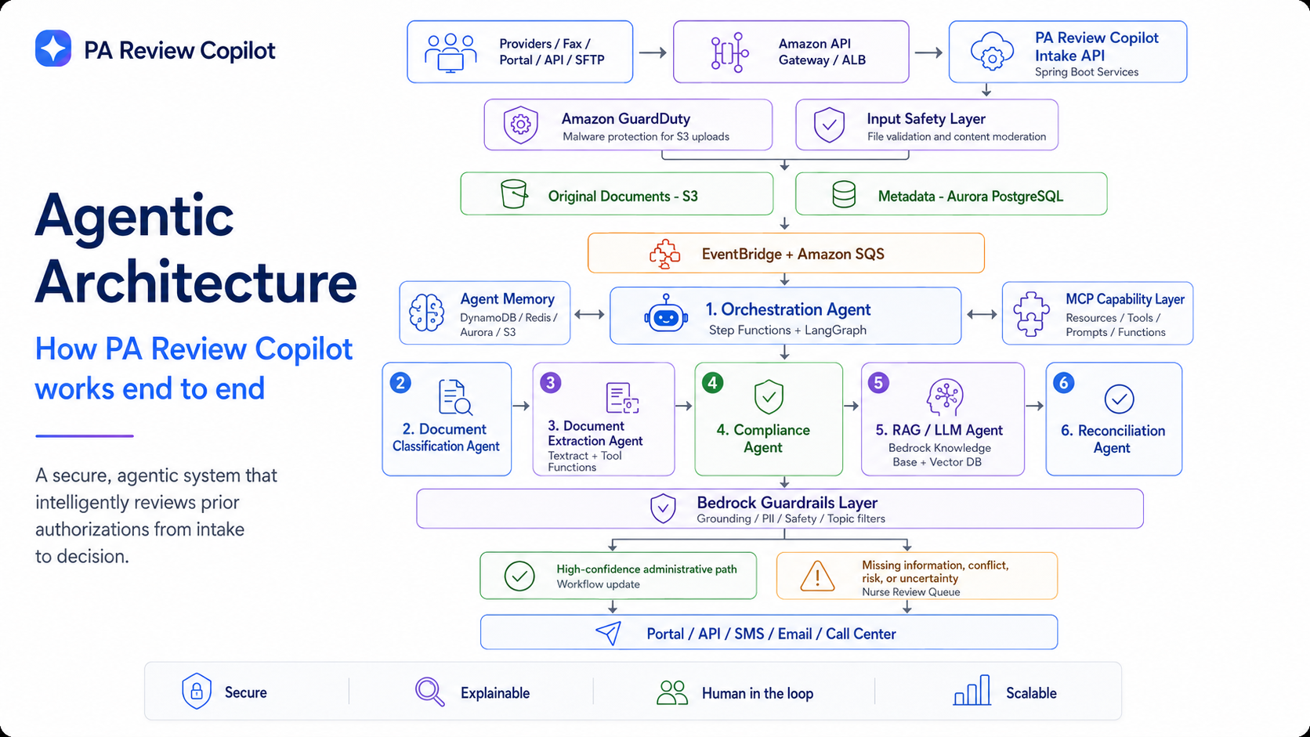
Notes:
Slide: Agentic Architecture

Slide 10
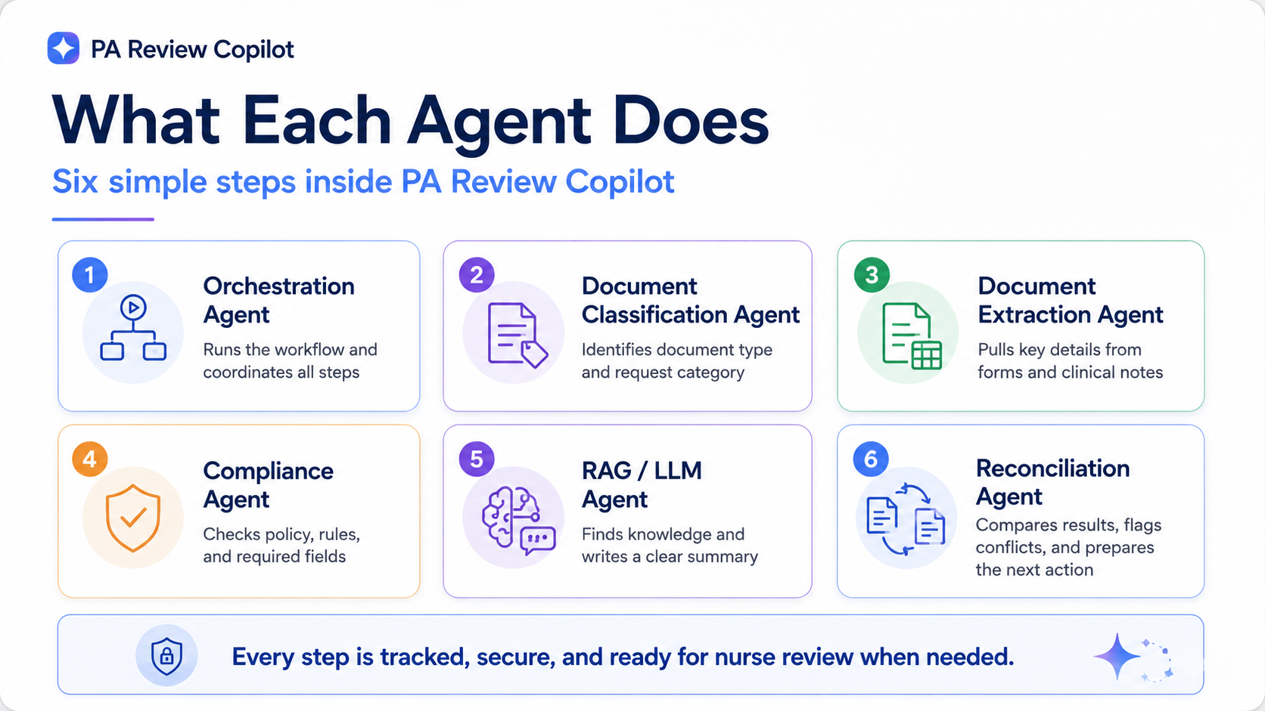
Notes:
Slide: What Each Agent Does

Slide 11
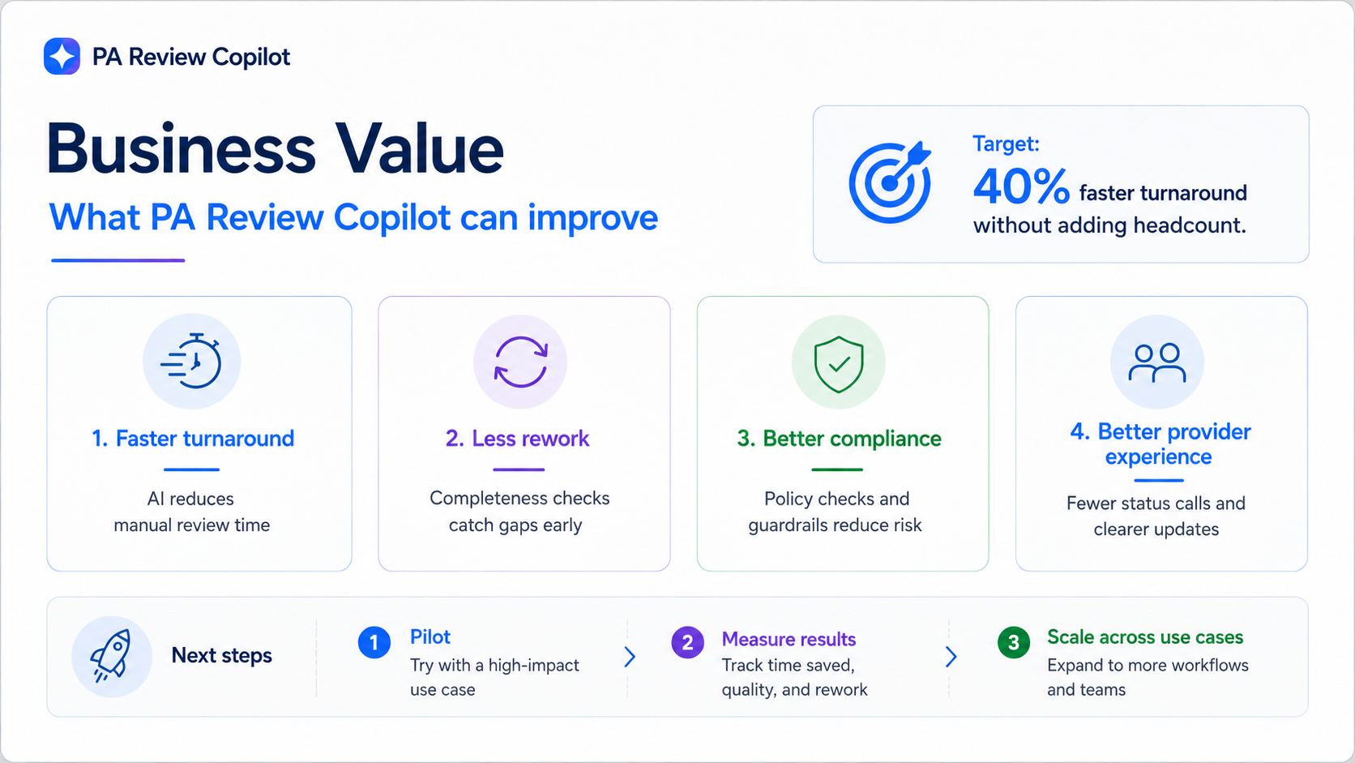
Notes:
Slide: Business Value

Slide 12
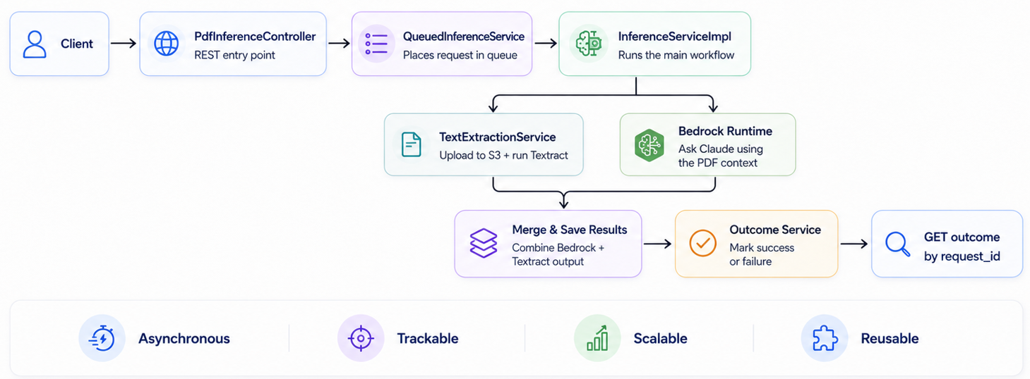
Spring Boot Microservice Flow
ARCHITECTURE FLOW
Approach 2 — rapid prototype: Claude completeness check & nurse copilot
PA Review Copilot · Enterprise Architecture
End-to-end asynchronous, trackable, scalable service flow

Slide 13
Recommendation
CONCLUSION
Adopt the Copilot first, then evolve into the full microservices platform
Option A · PA Review Copilot
Option B · PA Review System
Multi-agent AI, human-in-the-loop
Spring Boot microservices platform
· Assists nurses with classification, extraction, and compliance checks
· Clinical reviewers stay in control of every decision
· Fastest route to measurable value with minimal disruption
· Independent services for intake, validation, workflow, and tracking
· Scales securely across enterprise workloads
· Resilient, flexible, and extensible for the long term
Best for: rapid AI adoption
Best for: full PA automation
PA Review Copilot · Enterprise Architecture
Phased adoption — Copilot first, platform next

Slide 14
Questions & Discussion
Let's align on next steps and open items
📧
EMAIL
ganeshpunde@gmail.com
📋
DOCS
Architecture Decision Records available on Confluence
📅
NEXT
Follow-up Review: Schedule for Sprint 0 Kickoff
PA REVIEW COPILOT
—
Smarter Decisions, Faster Approvals

