Slide 1
MULTIPLICATION OF POLYNOMIALS USING FFT
TEAM 5
Ammu Mary (PES1PG21CS004)
Ganesh R (PES1PG21CS016)
Manoj KN(PES1PG20CS020)

Slide 2
Project Objective
Multiplication of two polynomials take O(n²), when the number of terms of the polynomials are n.
Multiplication of polynomials usually takes O(n*m where one polynomial has n and other has m terms. This can be reduced to O(n*log(m)) by using FFT.
We are using the Cooley-Tukey FFT Algorithm which is a type of FFT to perform multiplication.

Slide 3
Discrete Fast Fourier Transform
Directly calculating the DFT requires computing the sum from k = 0 to N 1 for each respective values of j .
When the complete output is computed, there will be a total of N2 operations where each operation is a multiplication followed by an addition.

Slide 4
Cooley-Tukey FFT Algorithm
Re-expresses the DFT of an arbitrary composite size N=N₁N₂ in terms of N₁ smaller DFTs of size N₂ recursively to reduce computation time to Nlog₂N for high values of N
Example: for N = 8, DFT(8) = DFT₁(4) + DFT₂(4)
So 8 = 2 * 4. N₁ = 2, N₂ = 4. Then we have 2 smaller DFTs of size 4
This also means:
DFT(12) = DFT₁(6) + DFT₂(6) ; N₁ = 2, N₂ = 6, or
DFT(12) = DFT₁(4) + DFT₂(4) + DFT₃(4) ; N₁ = 3, N₂ = 4
The Cooley Tukey is a divide and conquer algorithm.
In each recursive call, we divide the number of elements in half.

Slide 5




Formula for calculation of DFT
Most simplest and most common form of the Cooley-Tukey Algorithm
We divides a DFT of size N into 2 DFTs of size N/2
Regular DFT Formula
(Even and Odd portions)
Twiddle factored
Final Expression

Slide 6
COOLEY-TUKEY ALGORITHM (contd)
Parallel: Showing Example for N = 8
k =
m =
0
0, 1, 2, 3
1
0, 1, 2, 3
2
0, 1, 2, 3
3
0, 1, 2, 3
4
0, 1, 2, 3
k =
m =
5
0, 1, 2, 3
6
0, 1, 2, 3
7
0, 1, 2, 3

Slide 7
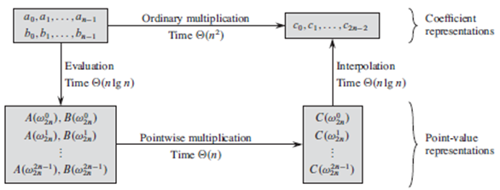
Multiplication of Polynomials
Multiplication of two polynomials take O(n²), when the number of terms of the polynomials are n.
The naive approach uses the coefficient form of the polynomial to calculate the product.
But a better approach is to convert from the coefficient form to point value representation.

Slide 8
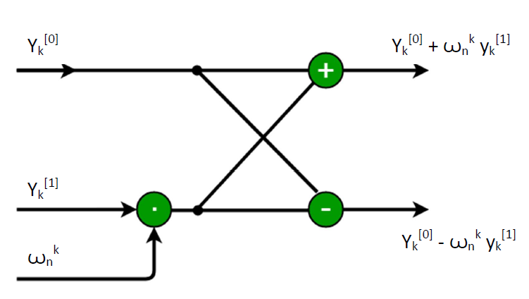
Iterative Fast Fourier Transformation for polynomial multiplication
Butterfly operation :-
The operation of multiplying the twiddle factor, storing the product into t, and adding and subtracting t from is known as a butterfly operation.

Slide 9
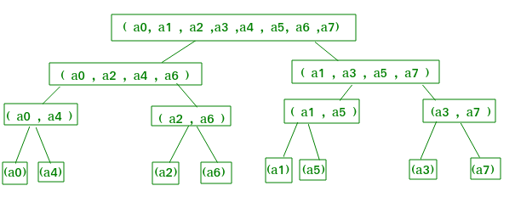
Example
Let us take for n=8 and proceed with the formation of the iterative FFT algorithm.
We arrange the elements of the initial coefficient vector into the order in which they appear in the leaves and trace the execution of the FFT bottom up.
First, we take the elements in pairs, compute the DFT of each pair using one butterfly operation, and replace the pair with its DFT. The vector then holds n/2 2-element DFTs.
Next, we take these n/2 DFTs in pairs and compute the DFT of the four-vector elements the vector then holds n/4 4-element DFTs.
We continue in this manner until the vector holds two (n/2) element DFTs, which we combine using n/2 butterfly operations into the final n-element DFT.

Slide 10
Bit Reversal Ordering :-
We arrange the coefficient vector elements in the order of leaves.
Example : -
The order in leaves 0, 4, 2, 6, 1, 5, 3, 7 is a bit reversal of the indices.
Start with 000, 001, 010, 011, 100, 101, 110, 111 and reverse the bits of each binary number to obtain 000, 100, 010, 110, 001, 101, 011, 111

Slide 11
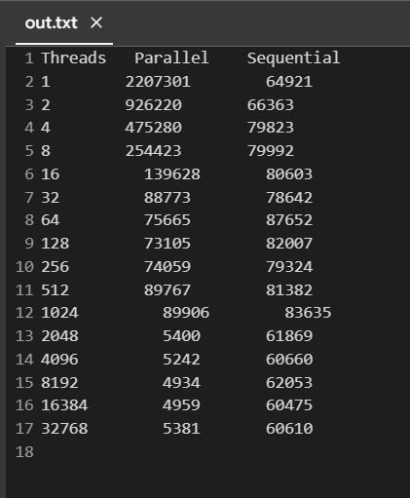
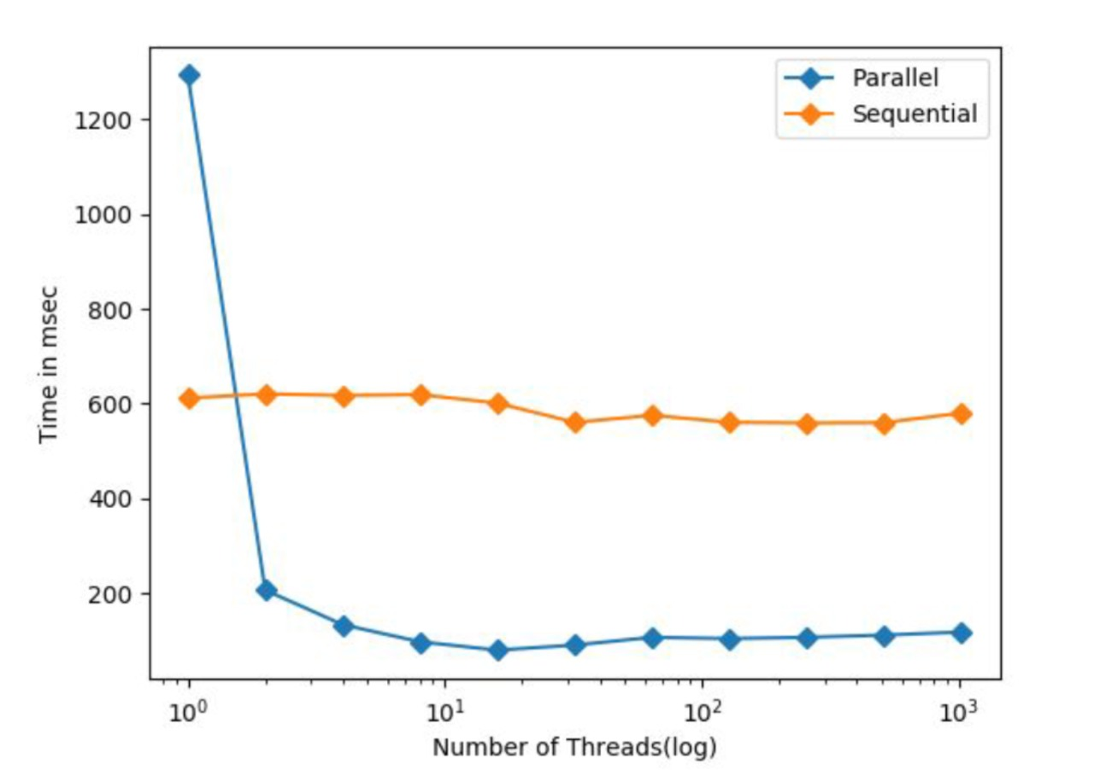
Parallel vs Sequential Comparison for input N=10000
Fig. Time taken for Parallel vs Sequential in microsecs

Slide 12
THANK YOU
Link for Project Code : - https://github.com/ganeshrajasekaran1996/MWP-Project

