Slide 1
Realization Of Multi-Axis Solar Tracker
M. S. Anees Ahmed
P. Ganesh Ram

Slide 2
Objectives:
To minimize the solar power losses using solar tracking system.
Increase the efficiency of solar power production.
Compare the power production charts with and without using Solar Tracker.
Optimize power consumption of the tracker using Stepper Motors and Micro-controllers.

Slide 3
Sun tracking algorithm:
This algorithm calculates the solar azimuth and zenith angles of the sun.
These angles are then used to position the solar panel or reflector to point toward the sun.
Some algorithms are purely mathematical based on astronomical references while others utilize real-time light-intensity readings.

Slide 4
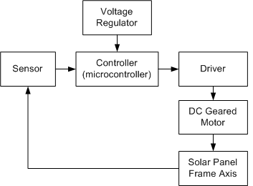
Solar tracker Concept:
Stepper Motor

Slide 5
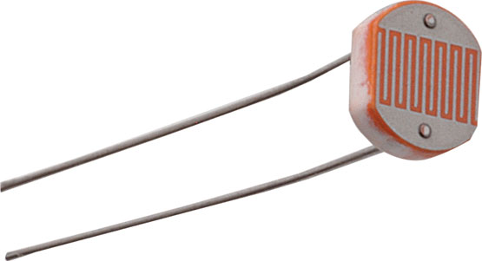
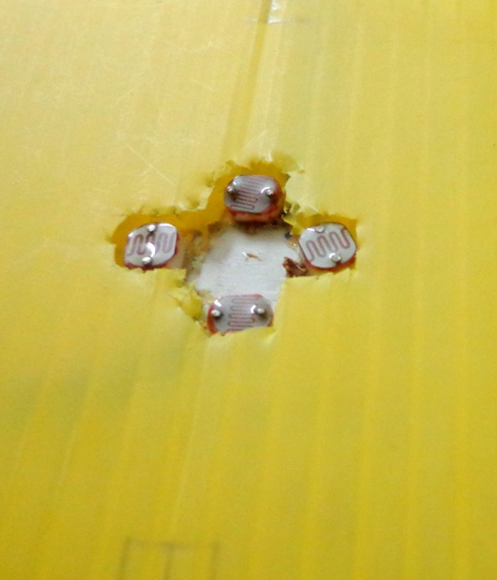
Light sensors
LDR(Light Dependent Resistors)
used as light sensors(also as shadow sensors).
Ldr resistance inversely propotional to the light ambience.
Imbalance in sets of sensors (Up & down)(Left & Right) used to position the panel in correct coordinates.

Slide 6
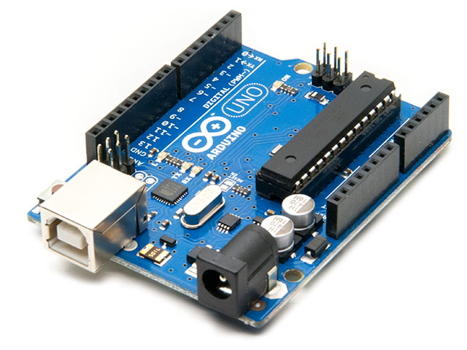
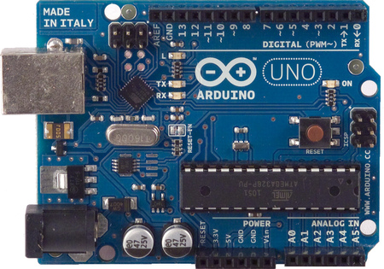
ARDUINO UNO R3 Microcontroller
Arduino is a open source programming environment with inbuilt library.
20 different languages.
20 operable pins (6 i/p pins and 14 o/p pins).
Built in power source for 3.3V and 5V.
Software written using Arduino are called sketches.

Slide 7
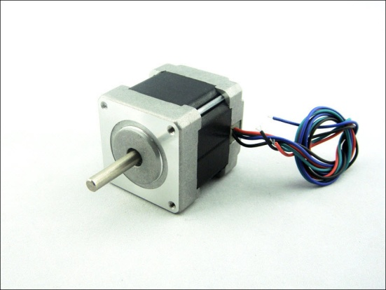
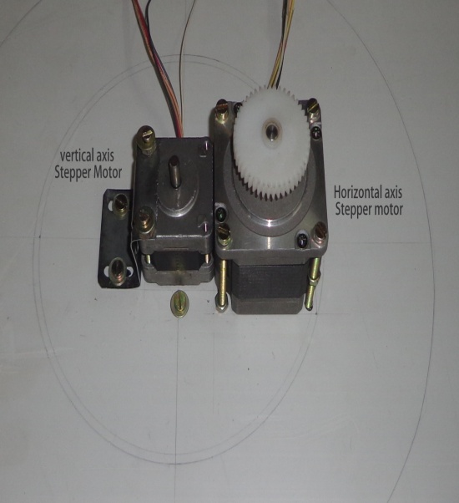
Stepper motors
5V Bipolar stepper motors with 200 steps/1 rotation used to maintain high precision in the tracker.
Good holding torque of 200mN.m.
1 step corresponds to 1.8 degrees.
Speed of the motor can be changed to our need(10 – few hundreds rpm).
Bipolar motors have 30% more torque than a unipolar stepper motor.
No resultant inertia.

Slide 8
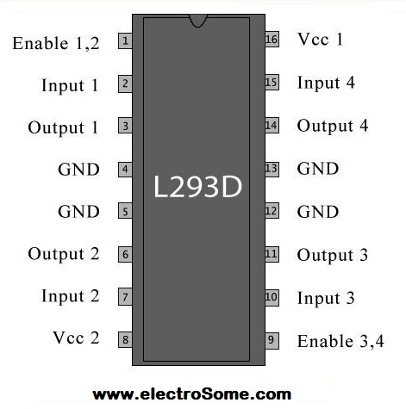
Stepper Motor Driver
L293D- exclusive stepper motor driver,16 pin IC.
Inbuilt heat sinks
Good max current ratings of 600mA.
Can drive upto 12V Stepper motor.
Cheaper.
Separate ENABLE pins.

Slide 9
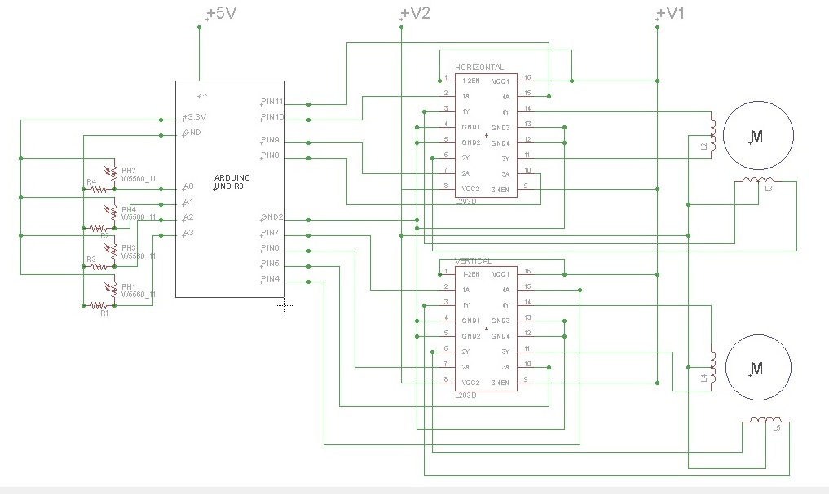
Driver Circuit

Slide 10
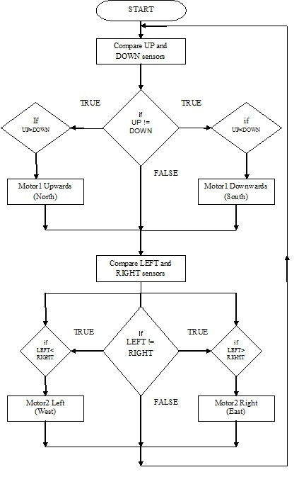

Slide 11
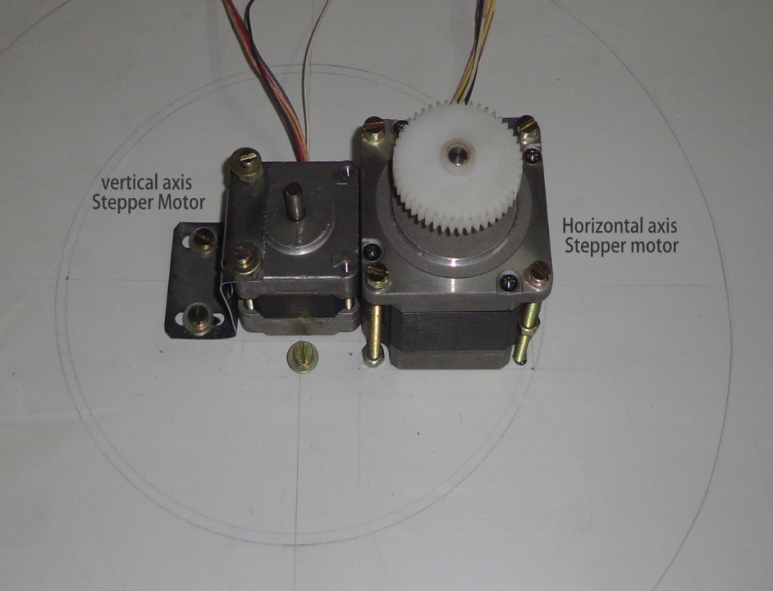
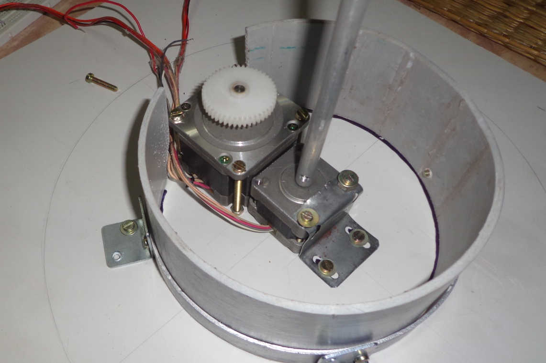
Tracker Model Construction

Slide 12
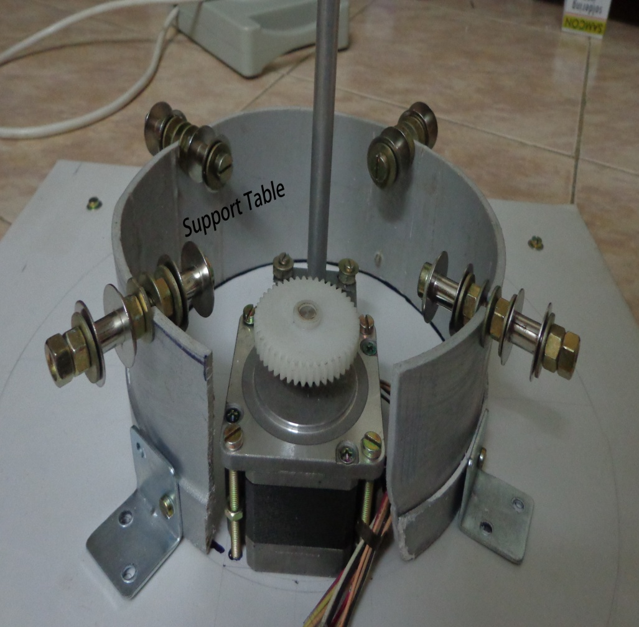
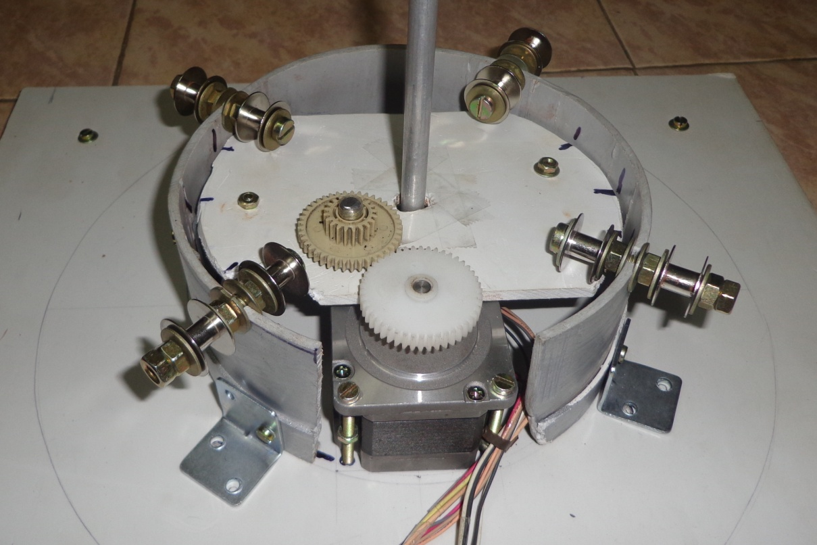
Base table

Slide 13
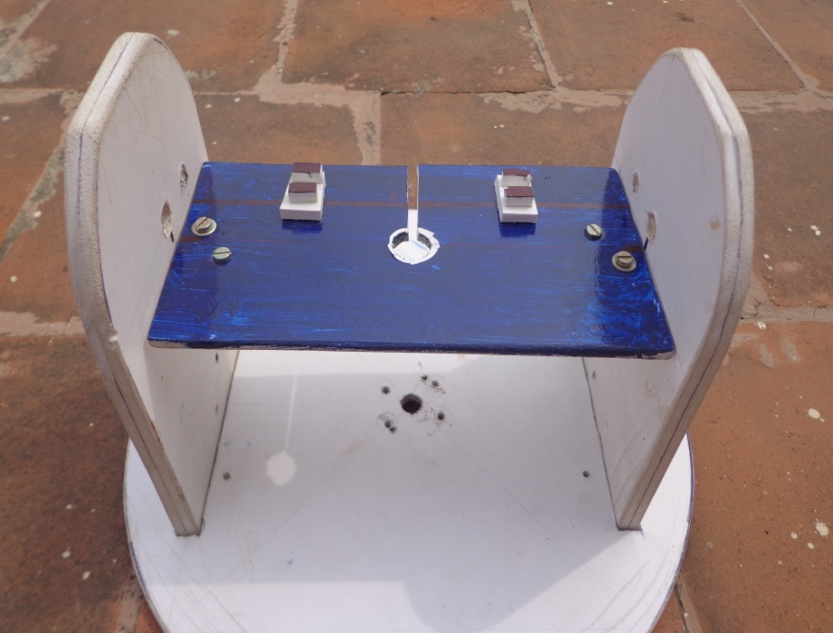
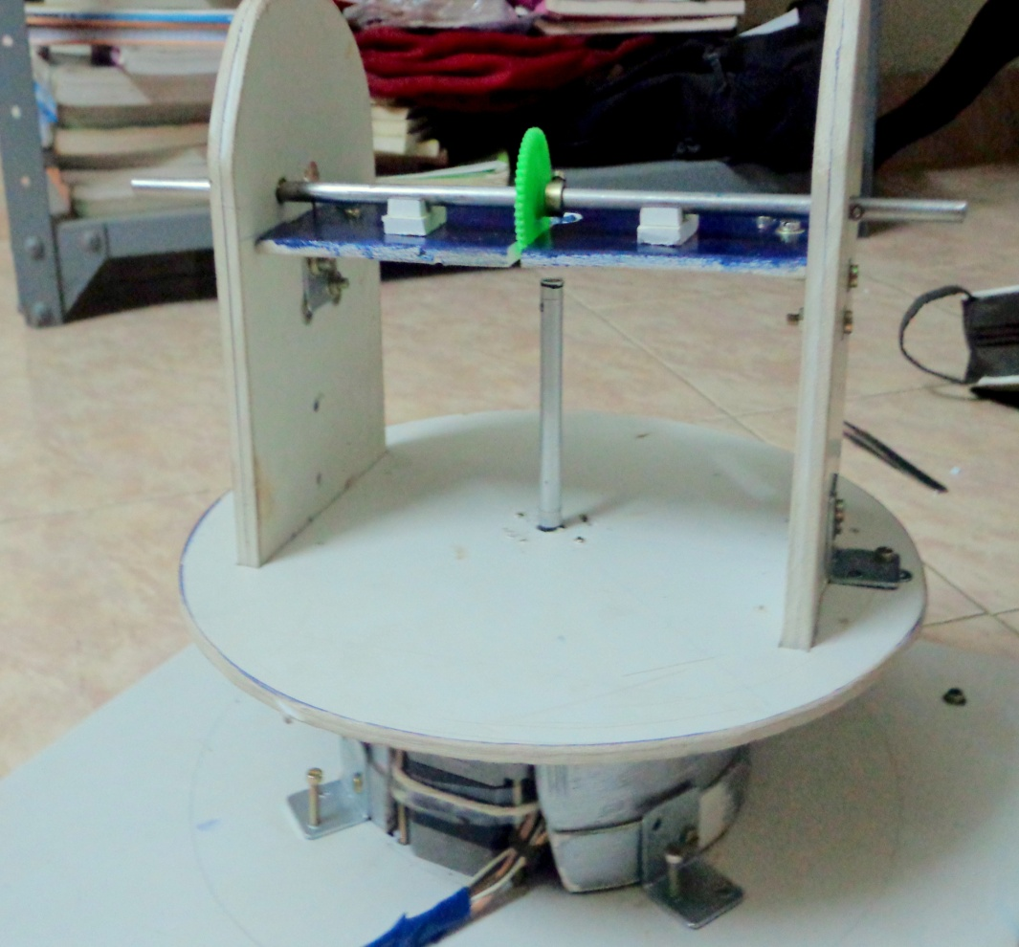
The Tracker

Slide 14
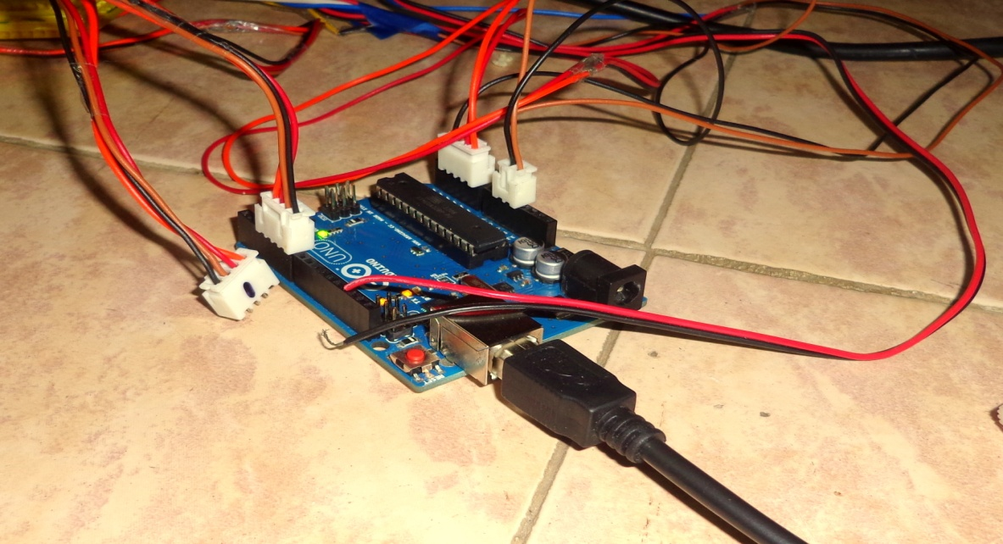
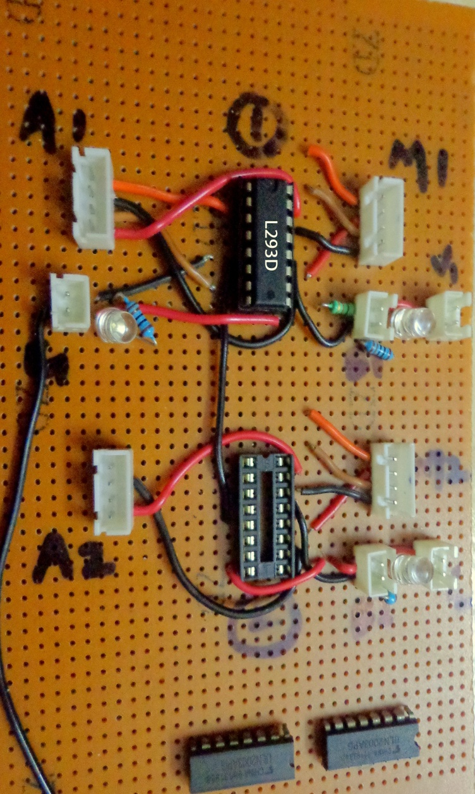
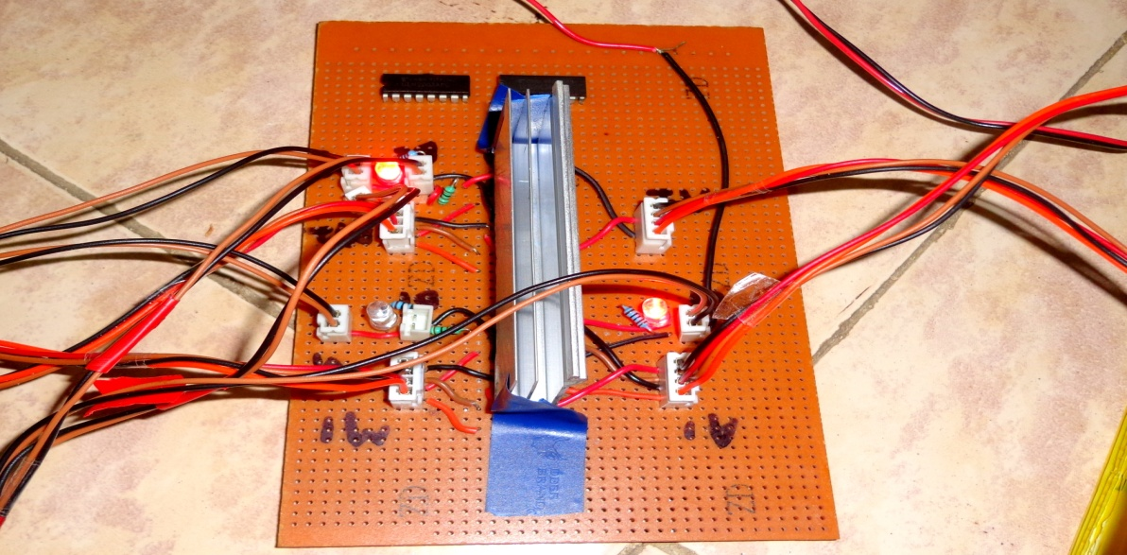
Circuits

Slide 15
Comparison Chart

Slide 16
Advantages:
Improved Efficiency.
More Flexible.
Easy to implement.
Bulk implementation can supply immense energy.
Orients to position of maximum light, thereby continuously producing maximum energy.
One of the effective and easiest methods to tap energy when compared to other processes.
Eliminates the problem of alignment(which are necessary for wind mills, stationary solar panel).

Slide 17
Future developments
Ambient condition monitoring for pressure, temperature and humidity may also be needed to optimize efficiency and power output.
An anemometer is used to measure wind speed. If the wind conditions are too strong, the panels are usually driven to a safe horizontal position and remain in the safety position until the wind speed falls below the set point.
Limit switches are used to control speed and prevent over travels. The mechanical over travel limits are used to prevent tracker damage.

Slide 18
References:
1. SOLAR TRACKER
By HAN WAN SIEW, ENG499 Capstone Project 2008.
2. POSITIONING SYSTEMS FOR SOLAR PANELS PLACED IN ISOLATED AREAS
by Laurentiu ALBOTEANU, Gheorghe MANOLEA, Florin RAVIGAN.
Annals of the University of Craiova, Electrical Engineering series, No.30,2006.
3. A Novel Low Cost Automatic Solar Tracking System by C.Saravanan, Dr.M.A.Panneerselvam, I.William Christopher. International Journal of Computer Applications (0975 – 8887) Volume 31– No.9, October 2011
4. A Design of Low Power Single Axis Solar Tracking System Regardless of Motor Speed
By Asmarashid Ponniran, Ammar Hashim, Ariffuddin Joret. InternationalJournal of Integrated Engineering, Vol. 3 No. 3
5. SIMPLIFIED SOLAR TRACKING PROTOTYPE
By Nader Barsoum, Pandian Vasant. Transaction in Controllers and Energy, ISSN: 1985-9406 Online Publication, June 2010
6. Light Sensors for Solar Trackers
By J. Rizk, A. Hellany, M. Nagrial. Recent Researches in Environment, Energy Planning and Pollution 2007.

Slide 19
Thank You

