Slide 1


AI / ML
House Price Prediction Model
NAME
COMPANY
DURATION
Internship Project
Presentation
Ganesh Sunil Rathod
EduTech Solutions
19-5-2026 – 25-6-2026

Slide 2

Introduction
2 / 10
Internship Overview
Project Purpose
Domain Relevance
Domain: AI / ML
Company: EduTech Solutions
Duration: 19-5-2026–25-6-2026-2026 – 20-5-2026-2026 – 20-5-
Focus: Real-world Machine Learning Projects
Guided by Mentor Rahul
Develop a machine learning model for house price prediction
Analyze housing data using statistical techniques
Support data-driven real estate decisions
Apply AI/ML concepts to practical business problems
AI is transforming real estate analytics
Predictive models help estimate property values
Data-driven pricing improves decision making
Hands-on exposure to industry ML workflows

Slide 3

Company Overview
3 / 10
About EduTech Solutions
Key Services
AI-driven personalised learning platforms
Data Analytics Platforms
Predictive Intelligence Systems
Educational Technology Solutions
EduTech Solutions is an innovative technology company specialising in education platforms, learning management systems, and AI-powered academic tools.
Founded with a mission to bridge technology and education, it serves thousands of students and institutions nationwide.
Internship Structure
Week 1:Training & Dataset Understanding
Week 2: Data Analysis & Visualization
Week 3: Model Development
Week 4: Testing & Documentation
The company invests in cutting-edge R&D, ensuring learners and educators benefit from the latest AI-driven insights and personalised experiences.

Slide 4



Objectives
4 / 10
Learning Goals
Technical Development
Project Objectives
Understand AI/ML project lifecycle end-to-end
Apply regression techniques
Perform EDA and feature engineering
Develop predictive analytics skills
Build predictive models using Python
Master data wrangling with Pandas & NumPy
Design interactive dashboards in Power BI
Practice version control using Git & GitHub
Predict house prices accurately
Identify important housing factor
Compare regression models
Deliver a complete ML solution

Slide 5

Project Overview
5 / 10
Problem Statement
Scope
House prices are influenced by multiple factors such as area, bedrooms, bathrooms, parking, and furnishing status. Manual estimation can be inaccurate and time-consuming.
Housing Dataset
Classification & regression ML models
Data Visualization
Price Prediction System
The objective is to build a machine learning model that predicts house prices based on housing characteristics.
Approach
Data Cleaning
Exploratory data analysis (EDA)
One-Hot Encoding
Model trainingRegression Modeling , Performance Evaluation

Slide 6

Methodology
6 / 10
01
Data Collection
02
Data Preprocessing
03
Model Development
04
Testing & Validation
Housing.csv Dataset
545 House Records
Structured & semi-structured sources
Multiple Housing Features
Handle missing values & outliers
Duplicate Removal
Train / test split (80 / 20 ratio)
One-Hot Encoding VIF Analysis
Baseline: Linear Regression
Ridge Regression
Feature importance analysis
Train-Test Split
MAE : Mean Absolute Error
RMSE : Root Mean Square Error
R² Score

Slide 7



Tools & Technologies
7 / 10
Programming & Data
Visualisation
Development & Version Control
Python 3.x
Matplotlib
Jupyter Notebook
Pandas
Seaborn
VS Code
NumPy
Git & GitHub
Scikit-learn

Slide 8

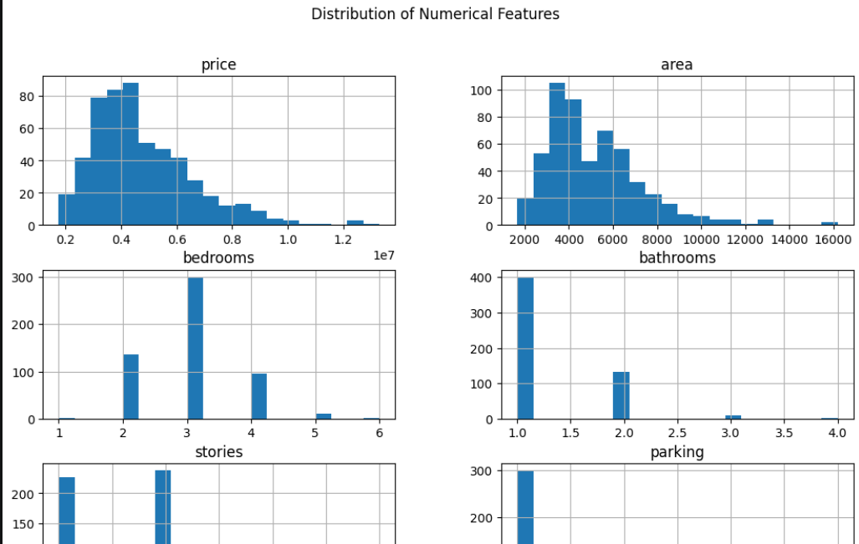
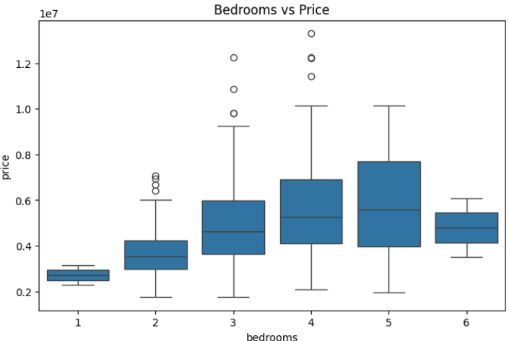
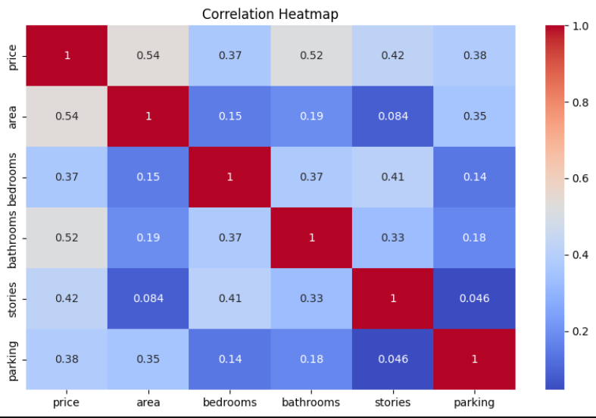
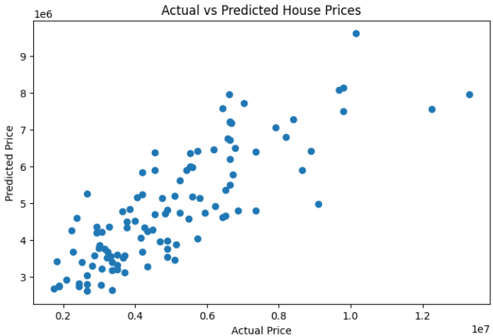
OUTPUT
8 / 10
House Price Prediction Model Output
Content:
Takes house features as input
• Analyzes housing attributes including:
Area
Bedrooms & Bathrooms
Stories
Parking
Furnishing Status
• Performs data preprocessing using: ◦ Missing Value Handling ◦ One-Hot Encoding ◦ Feature Engineering
• Predicts house prices using:
◦ Linear Regression ◦ Ridge Regression
• Evaluates model performance using: ◦ MAE ◦ RMSE ◦ R² Score
• Displays predicted house price accurately

Slide 9

Challenges & Learning
9 / 10
Challenges Faced & Solutions Applied
Skills Gained
⚠ Model Selection
✓
Data Preprocessing
→ Compared Linear & Ridge Regression
✓
Exploratory Data Analysis
⚠ Handling Categorical Variables
→ One-Hot Encoding Applied
✓
Regression Modeling
⚠ Feature multicollinearity detected
→ VIF-based feature selection or VIF Analysis Performed
✓
Statistical analysis & model evaluation
⚠ Feature Relationships
✓
Professional Technical documentation & reporting
→ Correlation Analysis Conducted

Slide 10


Conclusion & Future Scope
10 / 10
Project Summary
Achievements
Future Improvements
House Price Prediction Model Developed
Housing Dataset Successfully Processed
One-Hot Encoding Implemented
VIF Analysis Completed
Linear Regression Selected as Best Model
Successfully developed a House Price Prediction Model using Machine Learning
Achieved an R² Score of 0.65 on the test dataset
Performed Data Cleaning, EDA, and Feature Engineering successfully
Implemented One-Hot Encoding and Multi-Collinearity (VIF) Analysis
Compared Linear Regression and Ridge Regression to select the optimal model
Random Forest Regression
Real-time data streaming & live dashboard
XGBoost Models
Web-Based Prediction System
Real-Time Housing Analytics
Thank You | Questions & Feedback Welcome | EduTech Solutions Internship | Ganesh Sunil Rathod

