Slide 1


BY
Vishal sharma
Ganesh Sawhney
Mukesh Kumar Mishra
Arnav Gupta

Slide 2

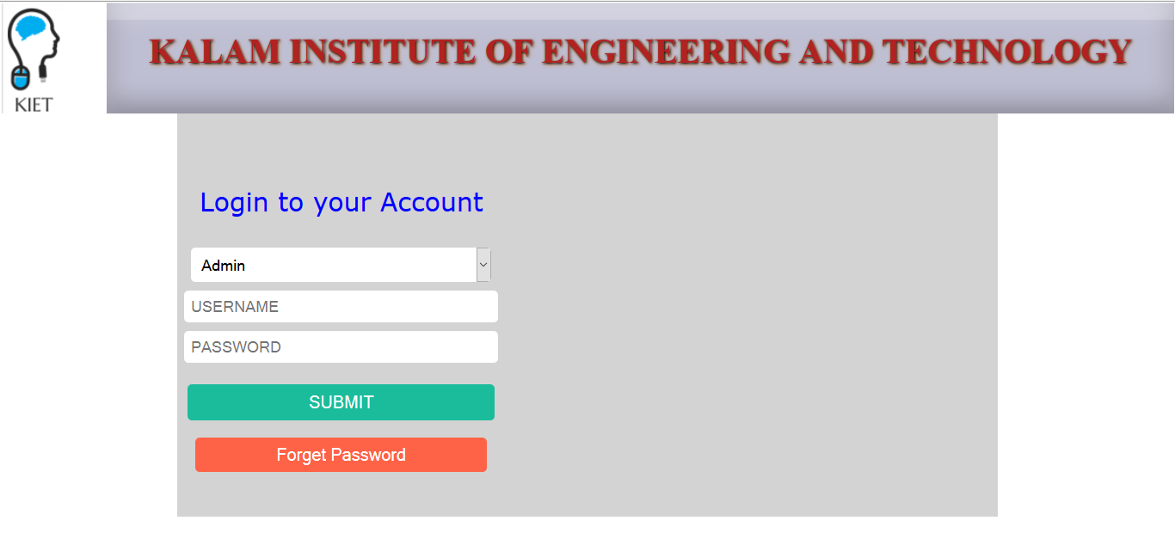
This is a web-related application that permits us to approach the entire knowledge regarding the college Management, employees, students, faculties etc. This kind of applications are commonly known as College Management System.
Following are the entities that we have worked on:
  Administrator
  Student
  Teacher
  Course
  Attendance
  Message
  Marks_lab
  Marks_theory

Slide 3

The objective of our project is to develop a web based application for college management system like we have webkiosk in our campus with added functionalities, security and performance.
Additional functionalities in our system-
Student notification system for low attendance in a subject
Messaging between student and teachers
Bug report
Option to share notice by the faculty to a class
File sharing and many more…
We don’t have the authority to add these functionalities in the webkiosk itself. But we surely can make one our self. And we can help other colleges to set up this system in their own institution.

Slide 4
  The webkiosk system at our campus is developed by campuslynx. Campuslynx has also developed similar systems for all the sister institutions of jiit, iit roorkee, thapar university, Sikkim manipal university, nit arunachal Pradesh, nirma university etc.
  This kind of project requires high level of security, reliability and robustness. And campusLynx holds expertise in that domain. One other reason for preference of campusLynx for such systems by major colleges might be lack of competition.
  Through this project, we aim to learn the skills required for such a system and try our fate in the market.

Slide 5

The project is divided into various modules for development. So far, we have developed these modules are-
WEEK 1- Login page
WEEK 2- Group homepage
WEEK 3- Development of database schema
WEEK 3- Writing queries for inserting database tables
WEEK 4- Login validation using php
WEEK 5- Administrator homepage
WEEK 5- Group homepage
WEEK 6- Option for inserting new student
WEEK 6- Option for inserting new teacher
WEEK 6- Option for inserting new course and new admin
WEEK 7- Student homepage
WEEK 7- Teacher homepage
WEEK 8- Student and teacher functionalities

Slide 6

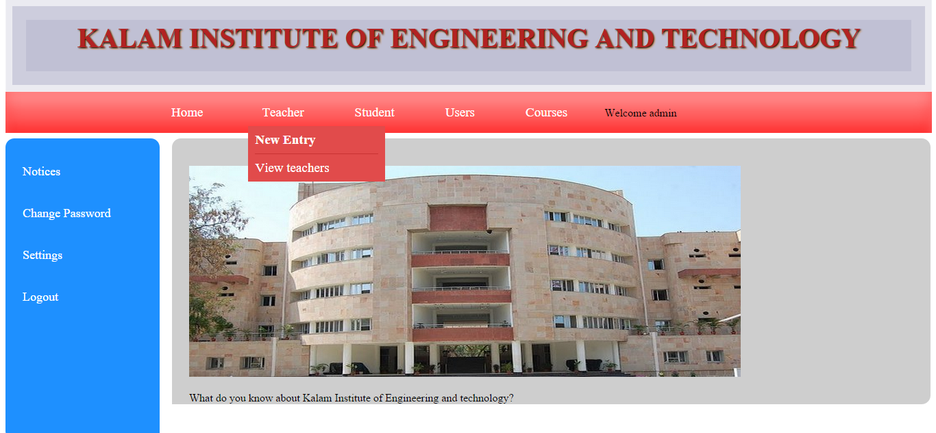
Front end technologies
HTML
HTML5
CSS
CSS3
JavaScript
Bootstrap
Jquery
Local Server
Xampp
Backend
PHP
Database
MYSQL

Slide 7
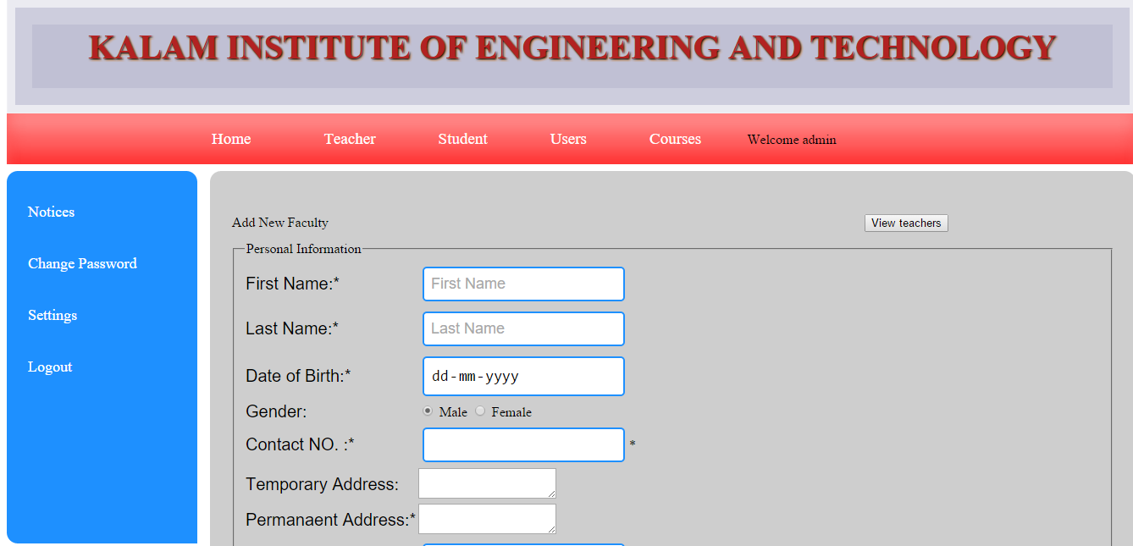
CURRENT PROGRESS
Login for admin, student and teacher
Session management
Option to add new student, new teacher and new admin
Option to view student details
Option to view teacher details
Option to edit student and teacher details
Option to view current attendance

Slide 8
NEXT MODULES
Option to edit information of existing entity (student, teacher, admin) by admin
Messaging between student, teacher and administrator
Bug report to the admin
Exam information maintenance
Normalisation of database
Enhancement of existing modules

